Slide 1












Magento DevOps Automation
PLAN
DEPLOY
Integration
OPERATE
CODE
BUILD
MONITOR
TEST

Slide 2
Magento & DevOps Tools
E-Commerce Technologies DevOps Technologies Project Management Tool Magento Jenkins JIRA
PHP Docker GIT
MYSQL Ansible
ModMan
Composer
SonarQube
PHP Unit
Selenium
YMAL
New Relic

Slide 3
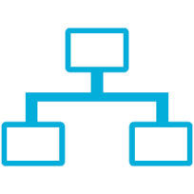



CI/CD PROCESSING DESIGN
DEV
TEST
PRODUCTION
DEV
QA
OPS

Slide 4
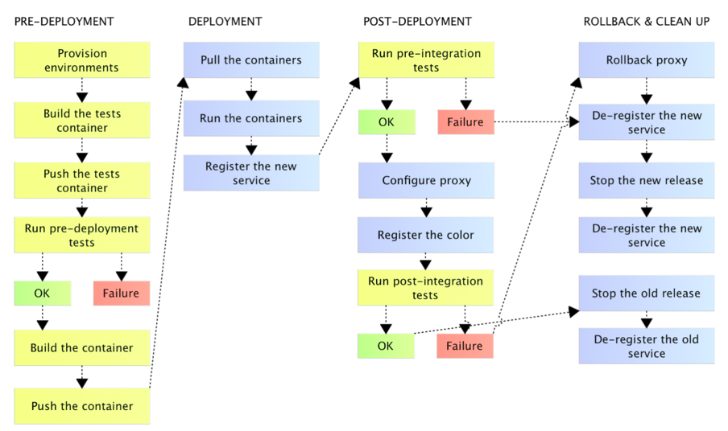
BUILD FLOW

Slide 5

BUILD PIPELINE
Pipeline version
Test
Release
Deploy to Test
n*
Success Build Done
Success Build Done
Processing
Generate docs
Deploy to Pre-Prod --> Prod
Success Build Done
Build yet to be start
Pipeline version
Test
Release
Deploy to Test
1
Success Build Done
Success Build Done
Success Build Done
Generate docs
Deploy to Pre-Prod --> Prod
Success Build Done
Success Build Done

Slide 6
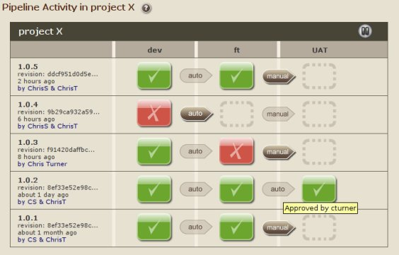
JENKINS PIPELINE ACTIVITY

