Slide 1

Akhanova Bagdina Akkassin Assel Bolekbayeva Anel Yussupova Arailym
GROUP MEMBERS

Slide 2

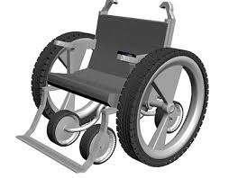
TOPIC OF THE PROJECT
Realization of a smart wheelchair with voice control system for people with disabilities

Slide 3
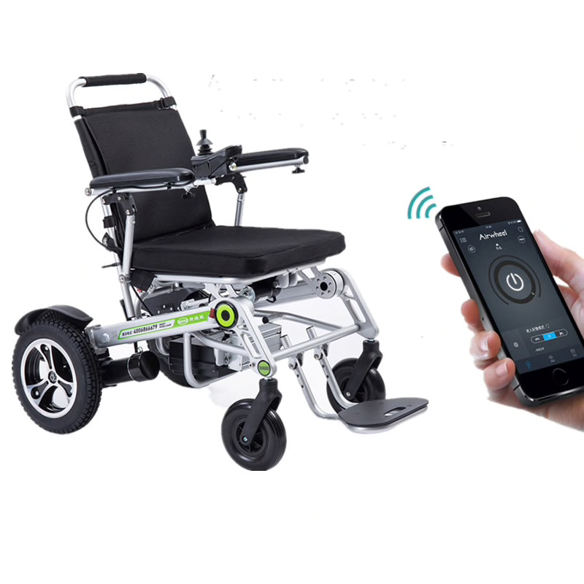
Aim of the project:
Develop prototype of a wheelchair with voice control system based on the Arduino microcontroller and to add voice recognition using Arduino, IOS program systems.

Slide 4
The first wheelchair for voice recognition was advanced and used in 1999 by the University of Siamo, Spain. Some of the proposed systems will be explained later on this basis here:
M. Sentil Sivakumar introduced an automatic wheelchair with voice control, which is an intelligent home navigation system. The wheelchair is also equipped with an obstacle avoidance system using an ultrasonic sensor.
Megha Muralidharan has introduced an intelligent voice recognition chair to move forward, backward, right, left using his voice.
B. Gokul suggested controlling the speed of a DC motor using voice recognition via Android Bluetooth. This system offers voice recognition through a mobile application.
Romil Chauhan proposed system that is called the “Voice Wheelchair Implementation Study”and has not been implemented yet, which suggests using the Raspberry Pi as a data processing unit instead of using an arduino / microcontroller.

Slide 5



To implement our project done followings:
1. Created Arduino based prototype of wheelchair with a voice control.
2. IOS application as a remote control with some additional functions
3. Did prototype using 3D modeling to show how it will look in real life

Slide 6
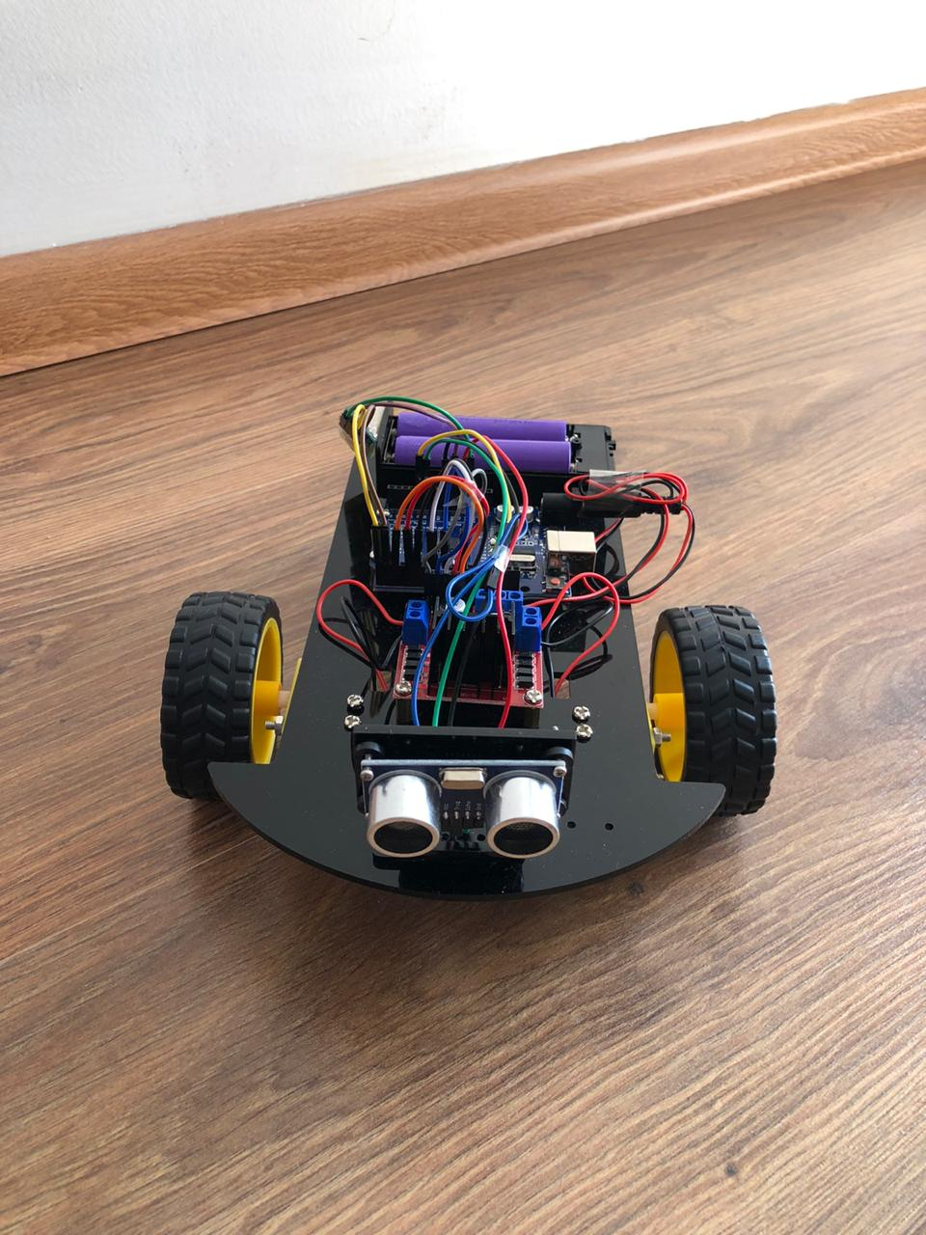
ARDUINO PROTOTYPE

Slide 7
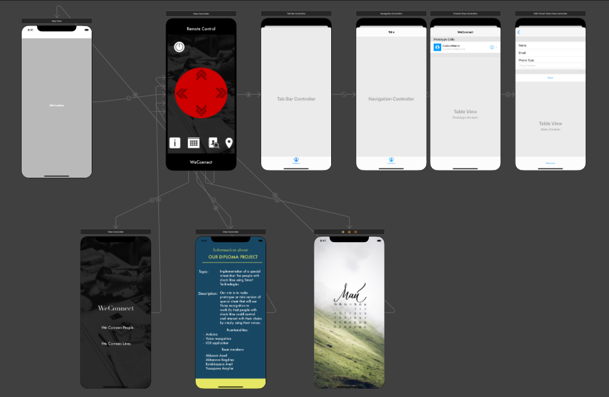
IOS APPLICATION

Slide 8
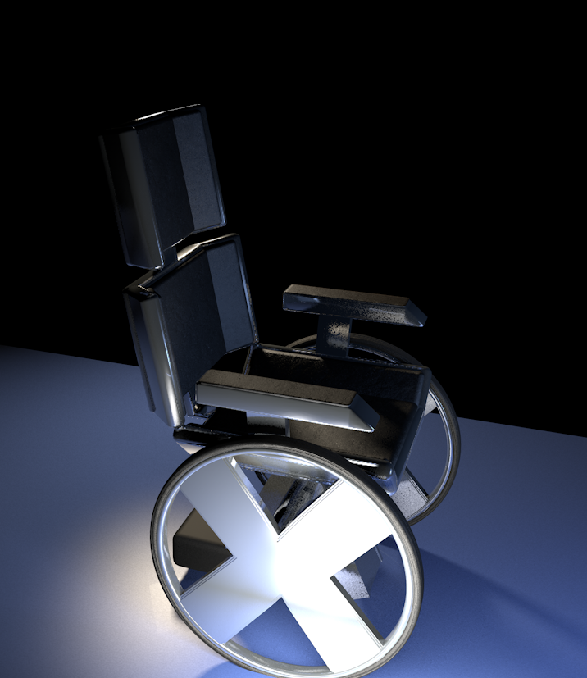
3D MODELING

Slide 9
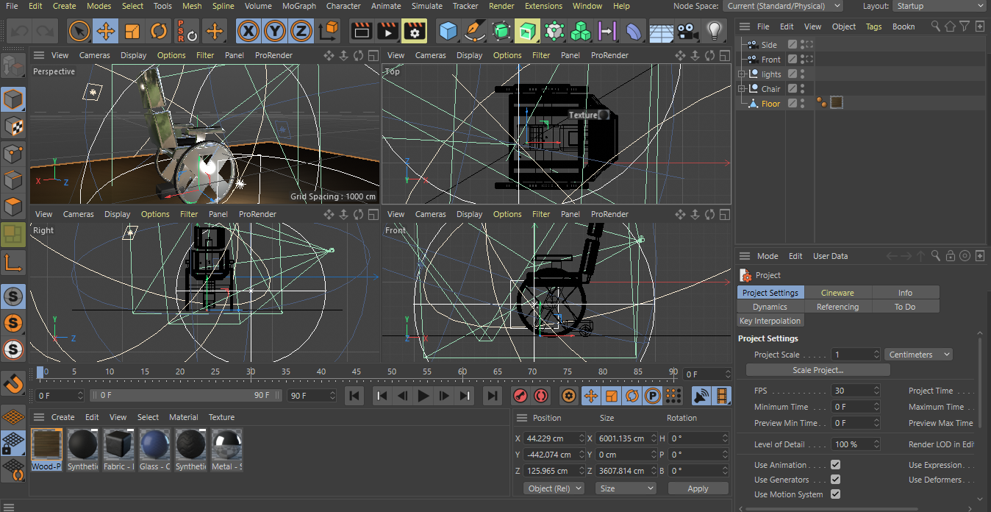

Slide 10

CONCLUSION
There are 680 thousand disabled people in Kazakhstan and 650 million people in the world, representing about 10 percent of the world's population, are disabled.
Smart Wheel Chair are mechanical devices designed to provide mobility with the help of a user team. Realizing our project will reduce the suffering of a disabled people, reduces human effort and power to operate wheelchair wheels

