Slide 1
Research & deployment Plan

Slide 2
Existing Setup
Scinet
PLP DEV
PLP QA
PLP PROD
FlexPLP
Proposed Setup
Scinet
PLP DEV
PLP QA
PLP PROD
FlexPLP

Slide 3
BENEFITS
Streamline the infra as envisioned part of GCP migration
Reduced infrastructure complexity
Reduced cost of operation & built
Easy maintainability for future changes

Slide 4
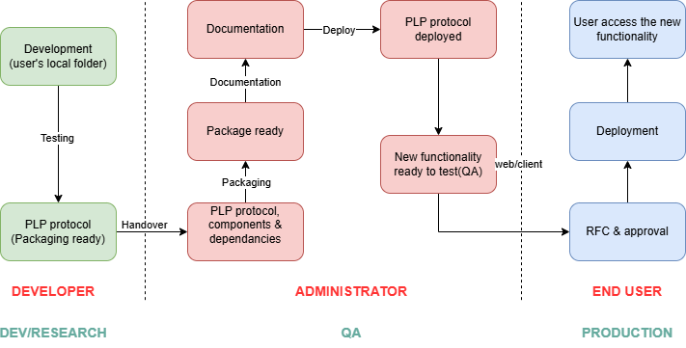
Proposed Workflow

Slide 5
Roles and Responsibilities
Developer Activities
Develops the PLP protocol in the local user’s environment.
Performs functional testing to validate correctness and stability.
Hands over the packaging-ready PLP protocol to the Administrator.
Administrator Activities
Receives the PLP protocol along with all required components and dependencies.
Prepares and reviews comprehensive documentation and RFC.
Confirms the package is complete and ready for deployment.
Deploys the PLP protocol.
Ensures the new functionality is successfully enabled and available for use.

Slide 6
Thank You

