Slide 1
E-Services
Java Assignment by:
Akshat Ahuja
Vaibhav Kumar
Chaitali Majumder
Anshika Chandra

Slide 2
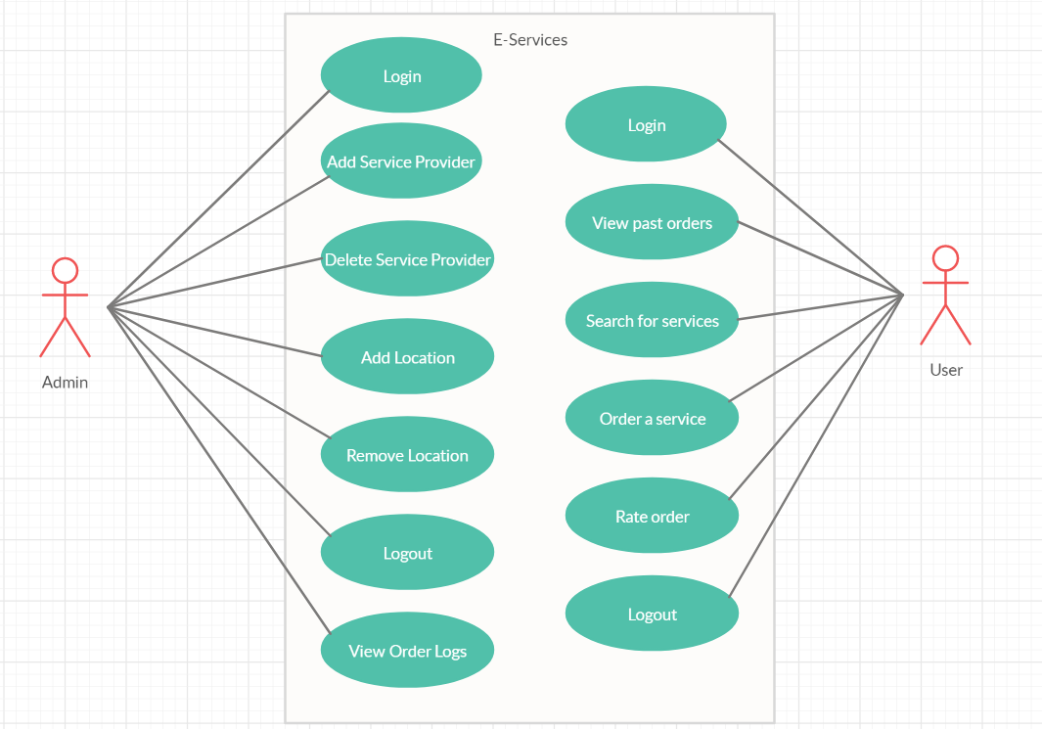
Use-case Diagram

Slide 3
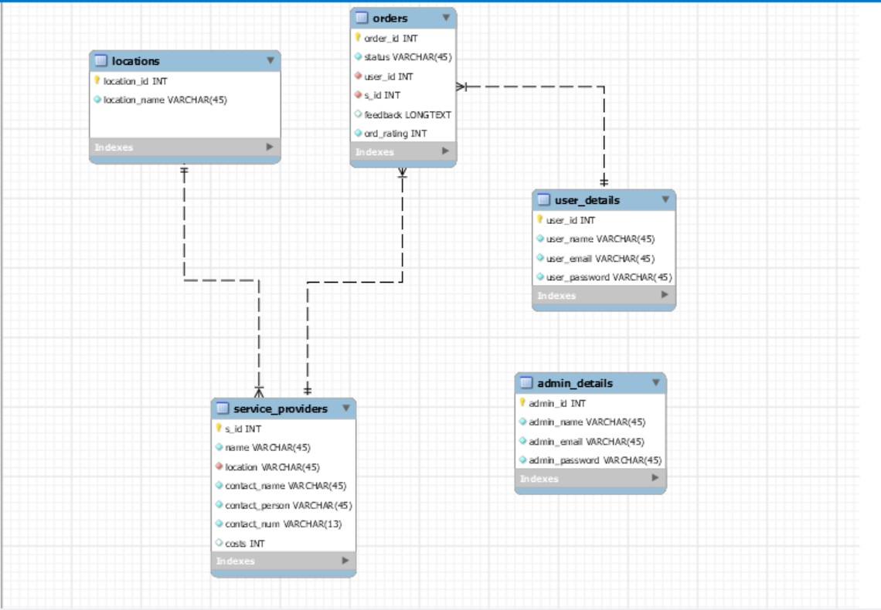
Database Diagram

Slide 4
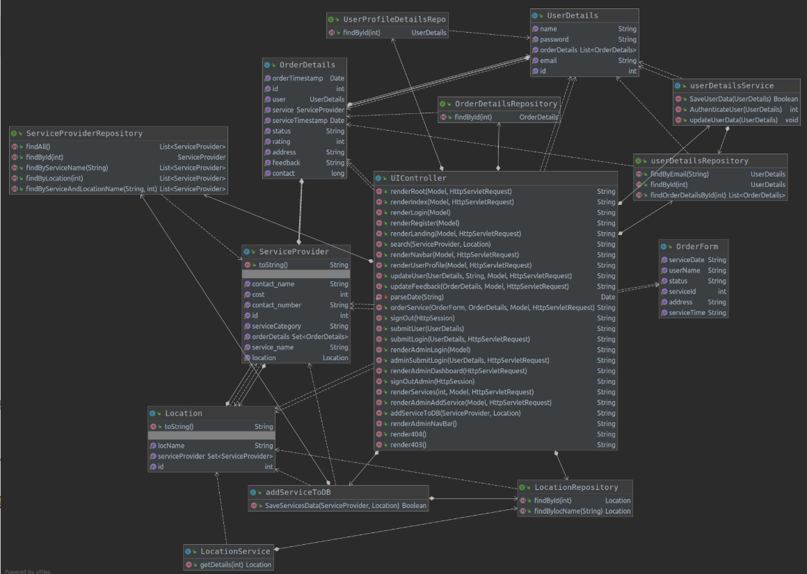
Class Diagram

Slide 5
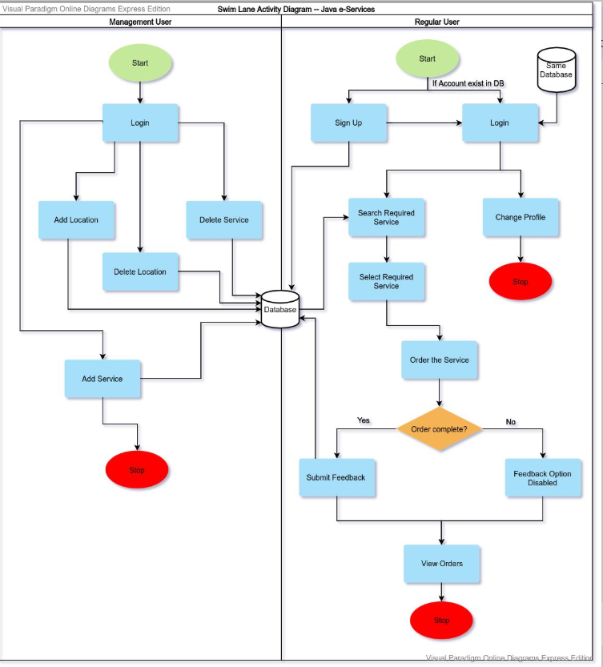
Activity Diagram

Slide 6
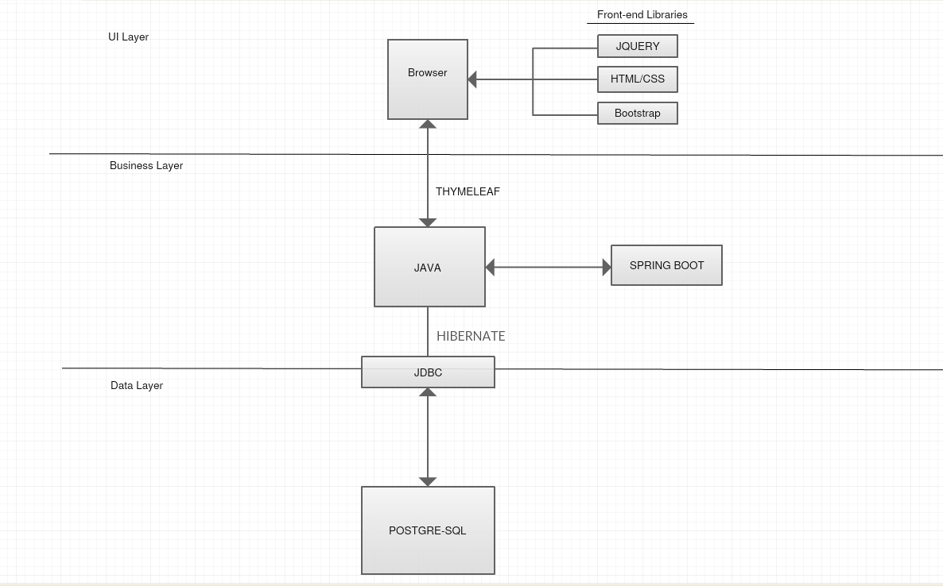
Tech Stack Diagram

Slide 7
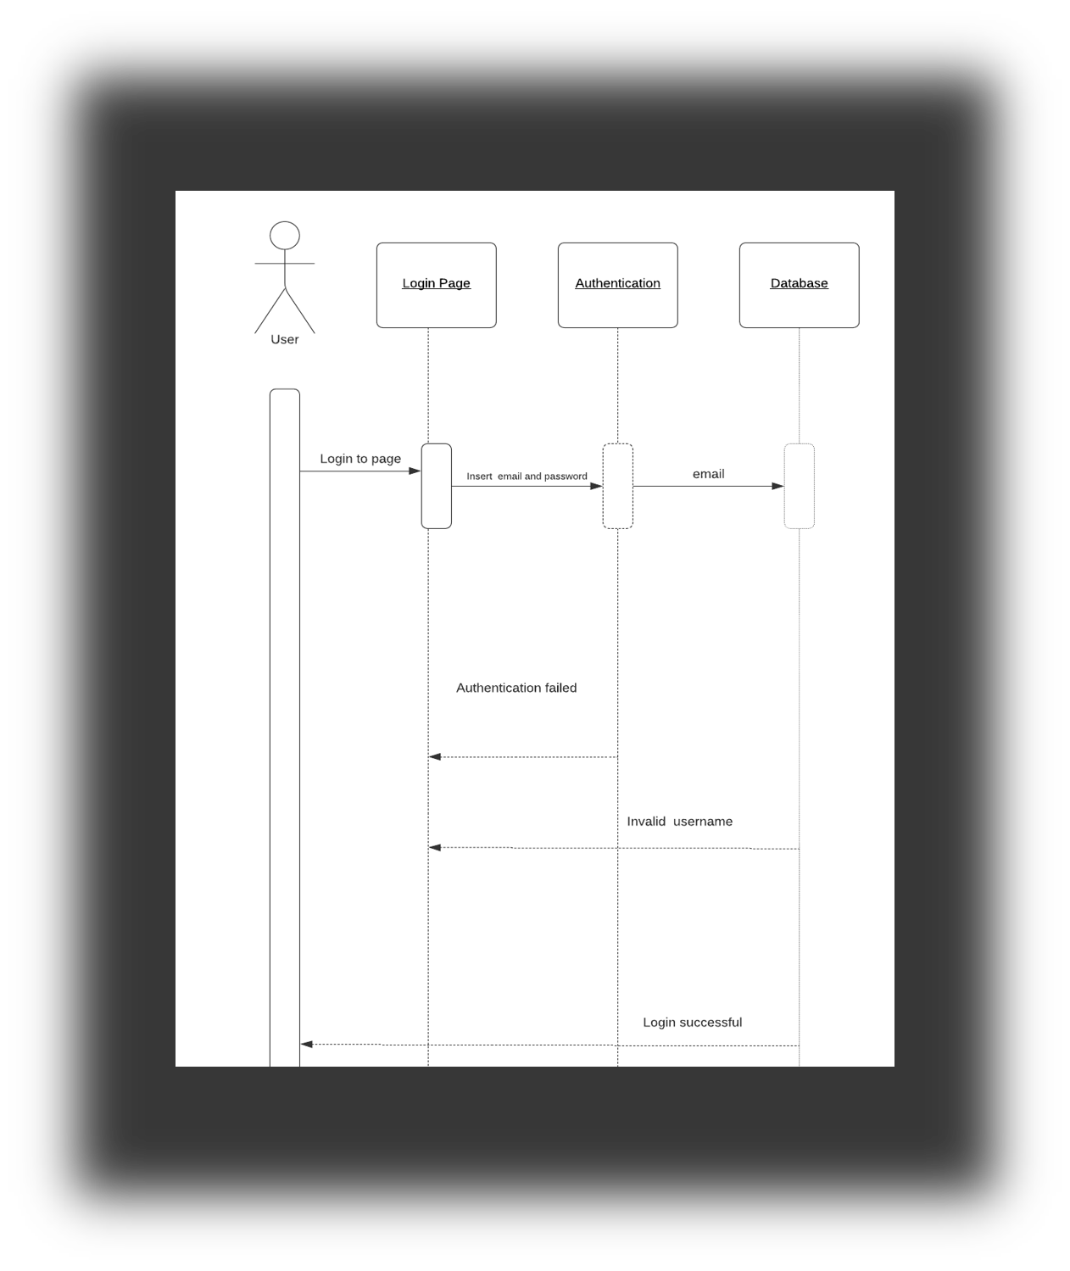
Sequence Diagram for login view

Slide 8
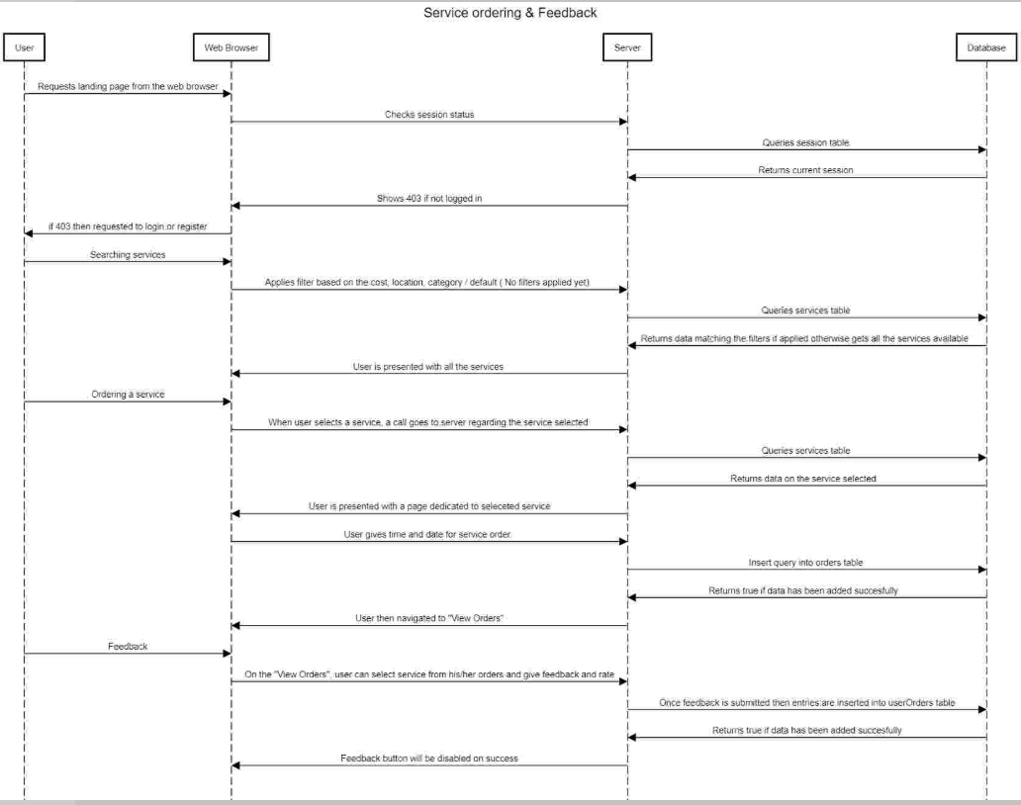
Sequence Diagram for user view

Slide 9
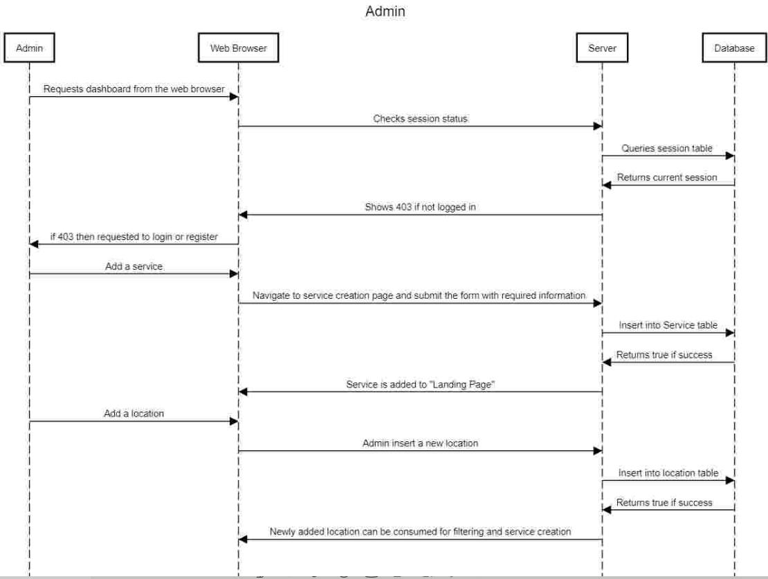
Sequence Diagram for Admin view

Slide 10
THANK YOU !!

