Slide 1
INTERNSHIP PROJECT PRESENTATION
Student Career Roadmap & Placement Readiness Tracking System
Product: PlacementOS (v2.0)
Candidate Name: Alex Mine • College: GITAM University • Department: Computer Science & Engineering
Role: Software Engineering Intern • Domain: Web Development & Client-Side Systems

Slide 2
PLACEMENTOS INTERNSHIP PROJECT EVALUATION
Problem Statement: Fragmented Placement Preparation
🧮 Quantitative Aptitude
Unstructured speed-math practice & random mock tests without difficulty tracking.
💻 Data Structures & Algorithms
Scattered problem tracking across notes with no topic balance (Trees/DP).
⚡ Programming Core
Lack of syntax & OOPs proficiency tracking across C++, Java, and Python languages.
🏗️ Projects & Portfolio
Unorganized full-stack & system projects without clear architectural milestone tracking.
🗣️ Communication & HR
Infrequent behavioral round practice & lack of STAR technique evaluation frameworks.
📄 Resume & Company Prep
Scattered company target lists & untracked application lifecycle status.

Slide 3
PLACEMENTOS INTERNSHIP PROJECT EVALUATION
Proposed Solution: PlacementOS Platform
🎯 Career Planning
Set target roles, dream companies, and graduation timeline goals in one place.
🗺️ Dynamic Roadmaps
Follow pre-configured, multi-domain preparation tracks (DSA, CS Core, Projects, HR).
📋 Task Management
Organize daily preparation tasks using interactive Kanban boards & priority tags.
📈 Skill Tracking
Track 4-tier skill levels (Beginner → Developing → Proficient → Expert).
📊 Progress Monitoring
Real-time productivity analytics, completion velocity, and streak tracking.
⚡ Placement Readiness
Algorithmic Placement Readiness Score (0-100) with actionable advice.

Slide 4
PLACEMENTOS INTERNSHIP PROJECT EVALUATION
Core Project Objectives
1. Structured Preparation
Eliminate random preparation by providing milestone-based domain roadmaps.
2. Progress Tracking
Provide visual progress indicators, task statuses, and completion velocity metrics.
3. Skill Gap Identification
Automatically detect weak domain areas (e.g. System Design vs DSA) for targeted prep.
4. Consistency & Streaks
Incentivize daily study habits with active streak counters and longest streak records.
5. High Productivity
Streamline prep workflow into Kanban task states with priority tags & filtering.
6. Placement Readiness Score
Evaluate student placement readiness objectively on a standardized 0-100 score scale.

Slide 5
PLACEMENTOS INTERNSHIP PROJECT EVALUATION
Functional Requirements (17 Official Specifications)
1. User Profile Management
2. Career Goal Management
3. Roadmap Creation
4. Task Management
5. Skill Tracking
6. Progress Monitoring
7. Placement Readiness
8. Dashboard
9. Analytics & Insights
10. Skill Gap Identification
11. Recommendations
12. History Management
13. Consistency Tracking
14. Achievement System
15. Search & Filtering
16. Data Export
17. Data Storage (LocalStorage)

Slide 6
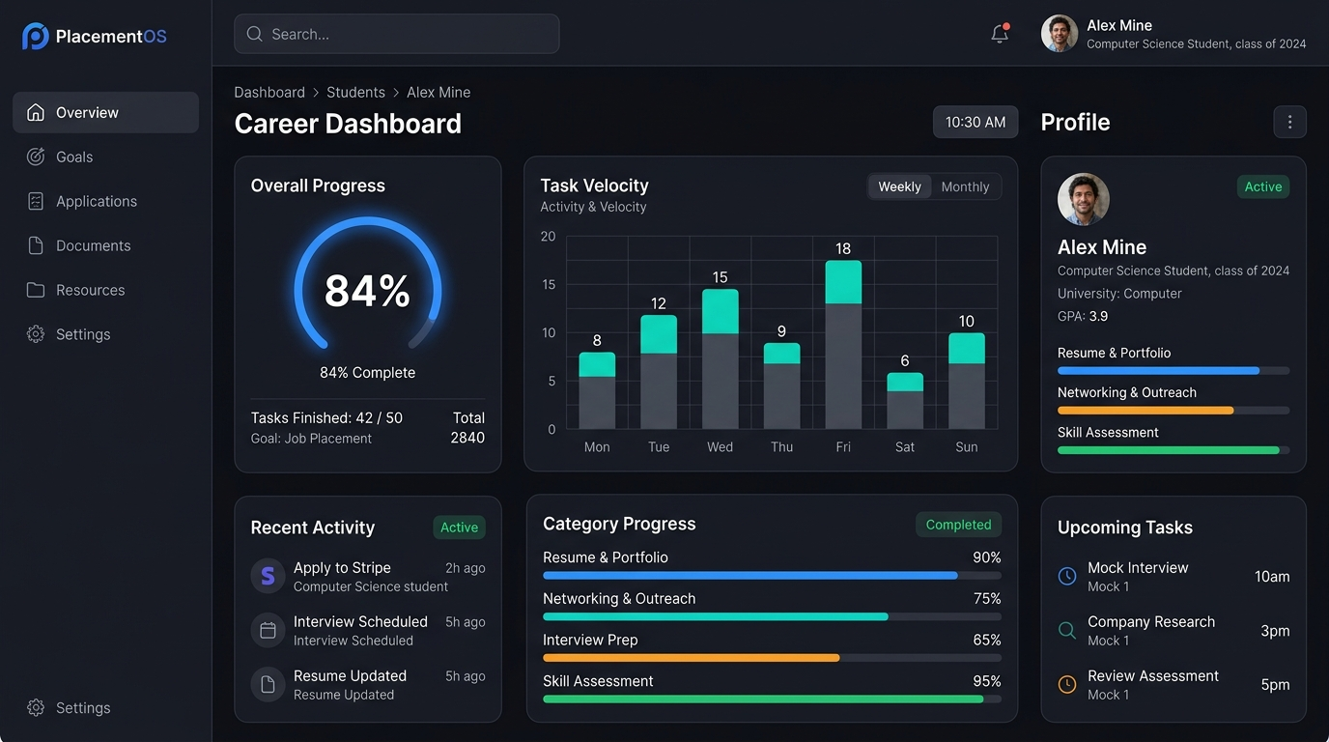
PLACEMENTOS INTERNSHIP PROJECT EVALUATION
Key Implemented Features & Application Interface
🗺️ Personalized Roadmaps
Multi-domain preparation tracks with milestone checkboxes.
📋 Task Management (CRUD)
Kanban board (Pending, In Progress, Completed) with priority tags.
📈 Skill Tracking & Streaks
4-tier skill mastery levels & daily study streak counters.
⚡ Placement Readiness
Dynamic score calculation with automated recommendation engine.

Slide 7
PLACEMENTOS INTERNSHIP PROJECT EVALUATION
Placement Readiness Score & Classification Matrices
🔄 READINESS EVALUATION PIPELINE
Preparation Data (Tasks/Roadmaps) ➔ Skill Progress Matrix ➔ Readiness Analysis ➔ Readiness Score (0-100) ➔ Readiness Level
🎯 SKILL LEVEL MATRIX (Per Skill)
• Beginner: Fundamental syntax & basic concepts. • Developing: Active problem solving & practical tasks. • Proficient: Advanced implementations & optimization. • Expert: Complete mastery & architectural application.
⚡ PLACEMENT READINESS LEVELS (Overall)
• Beginner (< 40%): Building initial preparation foundation. • Intermediate (40-64%): Steady task execution across core domains. • Advanced (65-84%): Strong preparation; interview ready base. • Interview Ready (85-100%): Meeting high placement benchmarks.

Slide 8
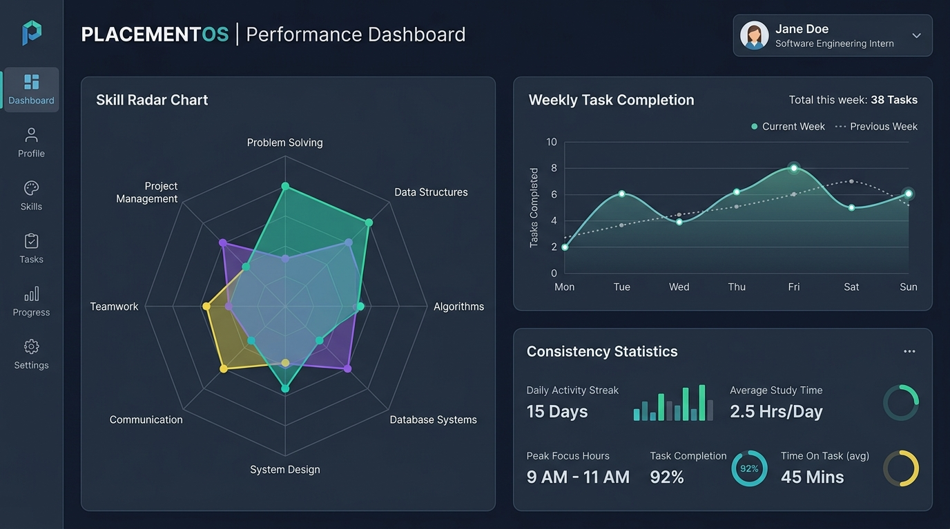
PLACEMENTOS INTERNSHIP PROJECT EVALUATION
Dashboard & Visual Analytics Interface
📊 Overall Progress & Score
Completion percentages & Placement Readiness Score gauge.
📋 Recent Tasks & Milestones
Task velocity, pending deadlines, and roadmap milestone updates.
🗺️ Category Breakdown & Advice
Domain progress meters & dynamic recommendation engine.
📈 Historical Trend Charts
HTML5 Canvas ChartEngine (Weekly velocity & consistency statistics).

Slide 9
PLACEMENTOS INTERNSHIP PROJECT EVALUATION
History Management, Consistency & Achievements
📜 History Management
Filterable audit log of completed tasks, readiness scores, and milestone achievements with timestamps.
🔥 Consistency Tracking
Tracks daily/weekly preparation habits (currentStreak), records all-time longestStreak, and active days.
🏆 Achievement System
Evaluates preparation milestones and unlocks gamified badges (e.g., DSA Master, Milestone Builder) with toast notifications.

Slide 10
PLACEMENTOS INTERNSHIP PROJECT EVALUATION
Technology & Client-Side System Architecture
🏛️ CLIENT ARCHITECTURE FLOW (HTML / CSS / JS / LOCALSTORAGE)
User ➔ UI (HTML/CSS) ➔ Views / Components ➔ State Management ➔ Engines / Services ➔ LocalStorage
⚡ Readiness Engine
Calculates category scores & Placement Readiness Score.
💡 Recommendation Engine
Generates personalized advice based on weak areas.
🔥 Streak Engine
Tracks daily active study streak counters.
🏆 Achievement Engine
Evaluates achievement criteria & unlocks badges.
🛡️ Validation Module
Validates profile inputs, CGPA, and task entries.
📥 Export Service
Handles JSON backup, CSV export & PDF report card printing.

Slide 11
PLACEMENTOS INTERNSHIP PROJECT EVALUATION
Expected Project Outcomes & Impact
🎯 Organized Preparation
Eliminates chaotic study habits through structured, multi-domain roadmaps.
⚡ Better Productivity
Boosts daily output with Kanban task organization, priority tags, and filtering.
🔍 Identify Skill Gaps
Instantly highlights weak domain areas prior to campus placement drives.
🔥 Improve Consistency
Maintains study momentum through daily streak tracking and milestone rewards.
📊 Measure Placement Readiness
Replaces guesswork with an objective Placement Readiness Score.
💼 Prepare Effectively for Interviews
Ensures students enter placement drives fully prepared across technical and core domains.

Slide 12
CONCLUSION & METHODOLOGY
Plan ➔ Prepare ➔ Track ➔ Analyze ➔ Improve ➔ Become Placement Ready
PlacementOS provides a lightweight, client-side, zero-cost career roadmap and placement readiness tracking system built with HTML, CSS, JavaScript, and LocalStorage.
🚀 LIVE SYSTEM DEMONSTRATION
Status: Active Client Application • Live System Demonstration • Thank You!

