Slide 1

Intelligent Customer Review Analyzer for E-Commerce
By
Name: AKSHAY KUMAR
Employee ID : - 8177692
AWS Intern
Manager : Ravi Kumar Jagarlapudi

Slide 2
AGENDA
Introduction
Problem Statement
Approach
System Architecture
Services Used
Final Result
Future Enhancement

Slide 3
INTRODUCTION
E-commerce platforms receive thousands of customer reviews, and analyzing them manually is time-consuming, inconsistent, and inefficient.
This project automates the entire review analysis process using AWS cloud services, ensuring scalability, accuracy, and real-time insights.
The system performs sentiment analysis, key phrase extraction, and review summarization using Amazon Comprehend and a SageMaker summarization model.
Processed results are stored in DynamoDB and visualized in QuickSight dashboards for decision-making and trend analysis.
The solution helps businesses understand customer satisfaction, identify issues, and improve products by extracting intelligence from raw review text.

Slide 4
PROBLEM STATEMENT
E-commerce platforms receive massive volumes of customer reviews, making it difficult for businesses to manually analyze and extract meaningful insights.
Manual review processing is slow, error-prone, and inconsistent, leading to missed customer complaints, unclear sentiment patterns, and delayed decision-making.
Traditional systems cannot efficiently detect sentiment, key issues, or emerging customer concerns, especially across large datasets and varied product categories.
Businesses lack an automated, scalable, and intelligent solution that can seamlessly analyze reviews, summarize customer opinions, and provide actionable insights in real time.

Slide 5
APPROACH
Data Ingestion through S3 Trigger:
Customer review CSV files are uploaded to Amazon S3, which automatically triggers a Lambda function to start the processing pipeline.
Automated NLP Processing with Amazon Comprehend:
The ingestion Lambda extracts review text and uses Comprehend to perform sentiment analysis and key-phrase extraction, converting raw text into structured insights.
Structured Storage in DynamoDB:
Processed review records—sentiment, rating, key phrases, and category—are stored in the ReviewAnalysis DynamoDB table for fast querying and retrieval.
Review Summarization using SageMaker:
A second Lambda function retrieves processed reviews, sends them to a deployed SageMaker summarization model, and stores the generated summary back into DynamoDB.
Dashboard Visualization in QuickSight:
Final cleaned data and summary are exported to S3 and visualized in Amazon QuickSight to produce KPIs, sentiment charts, word clouds, and review tables.

Slide 6
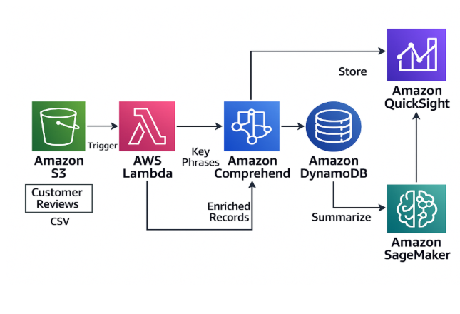
SYSTEM ARCHITECTURE
The system follows a modular, event-driven architecture where AWS S3 triggers an AWS Lambda function to perform NLP processing using Amazon Comprehend and BigBird/Pegasus models in SageMaker, with structured insights stored in DynamoDB and visualized through QuickSight dashboards.

Slide 7
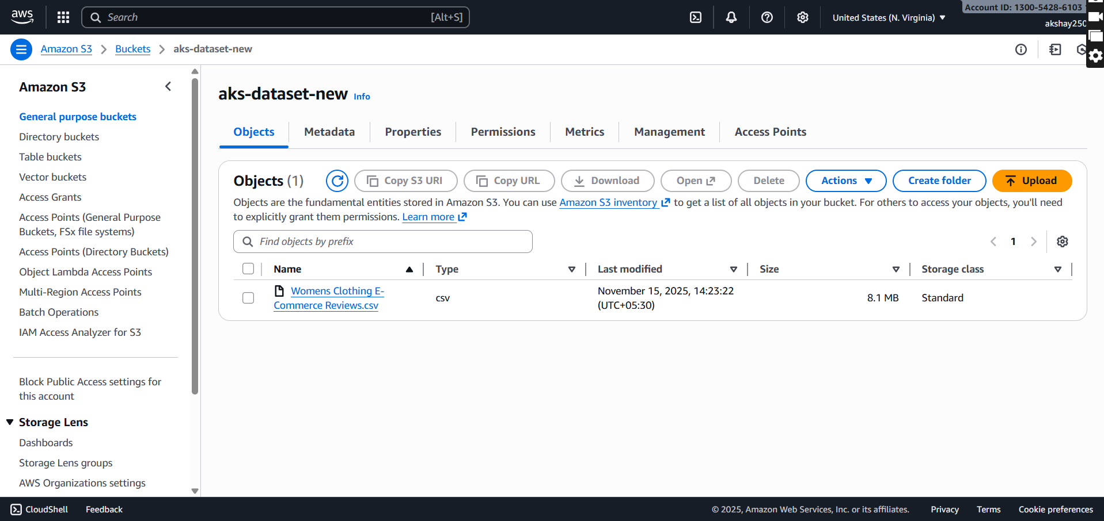
SERVICES USED
1. Amazon S3 (Simple Storage Service)
Used to store raw customer review CSV files. Uploading a file triggers the ingestion Lambda function.

Slide 8
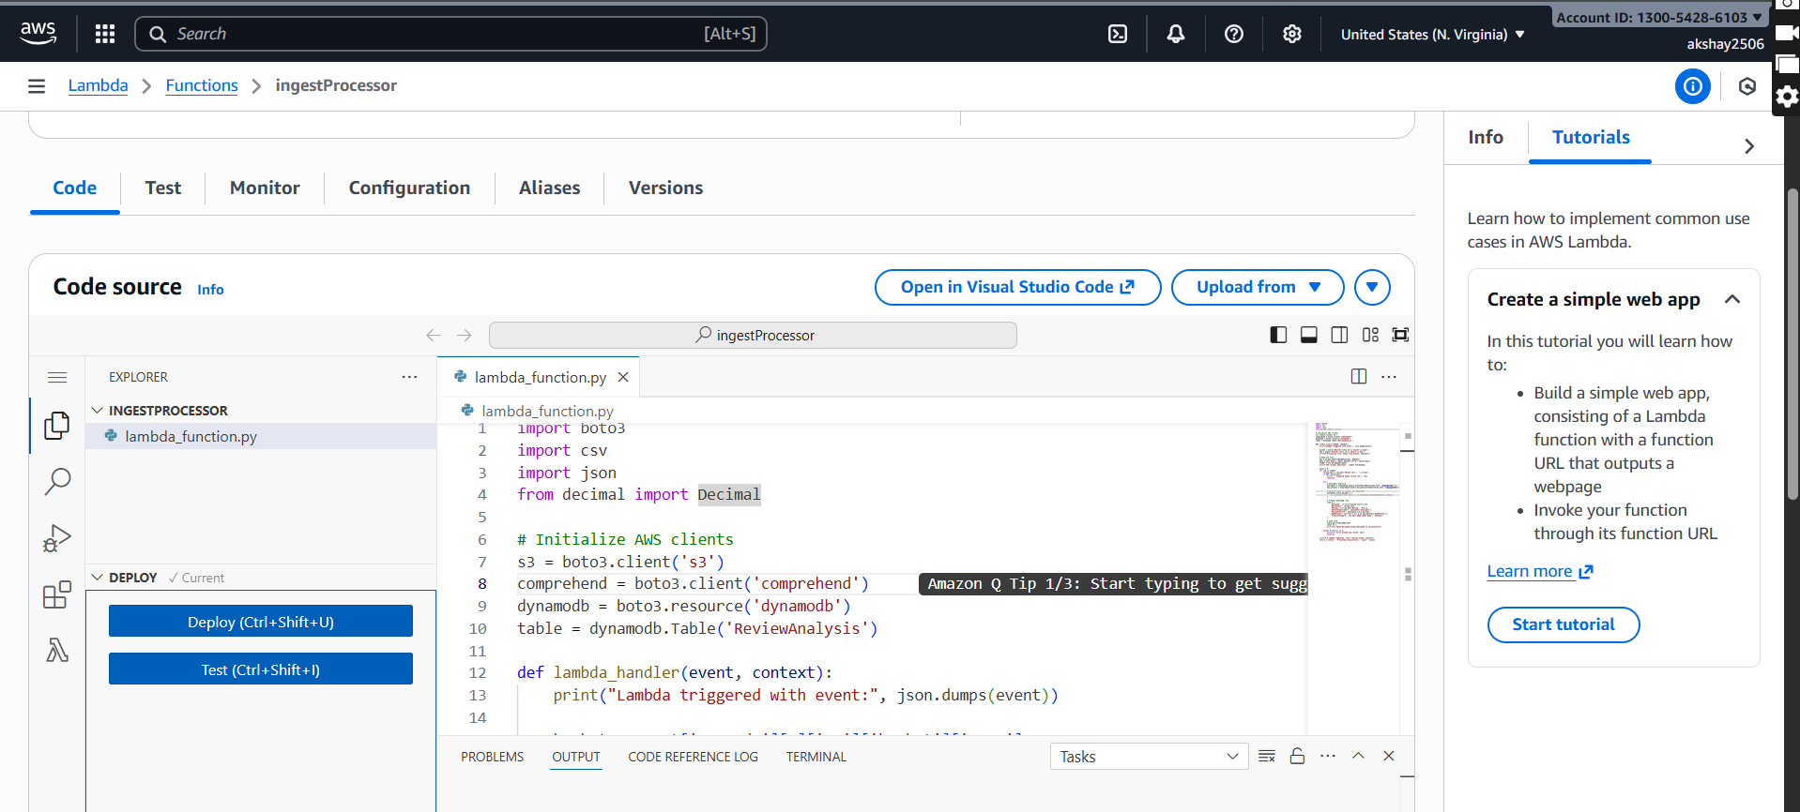
SERVICES USED
AWS Lambda
  Two Lambda functions are used:
  Ingestion Lambda: Reads CSV from S3, calls Comprehend, stores cleaned data in DynamoDB.

Slide 9
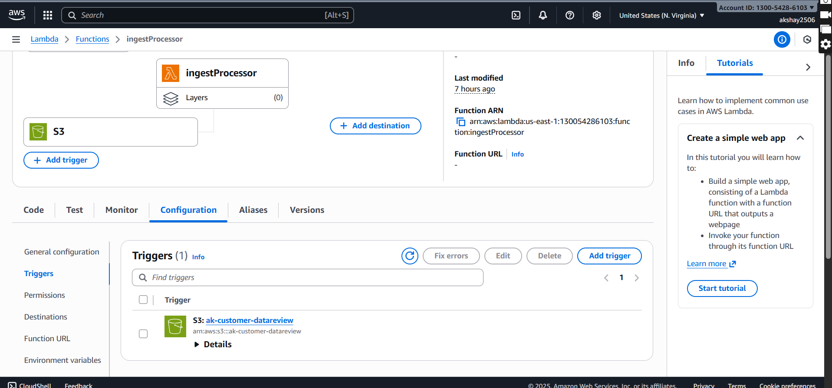
SERVICES USED
Summarization Lambda:
  Fetches reviews from DynamoDB, sends them to SageMaker, and stores the summary.
  AWS S3 Trigger

Slide 10
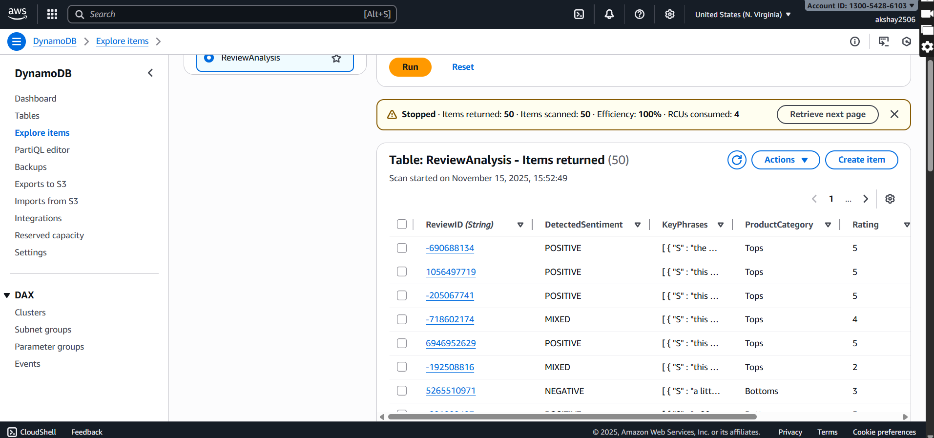
SERVICES USED
Amazon DynamoDB
  Serves as the database to store structured review data, including sentiment, rating, key phrases, and generated summaries.

Slide 11
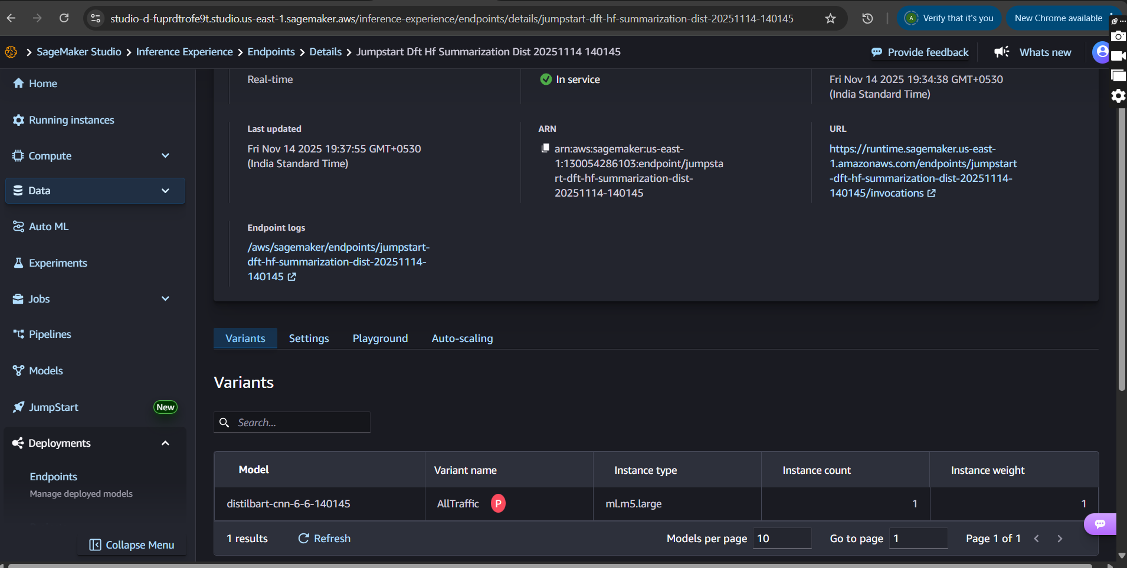
SERVICES USED
Amazon SageMaker (JumpStart Model)
  Used to deploy a pre-trained text summarization model, which generates a consolidated summary of all customer reviews.

Slide 12
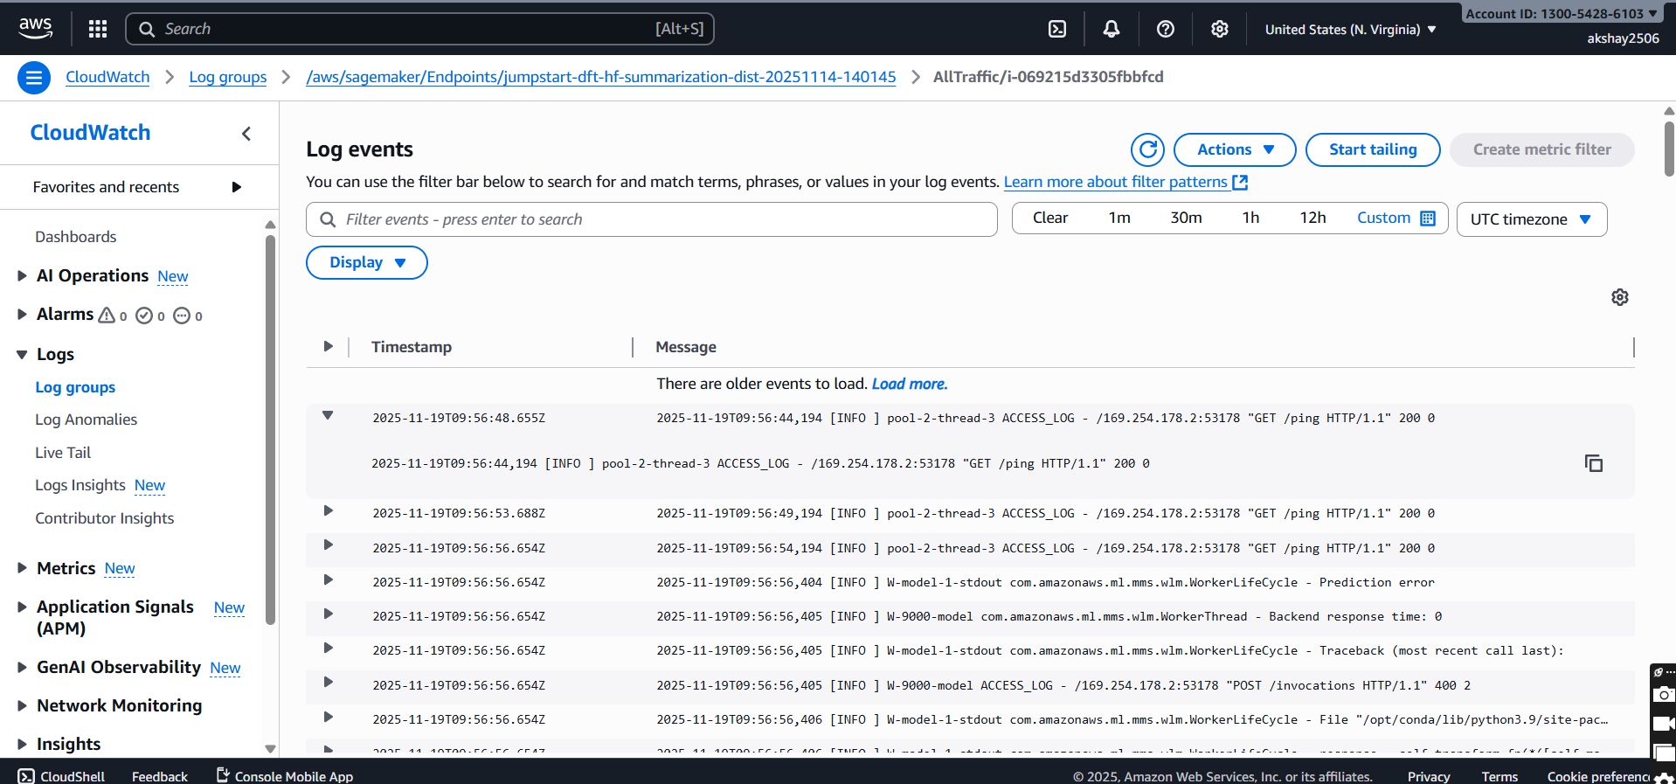
SERVICES USED
Amazon QuickSight and Cloud Watch
  Used to create dashboards and visualizations, including KPIs, sentiment distribution, rating analysis, and review tables.
  Cloud used for logs monitoring.

Slide 13
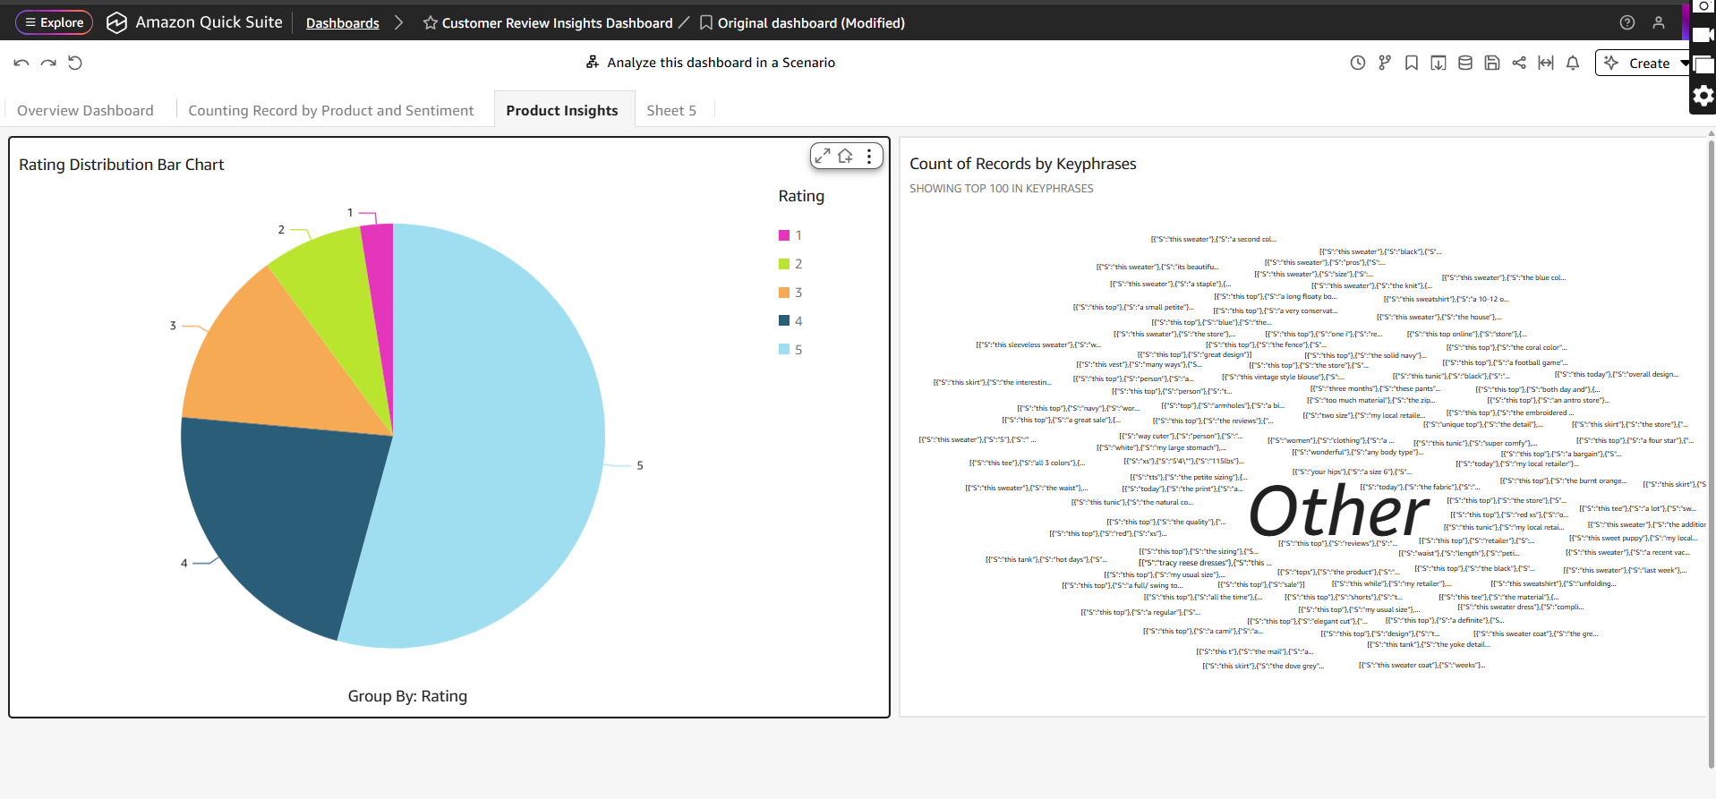
FINAL RESULT
The final QuickSight dashboard provides an interactive, end-to-end visualization of customer reviews, including KPIs, sentiment analysis, keyword insights, and product category trends, enabling clear and actionable business insights.

Slide 14
FUTURE ENAHNCEMENT
Integrate Amazon Kinesis to process customer reviews in real time instead of batch uploads. This enables instant sentiment detection and live dashboard updates.
Add Amazon Translate so reviews written in different languages can be automatically translated to English and analyzed using Comprehend.
Use Amazon SageMaker to build a recommendation model that suggests products based on customer sentiment patterns and keywords extracted from reviews.
Implement Amazon SNS to send automatic alerts when negative sentiment spikes or when specific keywords (e.g., “refund”, “broken”) appear frequently.

Slide 15


