Slide 1
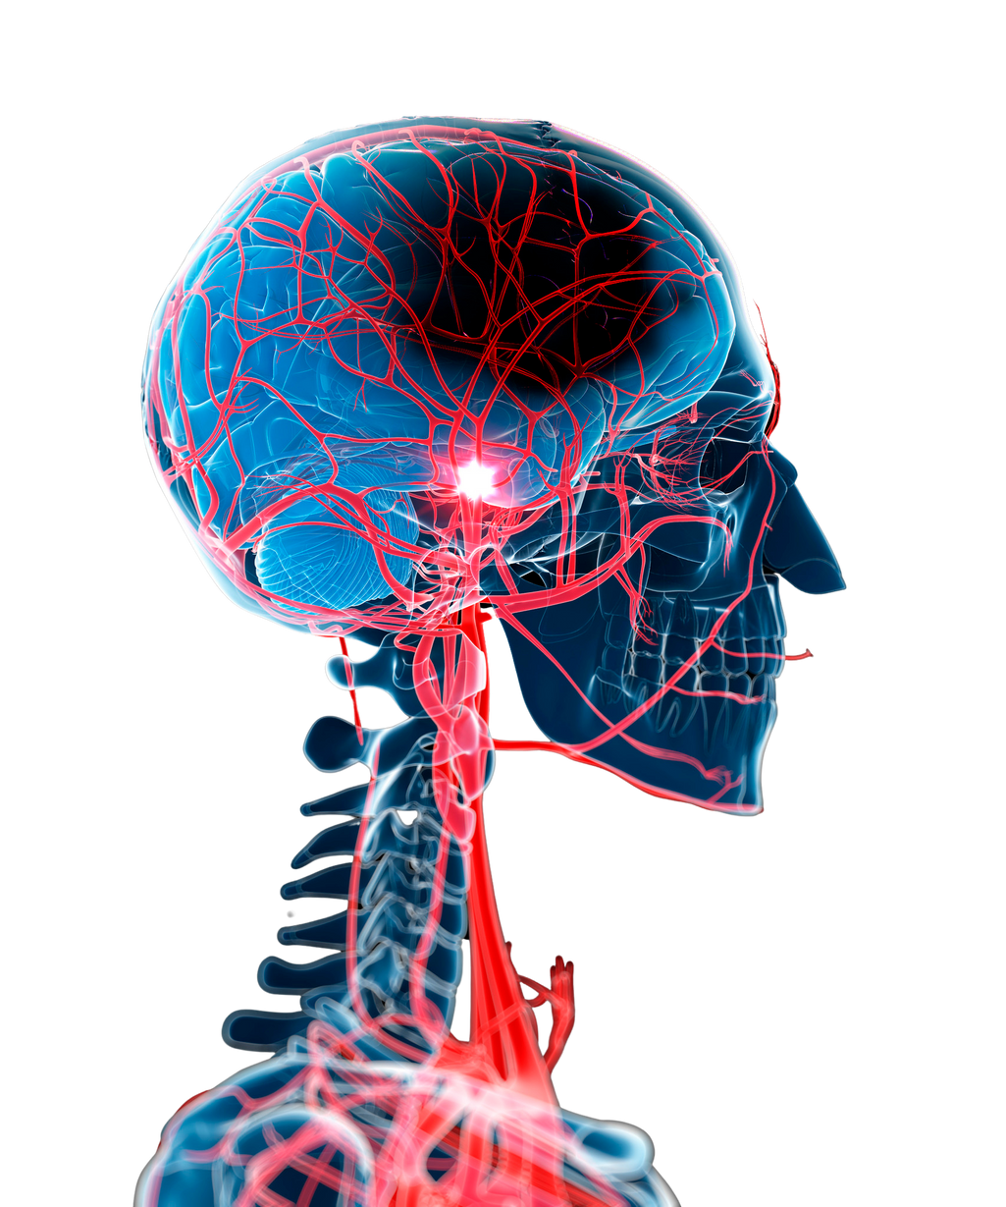
BRAIN
STROKE
PREDICTION
Presented by - Akshay Mirani

Slide 2
Introduction
- A stroke is a life-threatening condition that happens when part of your brain doesn't have
enough blood flow.
- An ischemic stroke is caused by a blockage cutting off the blood supply to the brain. This is the most common type of stroke. A hemorrhagic stroke is caused by bleeding in or around the brain. A transient ischemic attack or TIA is also known as a mini-stroke.
- Hemorrhagic strokes are particularly dangerous because they cause severe symptoms that get worse quickly.
- The Stages of stroke are Stage 1: Flaccidity(soft). Stage 2: Spasticity (clumsy neural
problem). Stage 3: Increased Spasticity. Stage 4: Decreased Spasticity
- Foods high in potassium, such as sweet and white potatoes, bananas, tomatoes, prunes, melon, and soybeans, can help you maintain healthy blood pressure—the leading risk factor of stroke.

Slide 3
Objective &Scope
• The prime objective of this project is to construct a prediction model for predicting stroke
using machine learning algorithms.
• The dataset was given by Mentorness Internship Program

Slide 4
Facts
• About 3.0 million deaths resulted from an ischemic stroke while 3.3 million deaths resulted from hemorrhagic stroke. Hence, correct detection and finding the presence of a stroke inside a human becomes essential. In the existing system, there are various medical instruments available in the market for predicting brain stroke but they are very much expensive and they are not efficient enough to be able to calculate the chance of having a brain stroke.
• Takes a lot of time to find the disease.
• Inaccuracy and inefficiency of results.

Slide 5
Proposed System
• Machine Learning is a faster-emerging technology of Artificial Intelligence that contributes various algorithms like Logistic Regression, SVM, Random Forests and many more which is effective in making decisions and predictions from the large quantity of data produced by the healthcare industry. Based on the proposed problem, ML provides different classification algorithms to divine the probability of a patient having a Brain Stroke.
• It detects the brain stroke disease less time.
• More accuracy and efficiency.

Slide 6
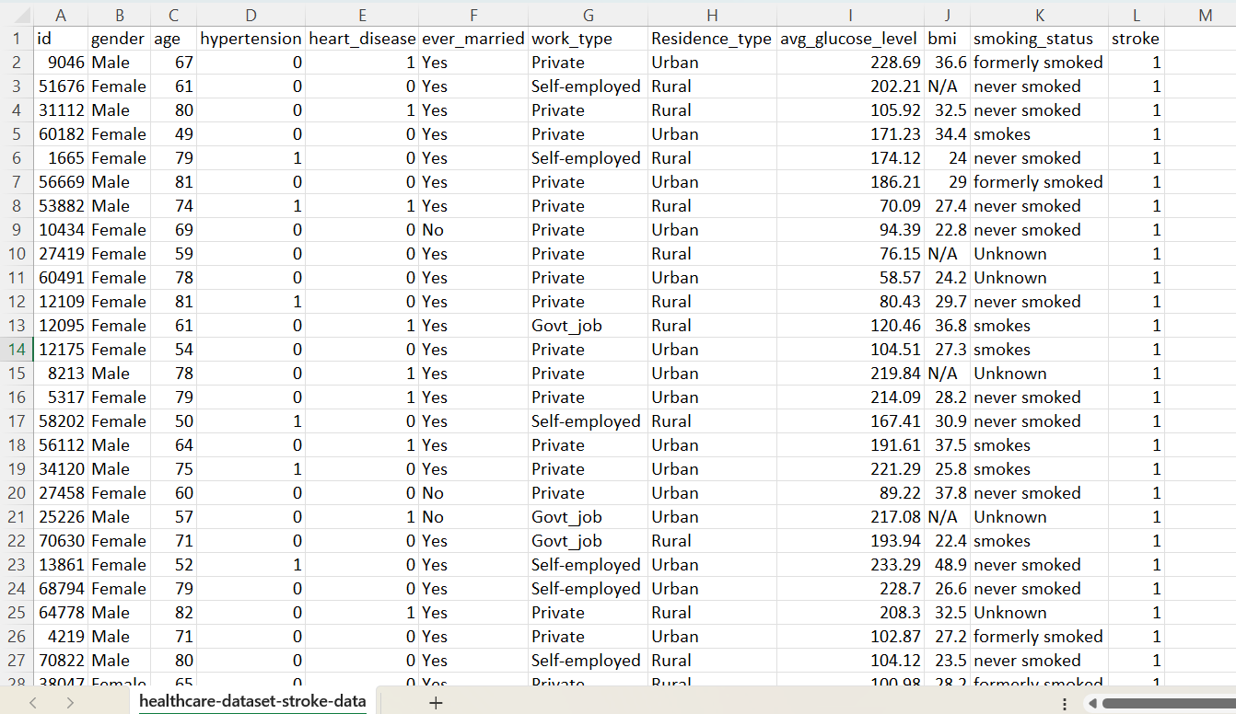
Dataset

Slide 7
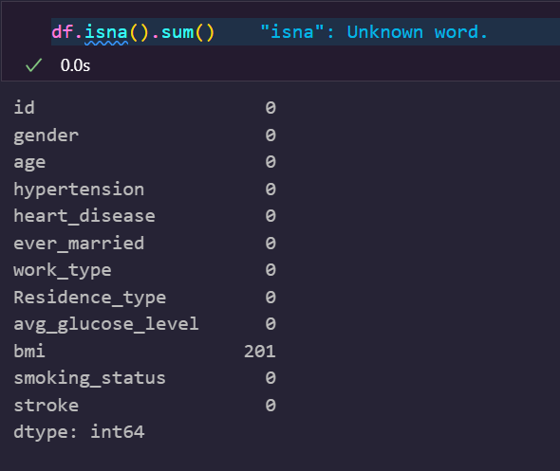
Checking Missing Value

Slide 8
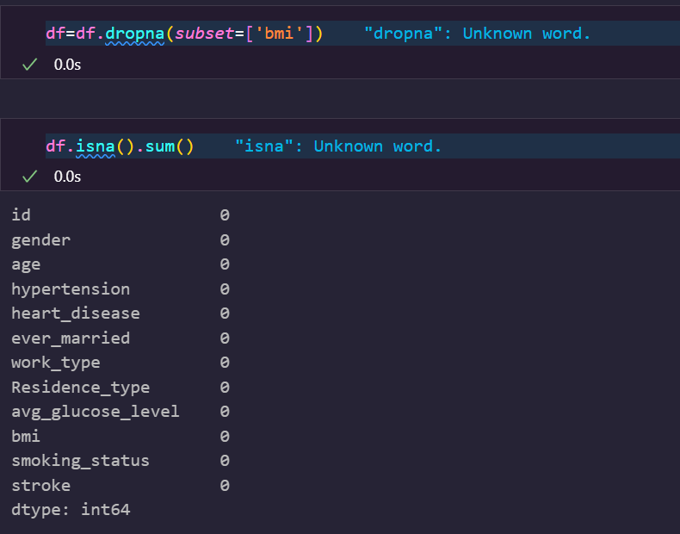
Treating Null Value

Slide 9
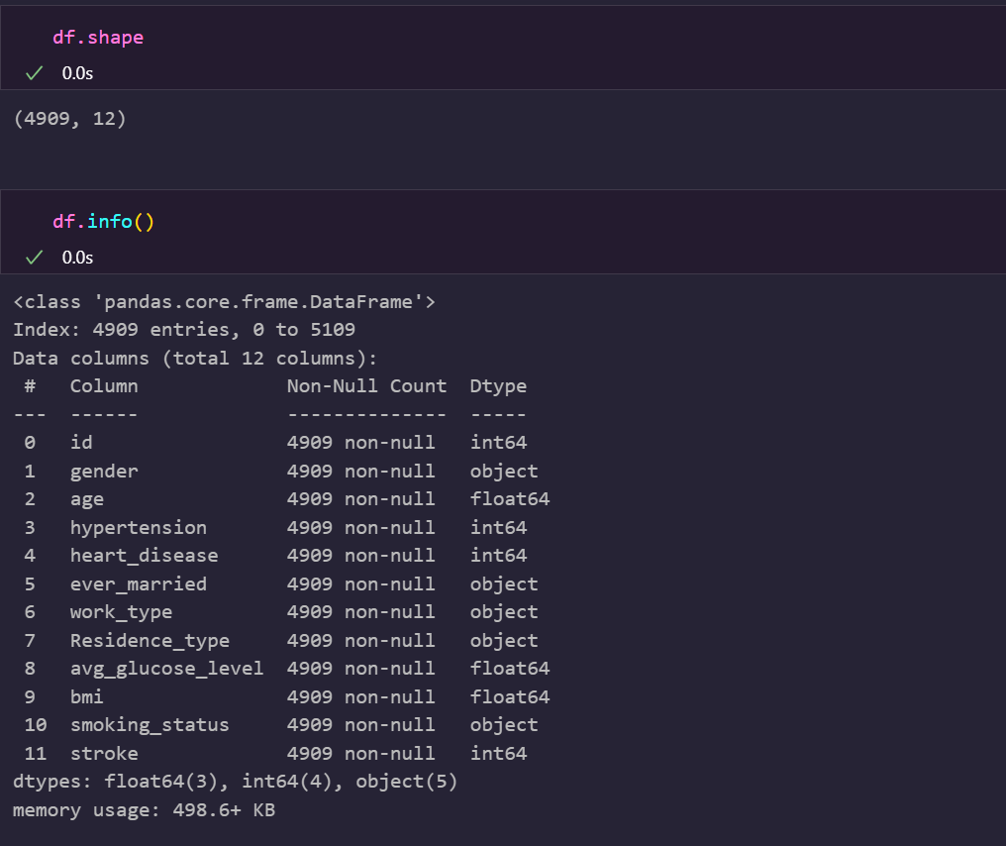
data Information

Slide 10
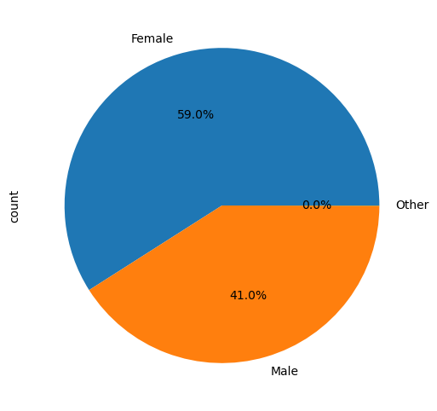
Graphical Visualization

Slide 11
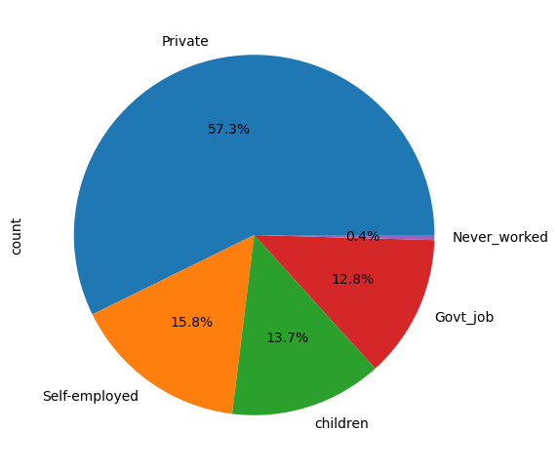
Graphical Visualization

Slide 12
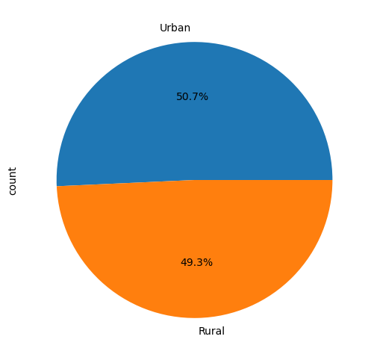
Graphical Visualization

Slide 13
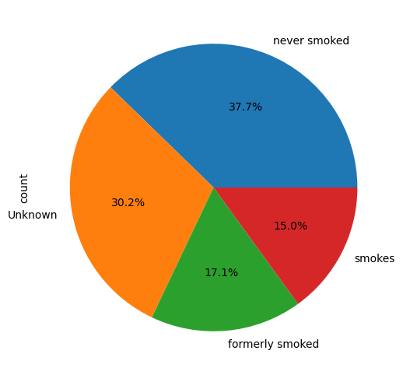
Graphical Visualization

Slide 14
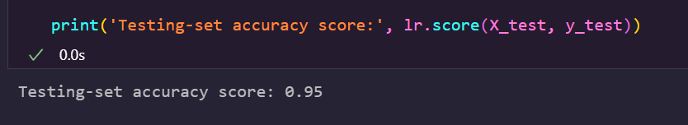
Machine Learning Algorithm(Logistic)

Slide 15
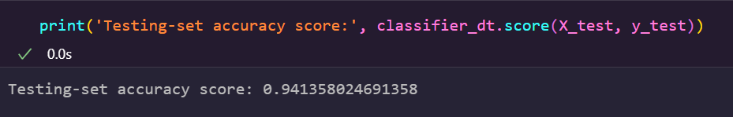
Machine Learning Algorithm(Decission tree)

Slide 16
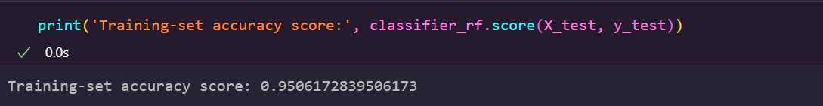
Machine Learning Algorithm(Random Forest)

Slide 17
Machine Learning Algorithm
Random Forest and Logistic Regression are giving the accuracy of 95% , so we will choose model and go for it

Slide 18


