Slide 1
BLACKBOARD MOSAICING
PARESH MISHRA (16UCS123)
AKANKSHA MAHESHWARI (16UCS111)

Slide 2
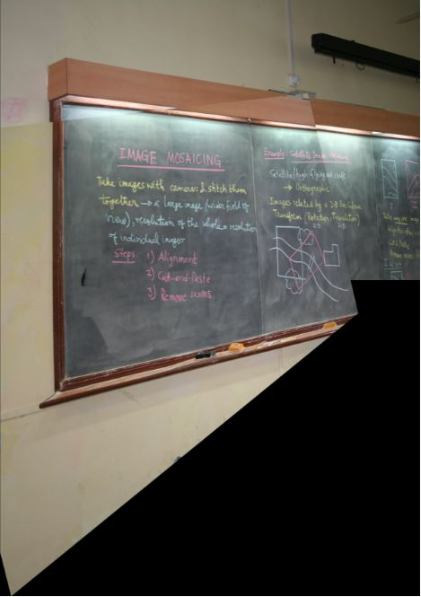
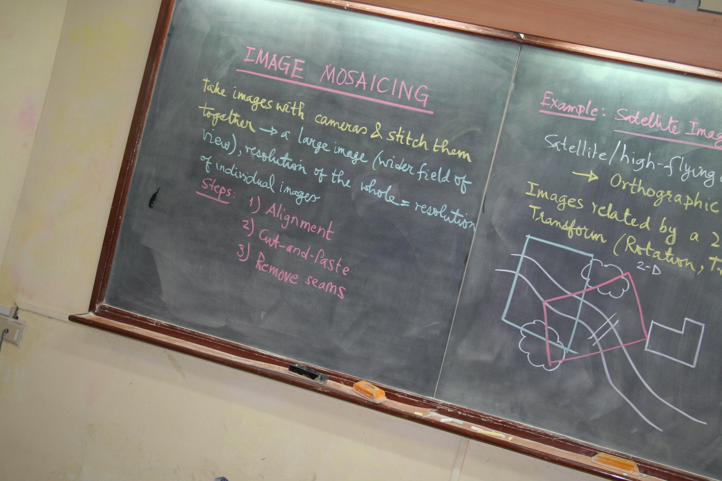
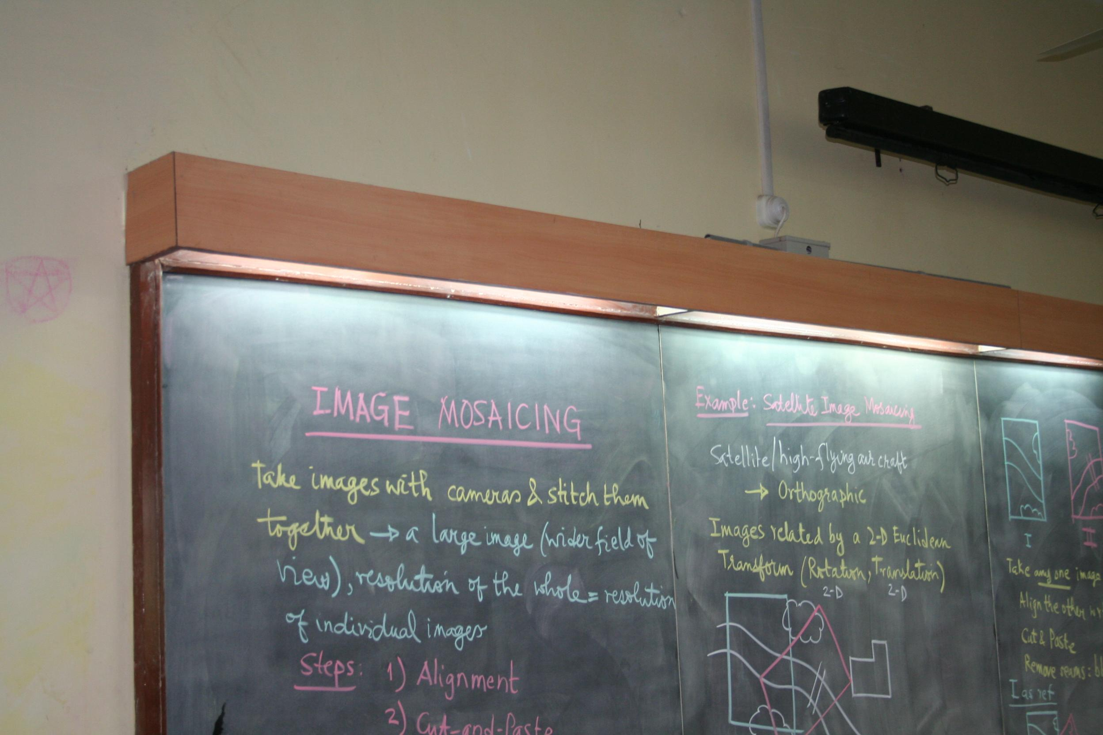
Image Mosaicing
It is the process of stitching multiple, overlapping snapshot images together in order to produce one large, high resolution composite image.
Image1
Image2
Stitched Image

Slide 3
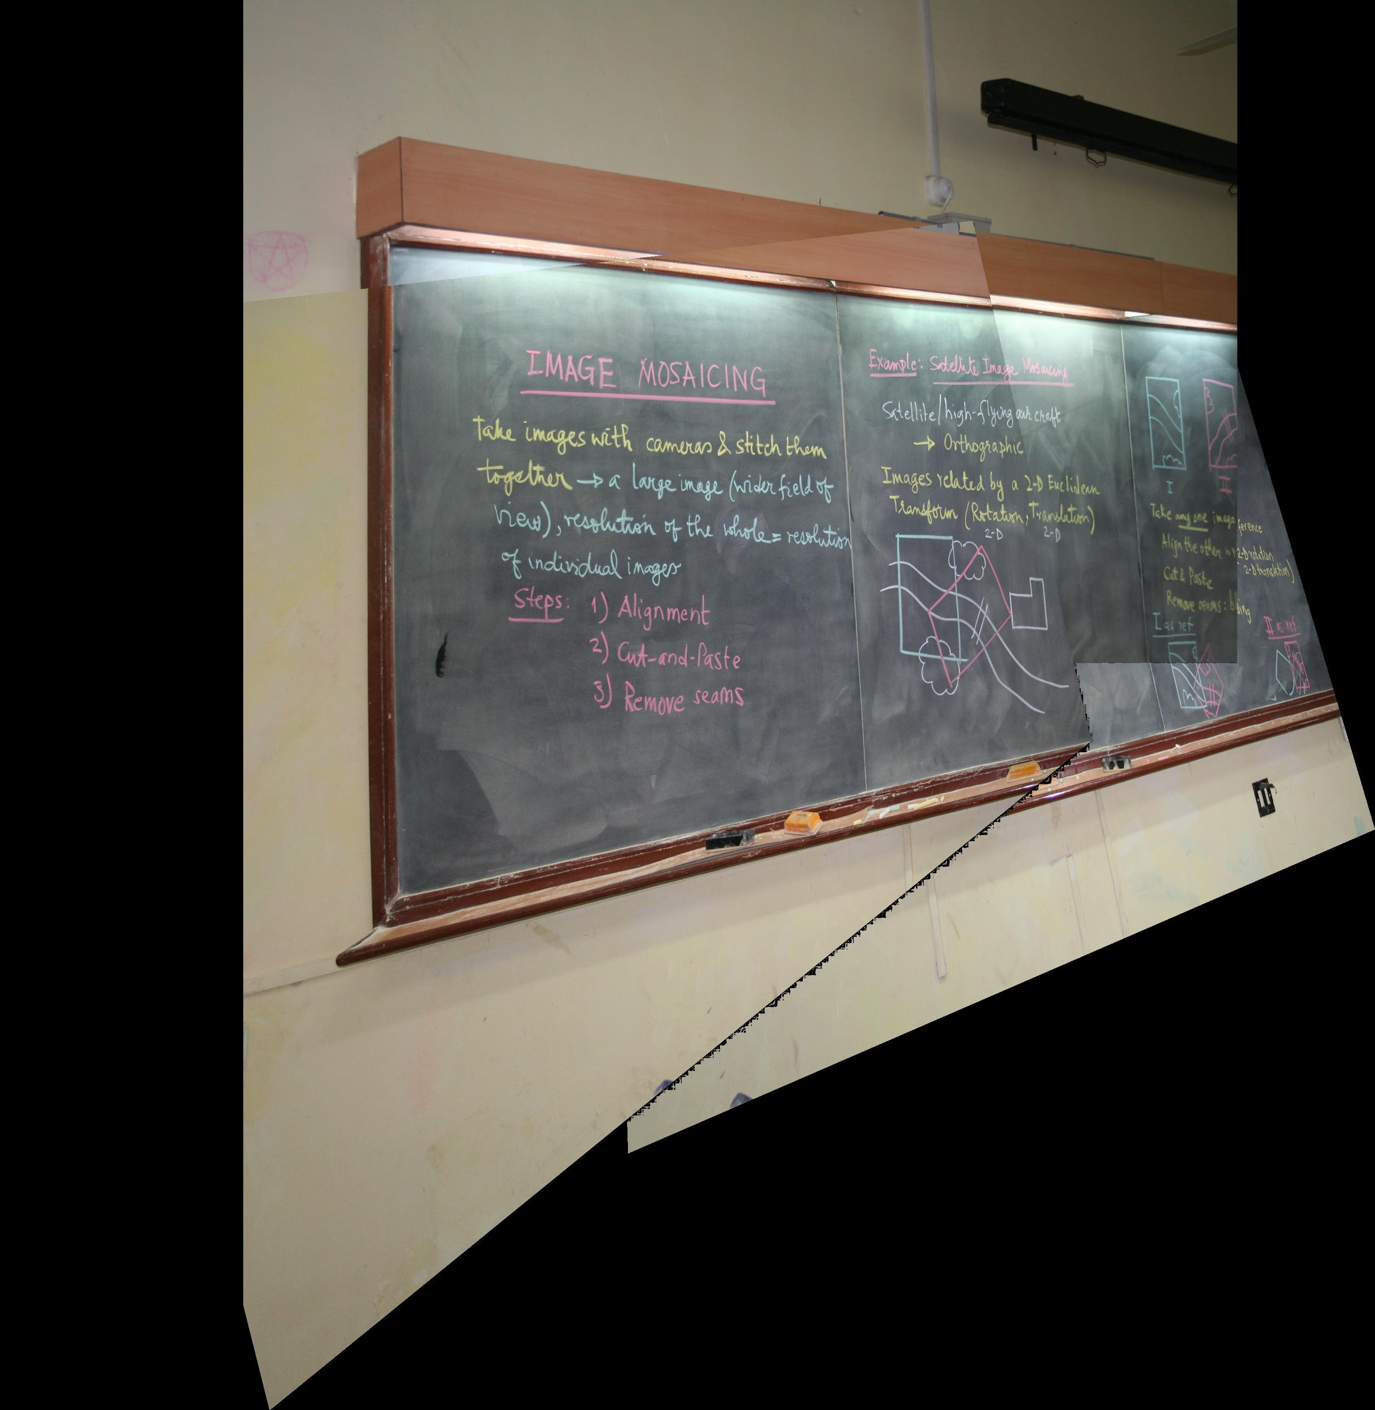
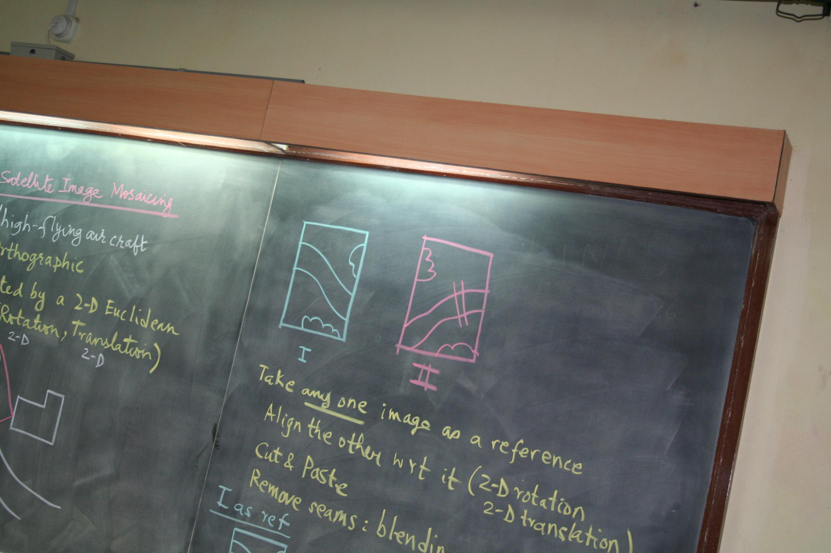
Method
Feature Extraction :
Features are the elements in the two input images to be matched

Slide 4
2. Finding Homography
Find the homography matrix and apply inverse homography on the corner points of second image
3. Defining Canvas size
Find the maximum and the minimum value of x and y coordinates in both the images. The final width of the canvas would be the maximum value of x + x offset and the final height will be maximum value of y + y offset.

Slide 5
4. Stitching of images
Paste the first image as it is on canvas after adding the x and y offset and iterating through whole image.
After stitching the first image apply the homography to each pixel of the canvas to get coordinate that matches with a pixel of second image then assign its color value to the pixel in canvas.

Slide 6
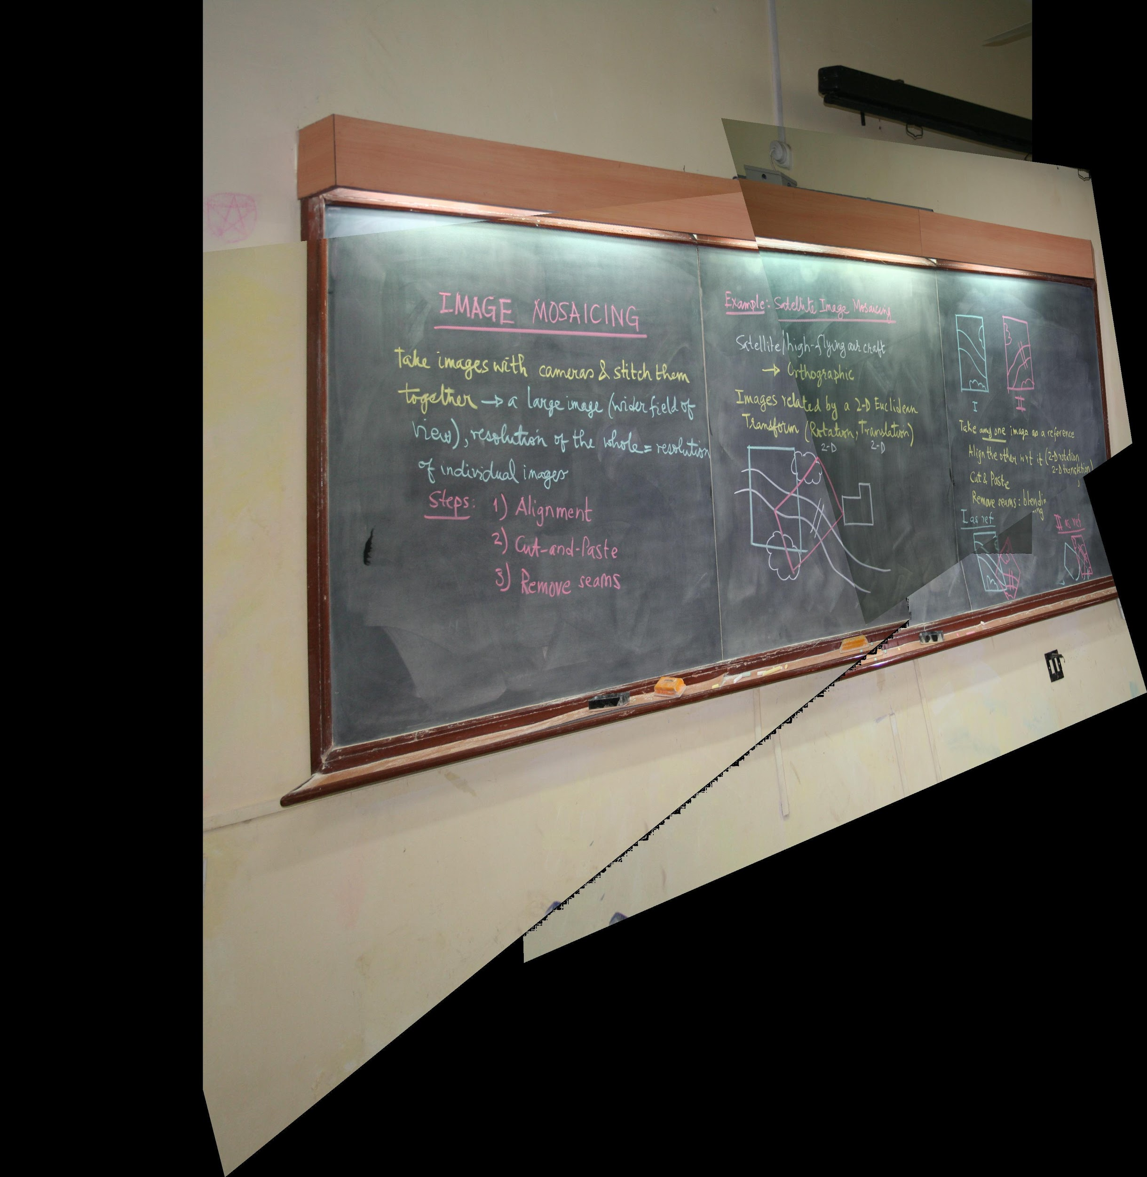
5. Image Output
Show the image output using imshow function
e.g.
Image2
Image1
Aligned Image

Slide 7
INPUT IMAGES : m0 and m5

Slide 8
OUTPUT

Slide 9
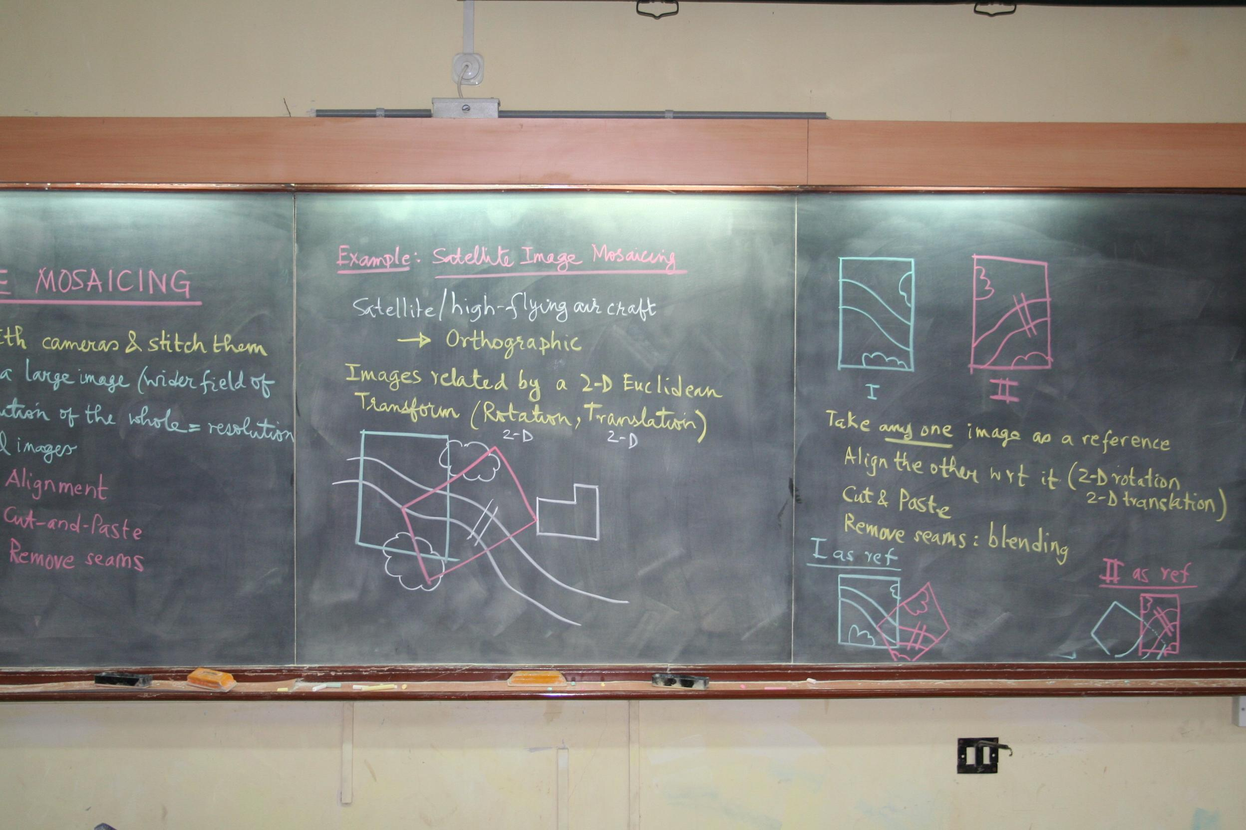
INPUT IMAGES : m0m5 and m4

Slide 10
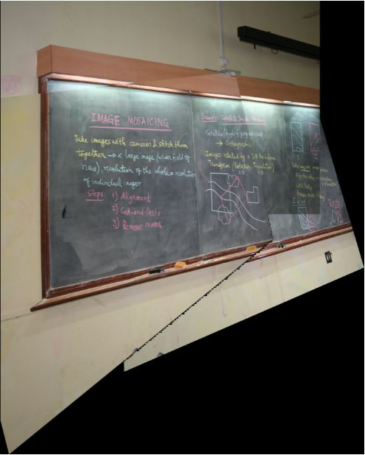
OUTPUT

Slide 11
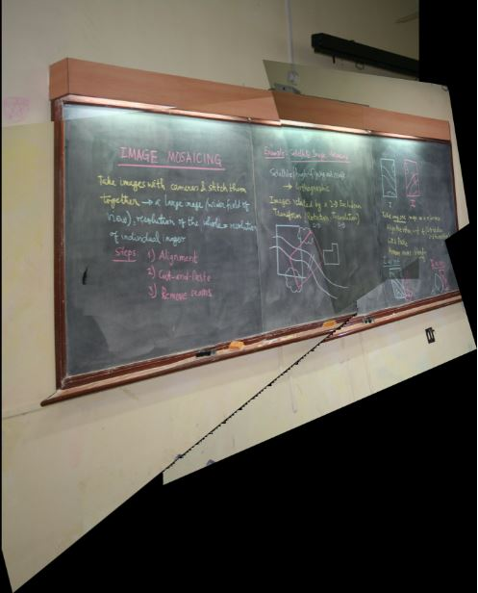
INPUT IMAGES : m0m5m4 and m2

Slide 12
OUTPUT

Slide 13
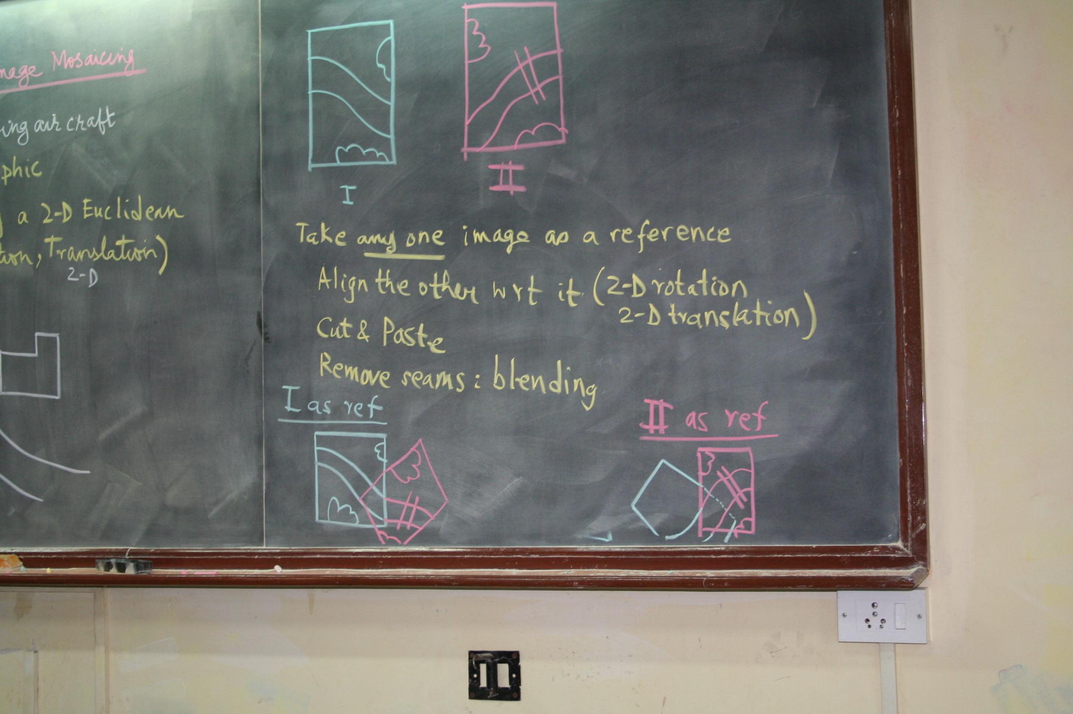
INPUT IMAGES : m0m5m4m2 and m3

Slide 14
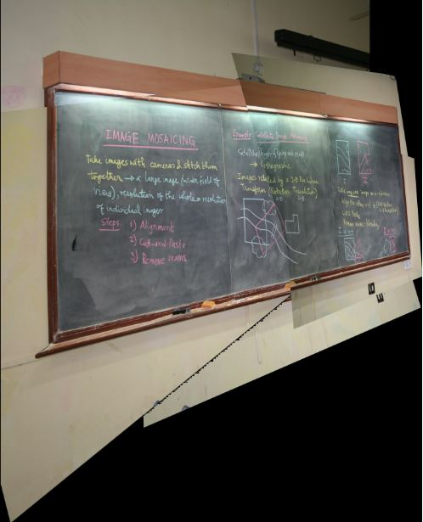
OUTPUT

Slide 15
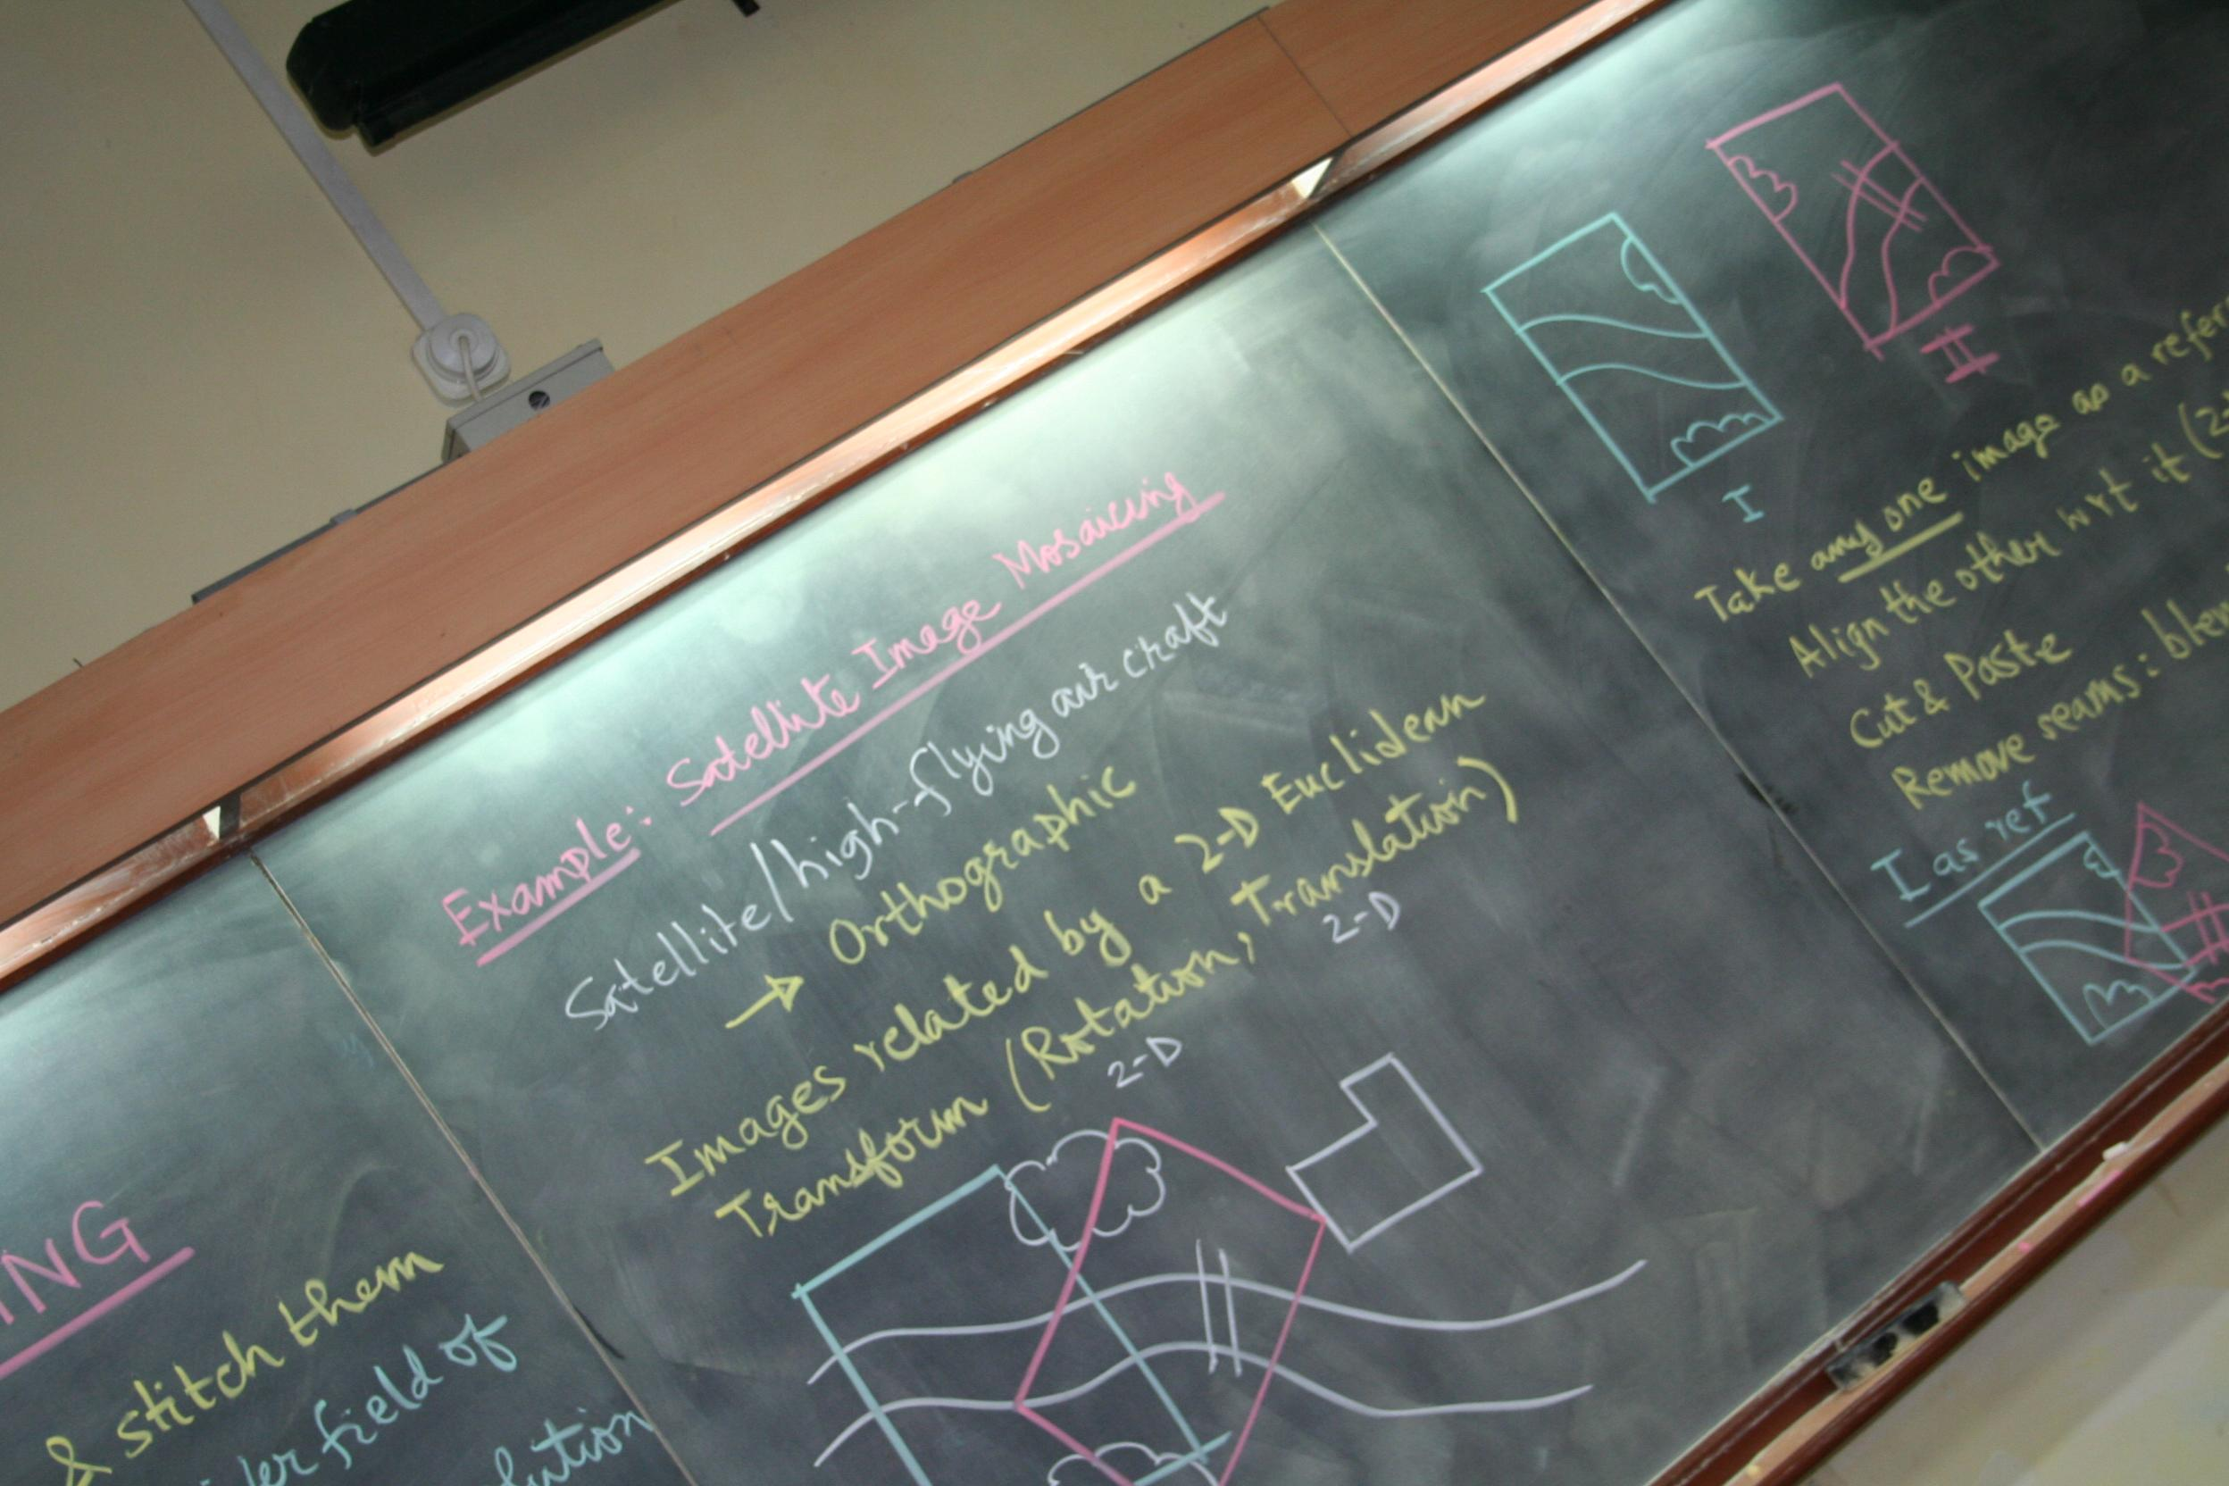
INPUT IMAGES : m0m5m4m2m3 and m1

Slide 16
OUTPUT

Slide 17
Observations
Algorithm works only for 2D images.
After stitching we get Large field of view.
Selection of images should be in correct order else it may fail.
After mosaicing more than 4 images to the reference image, the image alignment does not look good.

Slide 18


