Slide 1
KDD Final Project
Presentation
Alekhya Akkinepally

Slide 2
TASK DESCRIPTION:
To find a personal surprising element from the given Diabetes Corpus.
Defining the divergent and expected terms.

Slide 3
OVERVIEW:
Data Preprocessing
Converting to Document Term Matrix
Clustering
Finding the document containing the word
Plotting Wordcloud

Slide 4
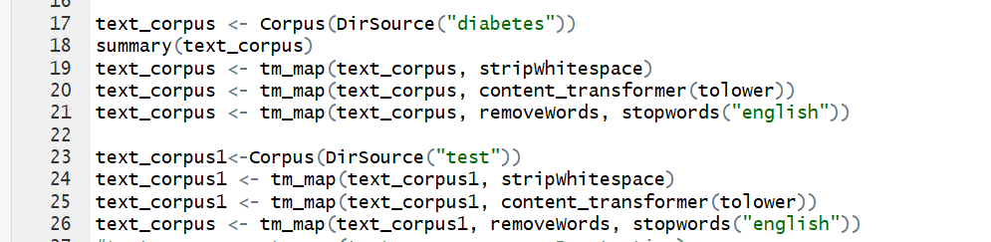
DATA PRE-PROCESSING:
Removing White Spaces
Removing stopwords
Converting to lowercase
Removing punctuations

Slide 5
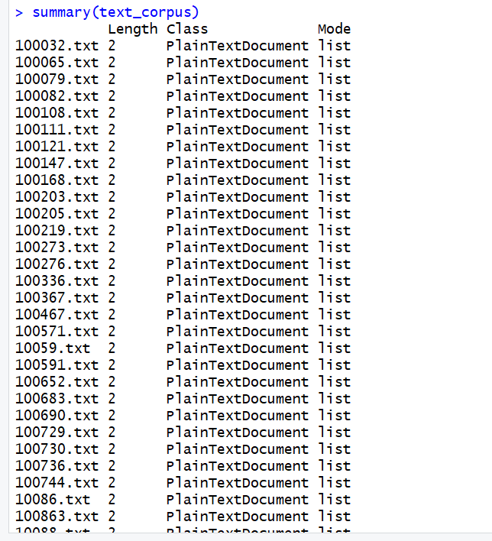
Text_Corpus:

Slide 6
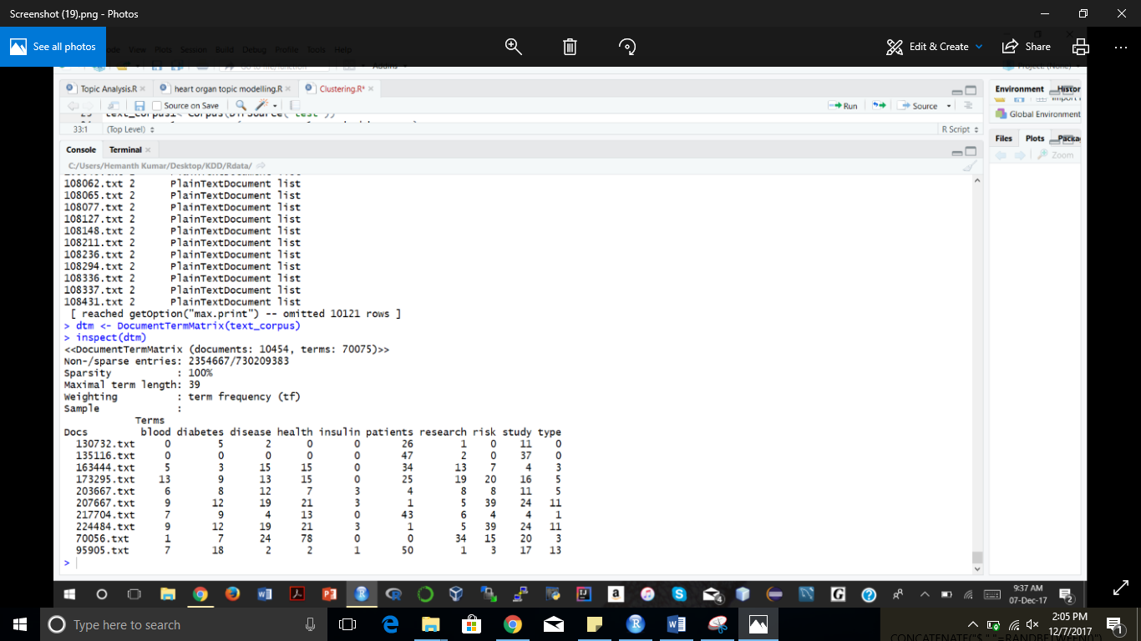
Converting to Document Term Matrix and Term Frequency- Inverse Document Frequency
Converting the corpus to Document Term Matrix
Converting the DTM to Tf-IDF

Slide 7
CLUSTERING:
Different clustering techniques:
SK-Means
Created a function which takes the sk means clusters as input and gives the words in each cluster as the output depending on the other inputs provided by the user..
Incorporated option for finding the unique words in the cluster and also the most common words.
If UNIQUE=TRUE unique words are obtained and when UNIQUE= FALSE common words are obtained.
Common Words are the most likelihood words.
Unique Words are the divergent words.

Slide 8
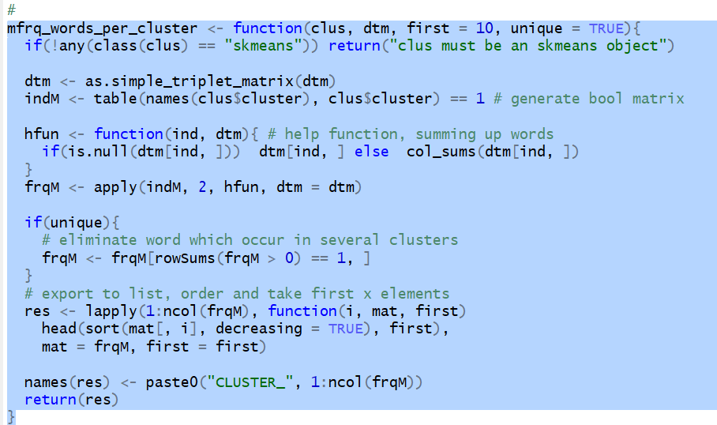
FUNCTION:

Slide 9
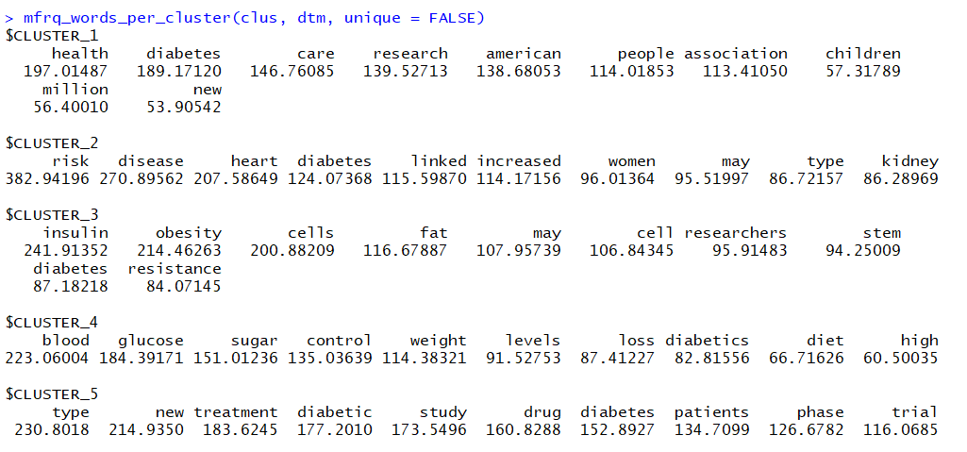
USING FUNCTION:
Creating clusters for the corpus
Providing input to the function with UNIQUE= FALSE. The term in each cluster are as following

Slide 10
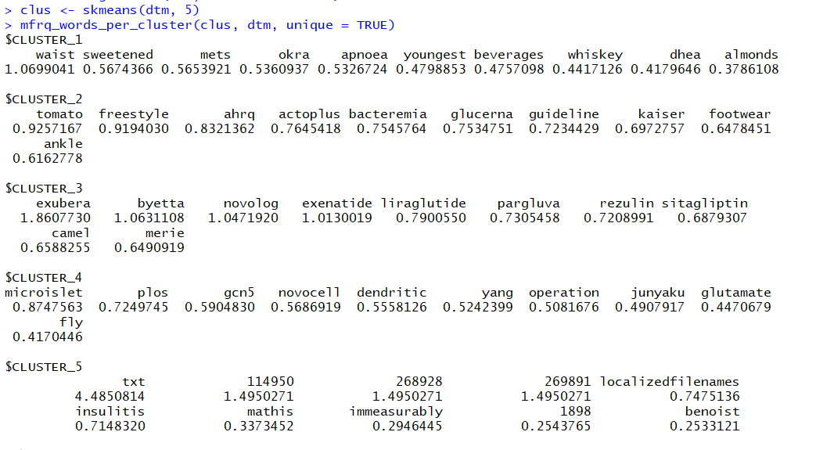
Providing input to the function with UNIQUE= TRUE. The term in each cluster are as following:

Slide 11
Finding Surprise Element:
Analyzing results when UNIQUE=TRUE
Found two words :
CAMEL
OKRA

Slide 12
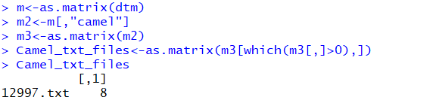
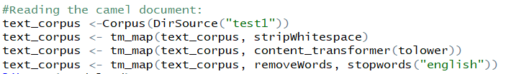
SURPRISE TERM CAMEL:
FINDING THE DOCUMENTS CONTAINING CAMEL WORD:
READING THE DOCUMENT CONTAINING THE CAMEL WORD:

Slide 13

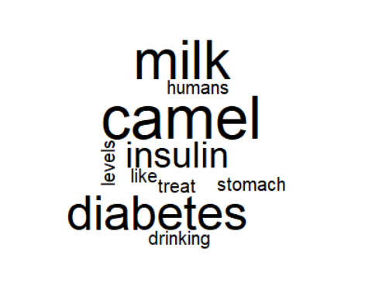
GETTING INFO FROM TEXT FILE:
Used the word cloud to get the brief info about the document:
WORD CLOUD:

Slide 14
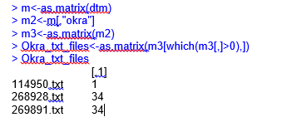
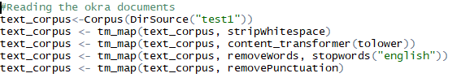
SURPRISING TERM OKRA:
FINDING THE TEXT FILES CONTAINING OKRA:
READING THE DOCUMENT CONTAINING THE CAMEL WORD:

Slide 15

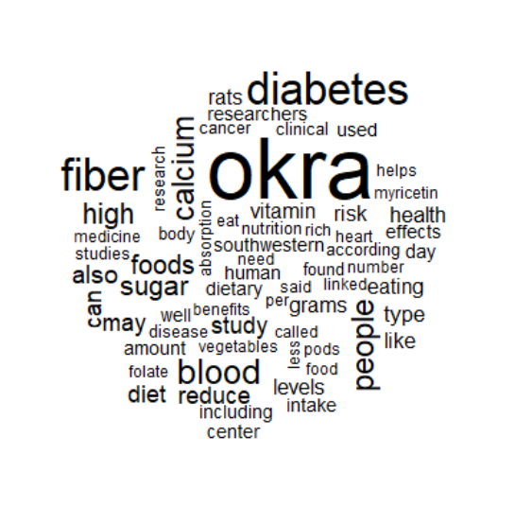
GETTING INFO FROM THE TEXT FILE:
Used the word cloud to get the brief info about the document:
WORD CLOUD:

Slide 16
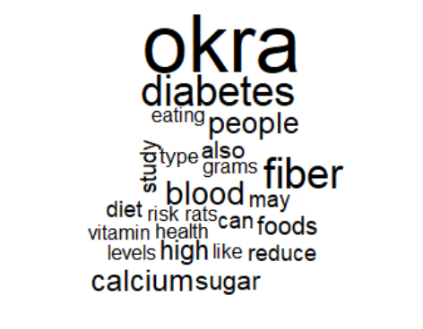
Getting more details:

Slide 17
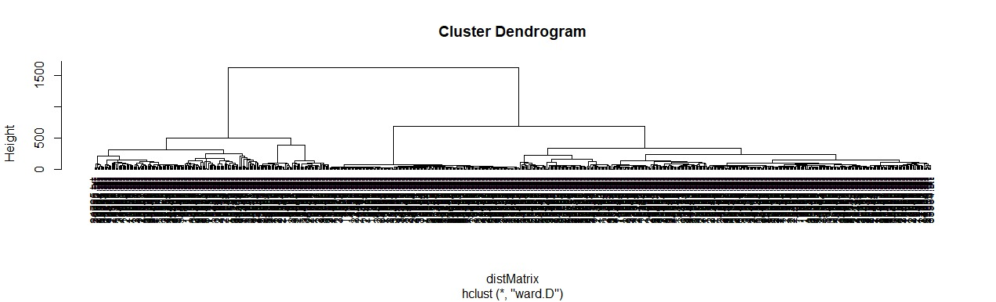
Other Techniques Used:
Hierarchical Clustering and drawing dendrogram:

Slide 18
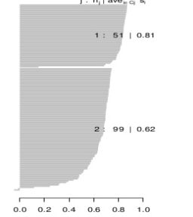
Partitions Along Medoid:

Slide 19
THANK YOU

