Slide 1
01
THE PROBLEM
Every architecture decision costs twice:
Once to make. Again every time the team has to rediscover why.
SLACK
Tradeoffs debated
THE RECURRING QUESTION
JIRA
“Why was checkout designed this way?”
Work broken down
GITHUB
Implementation changed
Search returns fragments. The team reconstructs the story manually, interrupts senior engineers, and repeats old debates.
PAGERDUTY
Incident pressure
ARCH REVIEW
5 tools
0 context
hours
Decision approved
one decision story
between the records
lost rediscovering why
The context tax compounds with every project, incident, and teammate.
ECHOMIND / HACKATHON PITCH
01

Slide 2
02
EXISTING SOLUTIONS & GAPS
Search finds documents. It does not reconstruct decisions.
The missing product is the connective tissue between records.
WHAT TEAMS USE
WHAT IT RETURNS
WHAT IS STILL MISSING
Search + Slack history
Messages and keywords
Causal story
ECHOMIND
Connect records first.
Wikis + ADRs
Curated snapshots
Real implementation trail
Generic AI chat
A fluent paragraph
Verifiable evidence
Then explain the decision with citations.
Ask a senior engineer
High-value context
Scalable company memory
The answer remains inspectable.
DIFFERENTIATOR
EchoMind reconstructs the story between documents.
ECHOMIND / HACKATHON PITCH
02

Slide 3
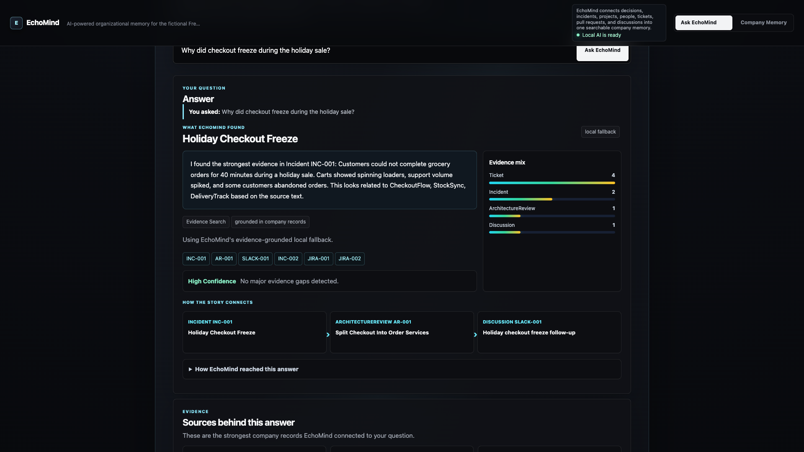
03
THE SOLUTION
Scattered work becomes an evidence-backed company memory.
Ask naturally. Understand the story. Inspect every source.
WORKING DEMO
One answer, four trust signals
01
Polished explanation
The result reads like a teammate who understands the history.
02
Confidence + evidence mix
Users see what supports the answer.
03
Contributors + timeline
The people and evolution stay connected.
04
Original source records
Every citation can be inspected.
95
21
6
4
connected records
decisions + incidents
known experts
active projects
ECHOMIND / HACKATHON PITCH
03

Slide 4
04
HOW IT WORKS
Evidence first. AI explains second.
Retrieval and relationships create the truth boundary; generation makes it readable.
1
INGEST
2
CONNECT
3
RETRIEVE
4
EXPLAIN
5
VERIFY
Jira · GitHub · Slack
Incidents · Reviews
People · Projects
Decisions · Events
Rank the strongest
related evidence
Ollama / OpenAI
or local fallback
Citations + source-
style records
TRUST BOUNDARY
Connected evidence
Grounded evidence package
Readable answer + citations
The model never replaces retrieval. It explains what retrieval found.
Reliable demo path today · Neo4j-backed production path next
ECHOMIND / HACKATHON PITCH
04

Slide 5
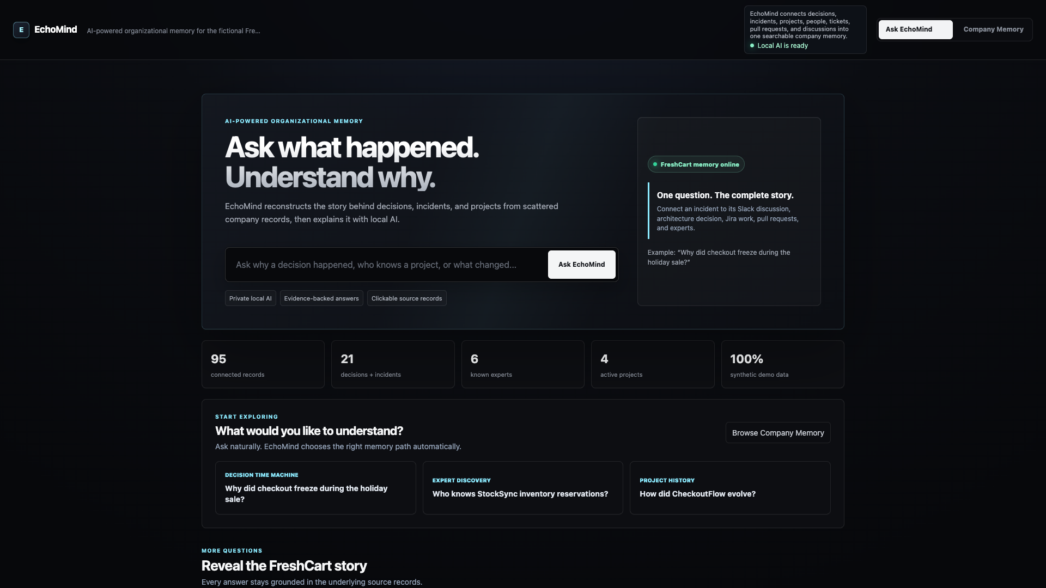
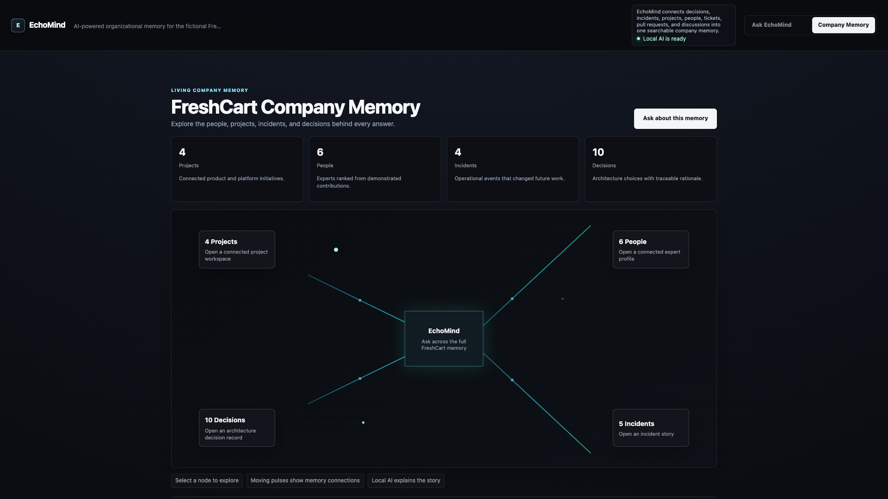
05
KEY FEATURES
One memory answers the three questions that slow teams down.
Different questions, one connected evidence model.
WHY?
WHO?
HOW?
TRUST
Decision Time Machine
Expert Discovery
Timeline Explorer
Traceable Sources
Reconstructs incidents, tradeoffs, and implementation.
Ranks people from demonstrated contributions.
Turns project events into a chronological story.
Opens every citation in its original context.
ECHOMIND / HACKATHON PITCH
05

Slide 6
06
DEMO FLOW
In 95 seconds, judges see the full trust loop.
Each interaction proves a different part of the product.
00s
18s
32s
42s
58s
79s
ASK WHY
READ ANSWER
OPEN SOURCE
FIND EXPERT
SEE TIMELINE
EXPLORE MEMORY
Natural-language entry
Grounded synthesis
Traceable evidence
Contribution ranking
Evolution reconstructed
Connected company map
WHAT JUDGES SHOULD NOTICE
The answer is useful. The evidence is inspectable. The memory connects people, decisions, and time.
Calm pacing · no hidden setup · no unfinished screens
ECHOMIND / HACKATHON PITCH
06

Slide 7
07
TECHNICAL INNOVATION
Graph-connected evidence keeps AI useful and accountable.
The hard part is not calling a model. It is constructing a trustworthy evidence package.
ANSWER EXPERIENCE
ENGINEERING CHALLENGES SOLVED
React + Tailwind · confidence · citations · memory map
Relationship-aware retrieval
Connects the story across record types.
MEMORY INTELLIGENCE
Explainable answers
Relationship retrieval · evidence ranking · expert scoring · timeline reconstruction
Keeps citations beside the explanation.
Demo reliability
Works even when an AI provider is offline.
SOURCE + AI LAYER
Production direction
Synthetic connectors · Ollama/OpenAI synthesis · deterministic grounded fallback
React · Spring Boot · Neo4j · FastAPI
DESIGN PRINCIPLE
AI improves the explanation; connected evidence protects the truth.
ECHOMIND / HACKATHON PITCH
07

Slide 8
08
BUSINESS IMPACT
A small reduction in context-hunting returns weeks of capacity.
Illustrative team scenario — transparent assumptions, not measured customer results.
50
× 30 min
= 25 hrs
≈ $130K
→
→
→
engineers
saved / person / week
returned every week
annual capacity at $100/hr
NEW HIRES
INCIDENT TEAMS
TECH LEADS
Understand why the system looks this way.
Find context and owners without chasing people.
Defend decisions and avoid repeating debates.
The deeper payoff: less dependency on individual memory and better decisions under pressure.
ECHOMIND / HACKATHON PITCH
08

Slide 9
09
FUTURE ROADMAP
From hackathon memory to the operating layer for decisions.
Each horizon increases trust, coverage, and proactive value.
NEXT
THEN
LATER
CONNECT REAL WORK
MEASURE TRUST
MAKE MEMORY PROACTIVE
Jira, GitHub, Slack, incidents
Access controls + incremental sync
Neo4j graph retrieval + semantic search
Answer evaluations + feedback loops
Decision capture + change-impact alerts
Onboarding journeys + cross-team memory
OUTCOME
OUTCOME
OUTCOME
Prove value with real team history
Make quality measurable and repeatable
Surface context before it is lost
North star: the right context appears before a decision is repeated or an incident escalates.
ECHOMIND / HACKATHON PITCH
09

Slide 10
10
WHY WE CAN WIN
Useful today. Technically defensible. Built for a universal problem.
EchoMind is a finished interaction with a credible path to enterprise value.
INNOVATION
Reconstructs decision history, not isolated documents.
TECHNICAL DEPTH
Retrieval, graph relationships, ranking, AI synthesis, traceability.
REAL-WORLD FIT
Every growing engineering organization loses context.
SCALABILITY
Starts with engineering memory; expands across the company.
Companies should not forget why they became what they are.
Ask what happened. Understand why.
ECHOMIND / HACKATHON PITCH
10

