Slide 1
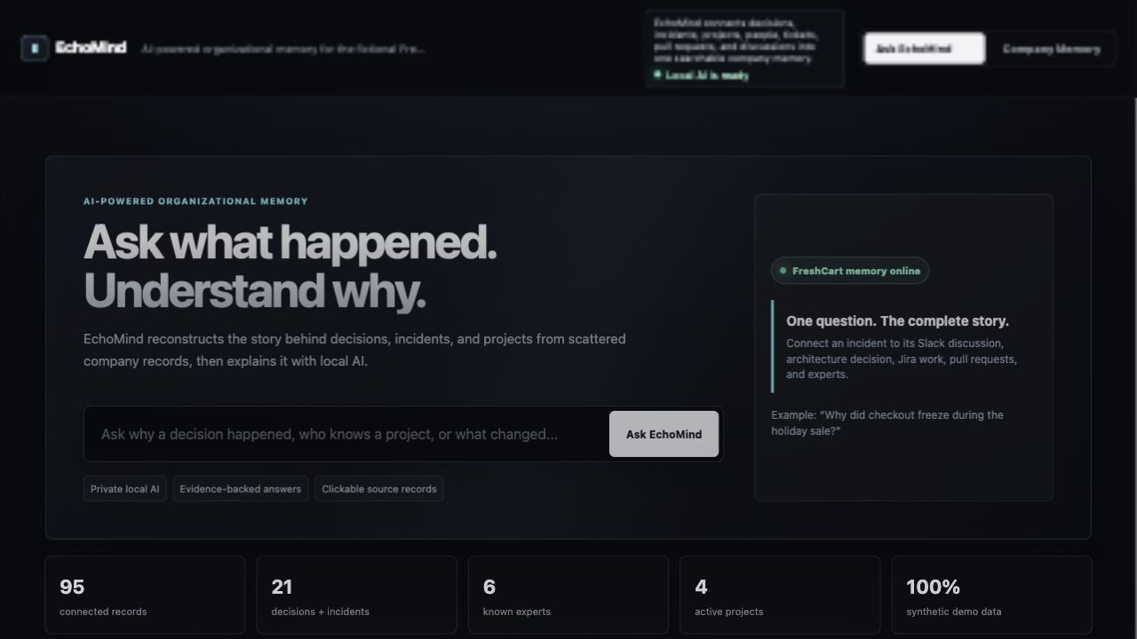
Ask what happened. Understand why.
EchoMind reconstructs decision history from incidents, architecture reviews, Jira tickets, pull requests, and team discussions.
Decision Time Machine
Expert Finder
Timeline Explorer
Hackathon MVP
Self-contained local demo with synthetic FreshCart data, traceable source records, optional Ollama/OpenAI answer synthesis, and deterministic fallback.
EchoMind hackathon MVP
01

Slide 2
ECHOMIND
Companies document work. They still forget context.
The answer to “why did we do this?” is usually split across five different systems.
Scattered evidence
Invisible expertise
Lost timelines
Incidents explain urgency. Architecture reviews record tradeoffs. Slack captures debate. Jira and PRs show implementation.
The right person is not always the loudest title. Expertise lives in contributions and incident response history.
New teammates see the current system but not the sequence of events that shaped it.
EchoMind turns scattered artifacts into an evidence-backed memory graph teams can ask, inspect, and trust.
EchoMind hackathon MVP
02

Slide 3
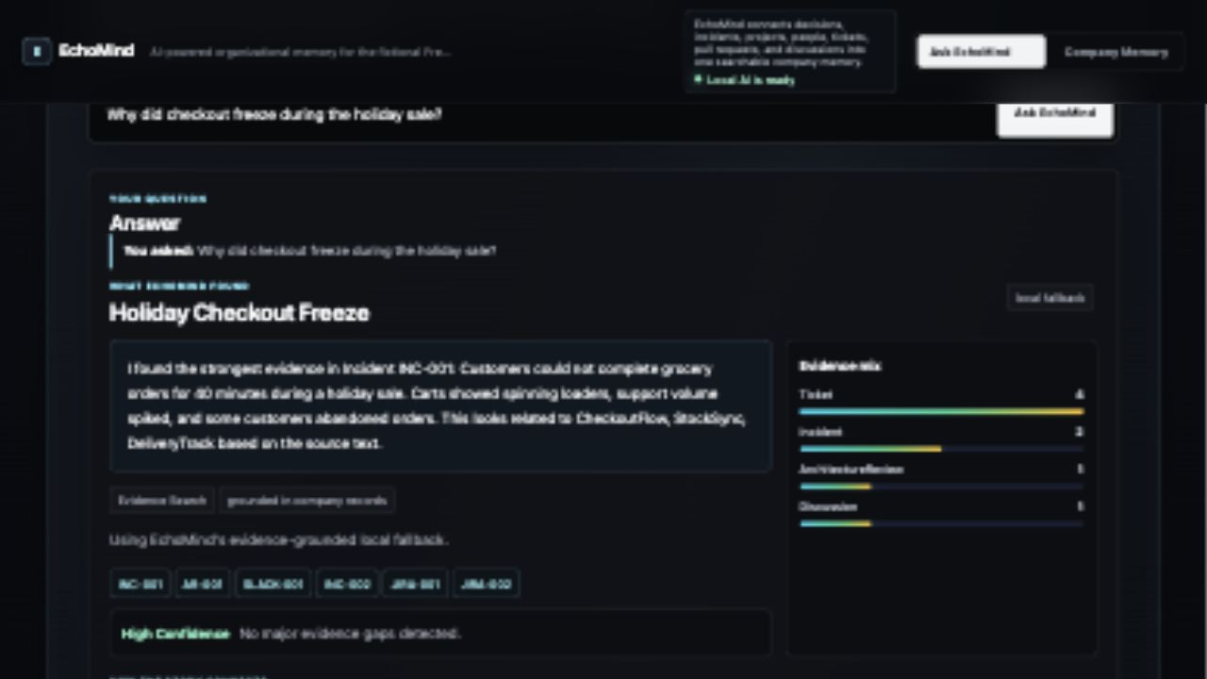
ECHOMIND
The product: one question, the complete story.
Users ask naturally. EchoMind retrieves evidence first, then explains it.
1. Ask
“Why did checkout freeze during the holiday sale?”
2. Ground
Find incidents, decisions, discussions, tickets, and PRs.
3. Explain
Return confidence, evidence mix, citations, and source records.
EchoMind hackathon MVP
03

Slide 4
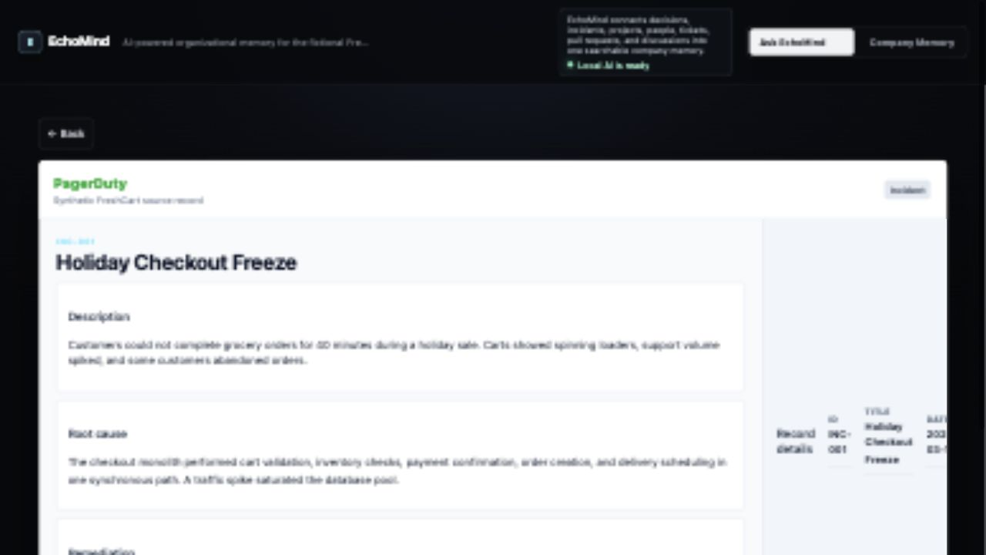
ECHOMIND
Traceable answers, not AI guesswork.
Every citation can open the original synthetic source record.
Incident INC-001
Holiday Checkout Freeze
Root cause
The checkout monolith handled too many synchronous responsibilities during a traffic spike.
Remediation
FreshCart created CheckoutFlow, split responsibilities, and added order lifecycle events.
EchoMind hackathon MVP
04

Slide 5
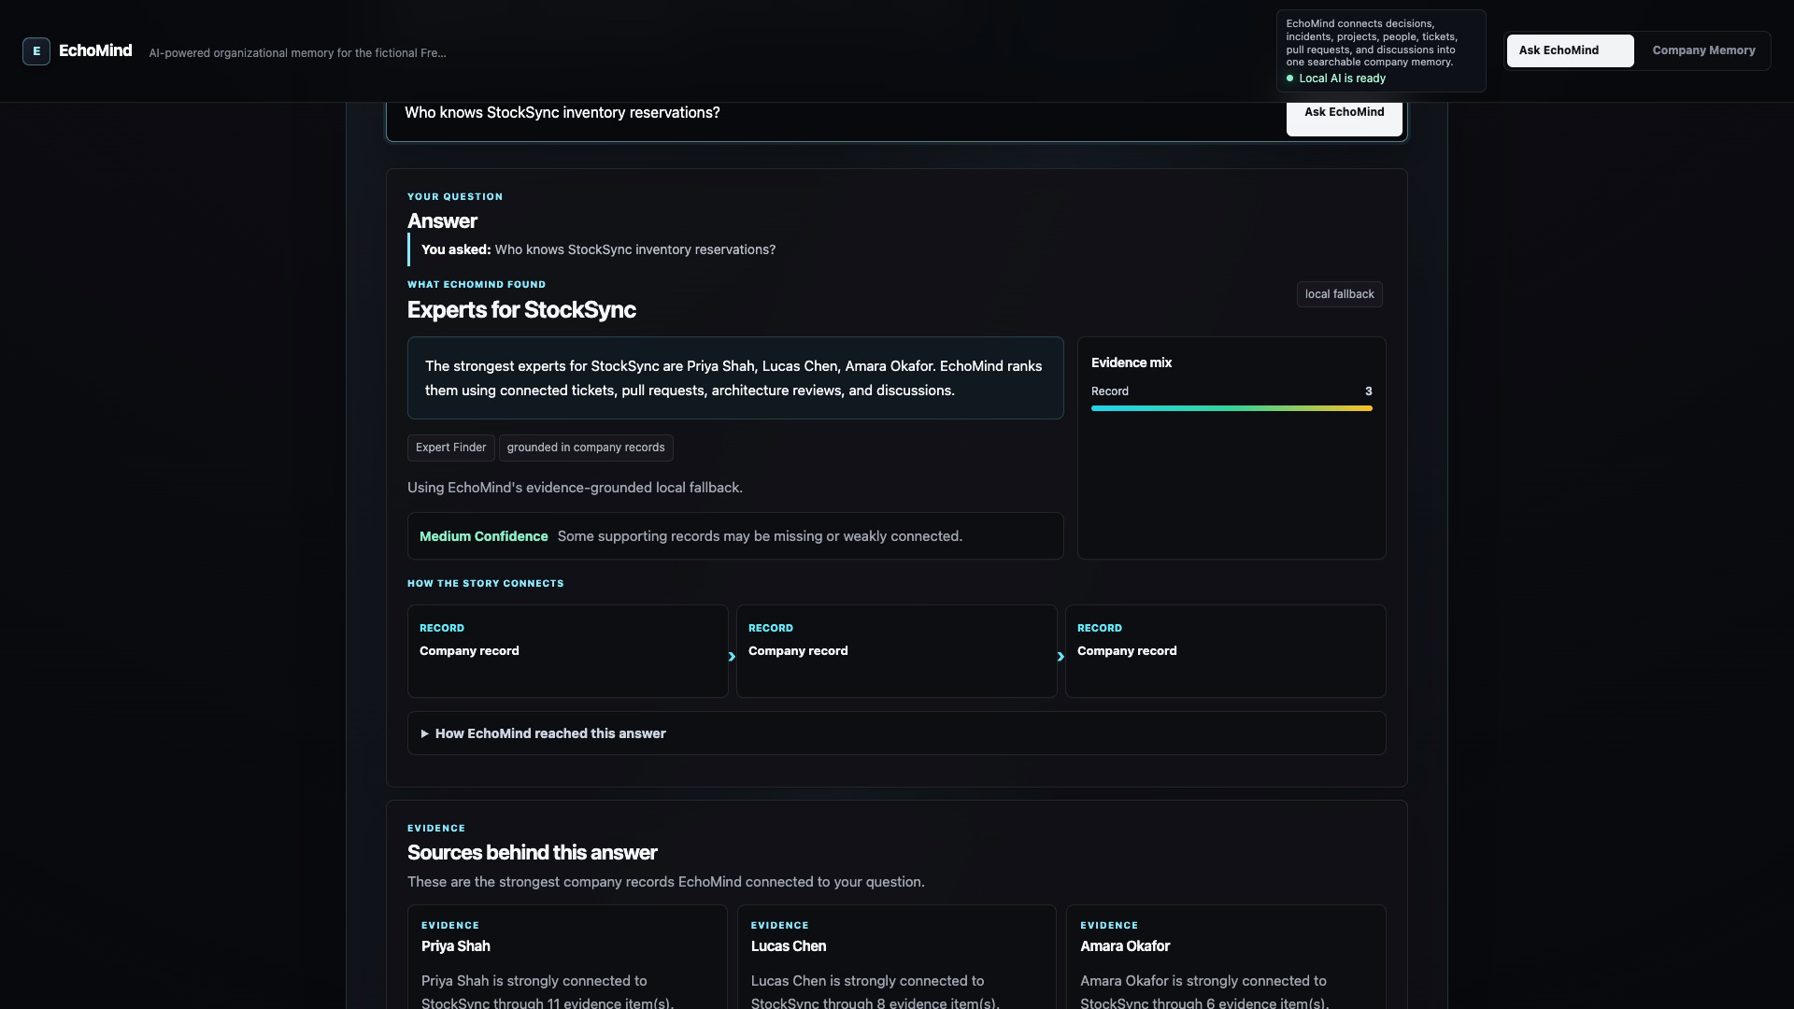
ECHOMIND
Expert Finder uses demonstrated work.
EchoMind ranks people from source evidence, not org-chart assumptions.
Signals
Tickets, pull requests, architecture reviews, discussions, and incident response.
Output
Ranked experts with confidence and connected evidence.
Demo answer
Priya Shah, Lucas Chen, and Amara Okafor surface for StockSync.
EchoMind hackathon MVP
05

Slide 6
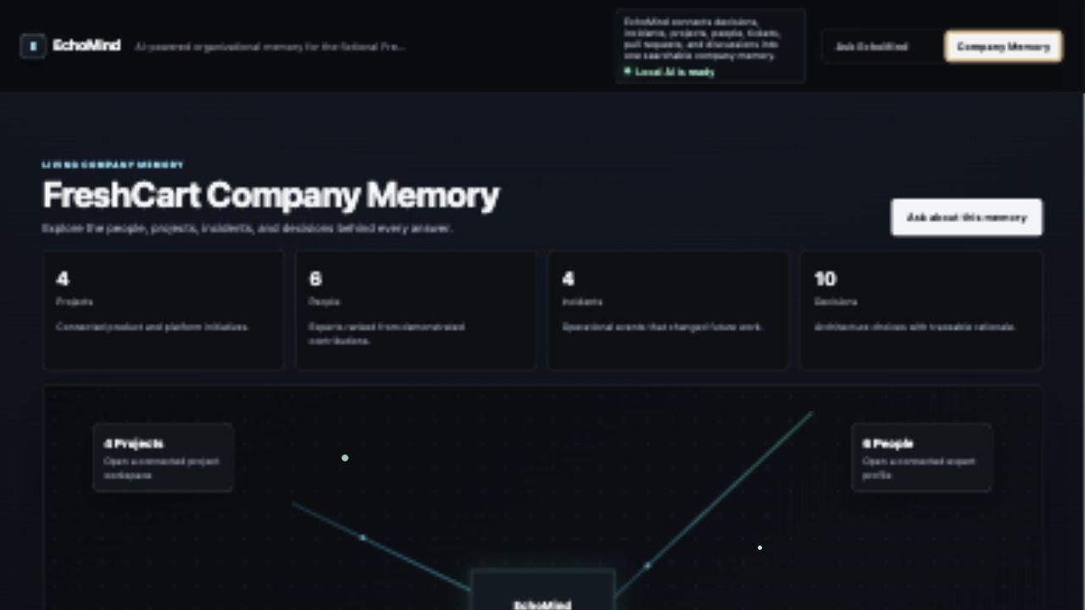
ECHOMIND
Company Memory makes the graph visible.
When users do not know what to ask, they can browse the connected system.
Projects
CheckoutFlow, StockSync, DeliveryTrack, and EchoMind.
People
Experts connected by real contributions and decisions.
Incidents + Decisions
Operational events connected to future architecture choices.
EchoMind hackathon MVP
06

Slide 7
ECHOMIND
Architecture: evidence first, AI second.
The demo is reliable locally, with a credible path to the full graph-backed architecture.
React + Tailwind
run_demo.py
Synthetic memory
Ollama / OpenAI
Polished ask and memory UI
Self-contained demo server and retrieval
FreshCart incidents, decisions, tickets, PRs, discussions
Optional answer polishing
Target production path: Spring Boot + Spring Data Neo4j + FastAPI AI service + Neo4j knowledge graph.
The language model improves explanation quality, but source retrieval decides what facts are allowed into the answer.
EchoMind hackathon MVP
07

Slide 8
ECHOMIND
Why this wins the demo.
EchoMind turns institutional memory into a product people can actually use.
First 10 seconds
Live proof
Future scope
A premium ask experience with a clear pain: why did this happen?
The synced demo shows asking, evidence, source inspection, experts, timeline, and memory map.
Real connectors, graph traversal, semantic retrieval, access control, and onboarding briefings.
The big idea: companies already have the knowledge. EchoMind makes sure it does not disappear.
EchoMind hackathon MVP
08

