Slide 1
Notes:
Hello! I’m Karl, and I’m here to talk about

Slide 2
Email
Notes:
Email! Specifically, I’m here to talk about

Slide 3
Nov 29 01:10:02 hidpl-data01 postfix/local[14743]: 01F84100DF727: to=<root@hidpl-data01.stanford.edu>, orig_to=<root>, relay=local, delay=0.09, delays=0.04/0.01/0/0.04, dsn=5.2.2, status=bounced (cannot update mailbox /var/mail/root for user root. error writing message: File too large)
Nov 29 01:10:02 hidpl-data01 postfix/cleanup[14738]: 13CA9100DF728: message-id=<20161129091002.13CA9100DF728@hidpl-data01.stanford.edu>
Nov 29 01:10:02 hidpl-data01 postfix/bounce[14744]: 01F84100DF727: sender non-delivery notification: 13CA9100DF728
Nov 29 01:10:02 hidpl-data01 postfix/qmgr[4177]: 13CA9100DF728: from=<>, size=3036, nrcpt=1 (queue active)
Nov 29 01:10:02 hidpl-data01 postfix/qmgr[4177]: 01F84100DF727: removed
Nov 29 01:10:02 hidpl-data01 postfix/local[14743]: 13CA9100DF728: to=<root@hidpl-data01.stanford.edu>, relay=local, delay=0.04, delays=0.02/0/0/0.02, dsn=5.2.2, status=bounced (cannot update mailbox /var/mail/root for user root. error writing message: File too large)
Notes:
all the generic, miscellaneous, probably cron job email your server is generating right now

Slide 4
????
Notes:
Where is that mail going? All that mail has to be going somewhere

Slide 5
root
Notes:
Probably to root.

Slide 6
root
?
Notes:
But, root at where? It might be going to

Slide 7
root@server.stanford.edu
root@server
Notes:
root on your local system…

Slide 8
root@server.stanford.edu
root@server
Filesystem Use% Mounted
/dev/sda2 100% /
Notes:
… which means it’s slowly filling up your disk.

Slide 9
root@server.stanford.edu
root@server
root@stanford.edu
Filesystem Use% Mounted
/dev/sda2 100% /
Notes:
It might be going to root at stanford, which is a valid email address…

Slide 10
root@server.stanford.edu
root@server
root@stanford.edu
Filesystem Use% Mounted
/dev/sda2 100% /
Filesystem Use% Mounted
/dev/sda2 100%/rootmail
Notes:
So it’s filling up someone else’s disk

Slide 11
root@server.stanford.edu
root@server
root@stanford.edu
Filesystem Use% Mounted
/dev/sda2 100% /
Filesystem Use% Mounted
/dev/sda2 100%/rootmail
(meh, whatever)
Notes:
Neither of these options are good. So

Slide 12
root@server.stanford.edu
root@server
????@???????????
Filesystem Use% Mounted
/dev/sda2 100% /
Notes:
where should you send it?

Slide 13
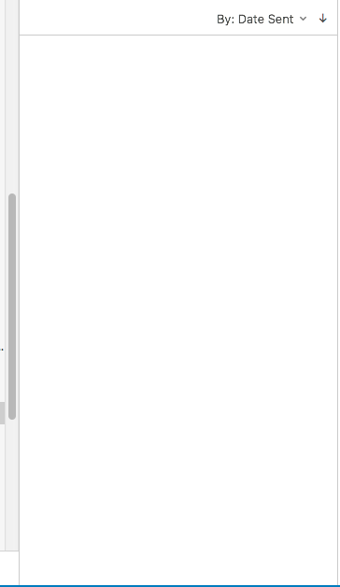
Send to yourself
Notes:
Well, you could send it directly to yourself

Slide 14
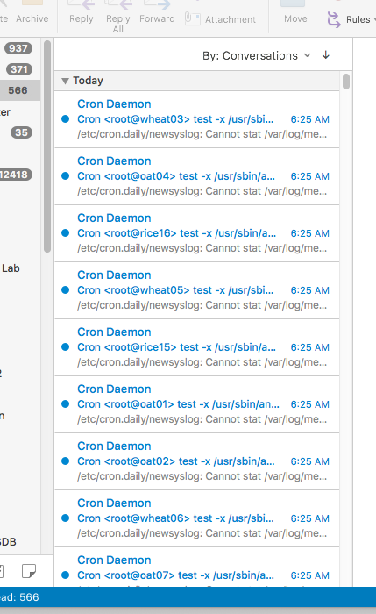
Send to yourself
Notes:
But if you like a clean inbox, that’s probably not a good idea.
Instead of sending it to yourself, you could

Slide 15
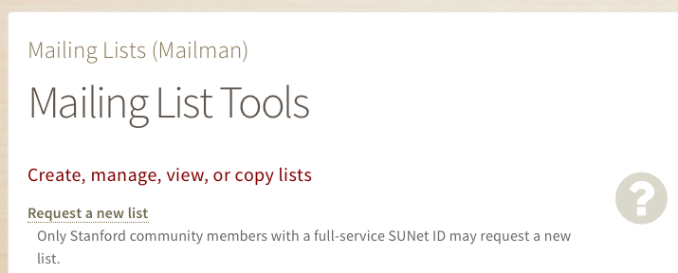
Send to a mailing list
Notes:
send it to a mailing list…

Slide 16

Send to a mailing list
No
X
Do Not
Notes:
(alarm)

Slide 17
Send to a mailing list
No
X
Do Not
Notes:
But that’s also not a good idea!

Slide 18
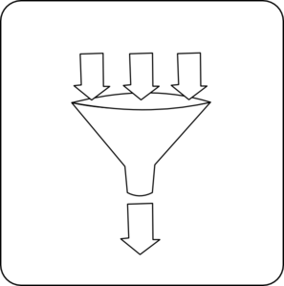
Send to a mailing list
Alert
Mail
Alert
Mail
Alert
Mail
Alert
Mail
Alert
Mail
Normal
Mail
Alert
Mail
Alert
Mail
Alert
Mail
Alert
Mail
Alert
Mail
Alert
Mail
Alert
Mail
Alert
Mail
Alert Mail
Alert Mail
Alert Mail
Notes:
Sending a flood of mail to a single list impacts service for every other list on the server, and at some point, you _will_ flood your list.

Slide 19
Send to ?
Notes:
So, where to send it? The answer can be found in

Slide 20

Send to !
Notes:
the recent Office 365 transition! Why not send it to…

Slide 21

Send to !!!
Notes:
a shared mailbox!

Slide 22
Send to a shared mailbox
Notes:
A shared mailbox gives you

Slide 23
Send to a shared mailbox
group-rootmail@stanford.edu
Notes:
a single email address, which you can access…

Slide 24
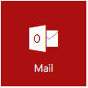
Send to a shared mailbox
group-rootmail@stanford.edu
Notes:
Through webmail

Slide 25
Send to a shared mailbox
group-rootmail@stanford.edu
Notes:
Outlook

Slide 26
Send to a shared mailbox
group-rootmail@stanford.edu
IMAP
Notes:
Or IMAP

Slide 27
Send to a shared mailbox
group-rootmail@stanford.edu
IMAP
office365:group-rootmail
Notes:
You get a workgroup to manage access control

Slide 28
Send to a shared mailbox
group-rootmail@stanford.edu
IMAP
office365:group-rootmail
50 GB
Notes:
And you can store up to 50 gigs of email

Slide 29
Send to a shared mailbox
group-rootmail@stanford.edu
IMAP
office365:group-rootmail
50 GB
FREE
Notes:
All for free.

Slide 30
I want one!
Notes:
Getting a group mailbox is easy!

Slide 31
I want one!
email.stanford.edu
Notes:
Start by going to email.stanford.edu

Slide 32
I want one!
email.stanford.edu
Email for Groups
Notes:
Click on “Email for Groups”

Slide 33
I want one!
email.stanford.edu
Email for Groups
Shared Email
Notes:
Click on “Shared Email”

Slide 34
I want one!
Notes:
And then submit a request.

Slide 35
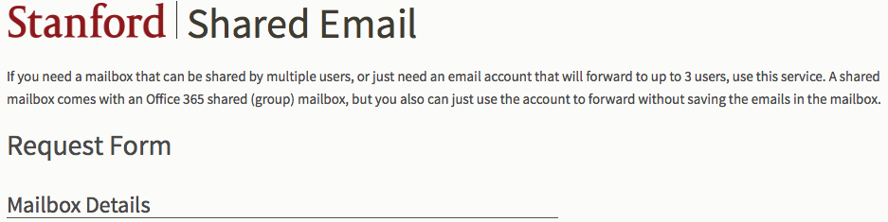
I want one!
Notes:
Once your request is approved, you’ll get an email with your workgroup’s name, and information on what to do next.

Slide 36
To:
root@server.stanford
root@server
root@server.stanford
root@server
Notes:
Now that you have your shared mailbox, how do you get mail there?

Slide 37
To:
root@server.stanford
root@server
⬇⬇⬇
root@server.stanford
root@server
⬇⬇⬇
Notes:
If you’re running Postfix, it can do the address translation automatically, so that mail sent to root@server

Slide 38
To:
root@server.stanford
root@server
⬇⬇⬇
farmshare-mail
@stanford.edu
root@server.stanford
root@server
⬇⬇⬇
farmshare-mail
@stanford.edu
Notes:
becomes mail sent to your shared mailbox @ stanford!

Slide 39
From:
app@server.stanford
apache2@server
⬇⬇⬇
Notes:
You can even have Postfix change From addresses for all the mail it sees, such as emails generated by the applications on your server.

Slide 40
From:
app@server.stanford
apache2@server
⬇⬇⬇
support
@stanford.edu
Notes:
This helps improve user experience by giving email recipients a reply address that might actually work.

Slide 41
https://github.com/akkornel/lightning-mail
Postfix config & slides
Notes:
I’m not going to go into detail here, but I have posted those Postfix snippets up on Github.

Slide 42
https://github.com/akkornel/lightning-mail
Postfix config & slides
[PRs Welcome!]
Notes:
If you use something other than Postfix, feel free to submit a Pull request with your configuration.

Slide 43
No
X
Do Not
Notes:
And so, with your newfound knowledge, I hope to never see another flooded list server ever again.

Slide 44
https://github.com/akkornel/lightning-mail
Postfix config & slides
[PRs Welcome!]
akkornel@stanford.edu
No, I can’t fix your email
Notes:
Thanks very much!

