Slide 1

COLLEGE OF ENGINEERING AND MANAGEMENT,KOLAGHAT
SANTU JANA
SEM:6TH
YEAR:3RD
Subject: Computer Network
ROLL:CSE/21/L-146
UNIVERSITY ROLL:10700121127

Slide 2

Microwaves
Microwave is a line-of-sight wireless communication technology that uses high frequency beams of radio waves to provide high speed wireless connections that can send and receive voice, video, and data information.
Microwave links are are widely used for point-to-point communications because their small wavelength allows conveniently-sized antennas to direct them in narrow beams, which can be pointed directly at the receiving antenna. This allows nearby microwave equipment to use the same frequencies without interfering with each other, as lower frequency radio waves do. Another advantage is that the high frequency of microwaves gives the microwave band a very large information-carrying capacity; the microwave band has a bandwidth 30 times that of all the rest of the radio spectrum below it.
Microwave radio transmission is commonly used in point-to-point communication systems on the surface of the Earth, in satellite communications, and in deep space radio communications. Other parts of the microwave radio band are used for radars, radio navigation systems, sensor systems, and radio astronomy.

Slide 3
Features of Microwaves
Microwaves travel in straight lines, and so the transmitter and receiver stations should be accurately aligned to each other.
Microwave propagation is line – of – sight propagation. So, towers hoisting the stations should be placed so that the curvature of the earth or any other obstacle does not interfere with the communication.
Since it is unidirectional, it allows multiple receivers in a row to receive the signals without interference.
Microwaves do not pass through buildings. So, indoor receivers cannot be used effectively.
Microwaves are often refracted by the atmospheric layers. The refracted rays take longer time to reach the destination than the direct rays. This causes out of phase transmission, called multipath fading.

Slide 4
Microwaves need unidirectional antennas to send out signals. Two types of antennas are needed −
Parabolic Dish Antenna − It is used by the receiving station. It is parabolic in shape, which concentrates all energy to a small beam thus achieving a strong signal with high SNR.
Horn Antenna − It has a stem with a curved head. In sending stations, outgoing waves from the stem are broadcast by the curved head as a series of parallel beams. In the receiving station, the rays are collected by the curved head and deflected in the stem.
Applications
Long distance telephone communication
Cellular phones
Television networks
Satellites
Wireless LANs

Slide 5
Advantages Of Microwave:
Microwave transmission is cheaper than using cables.
It is free from land acquisition as it does not require any land for the installation of cables.
Microwave transmission provides an easy communication in terrains as the installation of cable in terrain is quite a difficult task.
Communication over oceans can be achieved by using microwave transmission.
Disadvantages of Microwave transmission:
Eavesdropping: An eavesdropping creates insecure communication. Any malicious user can catch the signal in the air by using its own antenna.
Out of phase signal: A signal can be moved out of phase by using microwave transmission.
Susceptible to weather condition: A microwave transmission is susceptible to weather condition. This means that any environmental change such as rain, wind can distort the signal.
Bandwidth limited: Allocation of bandwidth is limited in the case of microwave transmission.

Slide 6
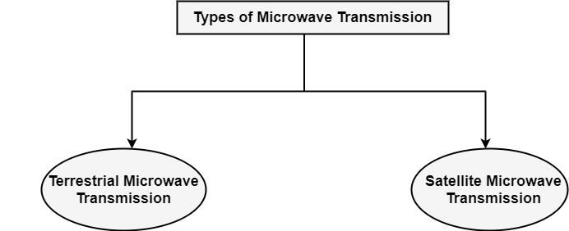
Types of Microwave Transmission

Slide 7
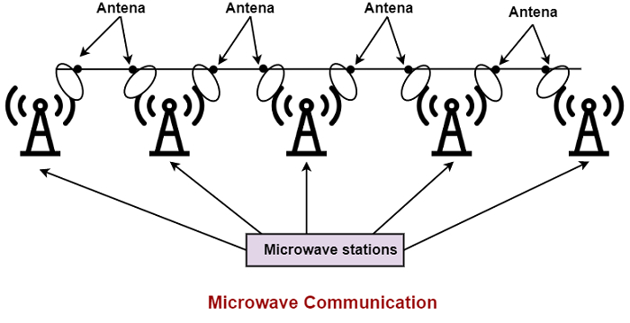
Terrestrial Microwave Transmission
Terrestrial Microwave transmission is a technology that transmits the focused beam of a radio signal from one ground-based microwave transmission antenna to another.
Microwaves are the electromagnetic waves having the frequency in the range from 1GHz to 1000 GHz.
Microwaves are unidirectional as the sending and receiving antenna is to be aligned, i.e., the waves sent by the sending antenna are narrowly focussed.
In this case, antennas are mounted on the towers to send a beam to another antenna which is km away.
It works on the line of sight transmission, i.e., the antennas mounted on the towers are the direct sight of each other.

Slide 8
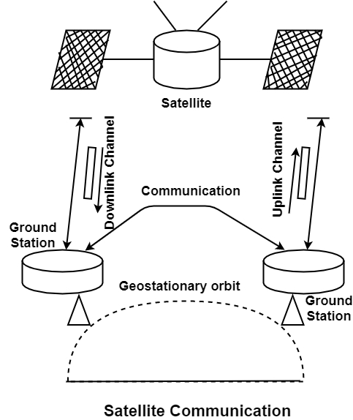
Satellite Microwave Communication
Satellite transmission is much like line-of-sight microwave transmission in which one of the stations is a satellite orbiting the earth. The principle is similar to terrestrial microwave, with a satellite acting as a super tall antenna and repeater. Although satellite transmission signals must still travel in straight lines, the limitations imposed on distance by the earth’s curvature are reduced. In this way, satellite relays allow microwave signals to span continents and oceans with a single bounce.

Slide 9
Advantages of Satellite Microwave Communication
Satellite is a single microwave relay station visible from any point of a vast area.
The transmission and reception costs are independent of the distance between two points.
A transmission station can retrieve its transmission & check whether the satellite has transmitted the information correctly.
Disadvantages of Satellite Microwave Communication
It is a very high cost of placing the satellite into its orbit.
Since the waves are transmitted by satellites all around the world. Therefore, the security of the message is fragile.
Satellite use microwaves which are vulnerable to electromagnetic interferences.

Slide 10
Conclusions
Microwaves are Useful for heating food and it emits microwaves to heat substance and Microwaves are safer because microwaves are not known to break molecules of substance and therefore it not known to harm DNA of living organism unlike other waves like X rays and gamma rays and MIcrowaves are emitted by magnetron in the machine and metal box prevents it to escape waves and Microwaves get harmed if you on it without anything in it.

