Slide 1

COLLEGE OF ENGINEERING AND MANAGEMENT,KOLAGHAT
SANTU JANA
SEM:6TH
YEAR:3RD
Subject: Image Processing
ROLL:CSE/21/L-146
UNIVERSITY ROLL:10700121127
Topic:Medical Image Processing

Slide 2
Medical Image Processing
Medical image processing encompasses the use and exploration of 3D image datasets of the human body, obtained most commonly from a Computed Tomography (CT) or Magnetic Resonance Imaging (MRI) scanner to diagnose pathologies or guide medical interventions such as surgical planning, or for research purposes. Medical image processing is carried out by radiologists, engineers, and clinicians to better understand the anatomy of either individual patients or population groups.

Slide 3
What are the benefits of medical image processing?
The main benefit of medical image processing is that it allows for in-depth, but non-invasive exploration of internal anatomy. 3D models of the anatomies of interest can be created and studied to improve treatment outcomes for the patient, develop improved medical devices and drug delivery systems, or achieve more informed diagnoses. It has become one of the key tools leveraged for medical advancement in recent years.
The ever-improving quality of imaging coupled with advanced software tools facilitates accurate digital reproduction of anatomical structures at various scales, as well as with largely varying properties including bone and soft tissues. Measurement, statistical analysis, and creation of simulation models which incorporate real anatomical geometries provide the opportunity for more complete understanding, for example of interactions between patient anatomy and medical devices.

Slide 4
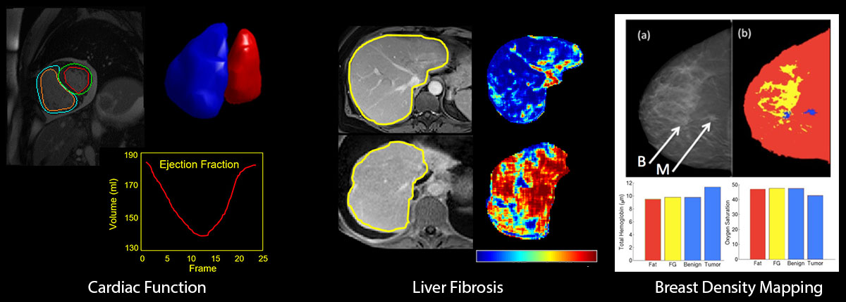
Quantitative Image Analysis Tools Provide Reproducible Results and Clinical Precision
After images are acquired, they are often processed or analyzed by a computer algorithm for various purposes (tomographic reconstruction, image correction or enhancement, or information extraction), and if they are to be used by human observers they must be presented on some type of display device. The Department of Medical Imaging has active research in all of these areas, covering image formation, qualitative analysis, evaluation and quantitative measures of structures at the molecular, cellular, tissue, and organ levels. Our overall goal is to facilitate cost efficient healthcare and improve patient outcomes through innovations in medical imaging. To achieve this we develop, optimize and validate advanced computational and data integration methods to analyze medical image data and create clinical decision tools that will permit quantitative clinical decision making solutions consistent with advances in personalized medicine.

Slide 5
How does medical image processing work?
The process of medical image processing begins by acquiring raw data from CT or MRI images and reconstructing them into a format suitable for use in relevant software. A 3D bitmap of greyscale intensities containing a voxel (3D pixels) grid creates the typical input for image processing. CT scan greyscale intensity depends on X-ray absorption, while in MRI it is determined by the strength of signals from proton particles during relaxation and after application of very strong magnetic fields.
For medical users, the reconstructed image volume is typically processed to segment out and edit different regions of anatomical interest, such as tissue and bone. In Synopsys Simpleware software, for example, users can carry out different image processing operations at the 2D and 3D level, including:
Reducing and removing unwanted noise or artifacts with image filters
Cropping and resampling input data to make it easier and faster to process images
Using segmentation tools to identify different anatomical regions, including automated techniques using AI-based machine learning algorithms
Applying measurement and statistics tools to quantify different parts of the image data, for example, centrelines
Importing CAD models, such as implants or medical devices, to study how they interact with individual anatomies
Exporting processed models for physics-based simulation, further design work, or for 3D printing physical replicas of the anatomy in question

Slide 6
Where and when does medical image processing fit in the product portfolio?
Simpleware software has extensive medical applications, from general research to clinical workflows that come under FDA 510(k) and CE-marking certifications. In general, the software provides multiple ways to work with MRI, CT, and other forms of medical image data, including the ability to easily create models that include CAD-designed implants and devices. Users such as device engineers apply the software to problems like planning surgical procedures, and assessing the performance of different implant designs through tools in Simpleware ScanIP, as well as export of models for simulation and design.

Slide 7
Going beyond medical image processing
Several additional modules are available with Simpleware ScanIP to do more with medical image data after initial processing. In addition, options are available for customizing steps and automating repetitive or time-consuming tasks. For example, medical users can:
Export STL files from processed medical images for 3D printing
Combine CAD-designed implants with anatomical image data for sizing and positioning
Generate volume meshes for Finite Element and Computational Fluid Dynamics simulation of physics, such as impact or stress and strain
Continue design work by converting processed image data into CAD-friendly NURBS, as well as communicating with leading CAD packages when developing products
Use a range of AI-enabled, automated off-the-shelf software tools and customized solutions for speeding up common medical image processing workflows

Slide 8
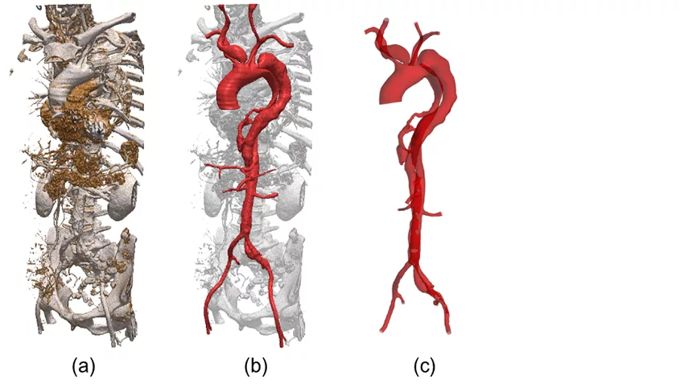
Putting Medical Image Processing into Practice
Segmentation of aortic dissection: (a) rendering of the CT data; (b) segmented mask after smoothing; (c) 3D model used in the simulation

Slide 9
A good recent example of how medical image processing involved patient-specific hemodynamic simulations of complex aortic dissections, part of work carried out at University College London into better understanding life-threatening vascular conditions. Researchers used Simpleware software to process CT scans and build models suitable for CFD analysis, with the following steps taken:
1. CT scans are obtained from patient-specific cases of aortic dissections
2. Data is imported to Simpleware ScanIP to reconstruct patient geometry, including the processing of noise, and segmentation of regions of interest such as the dissected aorta and branches
3. Scripting is used to automatically carry out smoothing algorithms to remove pixelation artifacts
4. Surface models are generated from the dissected aorta and imported to ANSYS® software to set-up CFD simulations, including intraluminal pressure and wall shear-stress-based indices,
5. Simulation results create hemodynamic insights that can be used to help future clinical

Slide 10
CONCLUSION
Computational modeling for medical image analysis has great impacts on both clinical applications and scientific researches. Recent progresses in deep learning have shed new light on medical image analysis by allowing discovering morphological and/or textural patterns in images solely from data. As deep learning methods have achieved the state-of-the-art performance over different medical applications, its use for further improvement can be the major step in the medical computing field. However, there are still rooms for improvements. First, lessoned in computer vision, where breakthrough improvements were achieved by exploiting large amounts of training data, e.g., more than 1 million annotated images in ImageNet (19), it would be one direction to build such big publicly available dataset of medical images, by which deep models can find more generalized features in medical images, thus allowing making a leap in performance.

