Slide 1

School Of Electrical Engineering
FOOT STEP POWER GENERATION FOR WHEATHER MONITORING SYSTEM
Submitted by.
Akash F Sanap (BETB76)
Sanjay S Hulbute (BETB75)
Guided By:
Prof: V. A.Katkar

Slide 2
CONTENTS
Introduction
Need of the system
Block Diagram
Working
Applications
Advantages & Disadvantages
Conclusion
Reference

Slide 3
INTRODUCTION:
In this project, we are going to design a setup that contains few piezoelectric sensors that will be able to generate sufficient amount of voltage by the application of strain on them. In this project, we will use the piezo crystal in the devices which go through vibrations during their functioning. The project will be designed such that its application will be user friendly, flexible and can be used in many applications accordingly. Also, the output current generated will be of sufficient magnitude in order to work efficiently.

Slide 4
NEED OF THE SYSTEM
The utilization of waste energy of foot power with human motion is very important for highly populated countries.
India and China where the roads, railway stations etc. are all over crowded and millions of people move around the clock.

Slide 5
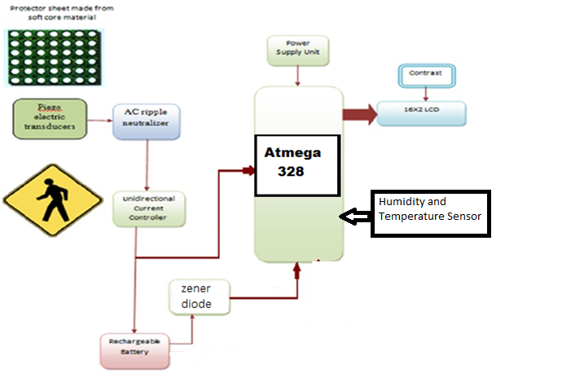
BLOCK DIAGRAM

Slide 6
WORKING
With application of force on piezoelectric transducer, its converts force into electrical energy. AC ripple neutralizer controls the fluctuation in generated voltages and unidirectional current controller controls the battery charging current with the help of Atmega328 microcontroller.
The voltage generated by series of sensors is stored in Lead Acid batteries. This voltage can be used to drive either DC or AC loads. For AC loads, pure sine wave inverter circuit is used. Inverter converts dc voltages stored in lead acid batteries in 220 volt AC.
AC voltage can be used to drive AC loads. User can use any type of inverter according to his/her requirement like pure sine wave inverter, square wave inverter and modified sine wave inverter.
Rating of battery charger also depends on amount of power generation from foot step.Atmega328 microcontroller displays the amount of battery charging.

Slide 7
APPLICATIONS
Power generation using foot step can be used in most of the places such as:
Colleges.
Schools.
cinema theatres.
Shopping complex and Many other buildings.
Care should be taken for batteries

Slide 8
ADVANTAGES
Power generation is simply walking on the step.
Power also generated by running or exercising on the step.
No need fuel input.
This is a Non-conventional system.
Battery is used to store the generated power.

Slide 9
DISADVANTAGES
Only applicable for the particular place.
Initial cost of this arrangement is high

Slide 10
Tinkercad Link
https://www.tinkercad.com/things/fLAnBkYwvN3-dazzling-sango/editel?tenant=circuits

Slide 11
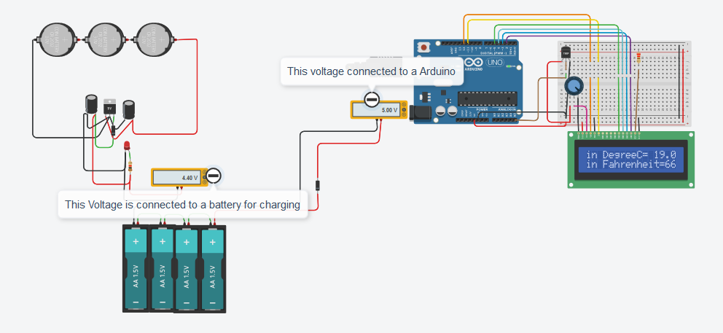
Simulation Result

Slide 12
FUTURE SCOPE
Man has needed and used energy at an increasing rate for his sustenance and wellbeing ever since he came on the earth a few million years ago. Due to this a lot of energy resources have been exhausted and wasted. Proposal for the utilization of waste energy of foot power with human locomotion is very much relevant and important for highly populated countries like India and China in future.

Slide 13
CONCLUSION
The project Footstep Power Generation uses the footstep to produce electricity. It is one of the best economical and affordable energy solution to the common people.
This can be used for many application in rural areas where power availability is less or totally absent. As India is and developing nation where energy management is big challenge for such a huge population

Slide 14
REFERENCES:
Gautschi, G. (2002). Piezoelectric sensors. Springer Berlin, Heidelberg, New York. p. 3
Wali, R Paul (October 2012). "An electronic nose to differentiate aromatic flowers using a real-time information-rich piezoelectric resonance measurement". Procedia Chemistry: 194–202
Becker, Robert O.; Marino, Andrew A. "Piezoelectricity". Department of Orthopedics Surgery at Louisiana State University Health Sciences Center. Archived from the original on August 2, 2009. Retrieved September 1, 2013.

Slide 15
ANY QUESTIONS?

Slide 16


