Slide 1

Lec 04 : Python Syntax Basics
1: Variables & Naming Conventions

Slide 2
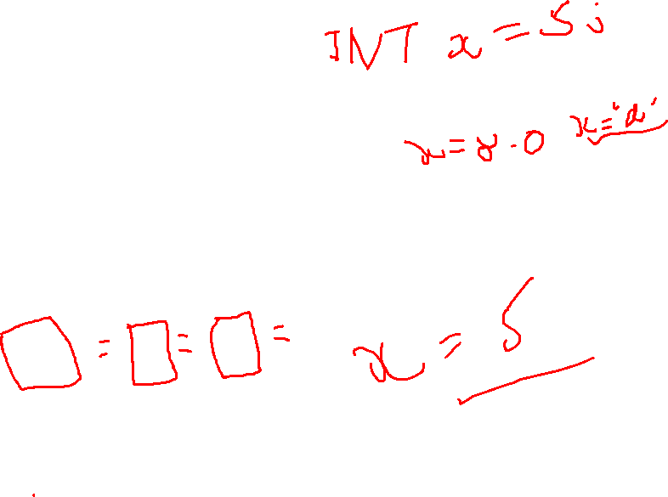
01. What is Variable ?
A variable is a named location in memory used to store a value. In Python, you don't need to declare a variable's type explicitly — Python figures it out automatically based on the value assigned (this is called dynamic typing).

Slide 3
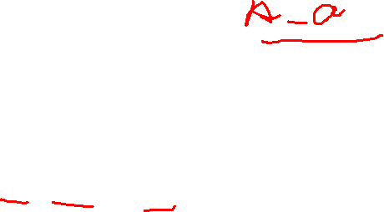
02. Rules for Naming Variables (Mandatory)
Must start with a letter (a-z, A-Z) or an underscore _ — not a digit.
Can only contain letters, digits, and underscores (no spaces, no special characters like @, -, %).
Case-sensitive — age, Age, and AGE are three different variables.
Cannot be a Python reserved keyword (e.g., if, for, class, True, None).

Slide 4
03. Naming Convention Best Practices
Convention | Used for | Example
smale_case | Variables and function names | total_price, user_age
UPPER_CASE | Constants (values that shouldn't change) | MAX_LIMIT = 100
PascalCase | Class names | class StudentRecord:
_leading_underscore | "Internal use" convention (weak privacy signal) | _internal_value
__double_leading_underscore | Name-mangling in classes (stronger privacy signal) | __secret

