Slide 1
IMDB Movie Analysis
Boula Akladyous
February 8, 2020

Slide 2


Descriptive analysis of the Movies and TV series streaming market which aims to analyze the following aspects:
reliability of the ranked movies provided by the IMDB platform.
what types of films are currently performing best at the box office.
provide a reliable list of the most ranked movie genres.

Slide 3
Project Outline
-Business Problem
-Market Analysis
-Conclusion

Slide 4

Business Problem
This project aims to analyze the ratings of the top rated movies on the IMDB platform, to help Microsoft Movies Studio decide what type of films to create.
Market Analysis
movie production revenue analysis
Top ranked films analysis

Slide 5
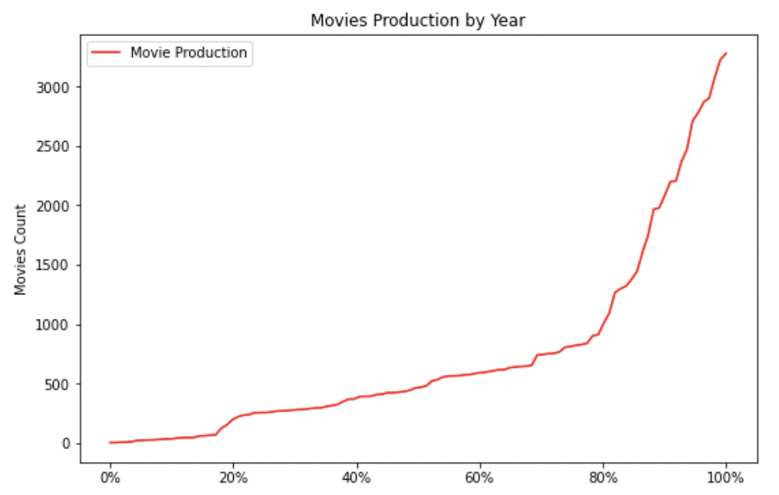
Market Analysis
Growing with respect to number of movies released from 1894 to 2020

Slide 6
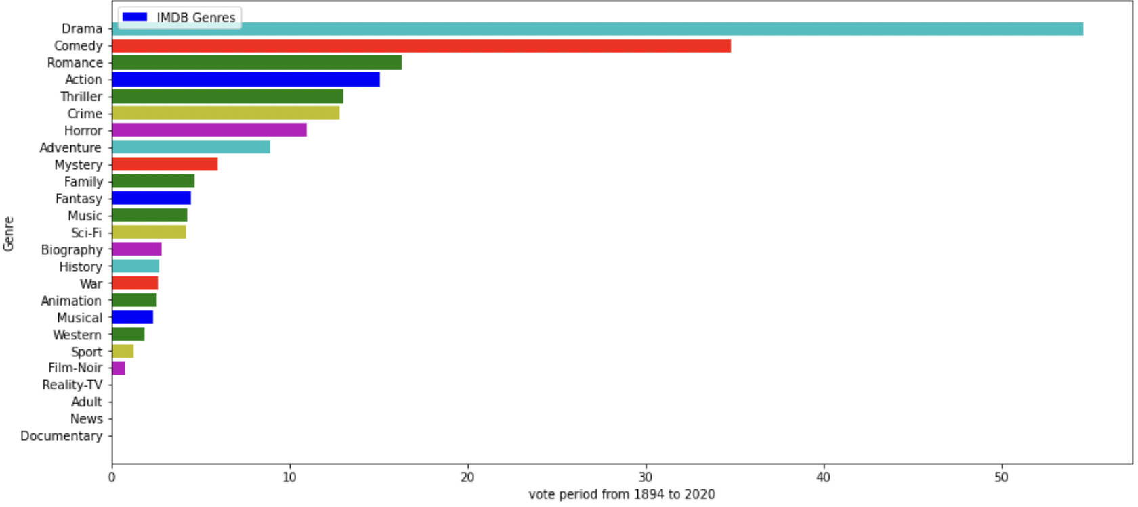
the graph below shows the ranking of the genres of the most voted movies from 1894 to 2020.

Slide 7
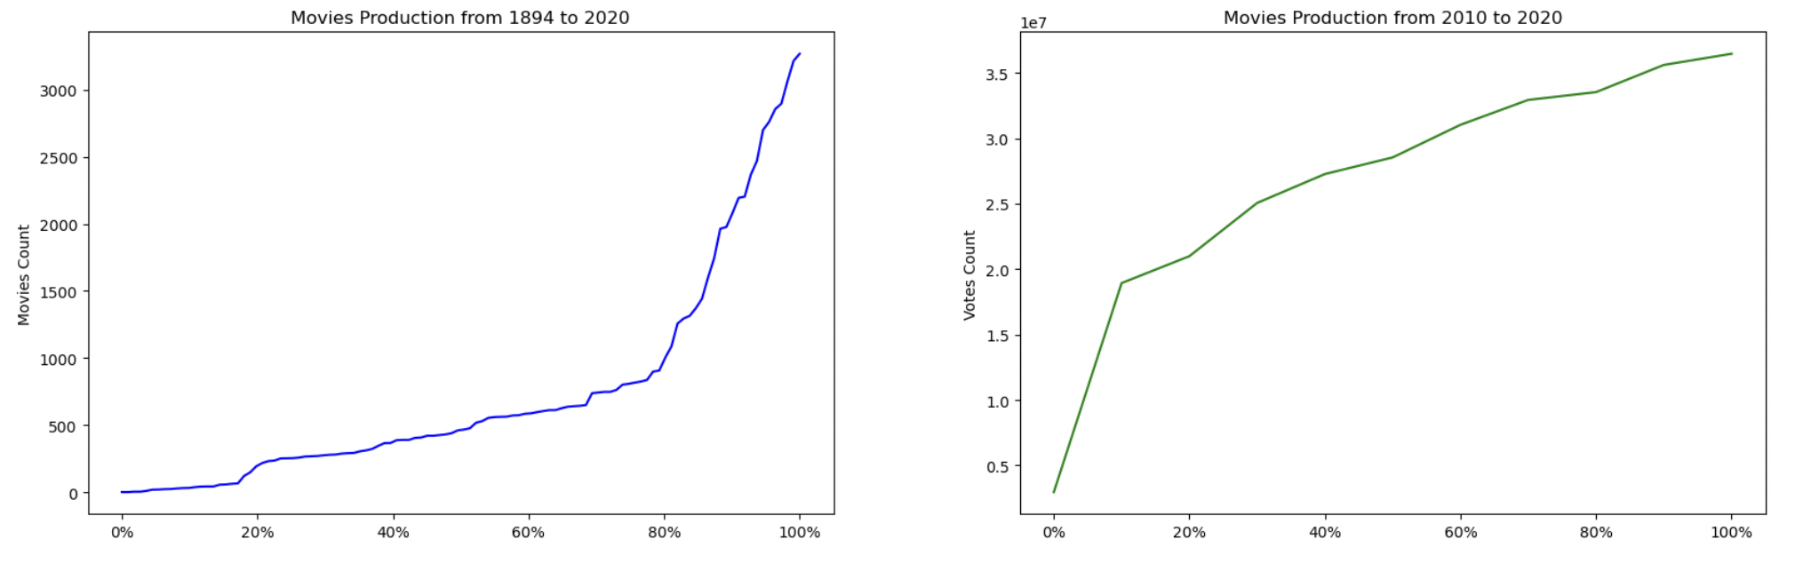
The average running time of all movies produced worldwide

Slide 8
Conclusion
Our analysis demonstrates the high growth of the video streaming market in terms of both production growth and revenue.Drama has been the most popular genre per decade except for the 80's when Comedy was more popular. Production lengths has soared from 1984 to 2020. Revenue and profitability have a weak positive correlation.

