Slide 1
PROJECT 3 MINING CHROME REPOSITORY
ELİF AKLAN 150110135
GİZEM ESRA ÜNLÜ 090120702
R. NUR TARLAKAZAN 090100019

Slide 2
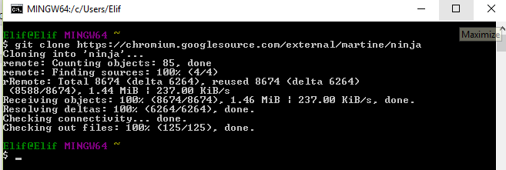
HOW TO MINE REPOSITORY
The first step was to choose which repository to clone. Ninja repository is chosen to realize the next required steps like in the following using the command on GitHub :

Slide 3
HOW TO MINE REPOSITORY
In order to choose specific time including people, committed files we used the most basic and powerful tool git log commands on Git Bash where the current location of Ninja Repository is.
Elif@Elif MINGW64 ~/ninja (master)
$ git log -p --pretty=fuller --before={4.weeks.ago} --after={2015-04-18} -- no-merges > log-raw.txt

Slide 4
HOW TO MINE REPOSITORY
With this command, git log –p part of the command, viewing commit message, author, date and actual changes placed in each commit can be realized. Another really useful option is –pretty which changes the log output to formats other than the default. Also, --no-merges flag indicate to only show changes that have not been merged yet to any branch:

Slide 5
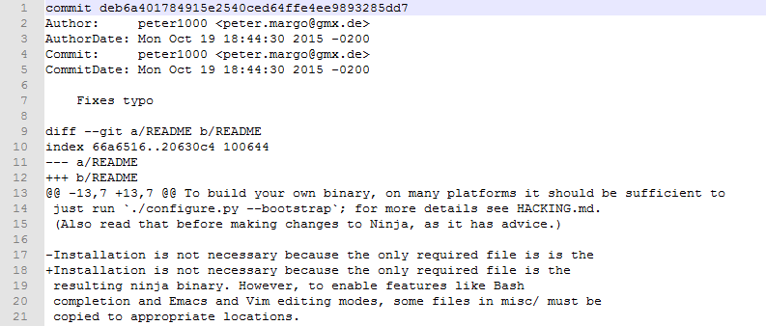
HOW TO MINE REPOSITORY

Slide 6
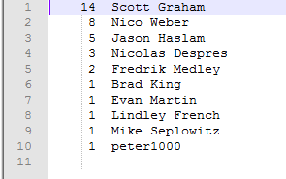
HOW TO MINE REPOSITORY
Elif@Elif MINGW64 ~/ninja (master)$ git shortlog -s -n --all --no-merges --before={4.weeks.ago} --after={2015-04-18} > log-raw2.txt
By this command, we can observe the number of commits which each developers have

Slide 7
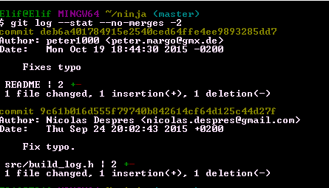
HOW TO MINE REPOSITORY
Elif@Elif MINGW64 ~/ninja (master)$ git log –stat –no-merges -2
This command provides to see the last 2 commits of authors made on how many files with what kind of changes like insertions and deletions.

Slide 8
IMPLEMENTATION
Implementation part consists of 5 main steps:
Creation of Class Structure
Identification Top Developers
Plot Representition of Developers
Creation of File-Developer Matrix
Creation of Graph

Slide 9
CREATION OF CLASS STRUCTURE
After data extraction, in order to processing the data which is created by git log scripts we used object oriented approach.
Class structure is implemented by using C++ programming language.

Slide 10
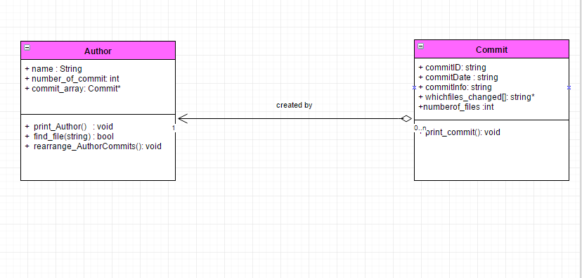
CREATION OF CLASS STRUCTURE

Slide 11
CREATION OF CLASS STRUCTURE
Author class represents developer who creates several commits.
Commit class represents commit which is created by a developer.
A commit has following attributes:
commitID: Each commit has a unique ID
commitDate: The date that the commit was done i.e information has been added into some place of repository.
commitInfo: Comments about a commit.
whichfiles_changed[]: array of all files which is changed in a commit.

Slide 12
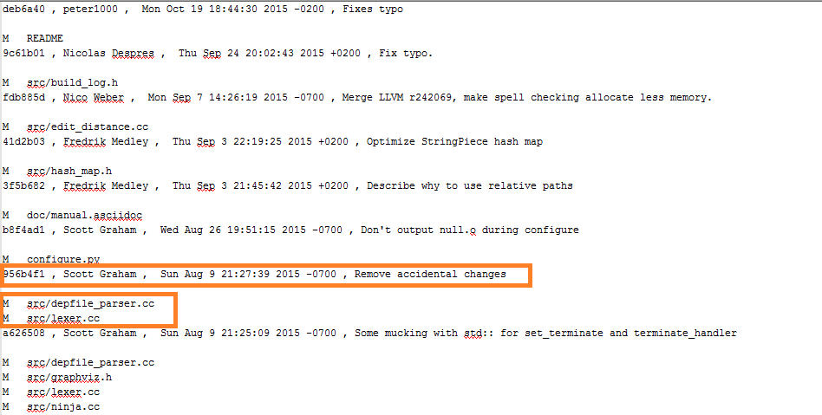
CREATION OF CLASS STRUCTURE
In data extraction part, log of all commits which are at the directory chromium/external/martine/ninja are exported into log-rawson. txt.
This line gives information which are commitID, author name, commit date, and commit notes respectively about developer.
These lines represent files which are changed by previous developer’s commit.

Slide 13
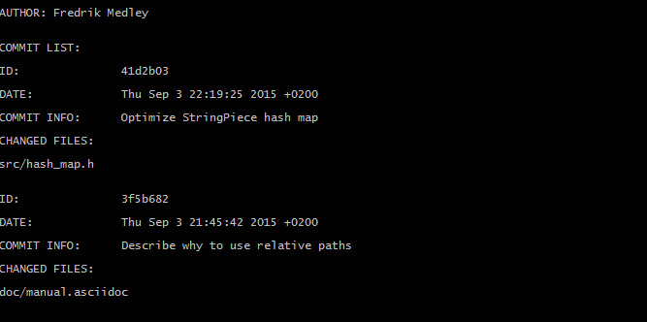
CREATION OF CLASS STRUCTURE
While reading the file, commit objects and author objects are created.

Slide 14
PLOT REPRESENTATION
For plotting the distribution of commits in terms of each developer, MATLAB is used.
By using following git script it is possible to know number of commits of each developer.
Elif@Elif MINGW64 ~/ninja (master)$ git shortlog -s -n --all --no-merges --before={4.weeks.ago} --after={2015-04-18} > log-raw2.txt

Slide 15
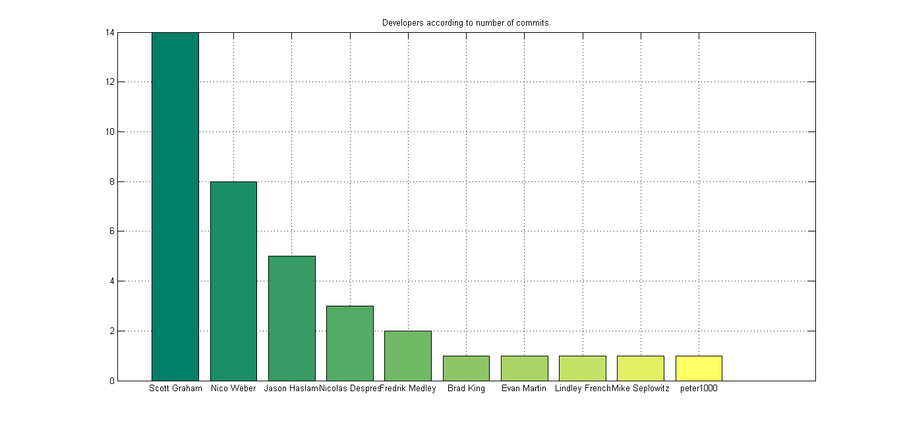
PLOT REPRESENTATION

Slide 16
IDENTIFICATION OF TOP DEVELOPERS
By using the log-row2.txt file which is created by git scripts, top developers who make %80 of commits can be easily determined. For calculation, identify_topdevelopers() function is used.
Developer Name | Number of Commits
Scott Graham | 14
Nico Weber | 8
Jason Haslam | 5
Nicolas Despres | 3

Slide 17
CREATION OF MATRIX
In this part, it is asked to create a matrix in each rows represent files and columns represent developers. For this purpose, after log-rawson.txt file is created, code.cpp file is run and matrix is created by using create_matrix() function.

Slide 18
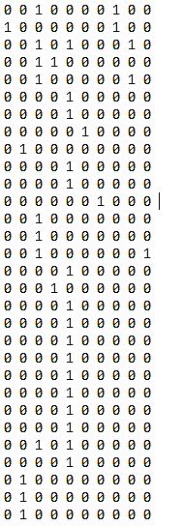
CREATION OF MATRIX
The output matrix has 10 columns and 30 rows.
There are 10 developers in selected chrome directory.
There are 30 files which are changed by developers in selected directory.
The index at (i,j) in matrix is 1, it indicates file i is committed by developer j,
The index at (i,j) in matrix is 0, it indicates file i is not committed by developer j

Slide 19
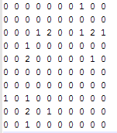
GRAPH REPRESENTATION
For creating graph, the matrix is used which is extracted before.
From this matrix, it is easily seen that the developers who changed same file.

Slide 20
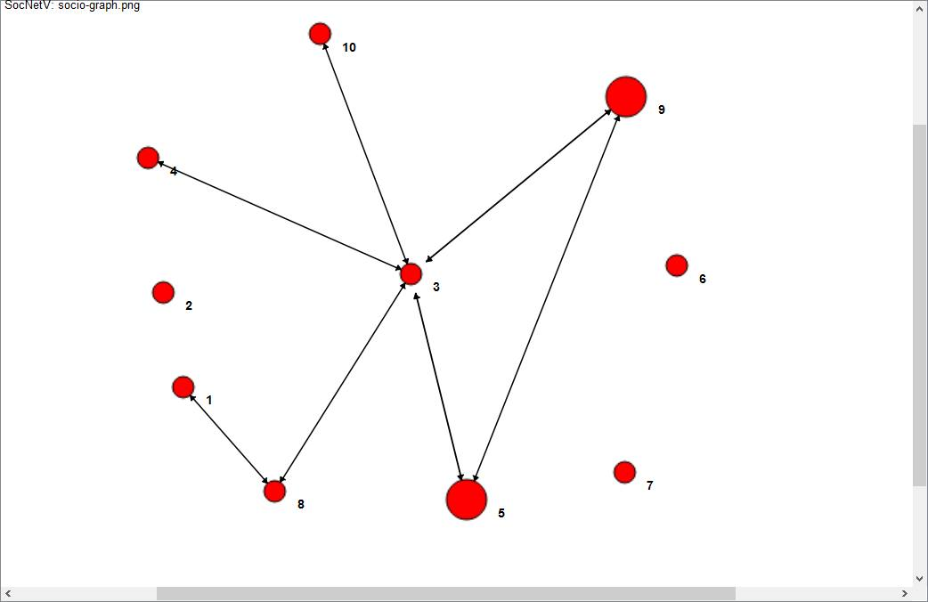
GRAPH
Developer Name | Node ID
peter1000 | 1
Nicolas Despres | 2
Nico Weber | 3
Fredrik Medley | 4
Scott Graham | 5
Lindley French | 6
Mike Seplowitz | 7
Evan Martin | 8
Jason Haslam | 9
Brad King | 10

Slide 21
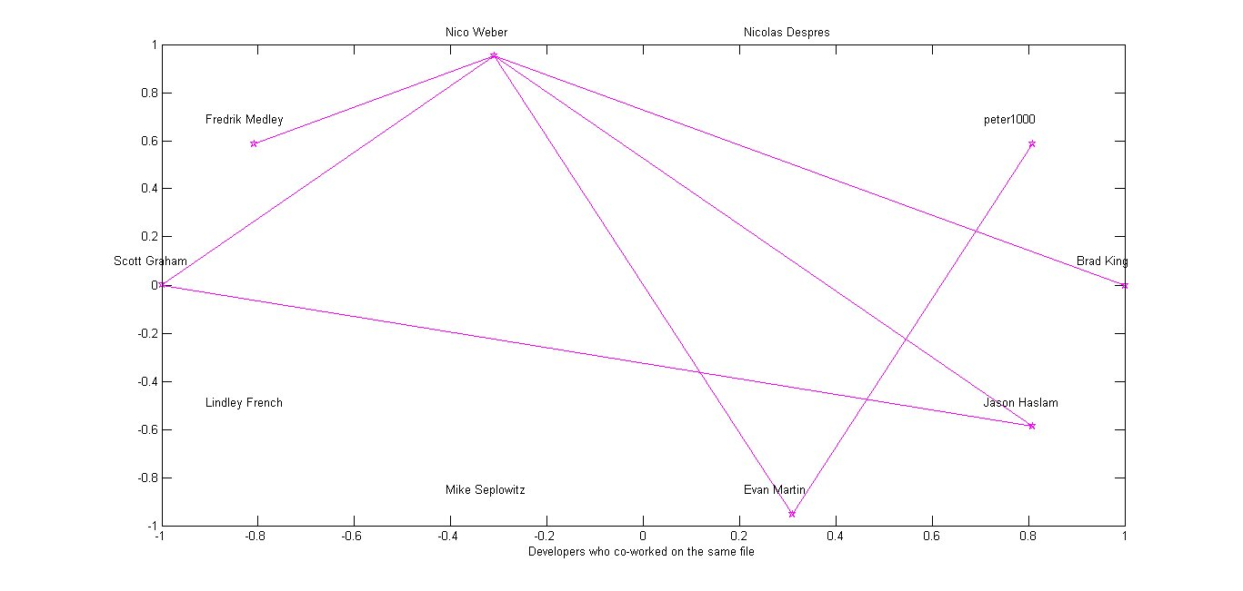
Graph Respresentation in Matlab

