Slide 1
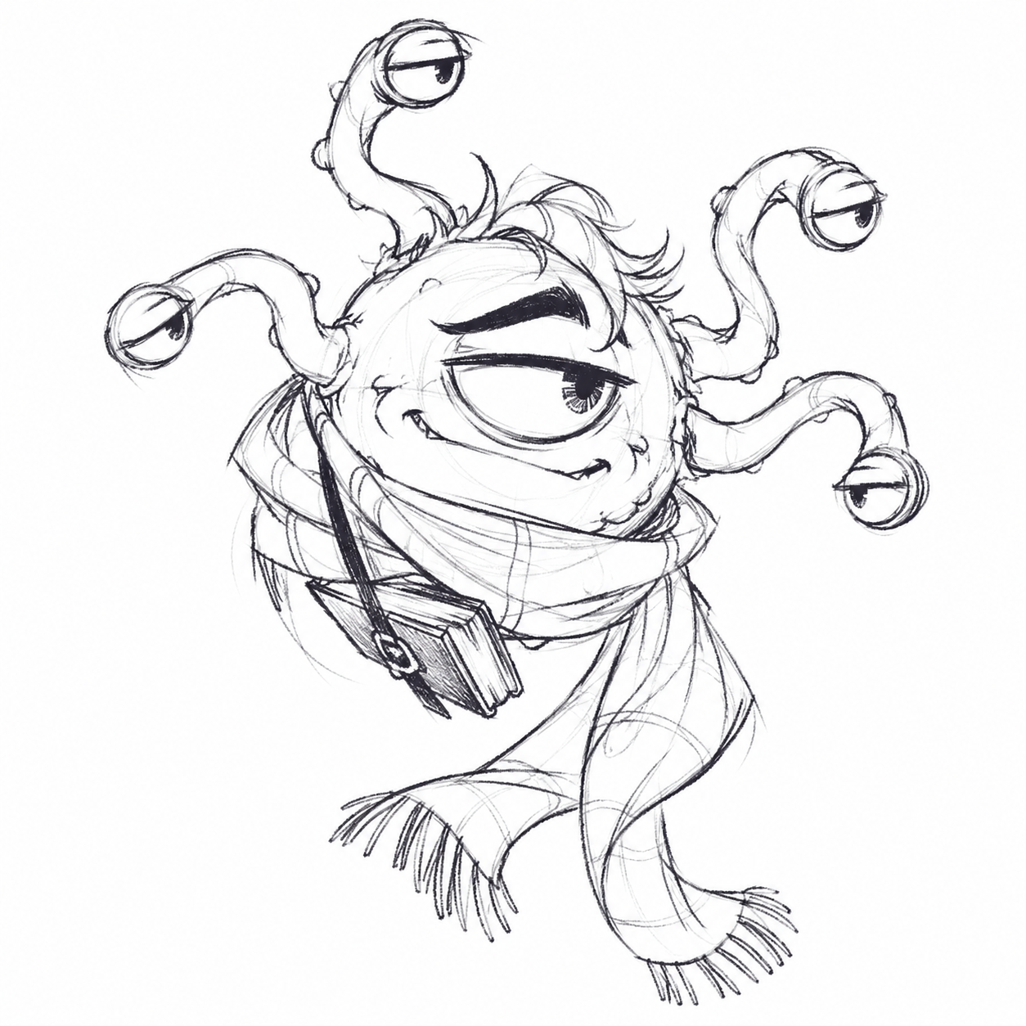
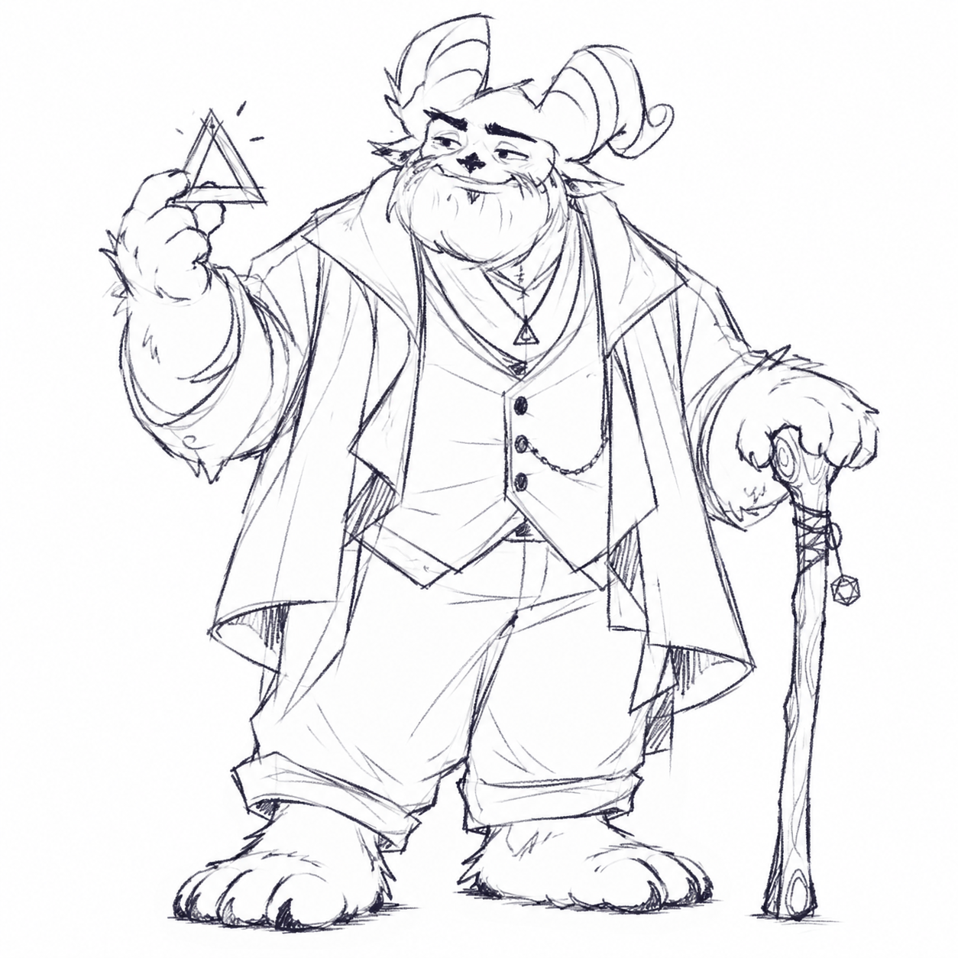
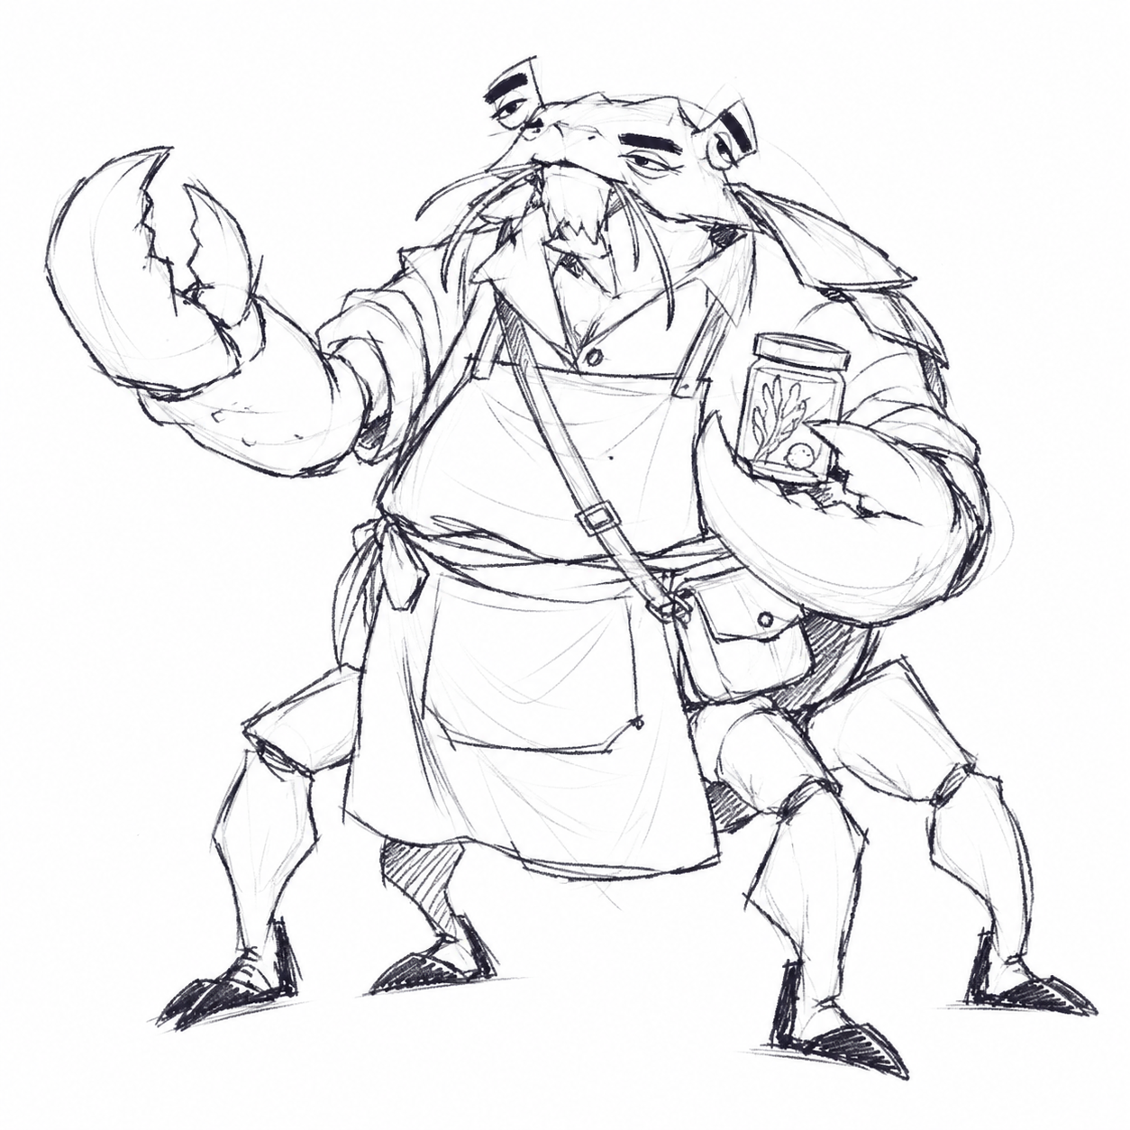
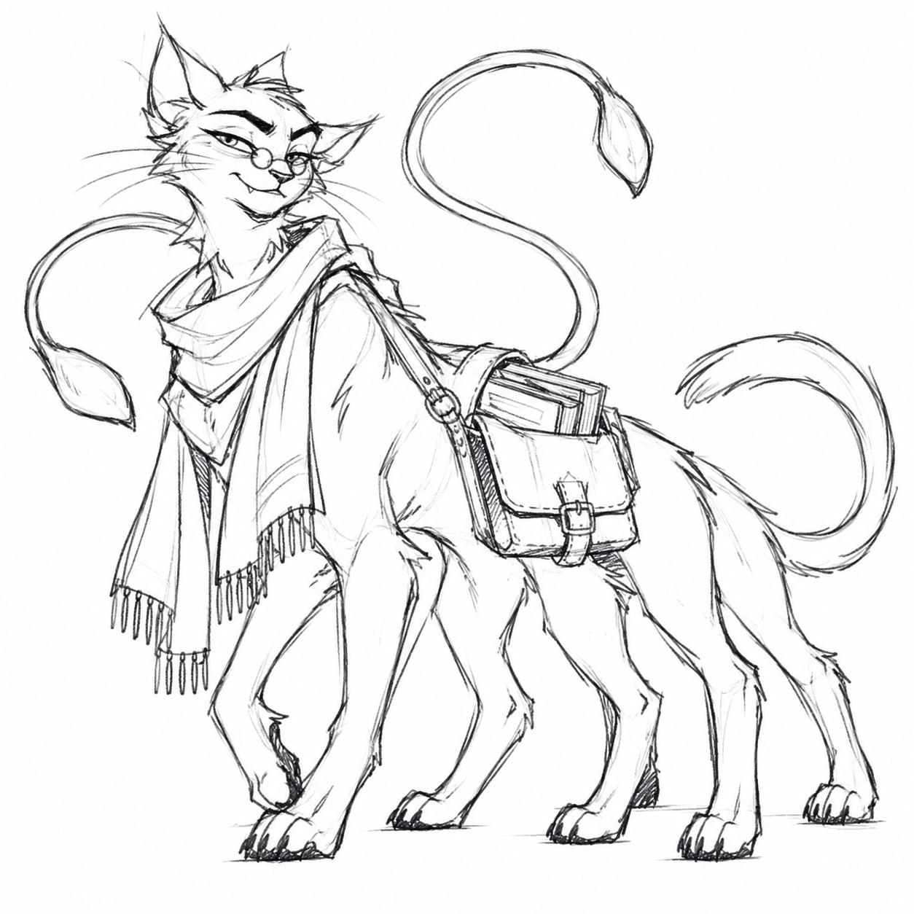
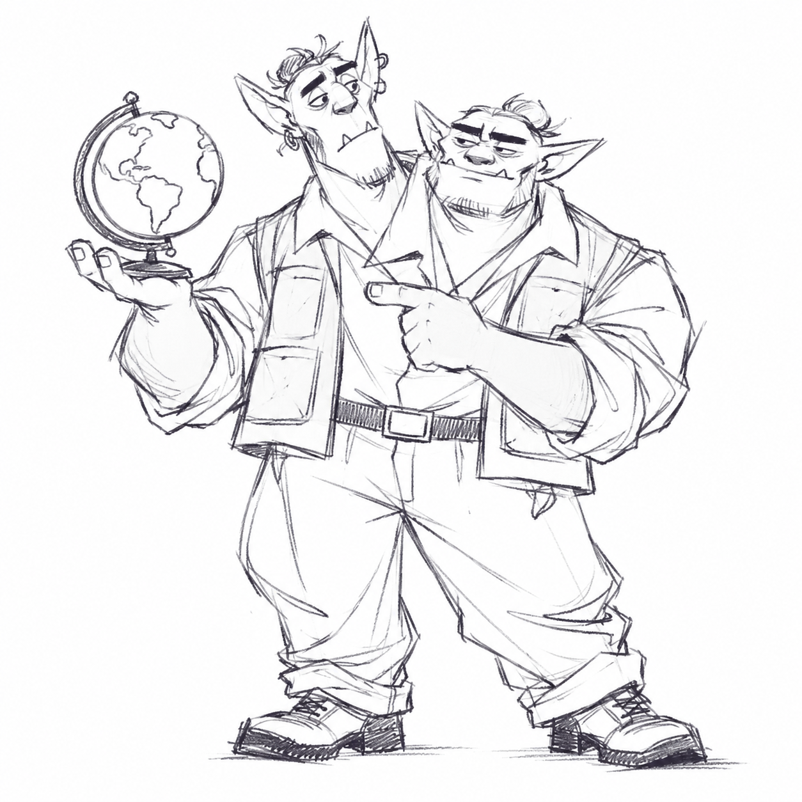
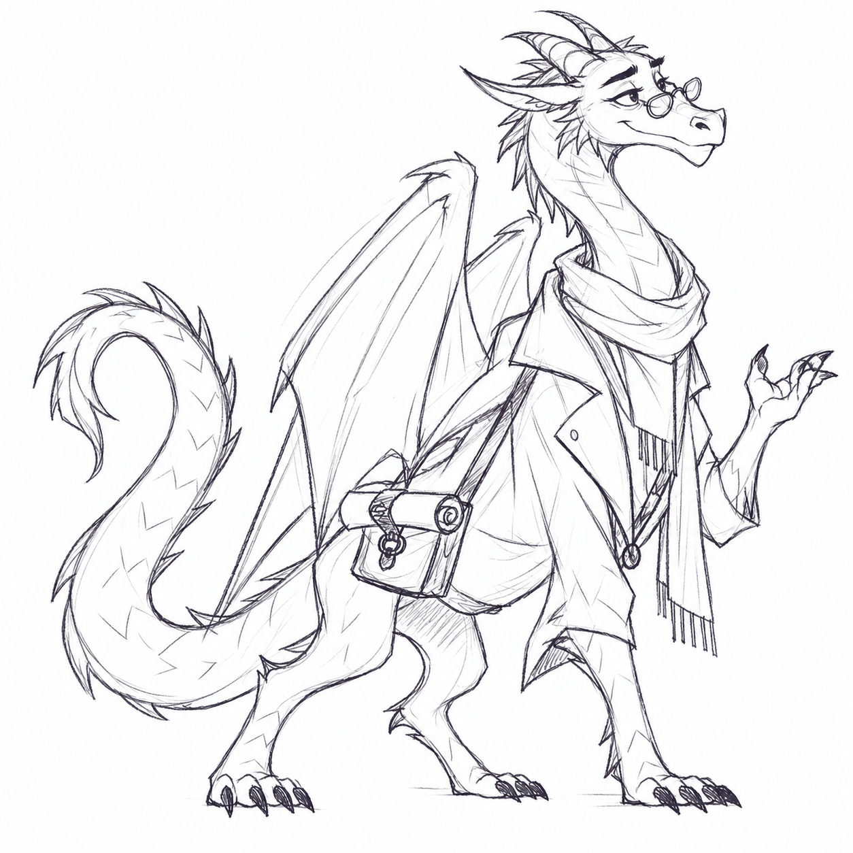
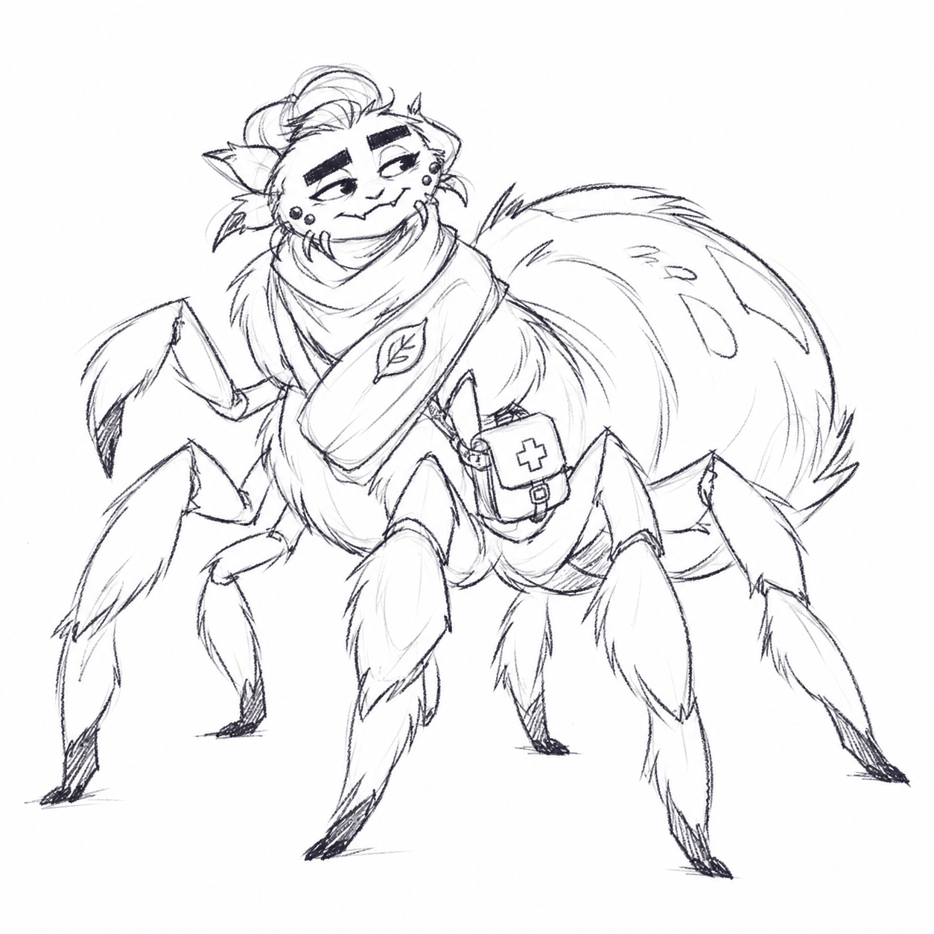
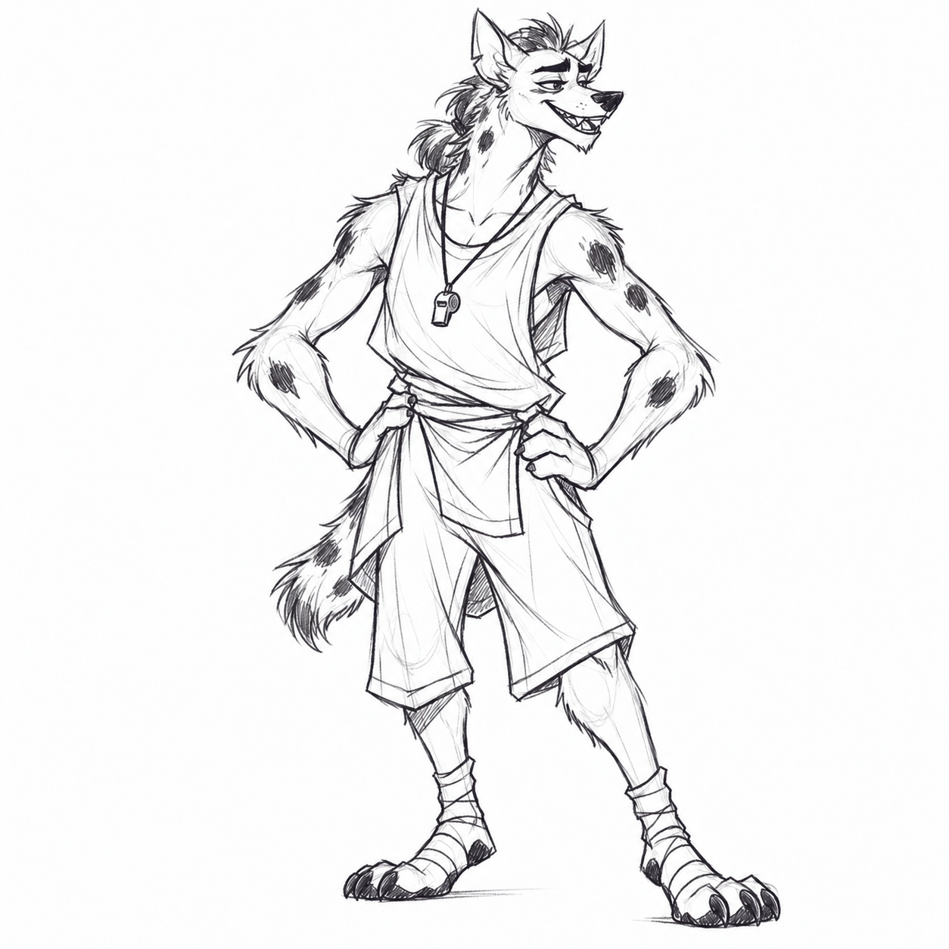
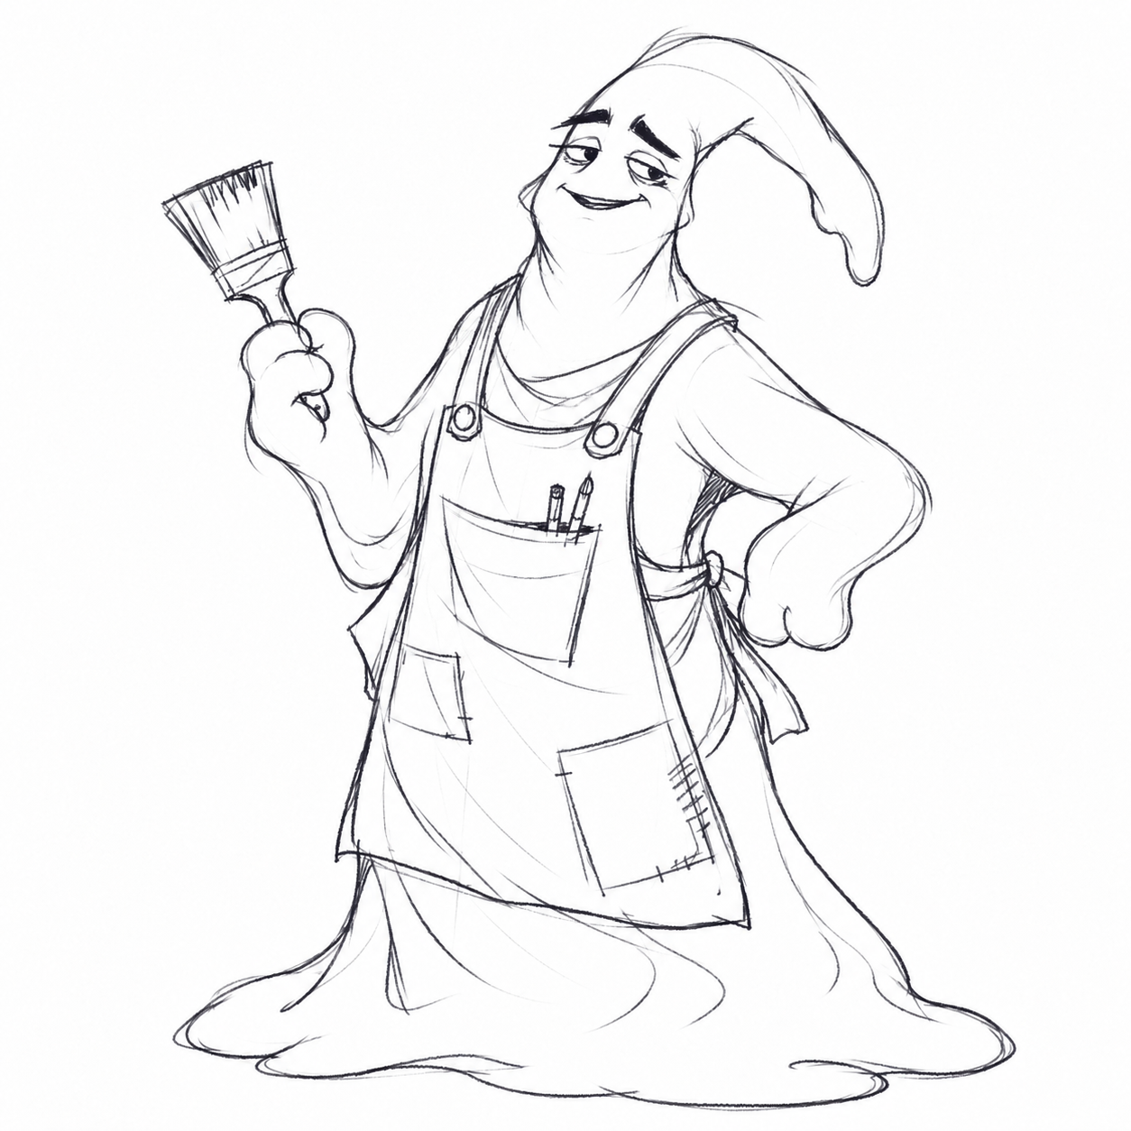
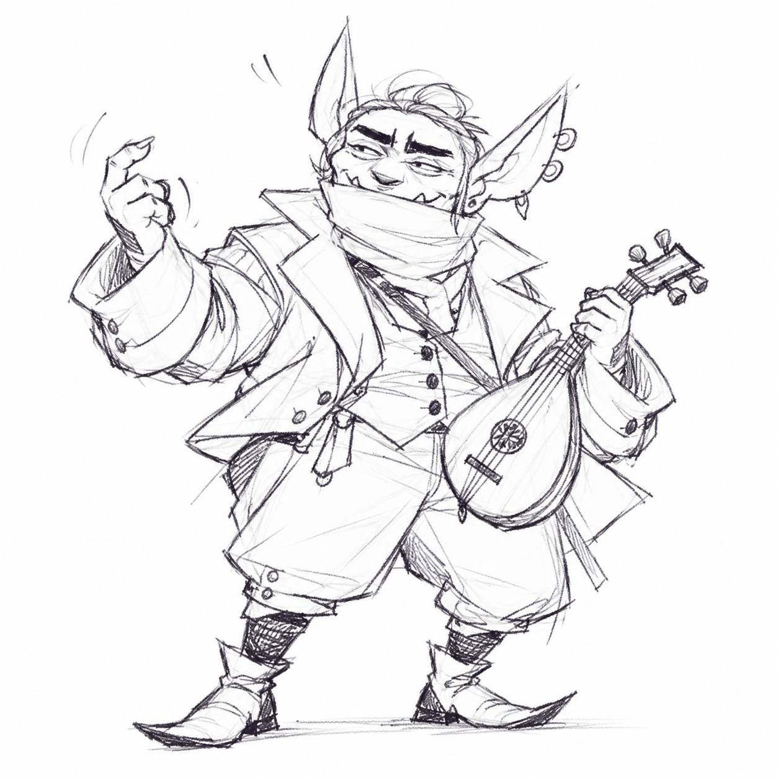
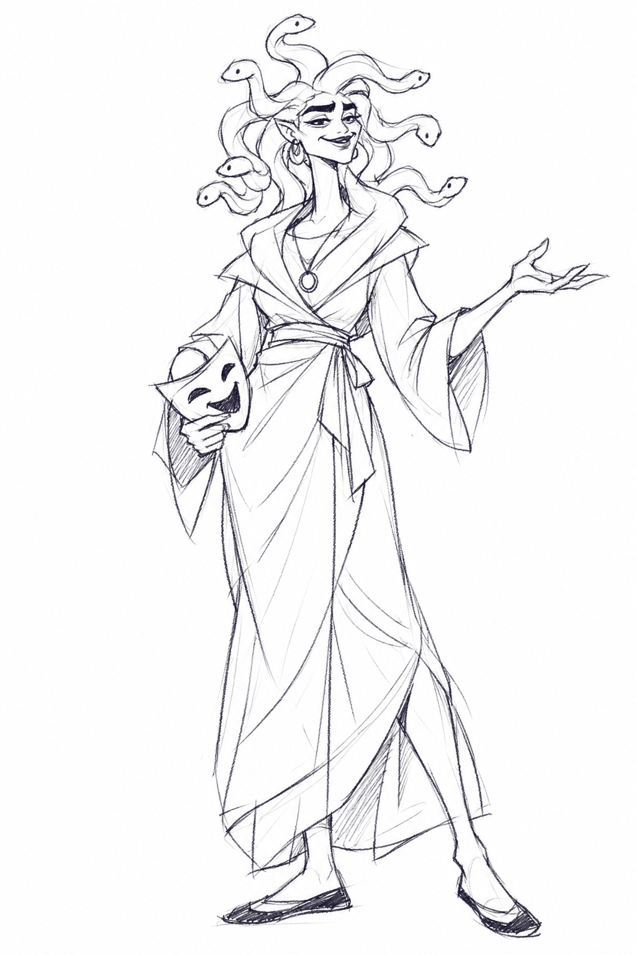
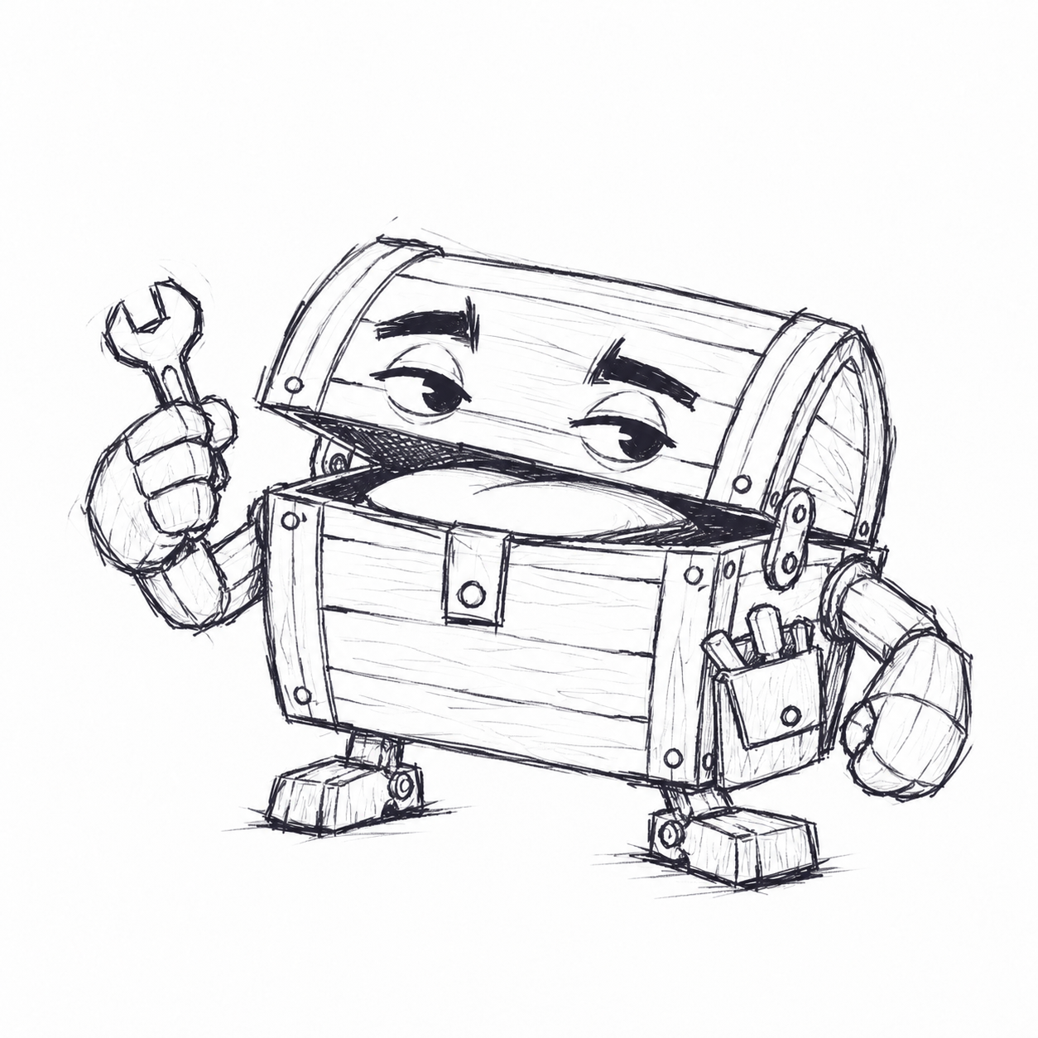
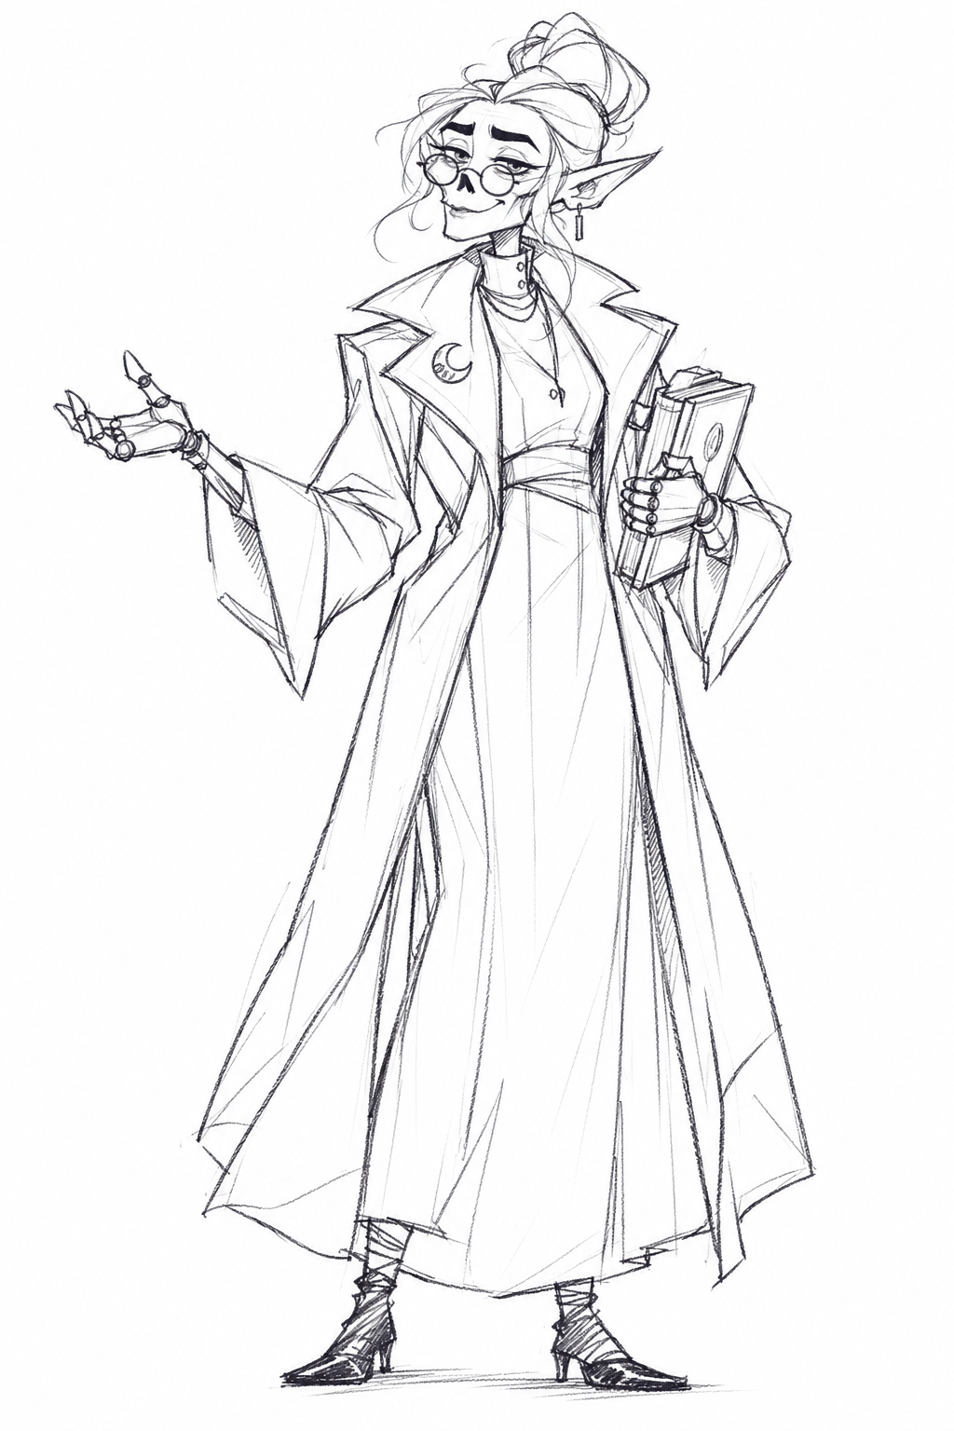
VR HIGH SCHOOL
ENGLISH
MATH
SCIENCE
HISTORY
GEOGRAPHY
LANGUAGE ARTS
HEALTH
PHYSICAL EDUCATION
ART
MUSIC
DRAMA
TECHNOLOGY
HEADMASTER
FACULTY DOSSIERS
VOICE / MOVEMENT / TEST DIALOGUE / FIRST DAY
Notes:
Teacher-facing creative proposal. Roster: /Users/arthurklein/Documents/Work/2026Nov/VR HS/docs/teachers.md. 13 faculty members, 14 proposed speaking voices because the ettin has two alternating heads. Preserve roster genders. Lesson timing and activities are design proposals.
Artwork: current individual black-and-white faculty drawings, with Language Arts and PE female (she/her) and Art non-binary (they/them).

Slide 2
SERVICE SHEET 01
VOICE CASTING
ElevenLabs Voice Design is the recommended starting point for this fantasy cast
Why this service
A repeatable audition
Voice Design accepts written character descriptions and offers several candidates to audition. Save a chosen voice for each teacher, then generate the test lines with the same saved voice.
1 Paste a teacher’s voice prompt into Voice Design.
2 Use that teacher’s test dialogue as preview text.
3 Audition welcome, feedback and help lines.
4 Save the chosen voice ID and delivery settings.
5 Regenerate a short scene to check consistency.
Plan recommendation
Creator is a practical starting plan for this cast: 30 custom voice slots cover the 14 proposed voices. Standard monthly price: $22 before tax. The first-month offer may differ. Verify the price before subscribing.
Performance direction
Keep the base voice clean and intelligible. Add any creature texture lightly in the sound mix. Treat pace ranges as acting targets, then adjust by listening. The ettin heads speak one at a time.
These sheets provide written prompts and dialogue. Audio generation is a separate production step.
Generate commercial assets under a paid plan. Voice Design is useful for exploration, but the service notes that output quality varies. Audition repeated scenes before committing to the whole script.
VR HIGH SCHOOL / ANGULAR ARCADE / PROPOSED PERFORMANCE DIRECTION
02
Notes:
Recommendation is a creative judgment based on the prompt-based design workflow. Checked 29 October 2026. Sources: https://elevenlabs.io/docs/eleven-creative/voices/voice-design (prompting, three candidates, saved slots, quality variability); https://elevenlabs.io/pricing (Creator standard monthly $22, 30 custom voice slots in plan comparison); https://elevenlabs.io/docs/overview/administration/billing (commercial rights on paid plans). Prices exclude taxes. No purchase or voice account changes requested.

Slide 3
MOVEMENT SHEET 02
ENSEMBLE PERFORMANCE
Friendly fantasy teachers with readable, deliberate behavior
Body language
Comfort in VR
One main gesture per thought. Let the body settle before the important instruction.
Teachers turn toward whoever is speaking, then hold a listening pose. Leave a clear pause for answers.
Each creature keeps its own gait and body mechanics. The dossiers describe idle, travel and teaching behavior.
Begin at a conversational distance. Match seated and standing viewing angles.
Offer reduced motion: smaller idle loops, still appendages and no displacement effect.
Keep the camera under the student’s control. Teachers never force movement, crowd the view or touch the avatar.
Shared rehearsal
Speech and attention
Each teacher performs a greeting, a student uncertainty, a supportive reply and a learning prompt. Use the labels as acting directions. Record only the spoken line.
Keep lip or lid motion tied to speech. Quiet idle sounds while another person talks. Provide captions, replay and a visible turn-taking cue. Physical sound effects stay below dialogue.
VR HIGH SCHOOL / ANGULAR ARCADE / PROPOSED PERFORMANCE DIRECTION
03
Notes:
Proposed performance and comfort direction, not a claim about an implemented rig or application. Creature silhouettes follow docs/art/concept-direction.md. These are artistic recommendations. Validate animations and interaction choices in the eventual VR experience.

Slide 4
FACULTY FILE 01
ENGLISH
The attentive editor
VOICE PROMPT / COPY INTO VOICE DESIGN
MOVEMENT DIRECTION
Native English, General American. Male, 45–55. Studio quality. Persona: witty, attentive librarian. Emotion: warm, curious. A rounded mid-low baritone with crisp consonants and a smile in the vowels. Measured phrasing, gentle emphasis on key words, and a short pause before a question. Keep the voice conversational and reassuring.
Float with a slow, shallow bob. Ease into turns and stop before speaking.
The central eye attends to the speaker. Two eyestalks track the page, the rest settle.
Lift one stalk to mark a revision. Never aim a ring of eyes at one student.
130–145 words/min (acting target)
BEHOLDER
TEST DIALOGUE / ROLE LABELS ARE NOT SPOKEN
TEACHER · WELCOME
Welcome to English. I have several eyes, but we will examine one sentence at a time.
Male / Bard
What if my first draft is bad?
Beholder’s Library
STUDENT
FIRST-DAY TEACHING HOOK
TEACHER · REASSURE
Then it is doing its job. A draft gives us something to improve.
Revise one plain sentence. Explain one word choice.
TEACHER · PROMPT
Try this: “The door opened.” Which word would make it more precise?
VR HIGH SCHOOL / ANGULAR ARCADE / PROPOSED PERFORMANCE DIRECTION
04
Notes:
Source identity, subject, gender, class and classroom: docs/teachers.md. Artwork: individual black-and-white faculty drawings based on the artist’s sketch references, in assets/concepts/2026-10-29/individual-line-drawings/faculty/. Voice, age, dialect, pace, movement, dialogue and first-day hook are proposed creative choices. Voice prompts follow https://elevenlabs.io/docs/eleven-creative/voices/voice-design. English emphasizes sentence craft. Language Arts emphasizes audience, storytelling and communication. For recording, use only the spoken teacher lines. Have a separate reader deliver the student lines during a scene audition. Preview the complete spoken passage when voice design requires a longer text sample. Keep creature effects out of the base voice prompt.

Slide 5
FACULTY FILE 02
MATH
The patient pattern finder
VOICE PROMPT / COPY INTO VOICE DESIGN
MOVEMENT DIRECTION
Native English, General American. Male, 50–65. Studio quality. Persona: patient mathematics mentor. Emotion: calm, quietly delighted. A deep, soft bass with a velvety texture and clear number pronunciation. Give each reasoning step its own breath. Warm chest resonance, gentle downward endings, and an unhurried pause after a question.
Heavy heel-to-toe steps with a soft knee bend. Let the coat and fur settle after each stop.
Use broad, slow hands to group objects. Tap one abacus bead per spoken count.
Lower the shoulders and bend toward the work, giving seated students equal attention.
115–130 words/min (acting target)
YETI WIZARD
TEST DIALOGUE / ROLE LABELS ARE NOT SPOKEN
TEACHER · WELCOME
Welcome. In this room, every solution begins with a small step.
Male / Wizard
I am slow at math.
Yeti’s Lair
STUDENT
FIRST-DAY TEACHING HOOK
TEACHER · REASSURE
You may take your time. Show me one part you understand.
Model the rule 2n + 3. Explain what changes when n increases by one.
TEACHER · PROMPT
A rune machine doubles its input, then adds three. Can you write a rule for any input?
VR HIGH SCHOOL / ANGULAR ARCADE / PROPOSED PERFORMANCE DIRECTION
05
Notes:
Source identity, subject, gender, class and classroom: docs/teachers.md. Artwork: individual black-and-white faculty drawings based on the artist’s sketch references, in assets/concepts/2026-10-29/individual-line-drawings/faculty/. Voice, age, dialect, pace, movement, dialogue and first-day hook are proposed creative choices. Voice prompts follow https://elevenlabs.io/docs/eleven-creative/voices/voice-design. English emphasizes sentence craft. Language Arts emphasizes audience, storytelling and communication. For recording, use only the spoken teacher lines. Have a separate reader deliver the student lines during a scene audition. Preview the complete spoken passage when voice design requires a longer text sample. Keep creature effects out of the base voice prompt. First-day math starter: use n=1,2,3 to build outputs 5,7,9. Invite students to explain why each input step adds two to the output. Accept words, tiles, a table or algebra. This is an informal algebra warm-up, not a placement test.

Slide 6
FACULTY FILE 03
SCIENCE
The careful field scientist
VOICE PROMPT / COPY INTO VOICE DESIGN
MOVEMENT DIRECTION
Native English, General American. Male, 35–50. Studio quality. Persona: enthusiastic field scientist. Emotion: curious, thoughtful. A warm mid-range tenor with a faint grain and precise diction. Start observations lightly, then slow down for evidence. Small rises of curiosity at questions, natural pauses, and restrained excitement when a student notices something.
Walk with an alternating, stable leg pattern. Let the shell lead a slow turn.
Hold samples in the small manipulators. Keep large claws open and below shoulder height.
Antennae lean toward evidence, then pause. Mouth tentacles stay subtle during speech.
130–145 words/min (acting target)
CHUUL
TEST DIALOGUE / ROLE LABELS ARE NOT SPOKEN
TEACHER · WELCOME
Welcome to the swamp laboratory. This leaf has a mystery on it.
Male / Druid
Those spots mean it is sick.
Chuul’s Swamp
STUDENT
FIRST-DAY TEACHING HOOK
TEACHER · REDIRECT
That is one possible explanation. First, tell me what you can observe.
Separate a leaf observation from an explanation. Name a test variable.
TEACHER · PROMPT
How could we test your idea without changing two things at once?
VR HIGH SCHOOL / ANGULAR ARCADE / PROPOSED PERFORMANCE DIRECTION
06
Notes:
Source identity, subject, gender, class and classroom: docs/teachers.md. Artwork: individual black-and-white faculty drawings based on the artist’s sketch references, in assets/concepts/2026-10-29/individual-line-drawings/faculty/. Voice, age, dialect, pace, movement, dialogue and first-day hook are proposed creative choices. Voice prompts follow https://elevenlabs.io/docs/eleven-creative/voices/voice-design. English emphasizes sentence craft. Language Arts emphasizes audience, storytelling and communication. For recording, use only the spoken teacher lines. Have a separate reader deliver the student lines during a scene audition. Preview the complete spoken passage when voice design requires a longer text sample. Keep creature effects out of the base voice prompt.

Slide 7
FACULTY FILE 04
HISTORY
The evidence detective
VOICE PROMPT / COPY INTO VOICE DESIGN
MOVEMENT DIRECTION
Native English, General American. Female, 35–50. Studio quality. Persona: perceptive archive detective. Emotion: composed, intrigued. A low alto with a smooth, lightly smoky texture and exact consonants. Dry humor, purposeful pauses, and soft emphasis on dates and sources. Build curiosity through timing while keeping every sentence clear and welcoming.
Use a low, six-legged feline walk with even weight. Pause with all feet grounded.
One tentacle points to a source while the other rests. Turn the ears before the head.
A faint offset silhouette may appear only during travel, then disappear before instruction.
125–140 words/min (acting target)
DISPLACER BEAST
TEST DIALOGUE / ROLE LABELS ARE NOT SPOKEN
TEACHER · WELCOME
History leaves clues. Today we have a diary and a town record.
Female / Rogue
What if they disagree?
Displacer Beast’s Forest
STUDENT
FIRST-DAY TEACHING HOOK
TEACHER · REASSURE
Excellent. We have a question worth investigating.
Compare two accounts of one event. Explain why they may differ.
TEACHER · PROMPT
Who made each source, and what could each person actually know?
VR HIGH SCHOOL / ANGULAR ARCADE / PROPOSED PERFORMANCE DIRECTION
07
Notes:
Source identity, subject, gender, class and classroom: docs/teachers.md. Artwork: individual black-and-white faculty drawings based on the artist’s sketch references, in assets/concepts/2026-10-29/individual-line-drawings/faculty/. Voice, age, dialect, pace, movement, dialogue and first-day hook are proposed creative choices. Voice prompts follow https://elevenlabs.io/docs/eleven-creative/voices/voice-design. English emphasizes sentence craft. Language Arts emphasizes audience, storytelling and communication. The source locations prose uses a conflicting male pronoun. This proposal follows the teacher table and keeps History female. For recording, use only the spoken teacher lines. Have a separate reader deliver the student lines during a scene audition. Preview the complete spoken passage when voice design requires a longer text sample. Keep creature effects out of the base voice prompt.

Slide 8
FACULTY FILE 05
GEOGRAPHY
Two viewpoints, one expedition
VOICE PROMPT / COPY INTO VOICE DESIGN
MOVEMENT DIRECTION
HEAD A: Native English, General American. Male, 40–50. Studio quality. Warm, practical map guide. Low baritone, rounded vowels and measured phrasing.
HEAD B: Native English, General American. Male, 25–35. Studio quality. Curious, friendly field partner. Bright light tenor, crisp consonants and quicker questions.
One shared, weighty walk. The torso turns first and both heads settle with a small delay.
The speaking head looks toward the student. The listening head nods and waits its turn.
One hand supports the globe while the other traces a route. Avoid tug-of-war gestures.
125–140 words/min (acting target)
ETTIN
TEST DIALOGUE / ROLE LABELS ARE NOT SPOKEN
HEAD A · WELCOME
Welcome, explorers. The map shows two paths to the tower.
Male / Fighter
One is shorter. Does that make it the easier route?
Ettin’s Mountain
HEAD B · QUESTION
FIRST-DAY TEACHING HOOK
STUDENT
Maybe the short one is steeper.
Choose a map route. Support the choice with distance or slope.
HEAD A · FOLLOW-UP
Good observation. Show us the contour lines that support your idea.
VR HIGH SCHOOL / ANGULAR ARCADE / PROPOSED PERFORMANCE DIRECTION
08
Notes:
Source identity, subject, gender, class and classroom: docs/teachers.md. Artwork: individual black-and-white faculty drawings based on the artist’s sketch references, in assets/concepts/2026-10-29/individual-line-drawings/faculty/. Voice, age, dialect, pace, movement, dialogue and first-day hook are proposed creative choices. Voice prompts follow https://elevenlabs.io/docs/eleven-creative/voices/voice-design. English emphasizes sentence craft. Language Arts emphasizes audience, storytelling and communication. For recording, use only the spoken teacher lines. Have a separate reader deliver the student lines during a scene audition. Preview the complete spoken passage when voice design requires a longer text sample. Keep creature effects out of the base voice prompt.

Slide 9
FACULTY FILE 06
LANGUAGE ARTS
The generous storyteller
VOICE PROMPT / COPY INTO VOICE DESIGN
MOVEMENT DIRECTION
Native English, General American. Female brass dragon, mature adult. Studio quality. Resonant low alto with bright brassy overtones and a light dry grain. Spacious vowels and rising story phrases suggest her towering scale. A generous, sociable storyteller. Use theatrical warmth, then soften when listening. Keep instructions concise and fully articulated, with room for students to respond.
Walk with deliberate claw placement. Keep the tail behind the body and wings folded.
Open one wing slightly to reveal a story prop. Use a relaxed chin tilt when listening.
Settle the jaw between phrases. Keep breath and wing movement quiet near a learner.
125–140 words/min (acting target)
BRASS DRAGON
TEST DIALOGUE / ROLE LABELS ARE NOT SPOKEN
TEACHER · WELCOME
Every story has a listener. Today, choose one person you want to reach.
Female / Bard
Can I tell a story instead of writing it?
Brass Dragon’s Lair
STUDENT
FIRST-DAY TEACHING HOOK
TEACHER · REASSURE
Certainly. Speak it, type it, or build it with pictures.
Tell a two-sentence arrival story. Name the intended audience and feeling.
TEACHER · PROMPT
Tell us about a surprising arrival at school. What should your listener feel?
VR HIGH SCHOOL / ANGULAR ARCADE / PROPOSED PERFORMANCE DIRECTION
09
Notes:
Source identity, subject, gender, class and classroom: docs/teachers.md. Artwork: individual black-and-white faculty drawings based on the artist’s sketch references, in assets/concepts/2026-10-29/individual-line-drawings/faculty/. Voice, age, dialect, pace, movement, dialogue and first-day hook are proposed creative choices. Voice prompts follow https://elevenlabs.io/docs/eleven-creative/voices/voice-design. English emphasizes sentence craft. Language Arts emphasizes audience, storytelling and communication. For recording, use only the spoken teacher lines. Have a separate reader deliver the student lines during a scene audition. Preview the complete spoken passage when voice design requires a longer text sample. Keep creature texture subtle enough for clear speech.
Current character canon: This teacher is female and uses she/her.
Full voice prompt from Character Register v1.2: Native English, General American. Female brass dragon, mature adult. Studio quality. A towering, long-necked dragon with a capacious chest: a resonant low alto with bright brassy overtones and a light, dry grain at the back of the throat. Spacious vowels and flowing, rising story phrases make her scale audible. A sociable, generous storyteller who savors a good anecdote. Shape key words with theatrical warmth, then lower the intensity when listening. Keep ordinary instructions concise and fully articulated.

Slide 10
FACULTY FILE 07
HEALTH
The calm wellbeing guide
VOICE PROMPT / COPY INTO VOICE DESIGN
MOVEMENT DIRECTION
Native English, General American. Female, 40–55. Studio quality. Persona: calm school wellbeing guide. Emotion: attentive, reassuring. A warm lower mezzo with a soft, clear texture. Even volume, short sentences, and generous pauses. Questions sound optional and respectful. Keep concern gentle and composed, with precise articulation of practical instructions.
Use a smooth alternating leg pattern. Keep the body level and approach from the front.
Stop outside the student’s personal space. Lift one foreleg slowly to indicate a rest spot.
Keep the web as scenery. Never drop from above, wrap a learner, or touch their avatar.
110–125 words/min (acting target)
GIANT SPIDER
TEST DIALOGUE / ROLE LABELS ARE NOT SPOKEN
TEACHER · CHECK-IN
You can tell me how you feel, or you can pass.
Female / Ranger
The headset is making me uncomfortable.
Giant Spider’s Web
STUDENT
FIRST-DAY TEACHING HOOK
TEACHER · SUPPORT
Pause here. You may take the headset off and ask the room facilitator for help.
Practice Pause and Help. Identify a way to request a break.
TEACHER · CHOICE
Would you prefer the seated screen activity or a quiet break?
VR HIGH SCHOOL / ANGULAR ARCADE / PROPOSED PERFORMANCE DIRECTION
10
Notes:
Source identity, subject, gender, class and classroom: docs/teachers.md. Artwork: individual black-and-white faculty drawings based on the artist’s sketch references, in assets/concepts/2026-10-29/individual-line-drawings/faculty/. Voice, age, dialect, pace, movement, dialogue and first-day hook are proposed creative choices. Voice prompts follow https://elevenlabs.io/docs/eleven-creative/voices/voice-design. English emphasizes sentence craft. Language Arts emphasizes audience, storytelling and communication. For recording, use only the spoken teacher lines. Have a separate reader deliver the student lines during a scene audition. Preview the complete spoken passage when voice design requires a longer text sample. Keep creature effects out of the base voice prompt.

Slide 11
FACULTY FILE 08
PHYSICAL EDUCATION
The encouraging movement coach
VOICE PROMPT / COPY INTO VOICE DESIGN
MOVEMENT DIRECTION
Native English, General American. Female gnoll, adult. Studio quality. Warm middle register with forward muzzle resonance and a dry, friendly rasp. Crisp rhythmic counting suggests her athletic build. A good-humored coach, energetic at classroom volume. Soften during reassurance, separate each instruction, and leave time for the learner to try. Keep every word clear.
Use a relaxed digitigrade walk. Ears and tail follow the body with light delayed motion.
Demonstrate a small shoulder reach and reset. Count visibly with fingers at a steady tempo.
Celebrate with a low fist pump. Keep jumps and running out of the first VR lesson.
140–155 words/min (acting target)
GNOLL
TEST DIALOGUE / ROLE LABELS ARE NOT SPOKEN
TEACHER · WELCOME
Welcome, team. Choose a comfortable position. Seated works too.
Female / Barbarian
Do I have to keep up with everyone?
Gnoll’s Cave
STUDENT
FIRST-DAY TEACHING HOOK
TEACHER · REASSURE
Choose your own pace. We are practicing control.
Try or describe a gentle reach, then return to rest.
TEACHER · PROMPT
Reach gently within your clear space, then return to rest. Tell me when you are ready.
VR HIGH SCHOOL / ANGULAR ARCADE / PROPOSED PERFORMANCE DIRECTION
11
Notes:
Source identity, subject, gender, class and classroom: docs/teachers.md. Artwork: individual black-and-white faculty drawings based on the artist’s sketch references, in assets/concepts/2026-10-29/individual-line-drawings/faculty/. Voice, age, dialect, pace, movement, dialogue and first-day hook are proposed creative choices. Voice prompts follow https://elevenlabs.io/docs/eleven-creative/voices/voice-design. English emphasizes sentence craft. Language Arts emphasizes audience, storytelling and communication. For recording, use only the spoken teacher lines. Have a separate reader deliver the student lines during a scene audition. Preview the complete spoken passage when voice design requires a longer text sample. Keep creature texture subtle enough for clear speech.
Current character canon: This teacher is female and uses she/her.
Full voice prompt from Character Register v1.2: Native English, General American. Female gnoll, adult. Studio quality. A tall, lean, hyena-like coach with a warm middle register, a forward muzzle-shaped resonance and a dry, pleasantly ragged rasp. Short energetic phrase attacks and crisp rhythmic counting suggest her athletic body ready to move. A good-humored coach who becomes gentler during reassurance. Allow an occasional small breathy chuckle between thoughts. Keep words open and clear, the pace responsive, and encouragement at normal classroom volume.

Slide 12
FACULTY FILE 09
ART
The playful experimenter
VOICE PROMPT / COPY INTO VOICE DESIGN
MOVEMENT DIRECTION
Native English, General American. Non-binary oobleck, adult, they/them. Studio quality. Soft middle register with rounded, gently viscous vowels and small elastic pitch slides. Their fluid body suggests a voice that reshapes a phrase as ideas arrive. A playful, encouraging studio teacher. Use buoyant phrasing and warm endings. Keep consonants distinct and instructions easy to follow.
Flow forward as one slime mass. Compress before travel and stretch slightly on arrival.
Form a broad base before using a brush. Small drips return to the body rather than scatter.
A hand reshapes into a simple tool grip. Hold the finished mark still for students to inspect.
130–145 words/min (acting target)
OOBLECK
TEST DIALOGUE / ROLE LABELS ARE NOT SPOKEN
TEACHER · WELCOME
Welcome to the studio. This shape was a square a moment ago.
Non-binary / Artificer
My picture does not look real.
Oobleck’s Workshop
STUDENT
FIRST-DAY TEACHING HOOK
TEACHER · REASSURE
It can still say something. Tell me what you want it to feel like.
Make a color-and-shape emblem. Explain one choice, with a fictional mood if preferred.
TEACHER · PROMPT
Choose two colors and one shape to show your first-day mood. You may keep its meaning private.
VR HIGH SCHOOL / ANGULAR ARCADE / PROPOSED PERFORMANCE DIRECTION
12
Notes:
Source identity, subject, gender, class and classroom: docs/teachers.md. Artwork: individual black-and-white faculty drawings based on the artist’s sketch references, in assets/concepts/2026-10-29/individual-line-drawings/faculty/. Voice, age, dialect, pace, movement, dialogue and first-day hook are proposed creative choices. Voice prompts follow https://elevenlabs.io/docs/eleven-creative/voices/voice-design. English emphasizes sentence craft. Language Arts emphasizes audience, storytelling and communication. For recording, use only the spoken teacher lines. Have a separate reader deliver the student lines during a scene audition. Preview the complete spoken passage when voice design requires a longer text sample. Keep creature texture subtle enough for clear speech.
Current character canon: Art is non-binary and uses they/them.
Full voice prompt from Character Register v1.2: Native English, General American. Non-binary oobleck, adult; they/them pronouns. Studio quality. A medium-sized shapeshifting slime whose light middle register has a soft, rounded, gently viscous texture. Vowels stretch slightly and settle with small elastic pitch slides, while consonants remain distinct. Their fluid body suggests a voice that can reshape a phrase as an idea occurs. A playful studio teacher, easily delighted by experiments. Use buoyant melodic changes and warm, gentle phrase endings. Keep the elasticity restrained and the teaching words easy to follow.

Slide 13
FACULTY FILE 10
MUSIC
The welcoming rhythm maker
VOICE PROMPT / COPY INTO VOICE DESIGN
MOVEMENT DIRECTION
Native English, General American. Female, 25–40. Studio quality. Persona: inventive music workshop leader. Emotion: bright, welcoming. A lively light alto with a faint husky edge, nimble consonants, and playful pitch changes. Speak with rhythmic clarity while leaving space for a reply. Warm encouragement, controlled volume, and clean spoken counting.
Take small, quick steps that settle into a planted stance. Tap a toe only during a beat.
Lead with a short wrist pickup, then four clear downbeats. Keep the instrument steady.
Still the hands and instrument while a student answers. Avoid constant background strumming.
140–155 words/min (acting target)
GOBLIN BARD
TEST DIALOGUE / ROLE LABELS ARE NOT SPOKEN
TEACHER · WELCOME
Welcome, musicians. Let us borrow a heartbeat and make a pattern.
Female / Bard
I do not play an instrument.
Goblin’s Workshop
STUDENT
FIRST-DAY TEACHING HOOK
TEACHER · REASSURE
You can tap, watch, or arrange the beat tiles.
Copy a four-beat pattern. Identify the rest on beat three.
TEACHER · PROMPT
Try four beats: tap, tap, rest, tap. Which beat stays silent?
VR HIGH SCHOOL / ANGULAR ARCADE / PROPOSED PERFORMANCE DIRECTION
13
Notes:
Source identity, subject, gender, class and classroom: docs/teachers.md. Artwork: individual black-and-white faculty drawings based on the artist’s sketch references, in assets/concepts/2026-10-29/individual-line-drawings/faculty/. Voice, age, dialect, pace, movement, dialogue and first-day hook are proposed creative choices. Voice prompts follow https://elevenlabs.io/docs/eleven-creative/voices/voice-design. English emphasizes sentence craft. Language Arts emphasizes audience, storytelling and communication. For recording, use only the spoken teacher lines. Have a separate reader deliver the student lines during a scene audition. Preview the complete spoken passage when voice design requires a longer text sample. Keep creature effects out of the base voice prompt.

Slide 14
FACULTY FILE 11
DRAMA
The attentive scene partner
VOICE PROMPT / COPY INTO VOICE DESIGN
MOVEMENT DIRECTION
Native English, General American. Female, 35–50. Studio quality. Persona: expressive drama teacher. Emotion: poised, playful. A rich contralto with precise diction and a broad, controlled pitch range. Give a phrase a clear intention, then pause to invite a response. Intimate classroom projection, warm humor, and gentle, specific feedback.
Walk with a tall, balanced posture and small stage turns. Gesture from open palms.
Snake hair follows her attention in a slow wave, then rests while another person speaks.
Invite eye contact as a choice. Her gaze has no harmful effect and triggers no surprise visual.
120–140 words/min (acting target)
MEDUSA
TEST DIALOGUE / ROLE LABELS ARE NOT SPOKEN
TEACHER · WELCOME
In drama, a small change can tell a different story.
Female / Sorcerer
I would rather watch first.
Medusa’s Lair
STUDENT
FIRST-DAY TEACHING HOOK
TEACHER · REASSURE
You may observe and tell us what you notice.
Compare two readings of a line. Identify the intended emotion.
TEACHER · PROMPT
I will say “You came back” with relief, then surprise. What changed in my voice?
VR HIGH SCHOOL / ANGULAR ARCADE / PROPOSED PERFORMANCE DIRECTION
14
Notes:
Source identity, subject, gender, class and classroom: docs/teachers.md. Artwork: individual black-and-white faculty drawings based on the artist’s sketch references, in assets/concepts/2026-10-29/individual-line-drawings/faculty/. Voice, age, dialect, pace, movement, dialogue and first-day hook are proposed creative choices. Voice prompts follow https://elevenlabs.io/docs/eleven-creative/voices/voice-design. English emphasizes sentence craft. Language Arts emphasizes audience, storytelling and communication. For recording, use only the spoken teacher lines. Have a separate reader deliver the student lines during a scene audition. Preview the complete spoken passage when voice design requires a longer text sample. Keep creature effects out of the base voice prompt.

Slide 15
FACULTY FILE 12
TECHNOLOGY
The friendly systems tinkerer
VOICE PROMPT / COPY INTO VOICE DESIGN
MOVEMENT DIRECTION
Native English, General American. Androgynous adult, 25–40, with a non-binary character identity. Studio quality. Persona: friendly systems tinkerer. Emotion: curious, practical. A clear middle register with a lightly textured timbre and precise articulation. Short, well-spaced instructions, lightly playful intonation, and patient troubleshooting. Choose the voice for character fit rather than a gender stereotype.
Move on short, hinged legs with a firm planted base. Lid motion is a small jaw-like opening.
Use the tongue as a stylus only on the teacher’s own device. Tools unfold slowly from the sides.
Close the lid gently after speech. Never disguise as a student’s controls or snap near hands.
130–145 words/min (acting target)
MIMIC
TEST DIALOGUE / ROLE LABELS ARE NOT SPOKEN
TEACHER · WELCOME
Welcome to Technology. My lid is open, and so is the help menu.
Non-binary / Rogue
I pressed the wrong button.
Mimic’s Lair
STUDENT
FIRST-DAY TEACHING HOOK
TEACHER · REASSURE
That happens. Let us find the undo action together.
Move a practice cube, then demonstrate or describe Undo.
TEACHER · PROMPT
Try it on this practice cube. What changed, and how could you reverse it?
VR HIGH SCHOOL / ANGULAR ARCADE / PROPOSED PERFORMANCE DIRECTION
15
Notes:
Source identity, subject, gender, class and classroom: docs/teachers.md. Artwork: individual black-and-white faculty drawings based on the artist’s sketch references, in assets/concepts/2026-10-29/individual-line-drawings/faculty/. Voice, age, dialect, pace, movement, dialogue and first-day hook are proposed creative choices. Voice prompts follow https://elevenlabs.io/docs/eleven-creative/voices/voice-design. English emphasizes sentence craft. Language Arts emphasizes audience, storytelling and communication. For recording, use only the spoken teacher lines. Have a separate reader deliver the student lines during a scene audition. Preview the complete spoken passage when voice design requires a longer text sample. Keep creature effects out of the base voice prompt.

Slide 16
FACULTY FILE 13
HEADMASTER
The steady keeper of the school
VOICE PROMPT / COPY INTO VOICE DESIGN
MOVEMENT DIRECTION
Native English, General American. Female, 65–80. Studio quality. Persona: wise, welcoming headmaster. Emotion: composed, kindly amused. A low, elegant mezzo with a fine dry grain and clear consonants. Deliberate pacing, gentle authority, and a small smile in moments of reassurance. Let silence make room for the listener rather than create suspense.
Take measured steps under the long coat. Keep the spine tall and shoulders soft.
A brass hand turns one ledger page, then rests. A small head tilt acknowledges a student.
Meet a seated learner at a comfortable viewing angle. Spell effects remain still during speech.
110–125 words/min (acting target)
LICH
TEST DIALOGUE / ROLE LABELS ARE NOT SPOKEN
HEADMASTER · WELCOME
Welcome to VR High School. You belong here before you solve a single puzzle.
Female / Wizard
What if I get lost?
Lich’s Tower
STUDENT
FIRST-DAY TEACHING HOOK
HEADMASTER · REASSURE
Choose Help, or ask a teacher. We will take the next step with you.
Choose one personal goal. Find Help and name a next step.
HEADMASTER · INVITE
Today, learn one control, meet one person, and leave with one question.
VR HIGH SCHOOL / ANGULAR ARCADE / PROPOSED PERFORMANCE DIRECTION
16
Notes:
Source identity, subject, gender, class and classroom: docs/teachers.md. Artwork: individual black-and-white faculty drawings based on the artist’s sketch references, in assets/concepts/2026-10-29/individual-line-drawings/faculty/. Voice, age, dialect, pace, movement, dialogue and first-day hook are proposed creative choices. Voice prompts follow https://elevenlabs.io/docs/eleven-creative/voices/voice-design. English emphasizes sentence craft. Language Arts emphasizes audience, storytelling and communication. The headmaster remains female, consistent with the roster. For recording, use only the spoken teacher lines. Have a separate reader deliver the student lines during a scene audition. Preview the complete spoken passage when voice design requires a longer text sample. Keep creature effects out of the base voice prompt.

Slide 17
LESSON DOSSIER 01
FIRST DAY: CAMPUS PASSPORT
Freshman orientation / 50-minute pilot / No subject knowledge assumed
Learning goals
The passport
By the end, each student can:
Find Pause and Help, then undo a practice action.
Support one choice with something they observed.
Contribute a sentence, image or spoken idea and name one question for tomorrow.
Students build a small welcome passport:
A route to the tower with a reason.
A revised arrival sentence.
An emblem made from color and shape.
Partners discuss choices. Each student keeps their own contribution.
Teacher preparation
Participation choices
Prepare a simple campus map, sentence tiles, shape/color tiles and a passport sheet. Test the controls, captions and seated option. A room facilitator supports headset use.
Offer seated VR, a screen version, pointing or speaking. Students may pass on introductions. Any student may pause or leave VR and continue the same task off-screen.
VR HIGH SCHOOL / ANGULAR ARCADE / PROPOSED PERFORMANCE DIRECTION
17
Notes:
Original lesson proposal based on the VRSchool faculty concept. Assumes a small-group pilot with a facilitator in the physical room. The repository currently contains a concept, not a playable application. Pause, Help and Undo are proposed labels: map them to the actual prototype before teaching. Use a screen-based teacher demonstration if these interactions do not exist. Suggested timing is flexible, not a universal headset exposure limit. Keep the same learning goals in all participation modes. Materials: headsets if available, display, campus map with route lengths and contour lines, practice cube or moveable screen object, sentence tiles, color/shape tiles, paper or digital passport and exit slip.

Slide 18
LESSON DOSSIER 02
FIRST-DAY RUNNING ORDER
50 minutes total / Two short VR blocks with a break between them
00–05
Welcome and choices
Off-screen. Introduce the goal, comfortable setup and the right to pause.
Room facilitator + Lich
05–13
Controls rehearsal
VR block A. Find Help and Pause. Move one cube, then undo.
Lich + Mimic
13–18
Break and reset
Off-screen. Offer rest, a quiet check-in and a screen option.
Room facilitator + Spider
18–34
Passport stations
VR block B. Three 4-minute stations, plus 4 minutes for transitions.
Ettin + Beholder + Oobleck
34–42
Partner sharing
Off-screen. Explain one choice. Partners take turns or contribute in writing.
Classroom facilitator
42–48
Exit check
Off-screen. Describe the controls, show one evidence-based choice and ask a question.
Mimic + Lich
48–50
Closing
Celebrate one discovery. Preview the next class and how to get help.
Lich
VR HIGH SCHOOL / ANGULAR ARCADE / PROPOSED PERFORMANCE DIRECTION
18
Notes:
Timing: 5+8+5+16+8+6+2=50 minutes. VR blocks total 24 minutes, with a five-minute off-screen break between. Shorten blocks, add breaks or use the screen version when learners need it. During the station block, use three groups. Each spends four minutes at Geography, English and Art, with four minutes total for moving and regrouping. If only one shared device or one facilitator is available, teach the same stations sequentially on a screen. Do not require all 12 subject teachers to appear in the first session. Faculty-file teaching hooks supply optional substitutions.

Slide 19
LESSON DOSSIER 03
PASSPORT STATIONS
Three low-stakes tasks / Four minutes each / One visible contribution per student
GEOGRAPHY
ENGLISH
ART
Ettin
Beholder
Oobleck
Students choose one of two routes to the tower. One is shorter and steeper. The other is longer and flatter.
Students revise “I went into the school.” They change one word to show how the arrival felt.
Students make a welcome emblem with two colors and one shape. They choose a mood or invent one for a character.
TEACHER PROMPT
TEACHER PROMPT
TEACHER PROMPT
“Which route fits our traveler, and what on the map supports your choice?”
“Which word carries your meaning, and what does it help the reader imagine?”
“What choice should someone notice first, and why?”
EVIDENCE + SUPPORT
EVIDENCE + SUPPORT
EVIDENCE + SUPPORT
Mark a route and give one reason from the map.
Support: offer labeled route cards, pointing or speech.
Keep the original and revised sentence. Explain the change.
Support: offer word tiles or dictation.
Share an emblem and explain one choice.
Support: name colors and shapes, or describe a design aloud.
VR HIGH SCHOOL / ANGULAR ARCADE / PROPOSED PERFORMANCE DIRECTION
19
Notes:
Original activities for freshman belonging and baseline observation, not graded subject placement. Geography route card example: route A 300 m with closely spaced contour lines, route B 450 m with wider spacing. Explain what contour spacing means before asking for a choice. Allow more than one defensible route depending on the traveler. English success depends on explaining a word choice, not spelling accuracy. Art success depends on intention, not realism. Students may describe a fictional feeling rather than disclose their own. Faculty-file hooks provide simple alternatives for other subjects.

Slide 20
LESSON DOSSIER 04
FACILITATION + EXIT CHECK
A successful first day leaves students oriented, included and curious
Opening language
Three individual checks
Lich: “Welcome. You may speak, type or point. You can pause at any time.”
Mimic: “We will practice a change you can reverse. Try one move, then find Undo.”
Spider: “A break is always an option. Tell the room facilitator if you need help.”
1 Controls: show or explain Pause, Help and Undo.
2 Reasoning: share one passport choice and the evidence or intention behind it.
3 Next step: ask one question or name one teacher or subject to explore.
When a learner needs support
Teacher record
Offer a model, then invite another try. If discomfort appears, stop the VR activity and offer the same task on a screen or paper. Give a private follow-up for any control the student could not find.
Mark each check as independent, with support or follow-up needed. Use observations to plan the next session. Keep public sharing optional and avoid comparing speed or artistic skill.
VR HIGH SCHOOL / ANGULAR ARCADE / PROPOSED PERFORMANCE DIRECTION
20
Notes:
Original facilitator script and formative assessment. The real-world facilitator retains responsibility for supporting students in the physical room. This is a pilot lesson plan, not a clinical protocol. Extend the final check if a student needs time. The prompt about questions may use an anonymous or written response. Example follow-up: rehearse Help privately at the beginning of the next session. Use each teacher’s dossier starter as an optional subject-specific warm-up on later days.

Slide 21
REFERENCE SHEET
SOURCE REGISTER
Roster facts follow the project documents. Performance and lessons are creative proposals.
Project references
Voice service references
Teacher List
13 roles, subjects, genders, classes and classrooms
Individual character line drawings
Revised art from the artist’s sketches
Current gender continuity
Language Arts and PE: female, she/her
Art: non-binary, they/them
ElevenLabs Voice Design documentation
Prompt structure, audition candidates and saved voices
ElevenLabs pricing
Creator monthly price and custom voice capacity
ElevenLabs billing documentation
Commercial use on paid plans
Proposal status
Reference date
Voices, delivery targets, animations, test scenes and lesson activities are new creative direction. The art is concept imagery. Controls and animations require a working prototype.
Service information checked 29 October 2026. Source links and roster notes appear in the relevant slide notes. Confirm current plan terms before production.
VR HIGH SCHOOL / ANGULAR ARCADE / PROPOSED PERFORMANCE DIRECTION
21
Notes:
Local primary sources: /Users/arthurklein/Documents/Work/2026Nov/VR HS/docs/teachers.md; /Users/arthurklein/Documents/Work/2026Nov/VR HS/docs/art/concept-direction.md. Images: assets/concepts/2026-10-29/individual-line-drawings/faculty/. External primary sources checked 2026-10-29: https://elevenlabs.io/docs/eleven-creative/voices/voice-design ; https://elevenlabs.io/pricing ; https://elevenlabs.io/docs/overview/administration/billing . The teacher table resolves gender continuity where classroom prose differs. Creative proposals are not externally sourced facts.
Current character canon, 29 October 2026: Language Arts and Physical Education are female and use she/her. Art is non-binary and uses they/them.

