Slide 1
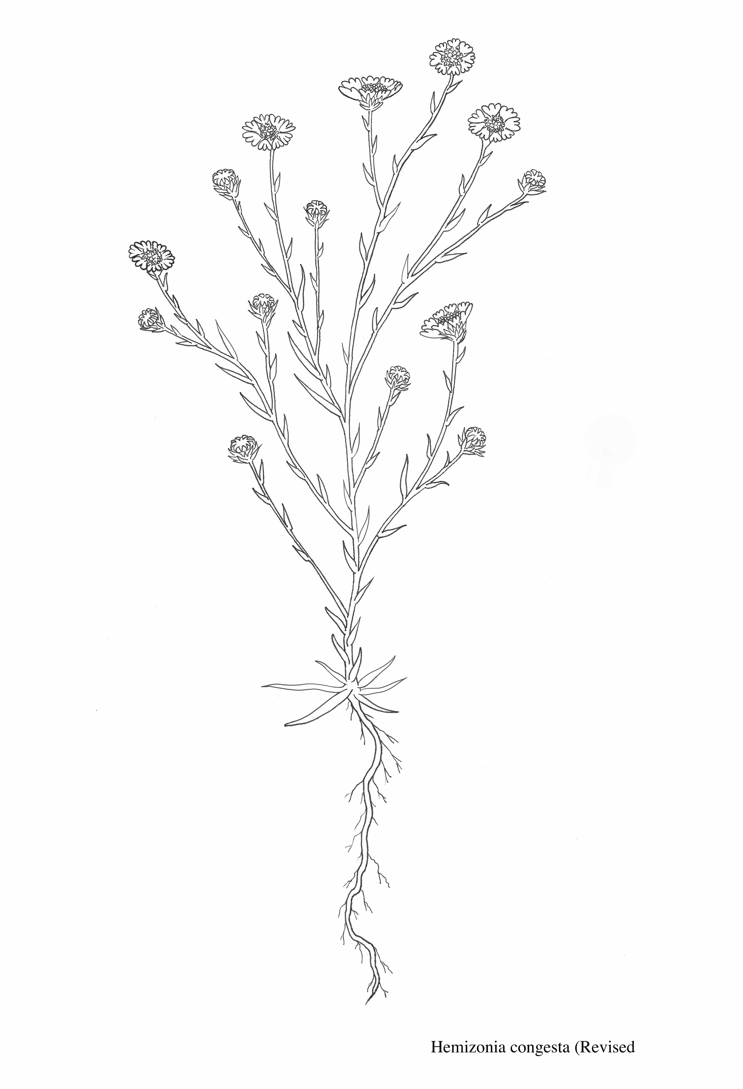
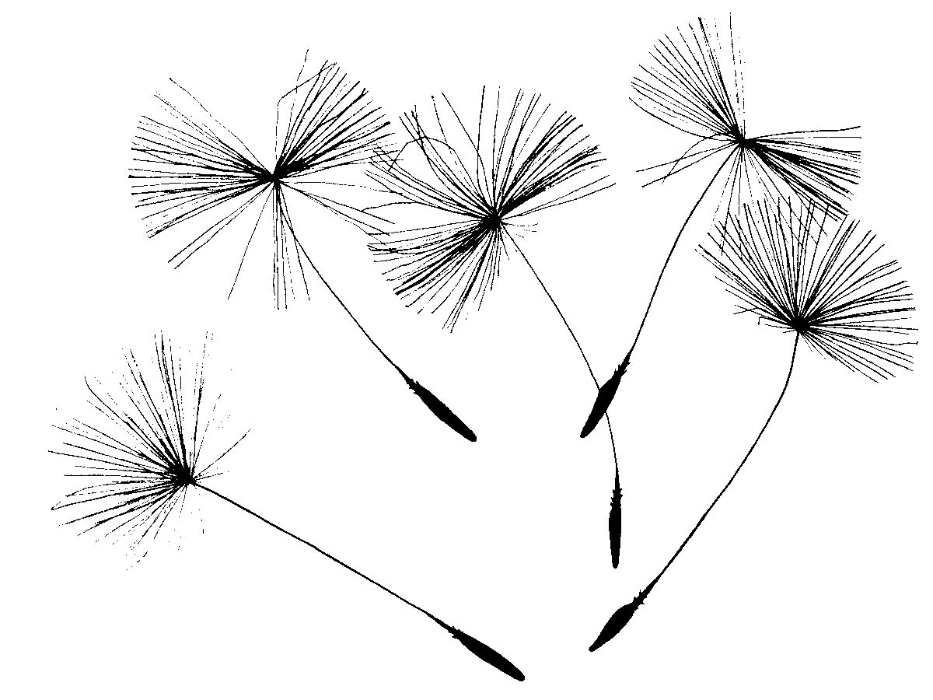
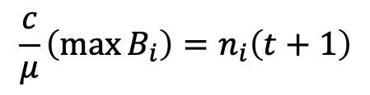
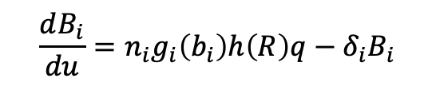
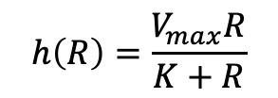
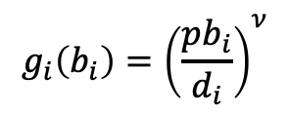
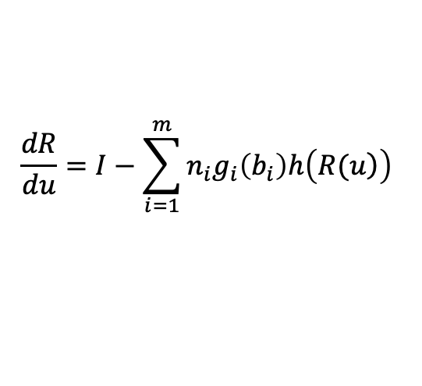
A)
B)
Growth Model
Reproduction
Loss
$$\frac{c}{μ}\left(\max{B_{i}}\right)=n_{i}\left(t+1\right)$$
Assimilation
Plant Biomass B(u)
$${\frac{dB_{i}}{du}=n}_{i}g_{i}\left(b_{i}\right)h\left(R\right)q−δ_{i}B_{i}$$
Root allocation
$$g_{i}\left(b_{i}\right)={\left(\frac{pb_{i}}{d_{i}}\right)}^{ν}$$
$$h\left(R\right)=\frac{V_{max}R}{K+R}$$
Seeds, n(t+1)
Soil Resources
R(u)
Soil Resources
R(u)
$$\frac{dR}{du}=I−\sum_{i=1}^{m}{n_{i}g_{i}\left(b_{i}\right)h\left(\left.R(u\right)\right)}$$
Notes:
So created a simulation model that captures some of these dynamics.
It explicitly tracks a single resource, which you could imagine is soil moisture. In this figure on the right you can see the resource is continually declining throughout the year.
Plants draw that resource down over time and it is never replenished--reflecting the lack of spring and summer rain in this system.
Plant growth, is shown in this lower figure on the right. You can see the growth trajectories of three different species shown in different colors. Species one is the earliest species shown in black, species two shown in red grows a little later into the season, and species three is the latest growing species shown in blue.
The differences in phenology and growth shown by these species are entirely due to just two parameters in the model, they have different maximum growth rates, r and different resource have saturation constants K.
Growth is given by this piecewise function shown here, where resource concentrations are great enough to ensure positive growth for that species the species grows, but when resource concentrations get below a certain level, then the growth can no longer be positive and I set growth to zero.
This determines the end point of each species growing season, at this point each species will reach it’s maximum biomass, and I make the assumption that this biomass is converted by some conversion function to seeds for the next year.

