Slide 1
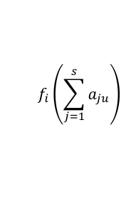

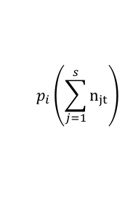
Growth/Survival
Adult Plants
Fecundity
Seeds
Seeds
$$p_{i}\left(\sum_{j=1}^{s}{n_{jt}}\right)$$
$$f_{i}\left(\sum_{j=1}^{s}{a_{ju}}\right)$$
n_{i,t}
a_{i,t}
n_{i,t+1}
$$n_{i,t+1} ∼{n_{i,t}g}_{i}(n_{i,t},n_{i,t}^{2},n_{i,t}n_{j,t})$$

Slide 2














$$n_{2}$$
$$n_{1}$$
$$t$$
$$n_{3}$$
$$f(n_{3})$$
$$\frac{n_{1t+1}}{n_{1}}\sim g(α_{12}n_{2}+β_{1(23) }n_{2}n_{3})$$
$$s_{2}$$
$$s_{1}$$
$$t+u$$
$$s_{3}$$
$$p(s_{2})$$
$$t+1$$
$$n_{3}$$
$$n_{2}$$
$$n_{1}$$

