Slide 1
Lab Meeting, June 2nd 2017
What are higher order interactions (HOI)?
Should we expect HOI’s among competing plants?

Slide 2
What are higher order interactions?
N₁
What’s the population growth rate of N₁?

Slide 3
What are higher order interactions?

Slide 4
What are higher order interactions?

Slide 5
What are higher order interactions?

Slide 6
What are higher order interactions?

Slide 7
What are higher order interactions?

Slide 8
Why would we see HOI?

Slide 9
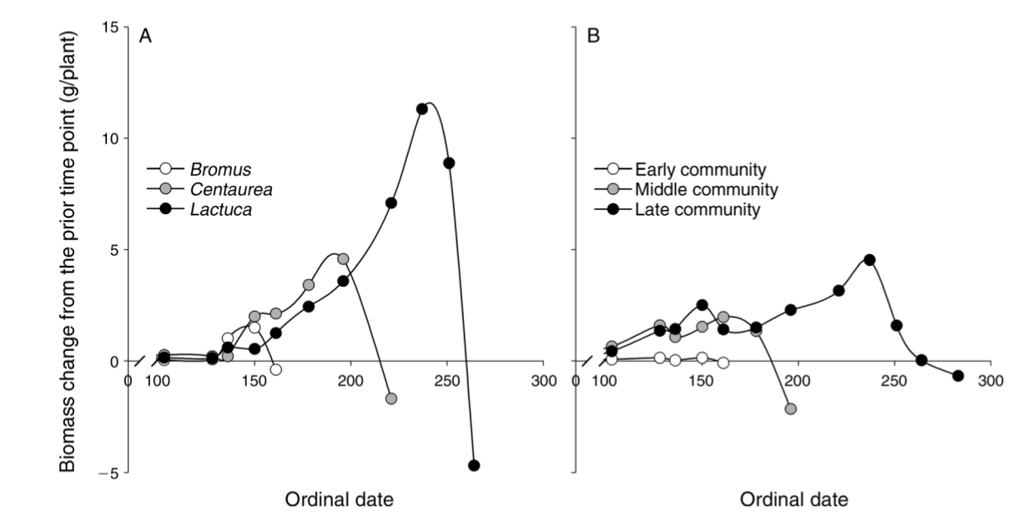
Phenology and competition at Sedgwick
Godoy, O., and J. M. Levine. 2013. Phenology effects on invasion success: insights from coupling field experiments to coexistence theory. Ecology 95:726–736.

Slide 10
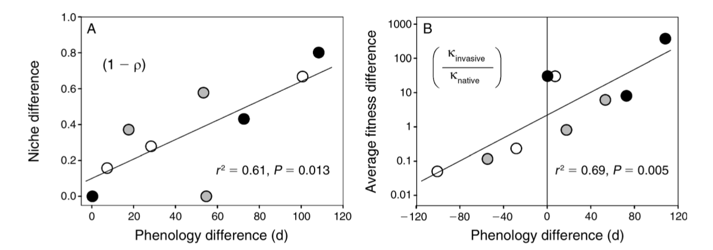
Phenology and competition at Sedgwick
Godoy, O., and J. M. Levine. 2013. Phenology effects on invasion success: insights from coupling field experiments to coexistence theory. Ecology 95:726–736.

Slide 11
Phenology and competition at Sedgwick
Observation 1: Phenological overlap influences competition.
Observation 2: Competition can shift species phenology.
  Species tend to flower earlier in response to competition.
Hypothesis: HOI could emerge from shifts in species’ phenology

Slide 12
Can we model this process?

Slide 13
Seasonal soil moisture
Soil Volume
Soil Moisture
Early
Mid
Late

Slide 14



Three species community
Soil Moisture
Early: N1
Mid:
N2
Late:
N3

Slide 15
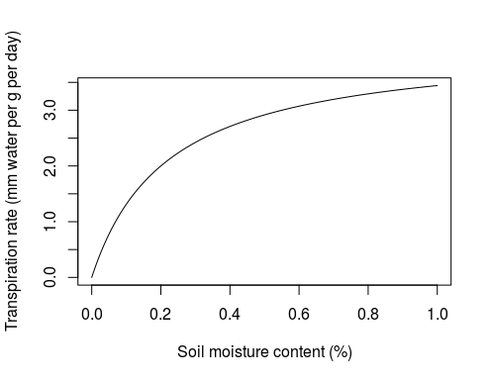
Transpiration rate, R = Soil Moisture

Slide 16
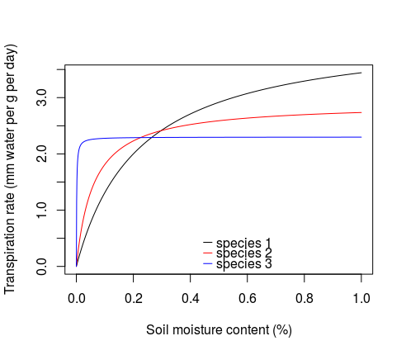
Transpiration rate, R = Soil Moisture
Species 1 = early
Species 2 = mid
Species 3 = late

Slide 17
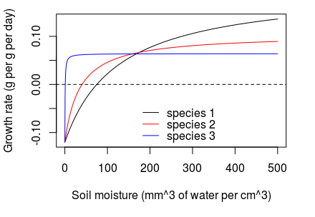
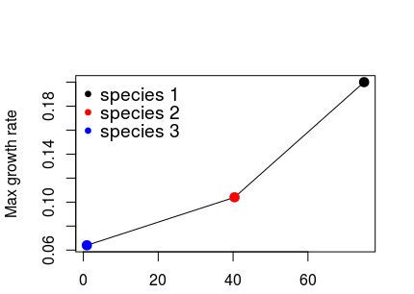
Growth rate depends on transpiration
Trade off between maximum growth rate and for water

Slide 18
Transpiration and growth switches off when plants can no longer grow.
This occurs when soil moisture reaches
Soil Water
Early: N1
Mid:
N2
Late:
N3

Slide 19
Transpiration rate
Growth is transpiration multiplied by water use efficiency (q) minus biomass loss due to tissue loss and respiration (m)
Soil moisture is lost to evaporation (ε) and to water lost to transpiration
Number of seeds produced is the total biomass at time of flowering multiplied by a seed conversion factor (c)

Slide 20
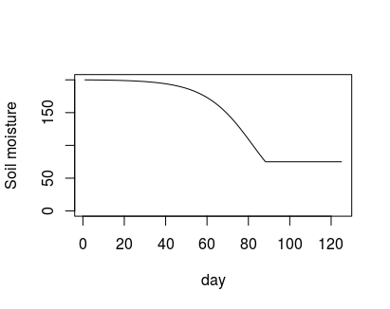
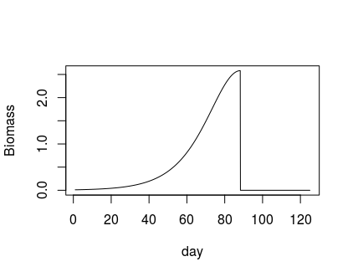
R*
Peak biomass/flowering

Slide 21
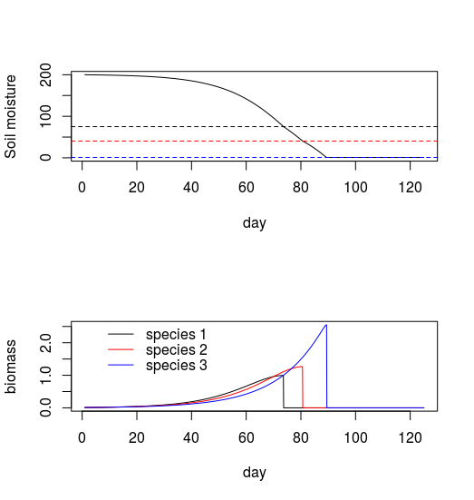
Species with smaller have later phenology

Slide 22
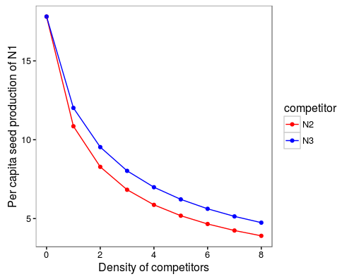
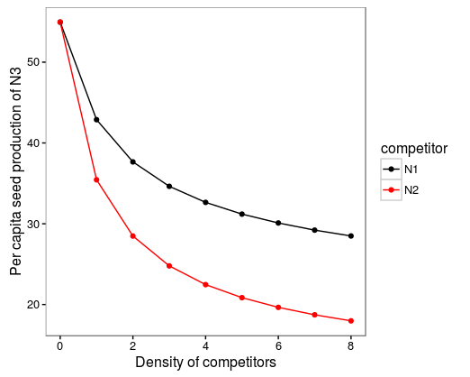
Interspecific competition

Slide 23
Phenology and competition at Sedgwick
Observation 1: Phenological overlap influences competition.
Observation 2: Competition can shift species phenology.
  Species tend to flower earlier in response to competition.
Hypothesis: HOI could emerge from shifts in species’ phenology

Slide 24
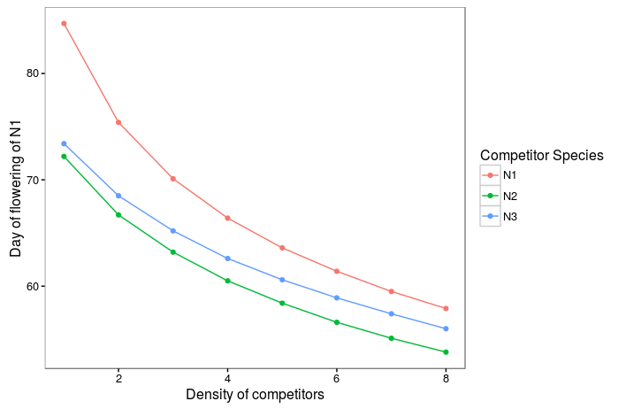
Phenology

Slide 25
Phenology and competition at Sedgwick
Observation 1: Phenological overlap influences competition.
Observation 2: Competition can shift species phenology.
  Species tend to flower earlier in response to competition.
Hypothesis: HOI could emerge from shifts in species’ phenology

Slide 26
Do HOI’s emerge?
Simulate two species competition.
Fit an annual plant model with pairwise competition coefficients.
Simulate THREE species competition.
Can we predict outcome from pairwise competition coefficients fit in step 2.

Slide 27
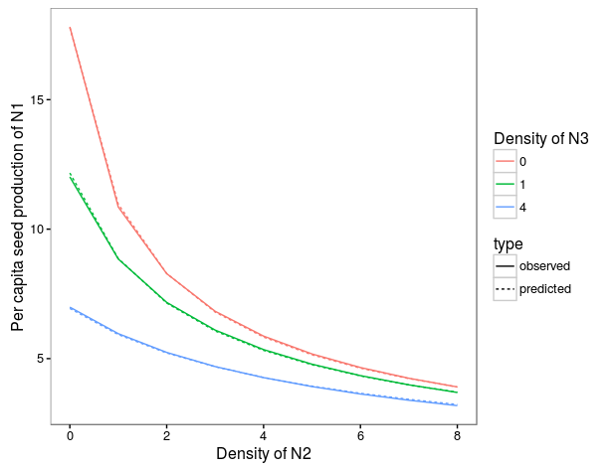
HOI effects on N1

Slide 28
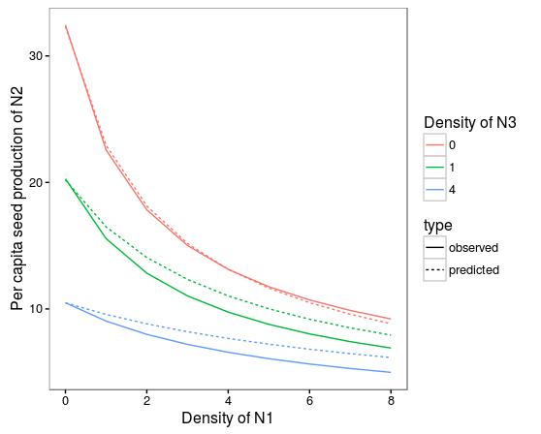
HOI effects on N2

Slide 29
HOI effects on N2

Slide 30
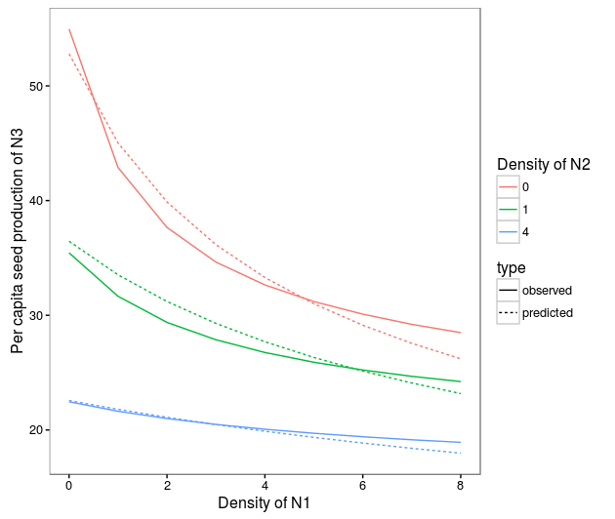
HOI effects on N3

Slide 31
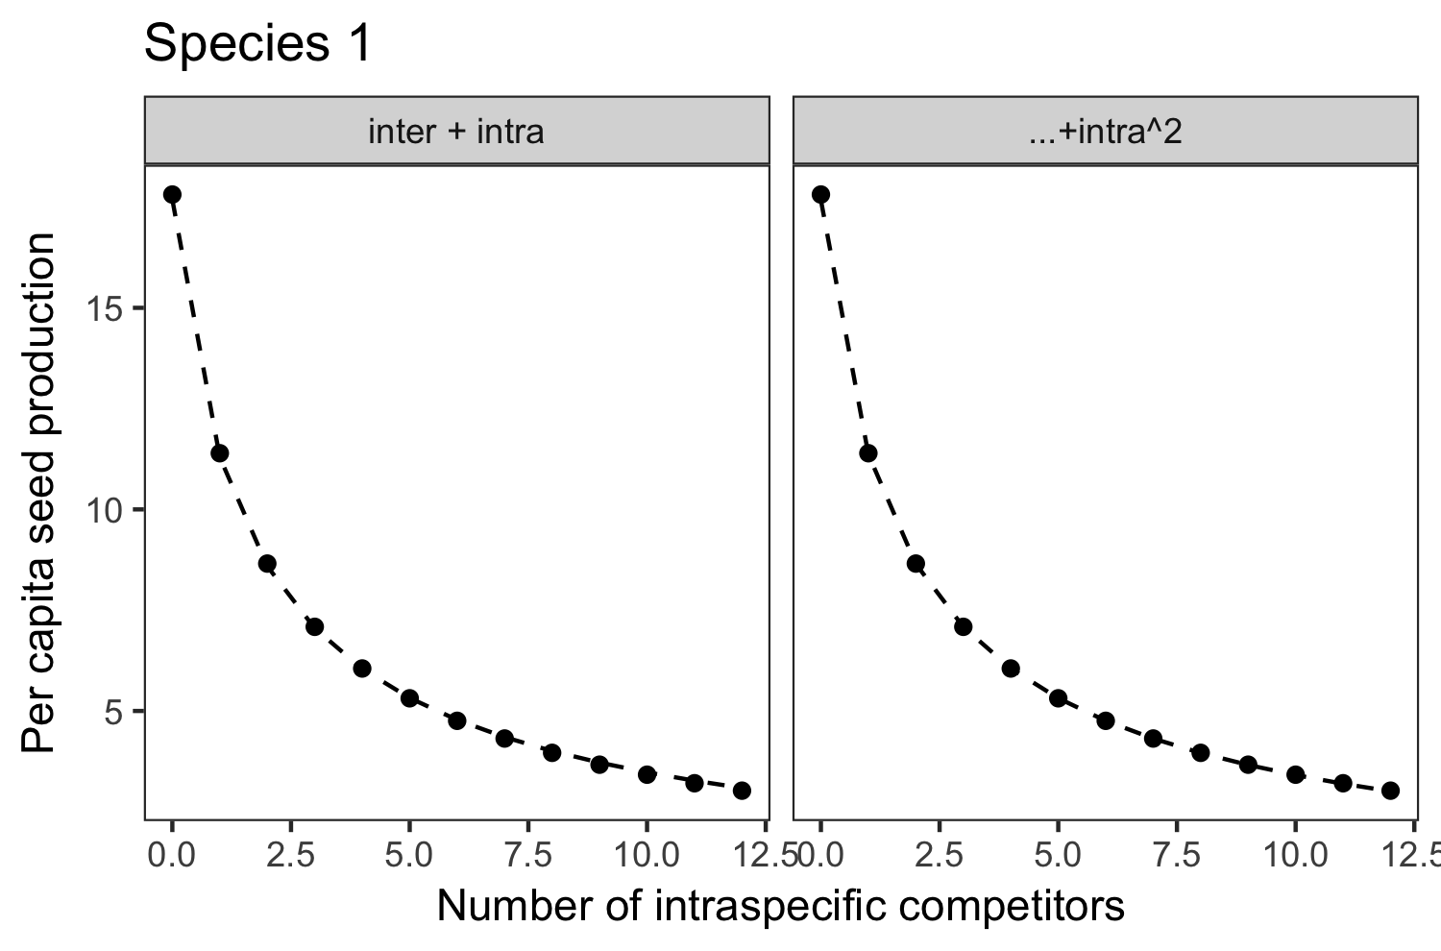
Intra

Slide 32
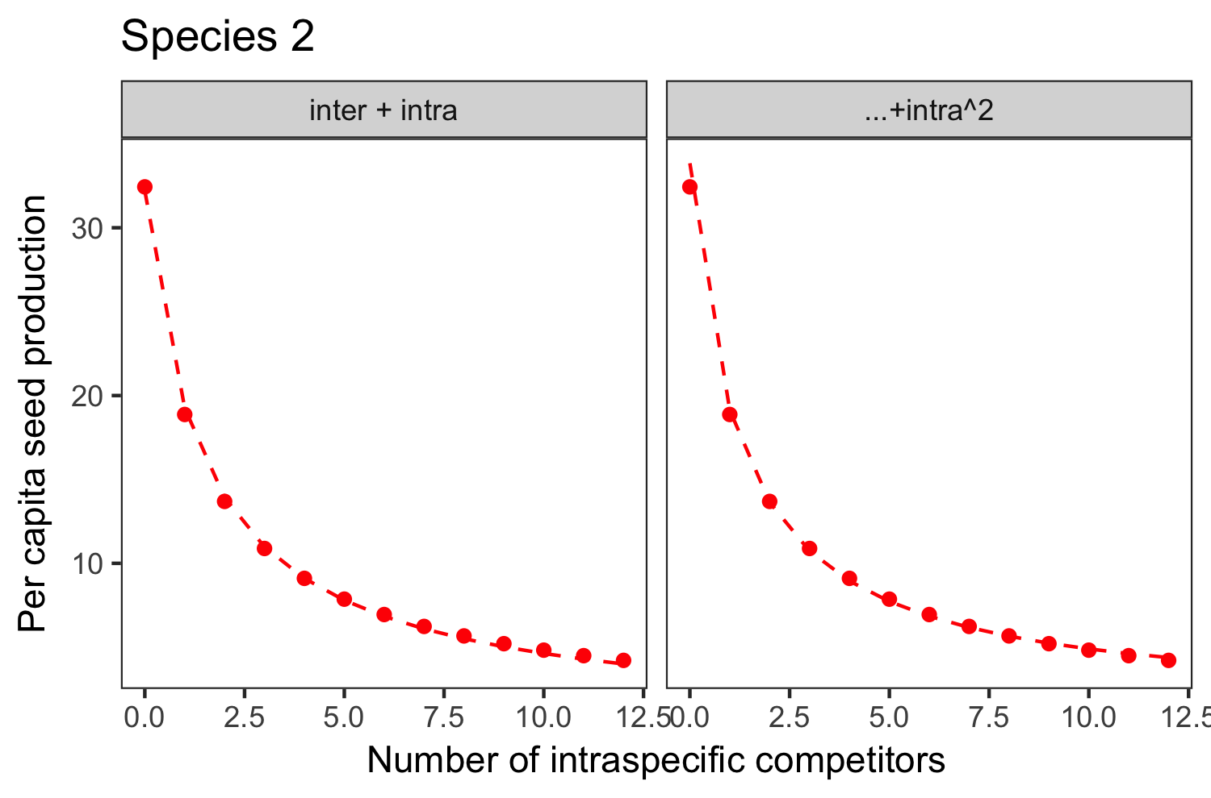
Intra

Slide 33
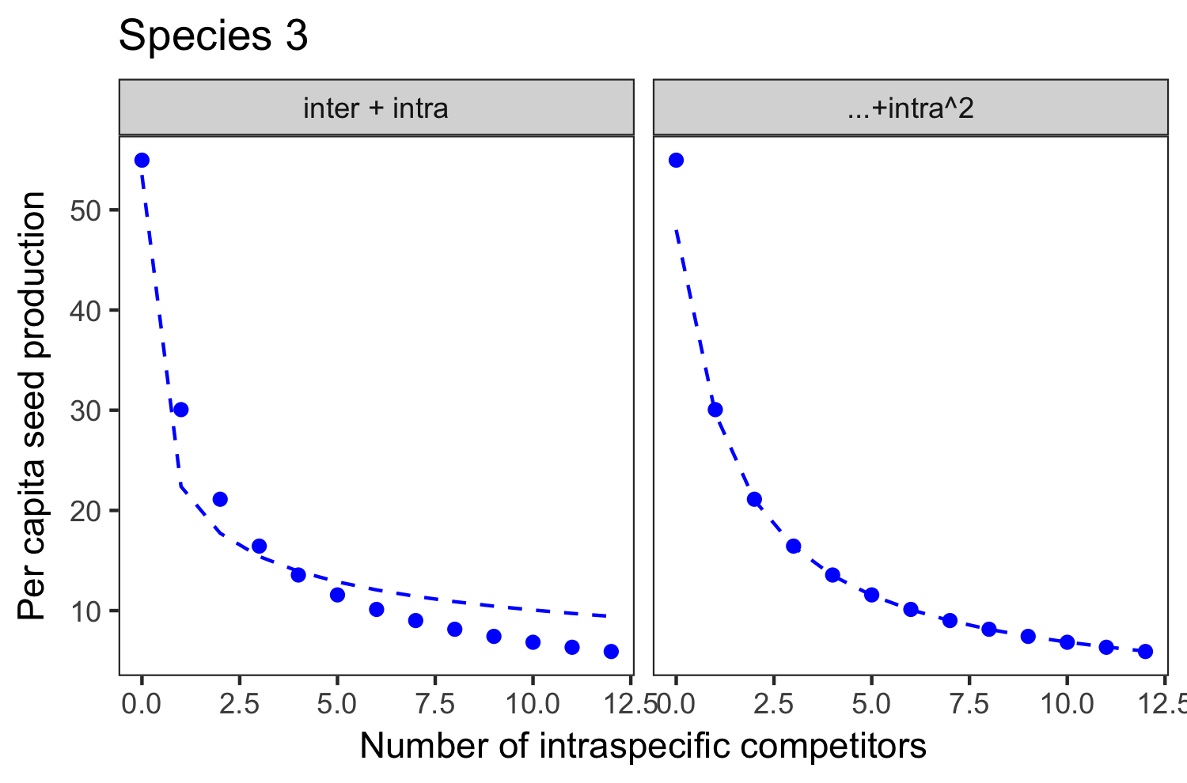
Intra

Slide 34
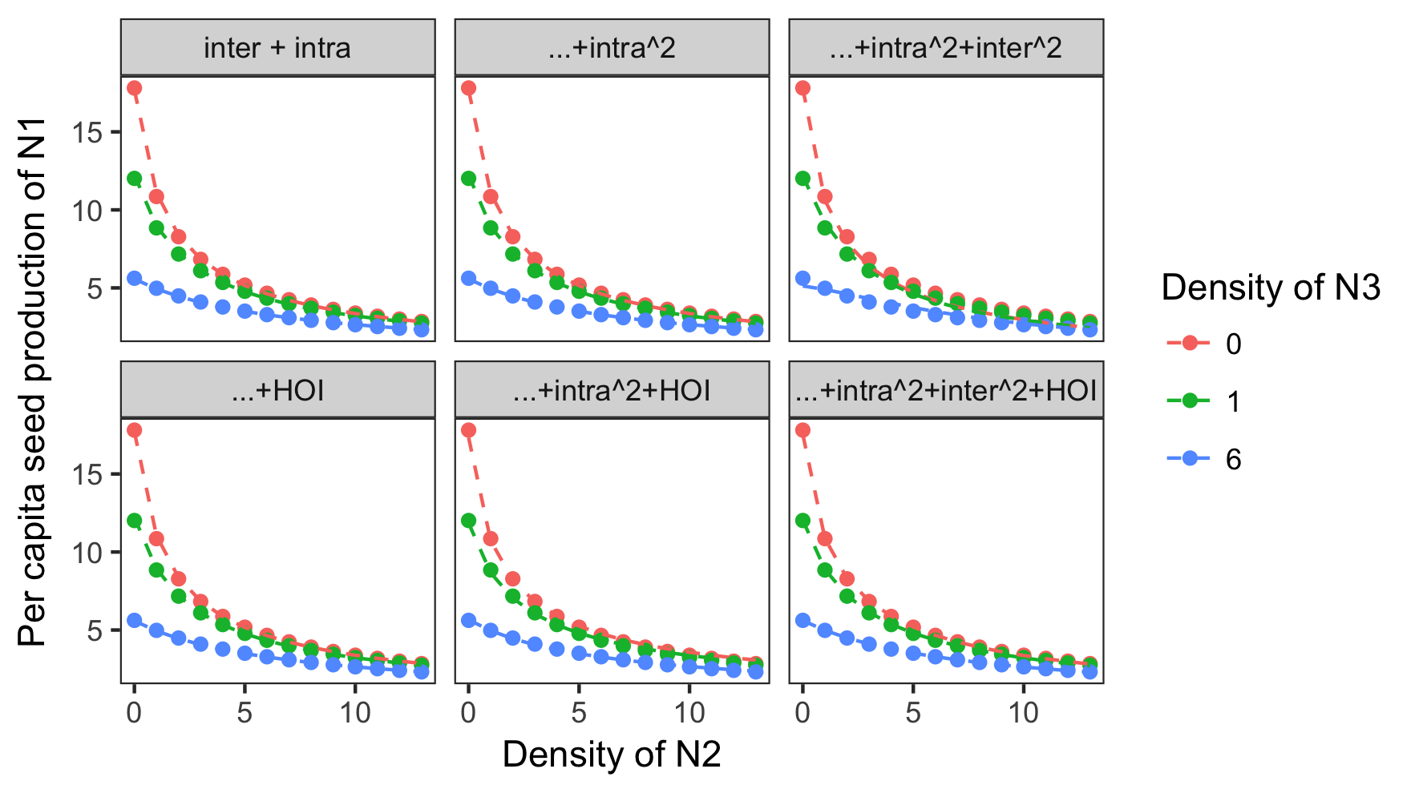
Inter

Slide 35
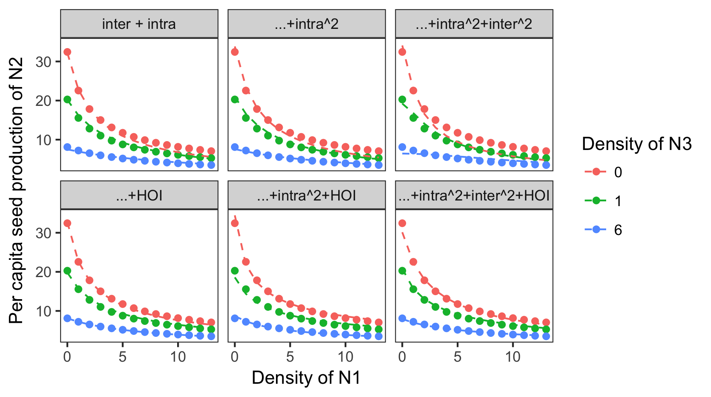
Inter

Slide 36
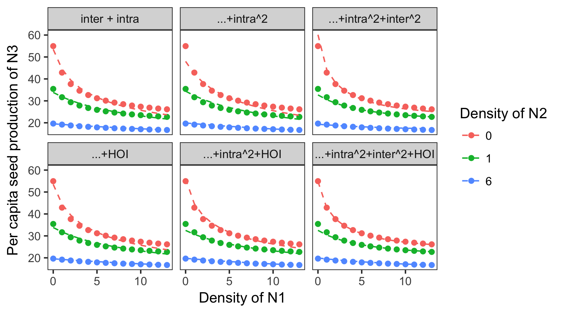
Inter

Slide 37
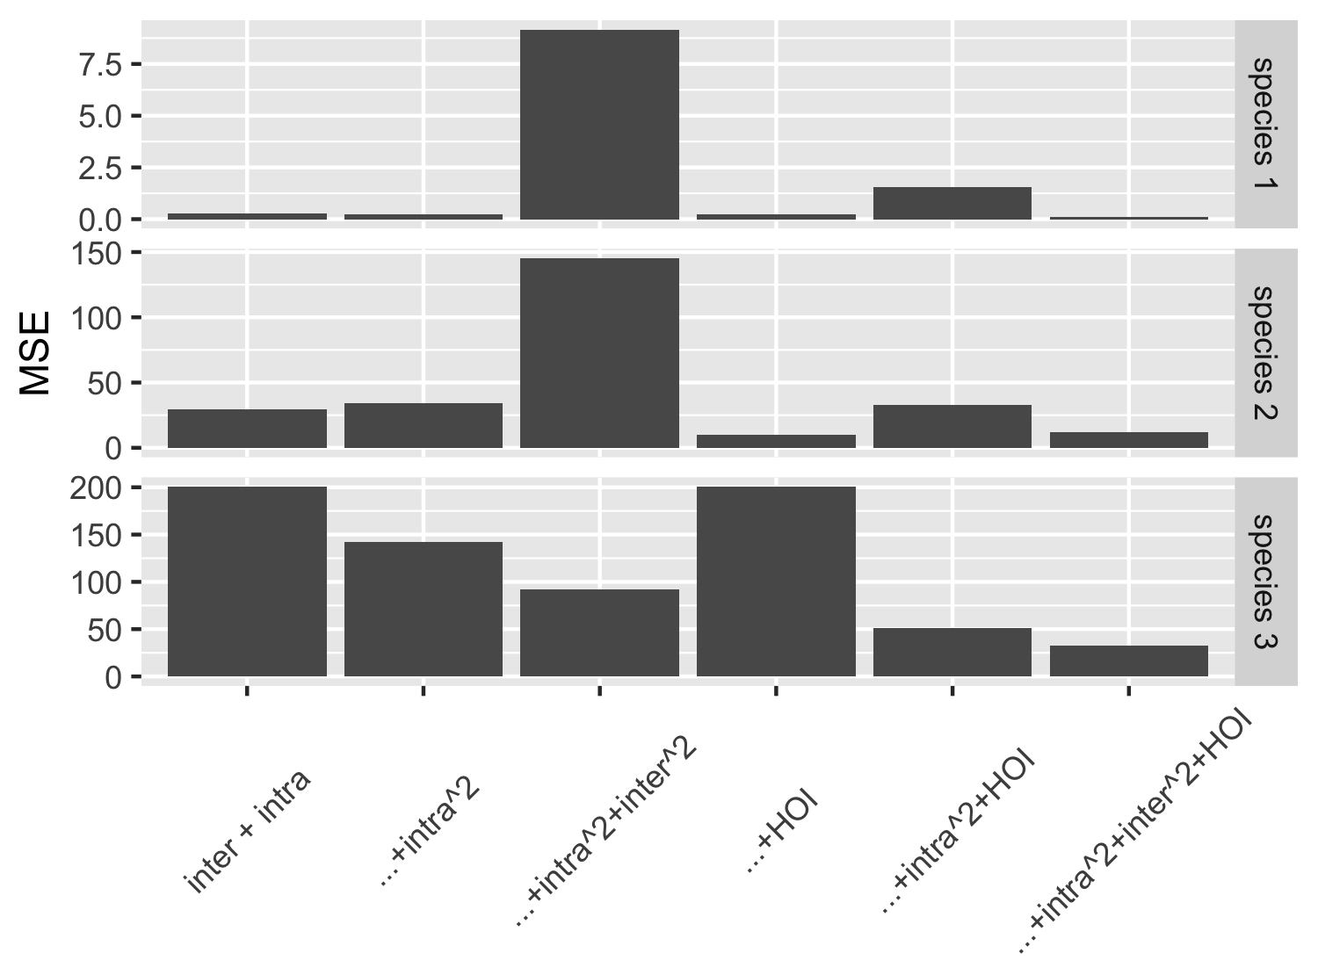
Model Fit

