Slide 1
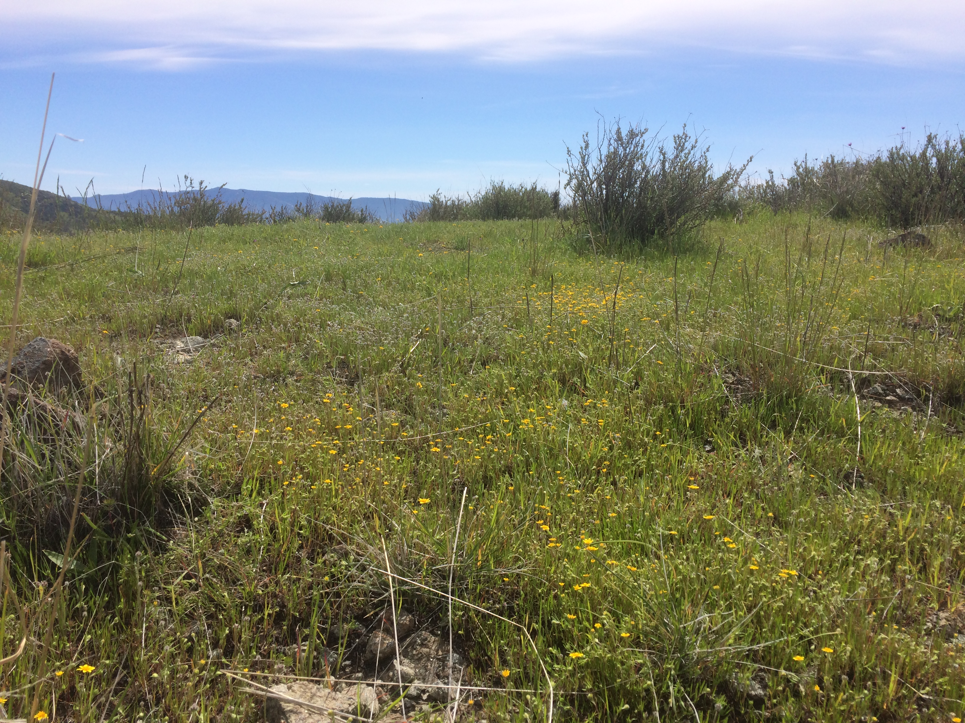
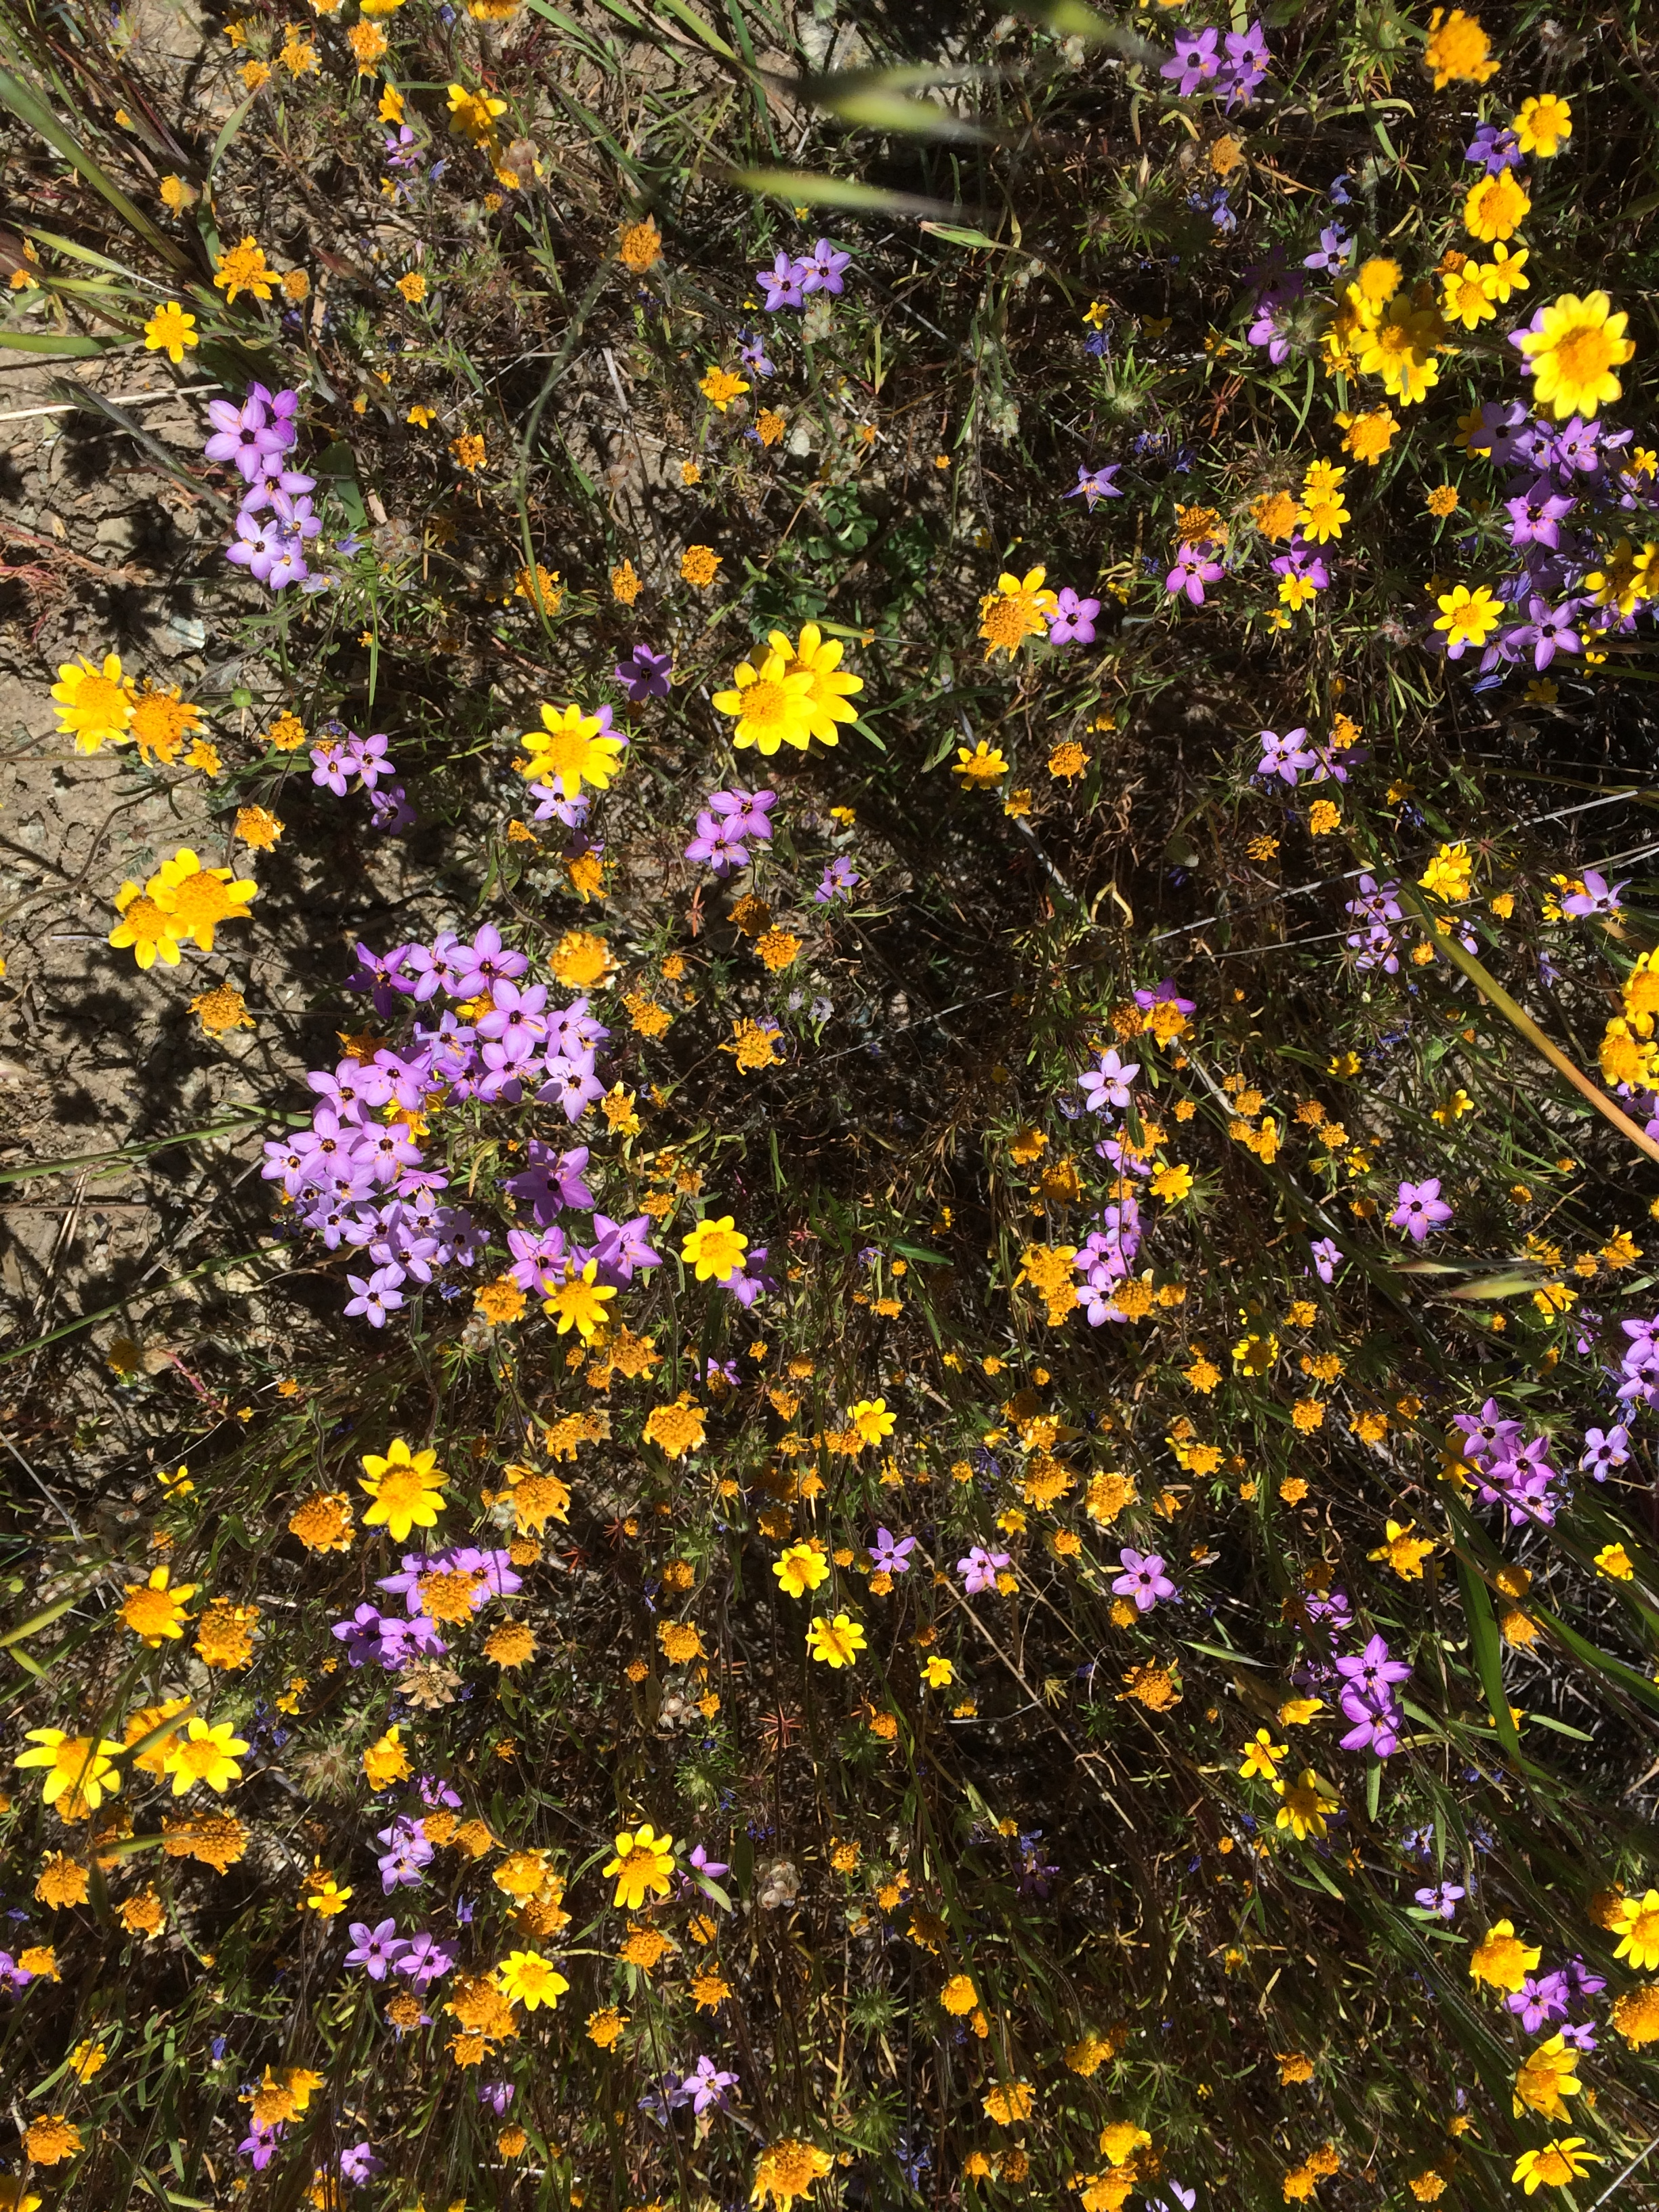
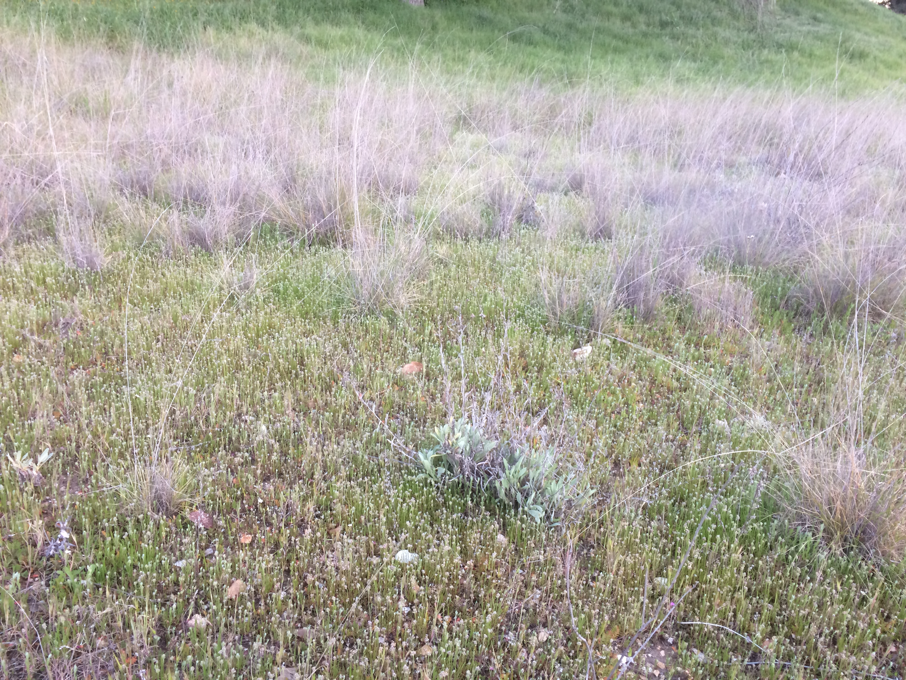
Species Composition in Sedgwick Annual Plant Communities

Slide 2
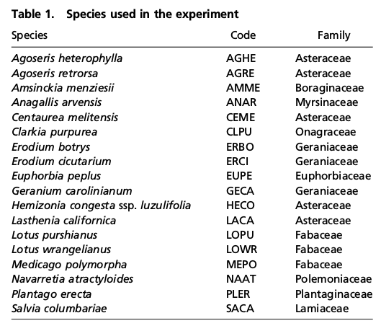
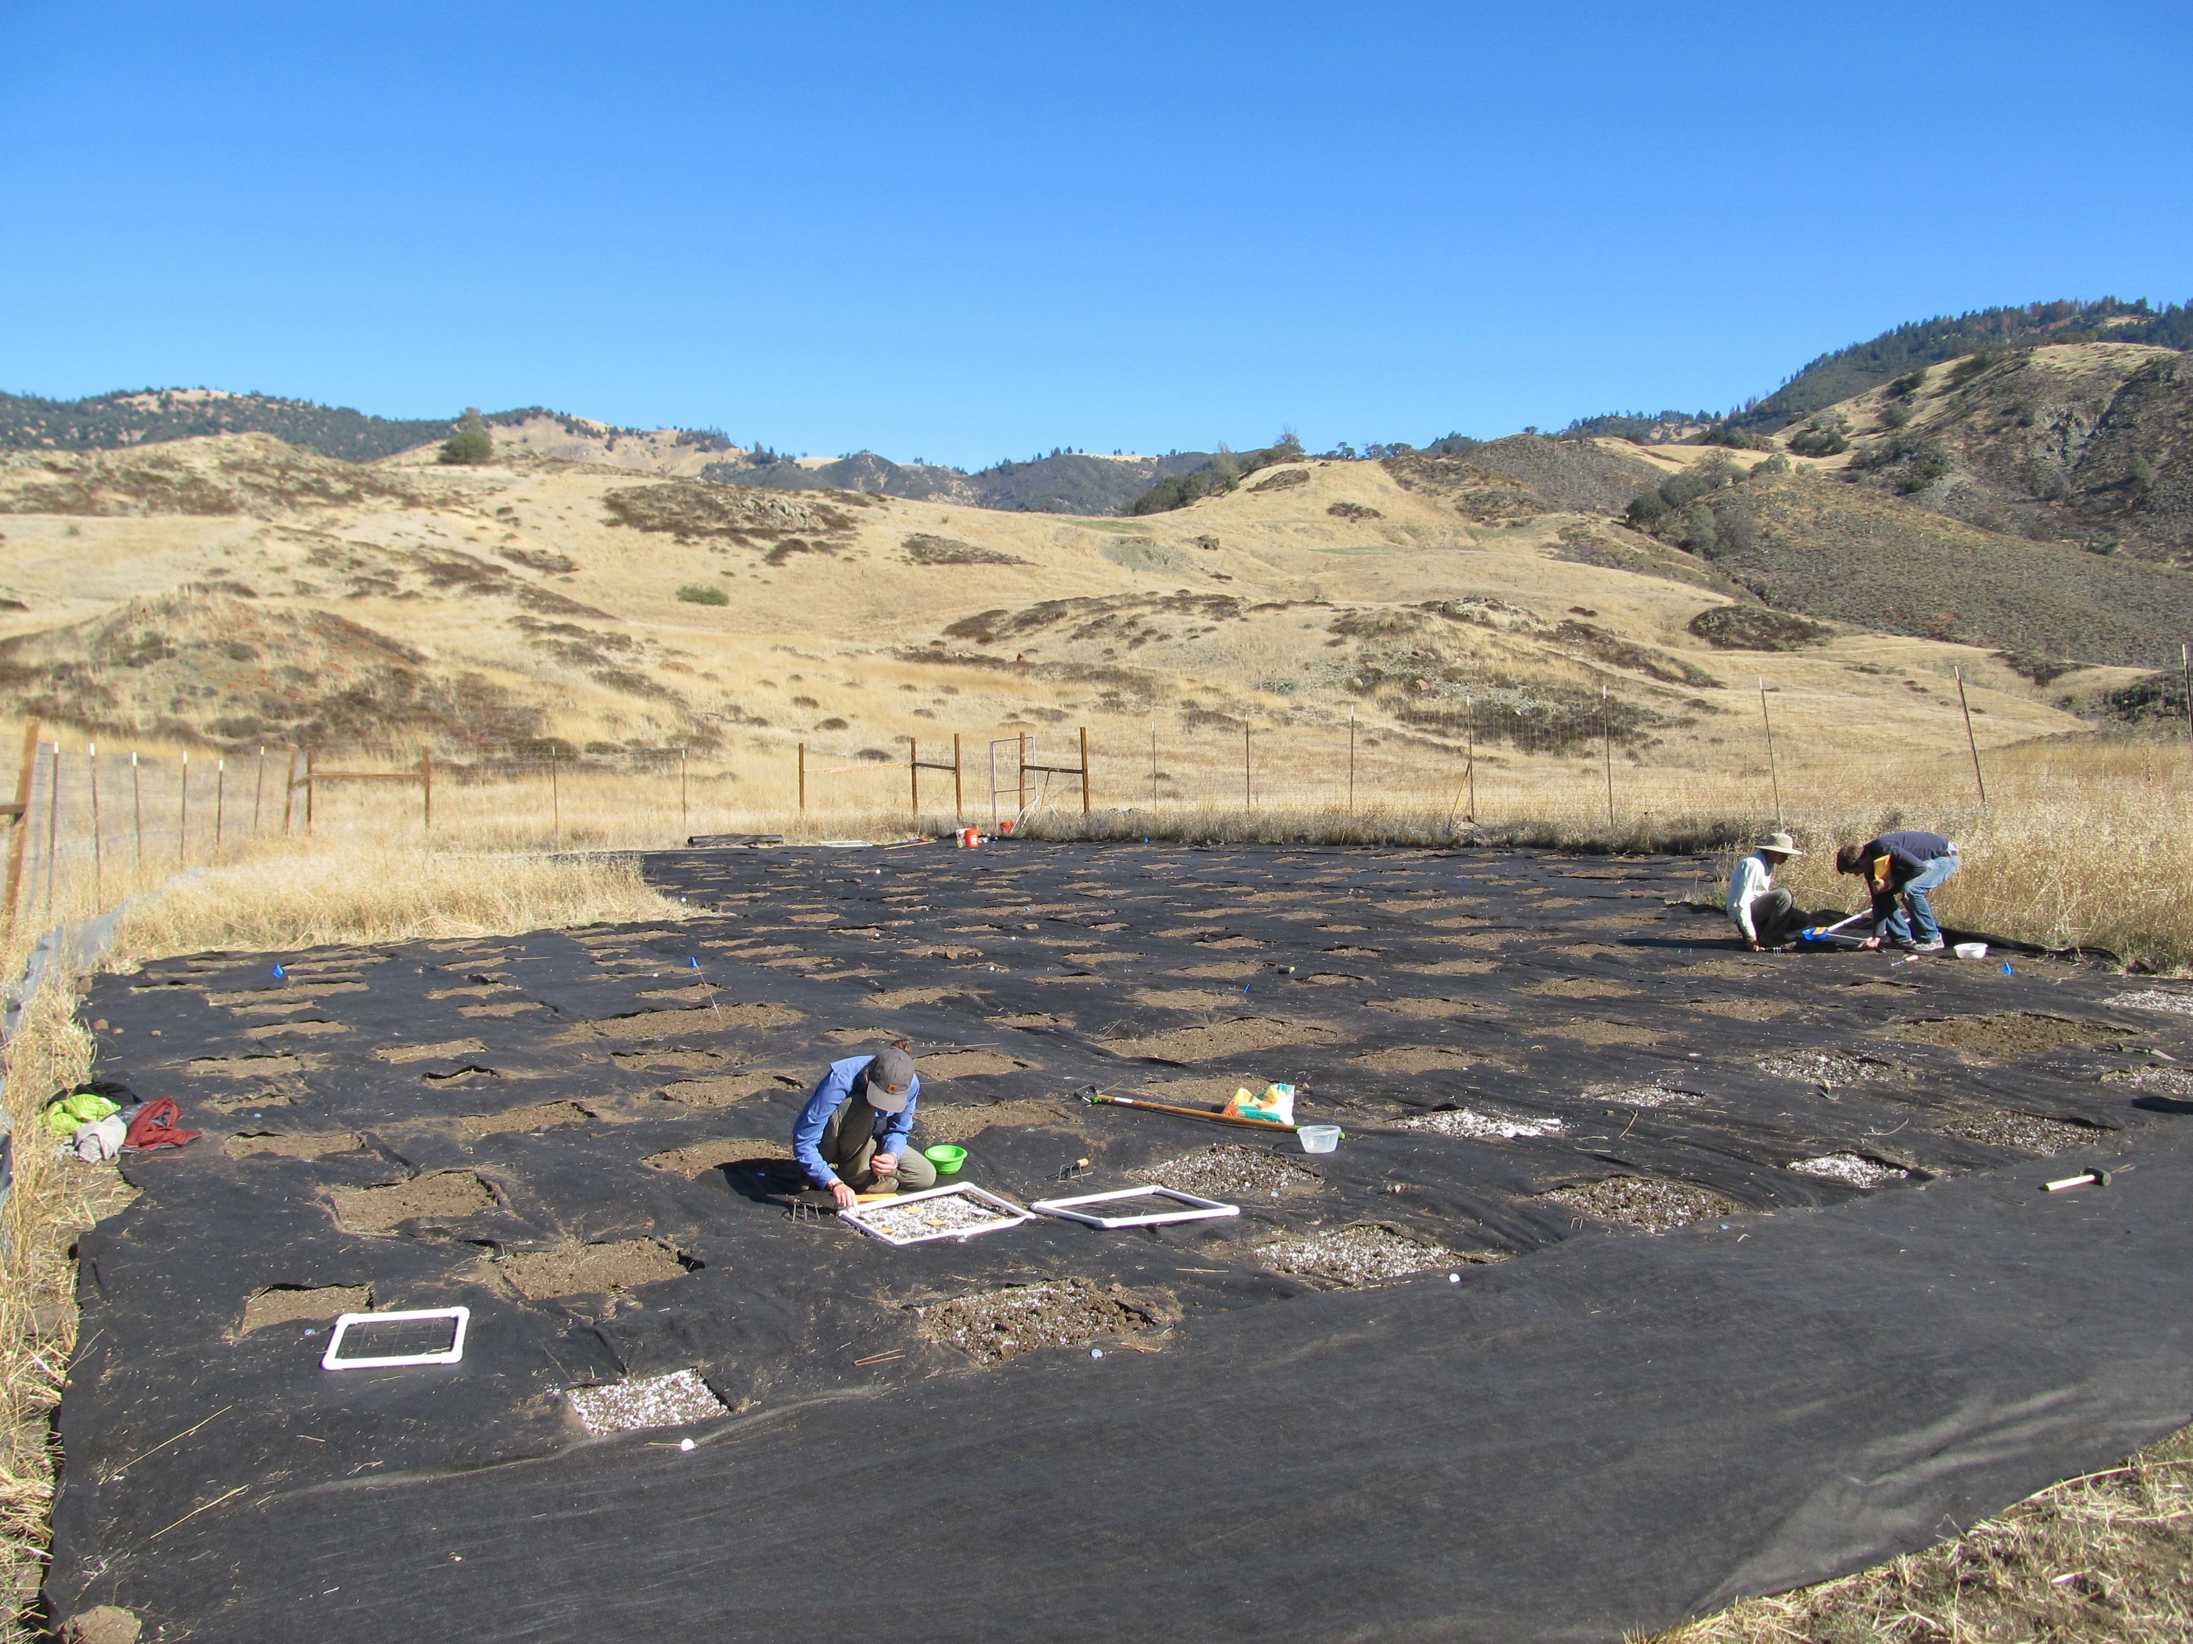
Experimental Communities

Slide 3
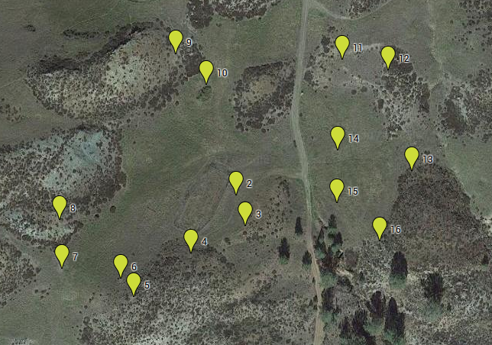
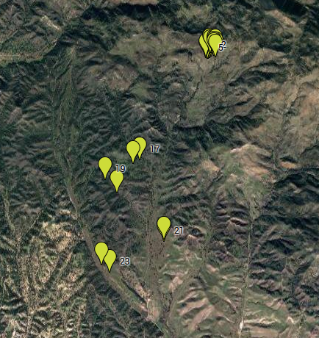
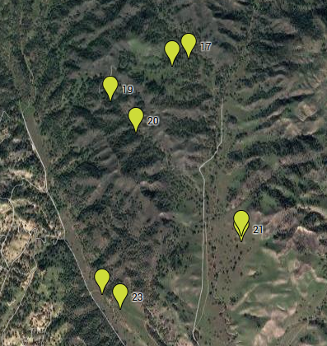
24 Common Gardens at Sedgwick
Upper Plots
Lower Plots

Slide 4
Community Sampling
5 subplots per plot
Subplot (0.5 x 0.5 m)
10 m Transect
“Microplot” 15 x 15 cm

Slide 5
Questions
What is the natural species composition at each of the 24 common garden plots?
How often do species used in experiments co-occur?
How do trait means and variances change across the landscape?

Slide 6
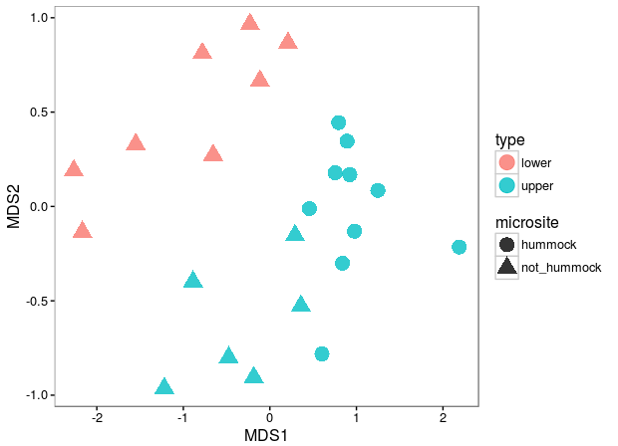
NMDS Ordination of Species Composition
Stress = 0.11

Slide 7
Upper Sites

Slide 8
NMDS Ordination of Species Composition
Stress = 0.11
9
10

Slide 9
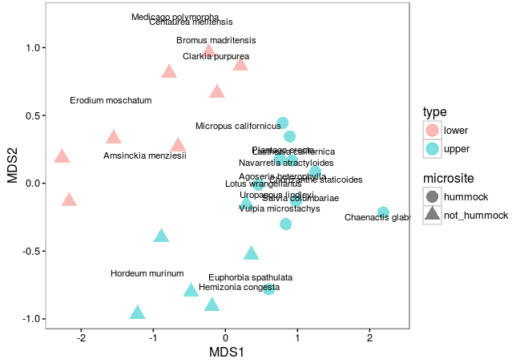
Focal Species
Stress = 0.11

Slide 10
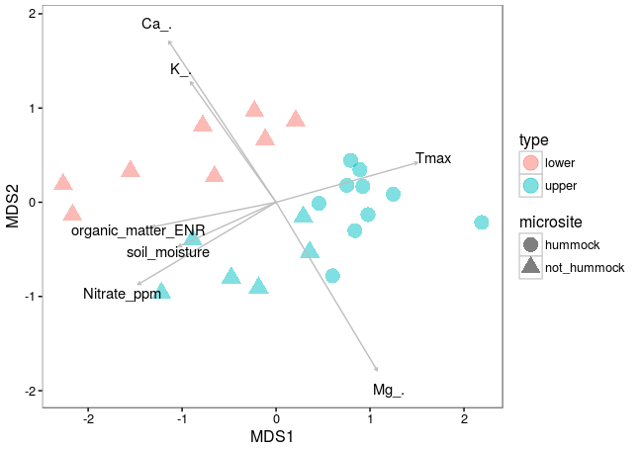
Environmental Factors

Slide 11
How do traits change along these gradients?

Slide 12
How often do focal species co-occur?
plot > subplot > microplot

Slide 13
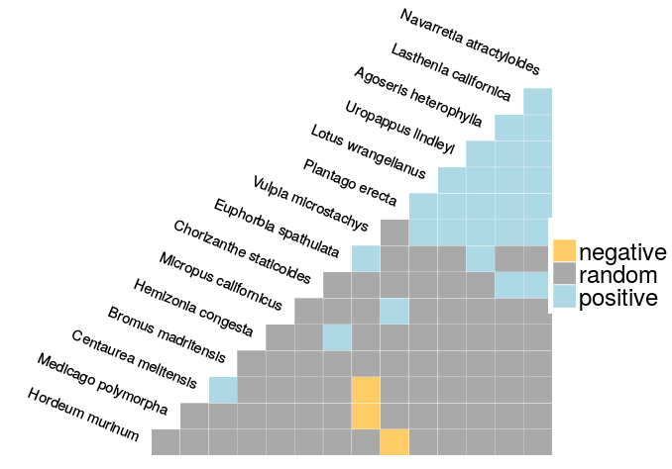
Focal species co-occurence
All plots
Plot level

Slide 14
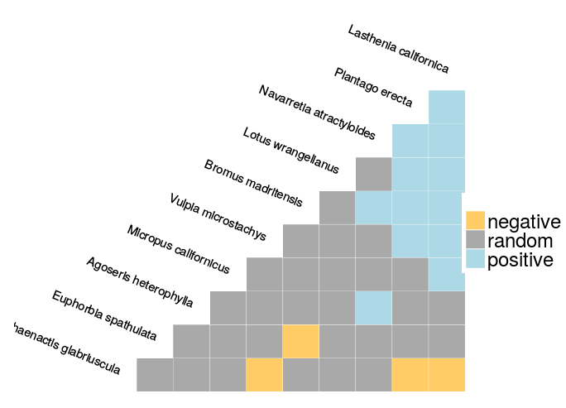
Focal species co-occurence
Only Hummocks
Microplot level

Slide 15
Do niche and fitness differences predict which species show positive co-occurrence at the microplot scale?

Slide 16
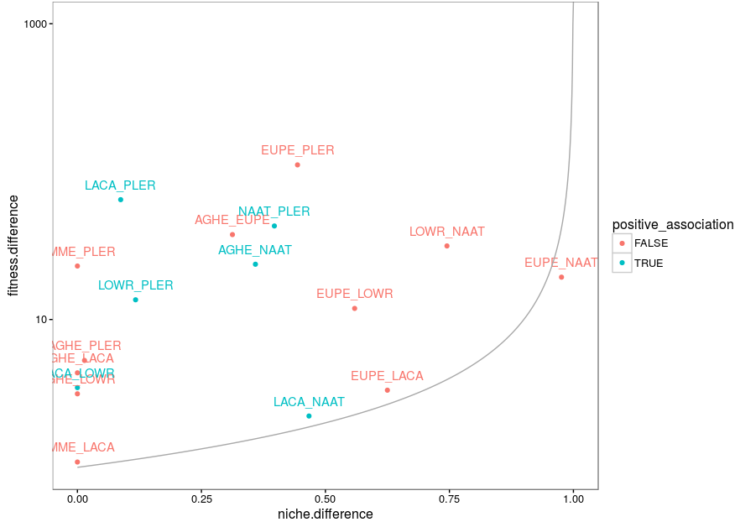
Hummock plots
Microplot

Slide 17
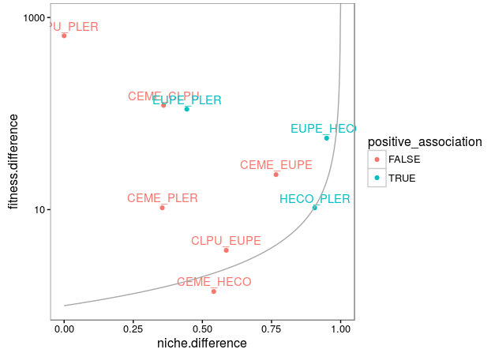
Non-hummock plots
Microplot

