Slide 1
Goals for this project
Link traits to changes in species composition across environmental gradients
Link trait differences to competitive coexistence
  Eventually
Mechanistically!

Slide 2
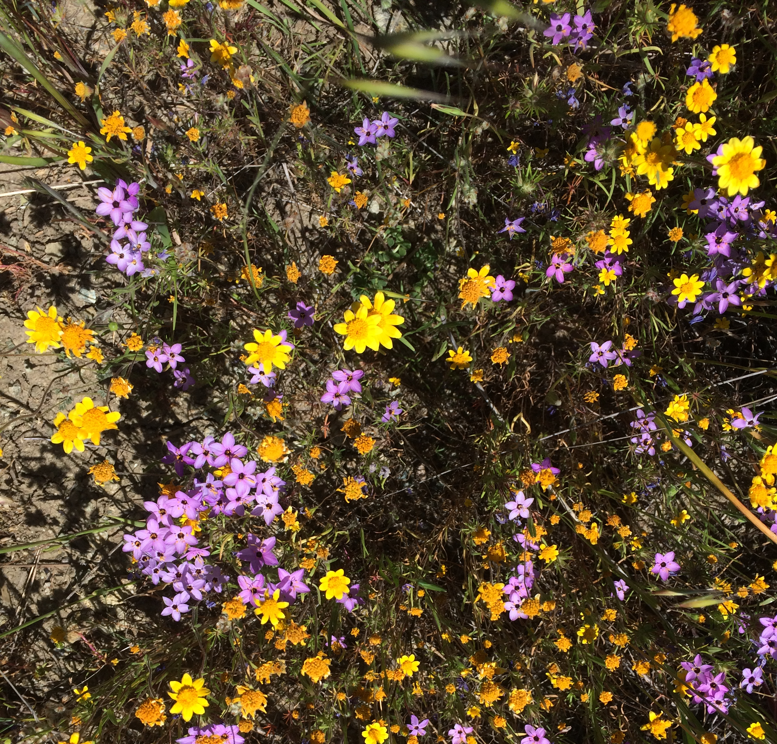
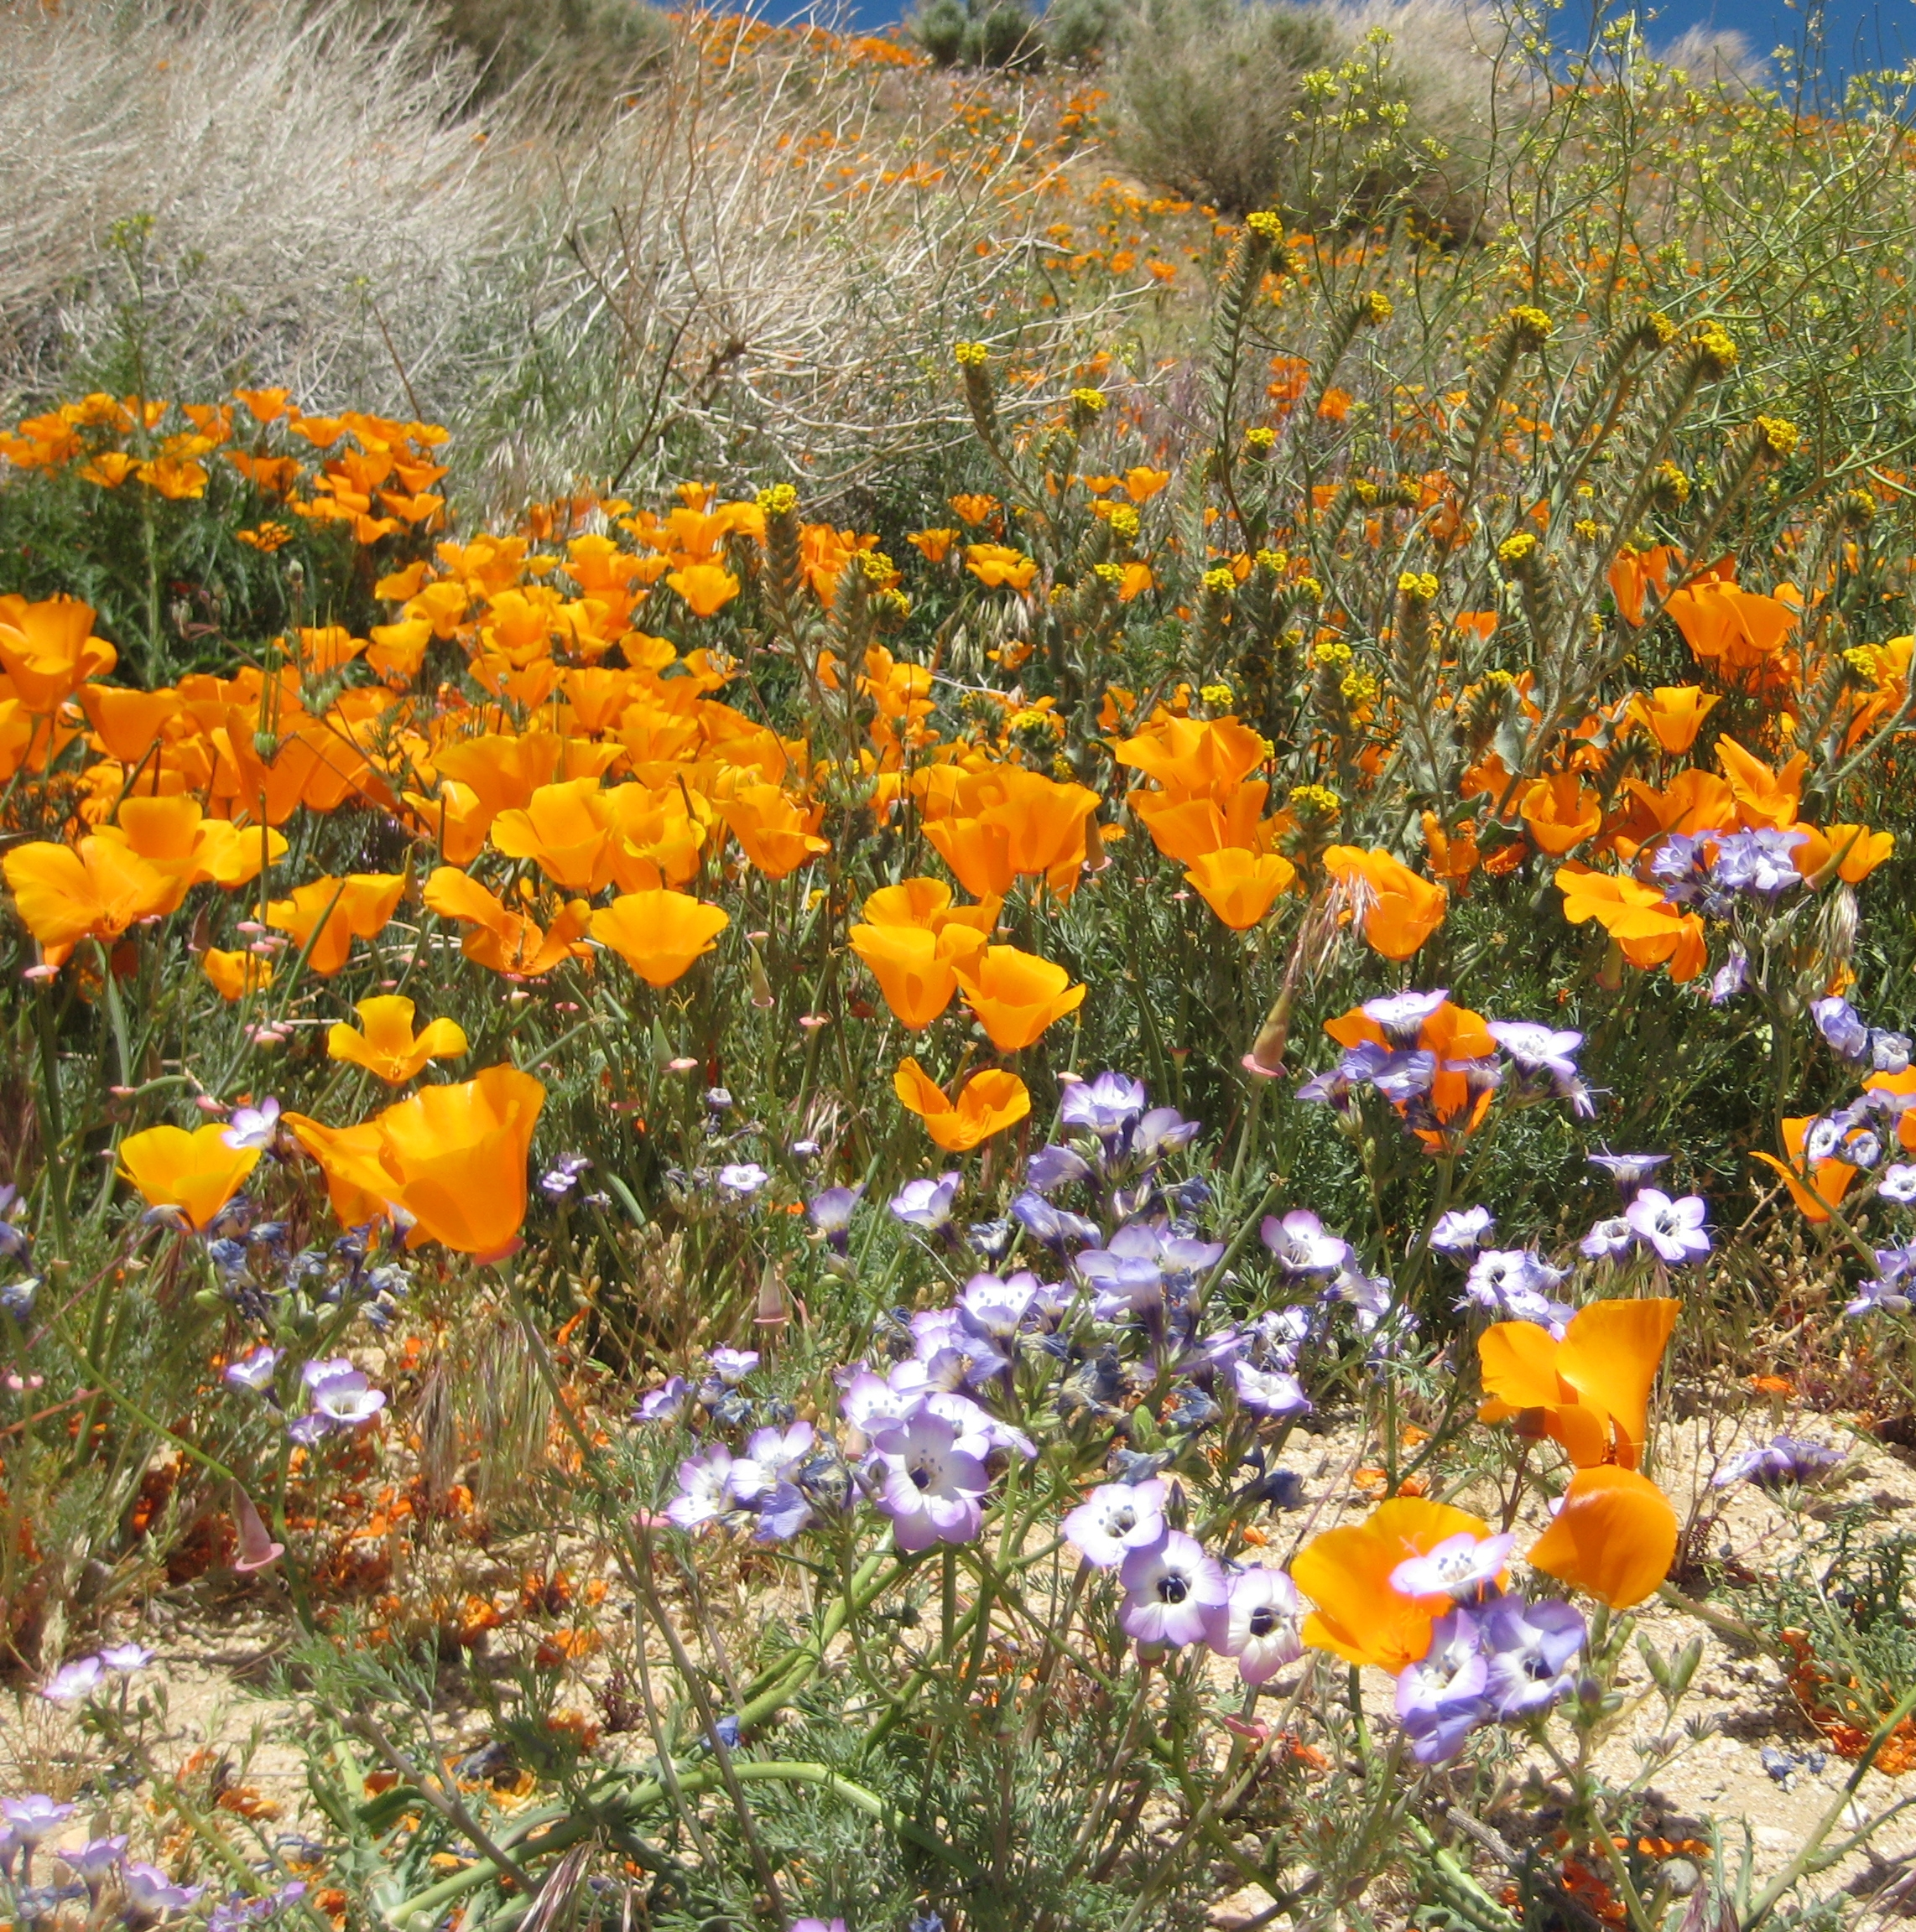
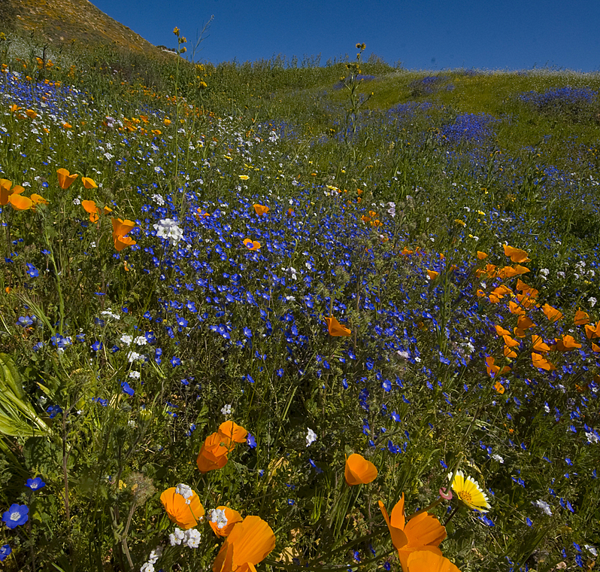
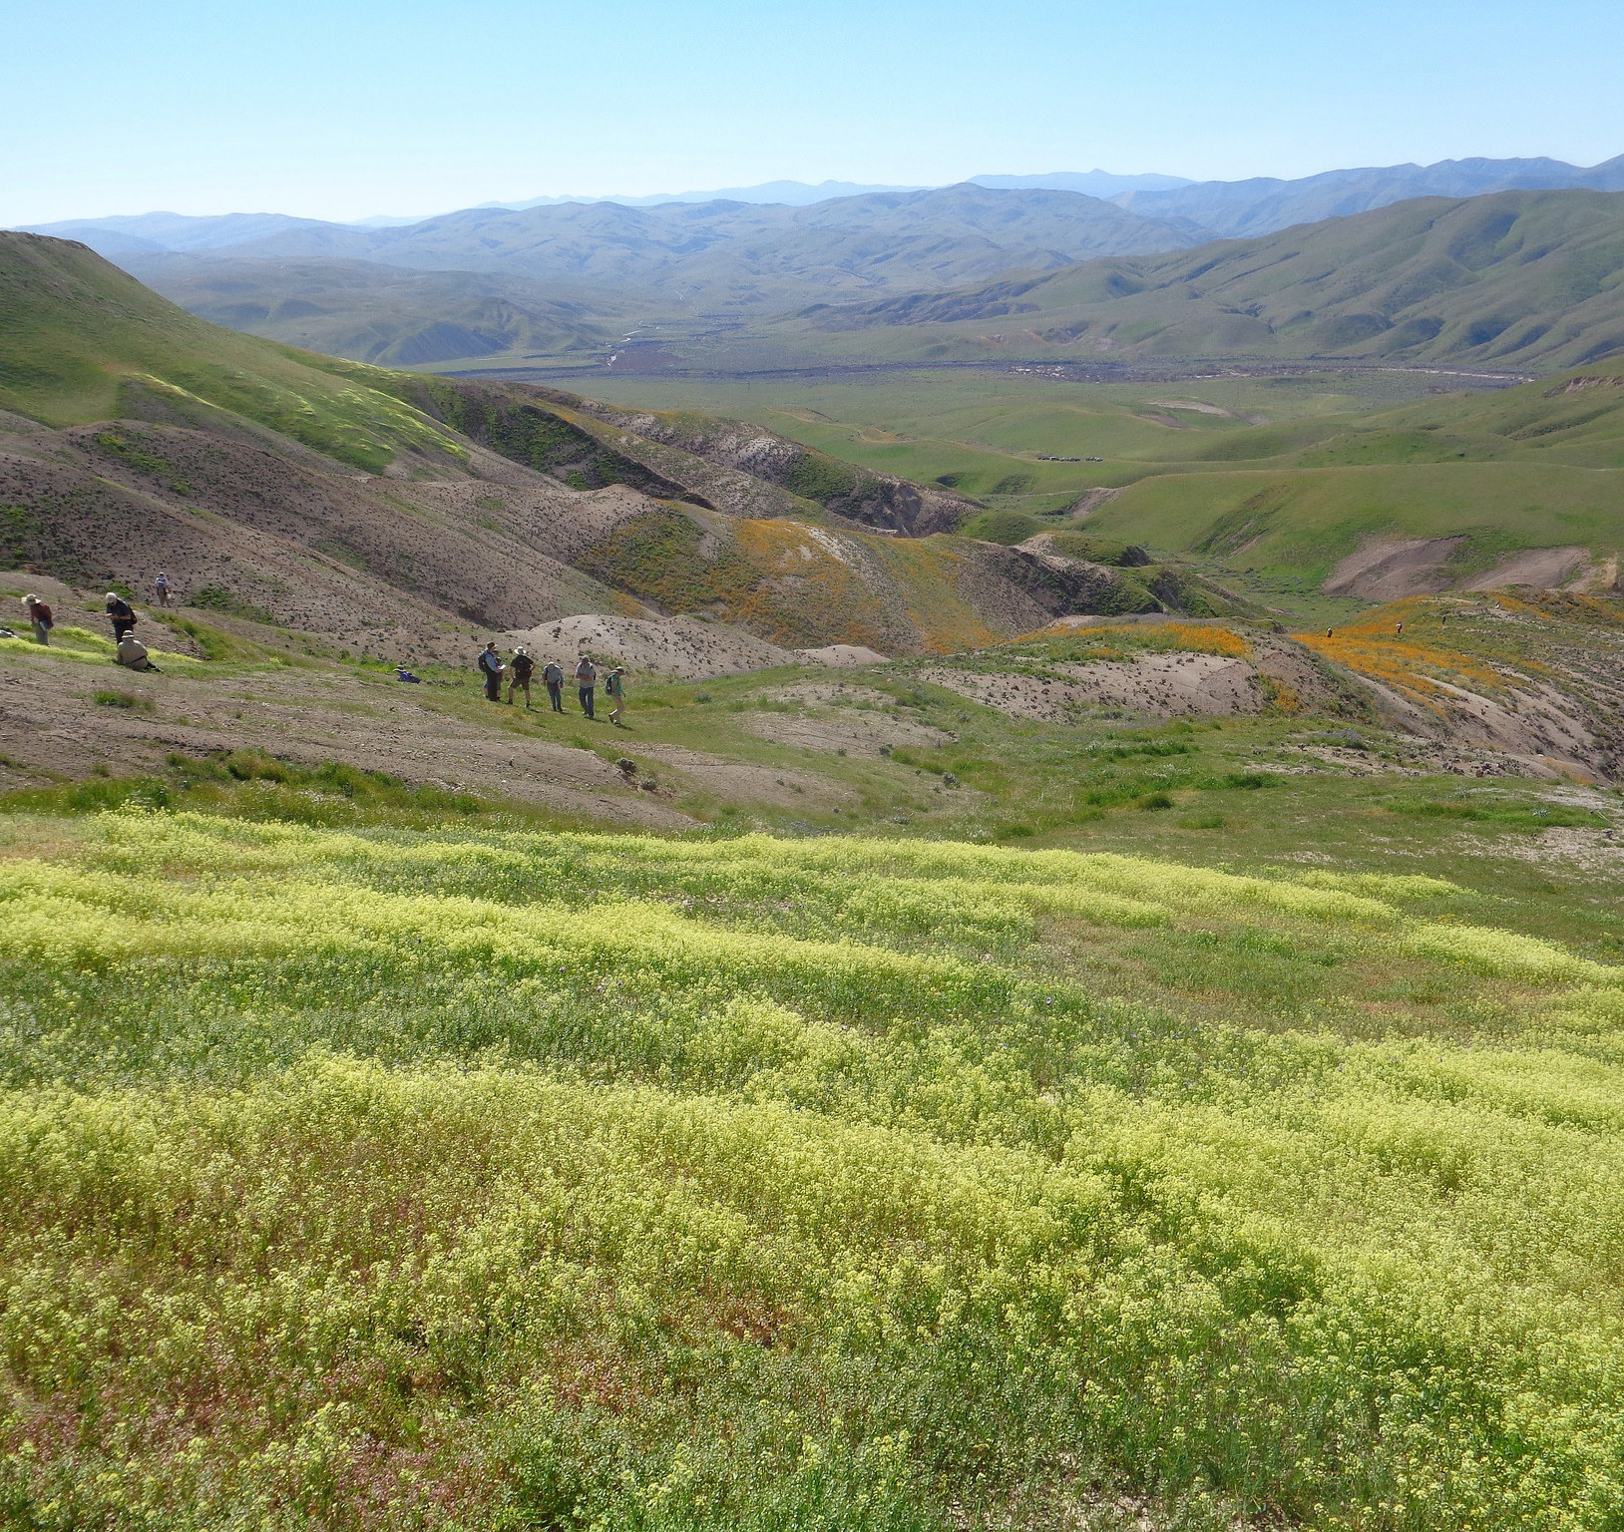
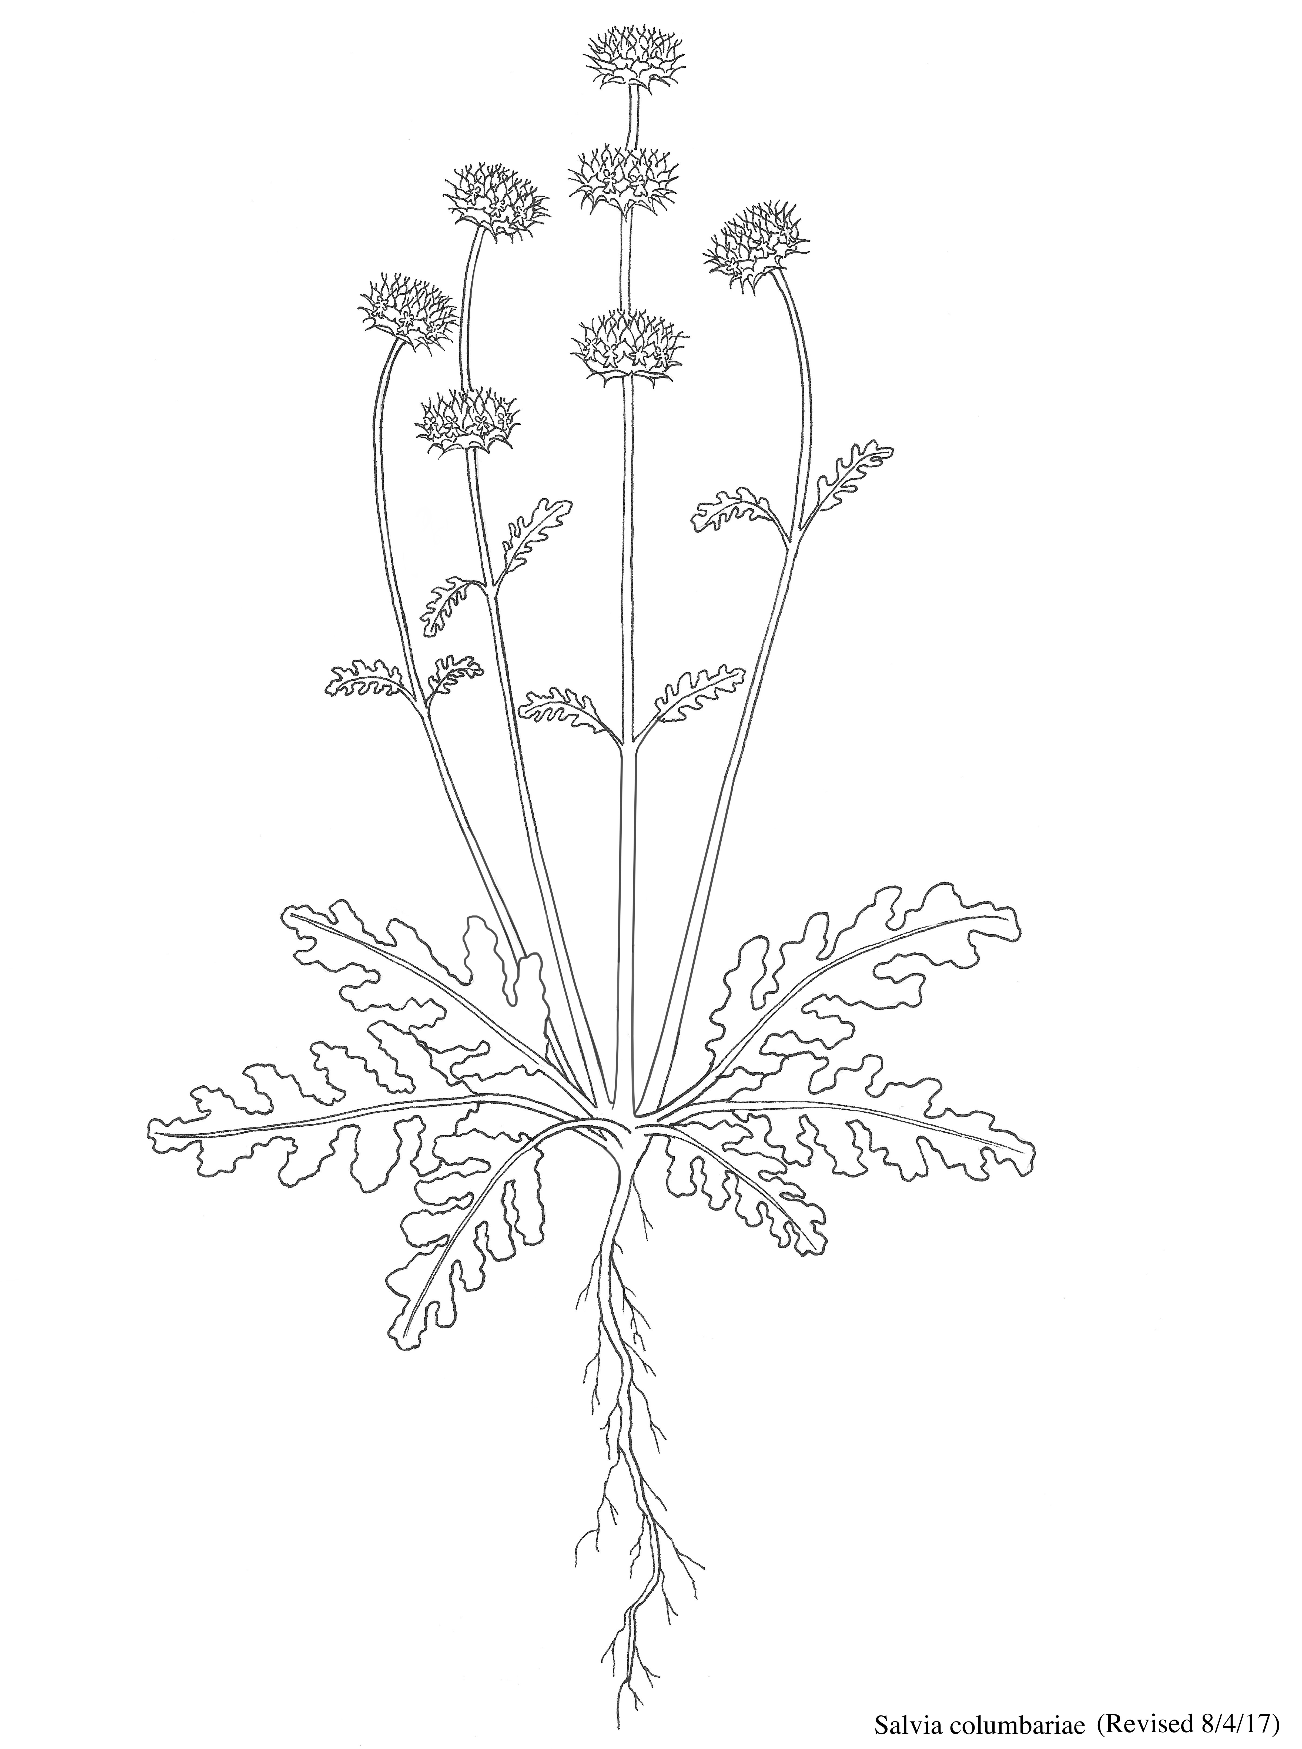
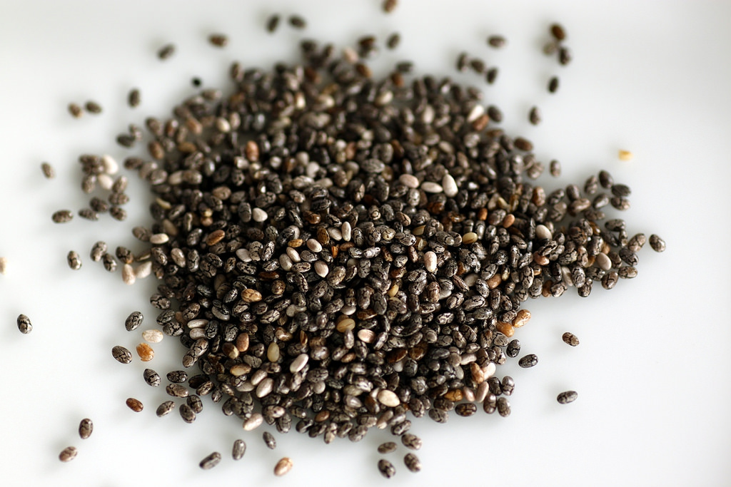
Annual Plants in California

Slide 3
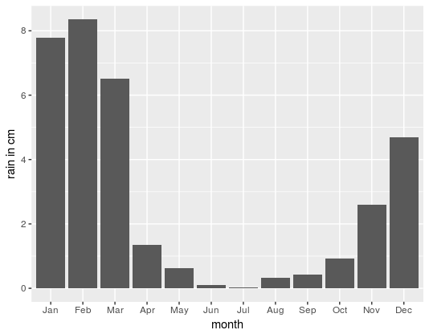
California Climate
Precipitation Santa Monica, CA

Slide 4
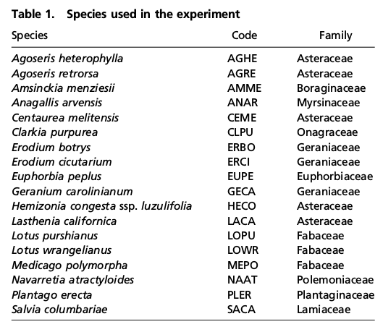
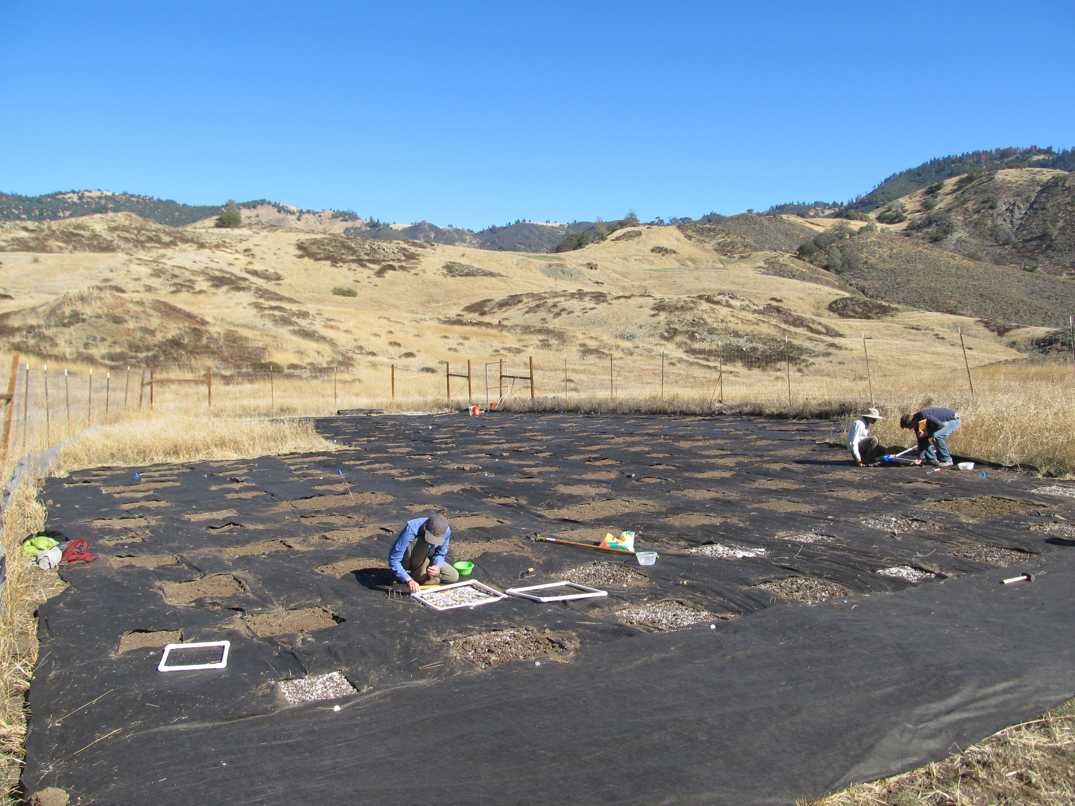
Experimental Communities

Slide 5
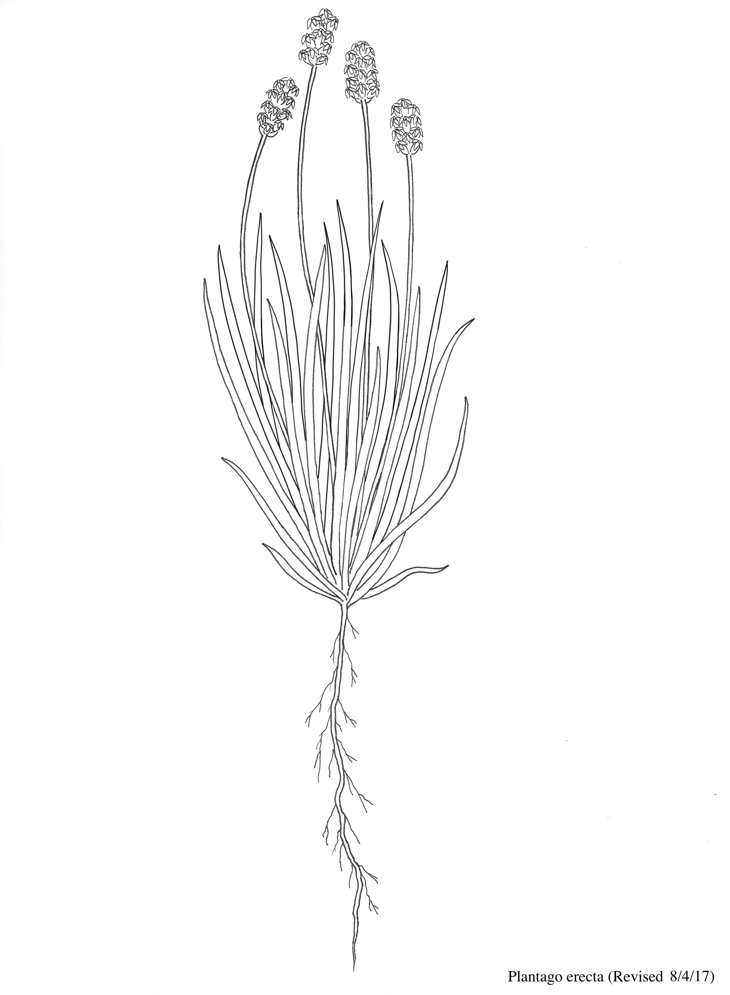
Annual Plant Model
H₂0
T
R
C
A
U
N
H₂0
T
Illustration by Joann Shih

Slide 6
Annual Plant Model
Fitness: seed g yr⁻¹
Allocation
Seeds
Leaves
Roots
Carbon
Nitrogen
Illustration by Joann Shih

Slide 7
Functional Traits
Phenology
SLA
*WUE?
N_{leaf}
Height
Rooting depth
SRL
Illustration by Joann Shih

Slide 8
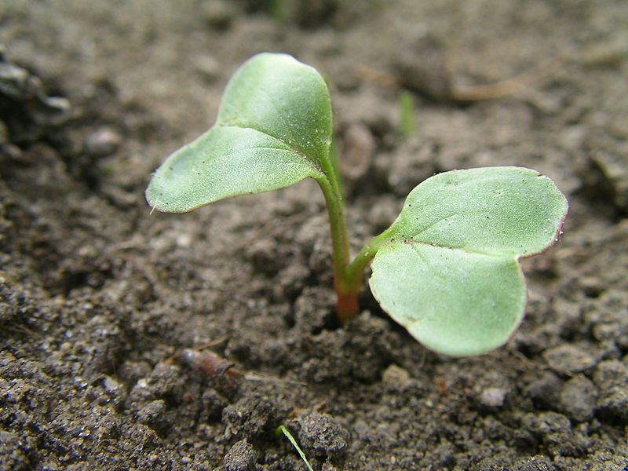
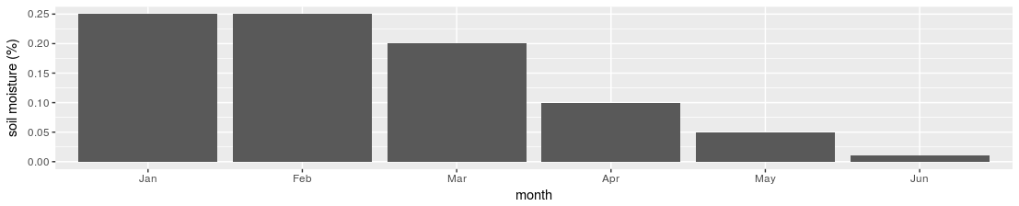
How does a model like this work?
Initiation of flowering
Seeds
Biomass (g)
Leaves
Roots

Slide 9
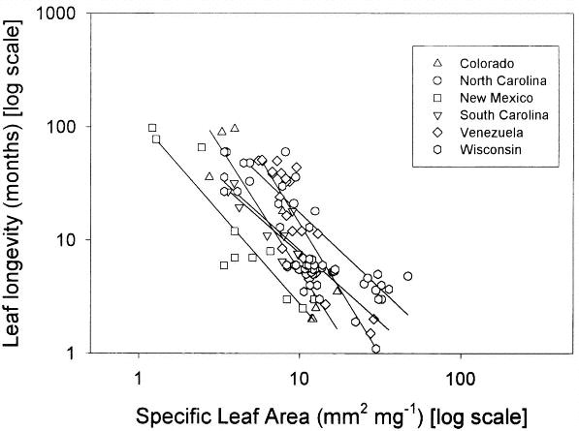
Acquisitive/Conservative Trade-off
Mark Westoby, et al. The Time Value of Leaf Area. The American Naturalist 2000, 155:649-656.
DOI: 10.1086/303346
Copyright © 2000 The University of Chicago

Slide 10
Question 1:
Can this model explain changes in species traits across environmental gradients?

Slide 11
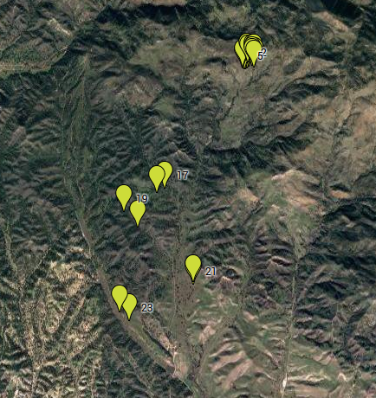
24 Common Gardens at Sedgwick
Upper Sites
Lower Sites

Slide 12
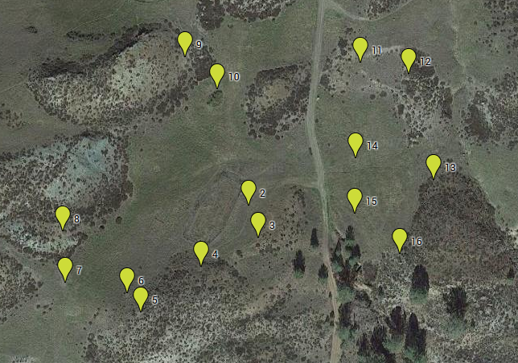
Upper Sites

Slide 13
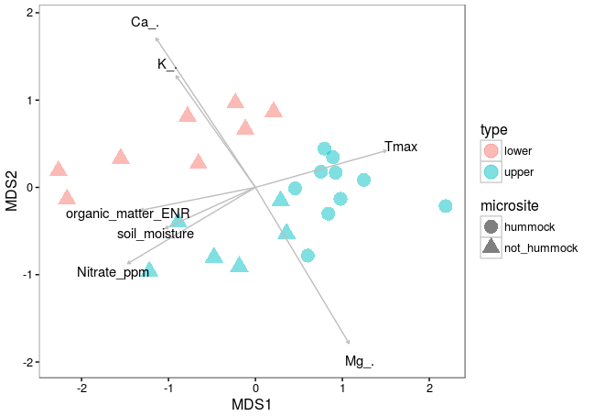
Environmental Factors

Slide 14
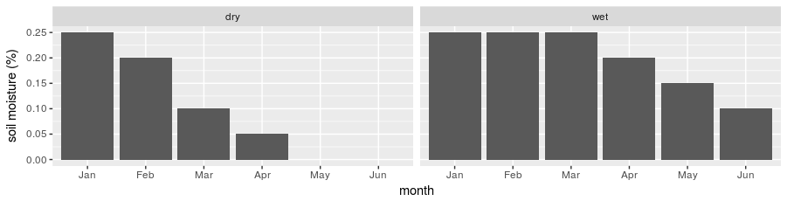
Dry site
early flowering
high RGR, SLA, SRL
Biomass (g)

Slide 15
Dry site
late flowering
Biomass (g)
low RGR, SLA, SRL

Slide 16
Wet site
Late flowering
High SLA, SRL
Biomass (g)

Slide 17
Questions
Does this model capture the major trade-offs in this system?
Is the resource acquisitive/conservative trade-off realistic?
What about Nitrogen?
What about light competition?
What about stem allocation?
What about temperature?
Can we simulate coexistence between early and late species?

