Slide 1



VIDYAVARDHINI’S COLLEGE OF ENGINEERING AND TECHNOLOGY
(NBA & NAAC Accredited)
(Autonomous Institute Affiliated to University of Mumbai)
Title : InveXa STacK
A multistore Grocery- Inventory system with Demand prediction
Track No. : 4 – Mobile & Web Application
Group No:13
Group Member: 46- Aklesh Harijan
49- Sanskar Jadhav
50- Samyak Jagtap
52- Abhishek Jambhale

Slide 2
ABSTRACT
Problem: Grocery inventory systems often lack real-time tracking, automation, and secure multi-store handling, causing waste and stock issues.
Solution: InveXa STacK is a MERN-based system with database isolation for secure multi-store operations.
Features: Tracks products by expiry, batch, and location, with automated low-stock alerts to suppliers.
Analysis: Uses data analytics and AI for forecasting, demand insights, and reducing overstock, with scope for future expansion.

Slide 3
INTRODUCTION
Problem: Multi-outlet grocery stores struggle with real-time inventory tracking, expiry management, and affordable, specialized tools.
Gap in Market: Existing solutions are either expensive enterprise systems (like SAP, Oracle) or basic SaaS tools lacking grocery-specific features.
Solution: InveXa sTacK is a cost-effective, cloud-based system with per-store database isolation, RBAC roles, AI-driven reorder insights, and a lightweight frontend.
Scope: The system design, implementation, architecture, and future improvements are detailed across multiple sections.

Slide 4
LITERATURE SURVEY
ERP Systems: Costly and complex systems not suitable for small grocery businesses.
Cloud Tools: Affordable tools but missing grocery-specific features like batch management, expiry tracking and proper data isolation.
Open Source: Flexible tools but require high technical skills and lack AI features.
Chosen Methods: Email OTP, JWT, and database-per-tenant selected for security and efficiency.

Slide 5
PROBLEM DEFINITION
No Unified System: No single affordable platform for managing multiple stores.
High Cost Issue: ERP systems are too expensive for small businesses.
Feature Gap: Existing tools lack inventory tracking and demand prediction
Data Risk: Poor data isolation can lead to data leakage between stores.

Slide 6
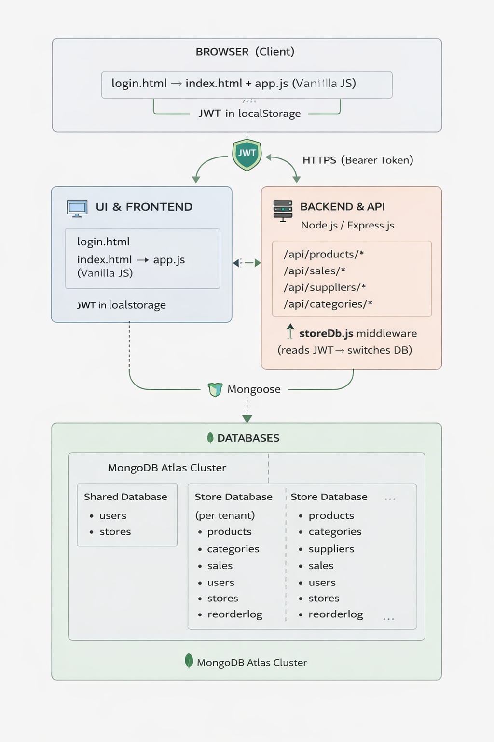
Proposed approach / System Design
Multi-Tenant Design: Each store gets its own database to ensure complete data isolation.
Low Stock Alert with Auto Reordering: Alert popups with email auto reordering(SMPT and Nodemailer)
JWT Authentication: Every request is verified using token-based secure access.
RBAC System: Different roles (Owner, Admin, Manager, Staff) control access levels.

Slide 7
IMPLEMENTATION/METHODOLOGY
Agile Development: System built in phases from basic features to full product.
Technology Used: Node.js, Express, MongoDB, and simple frontend used.
Security System: Uses JWT, OTP, and role-based access control.
AI Method: Uses linear regression and safety stock formula for predictions.

Slide 8
RESULT AND DISCUSSION
Full Implementation: All planned features successfully completed.
Prediction Result: System gives around 85% accurate demand prediction.
Data Security: Strong isolation ensures no data leakage between stores.
Limitations: Issues with seasonal demand, email dependency, and scalability.

Slide 9
CONCLUSION
Achievement: InveXa sTacK delivers low-cost, AI-powered inventory management using a lean Node.js architecture.
Core Strengths: Secure multi-tenant design with database isolation, JWT-based RBAC, OTP verification, and demand prediction without heavy ML.
Impact & Future: Fully implemented system with scope for advanced forecasting, mobile (PWA) support, and barcode-based management.

Slide 10
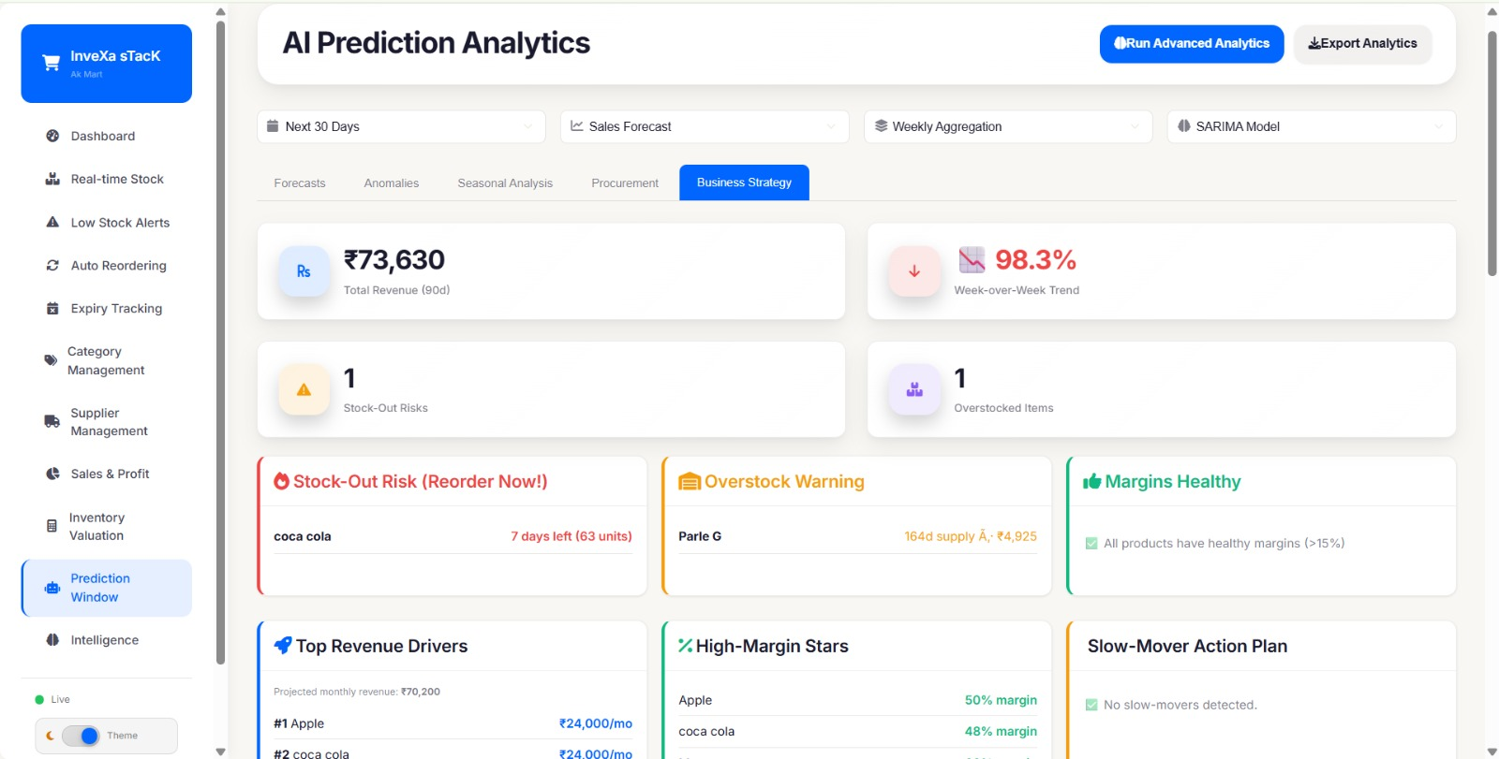
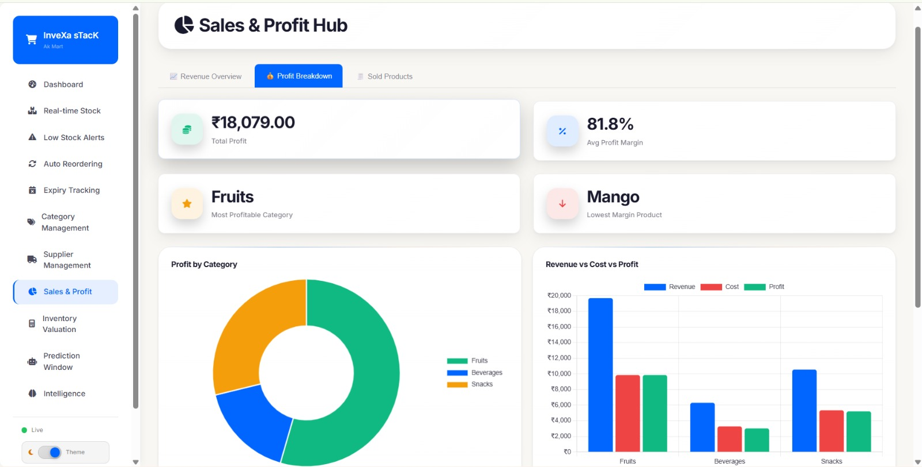
Technical Showcase

Slide 11
REFERENCES
MongoDB: Read on MongoDB
OWASP: Read on OWASP
Nodejs: Read on Nodejs
JWT: Read on JWT

