Slide 1
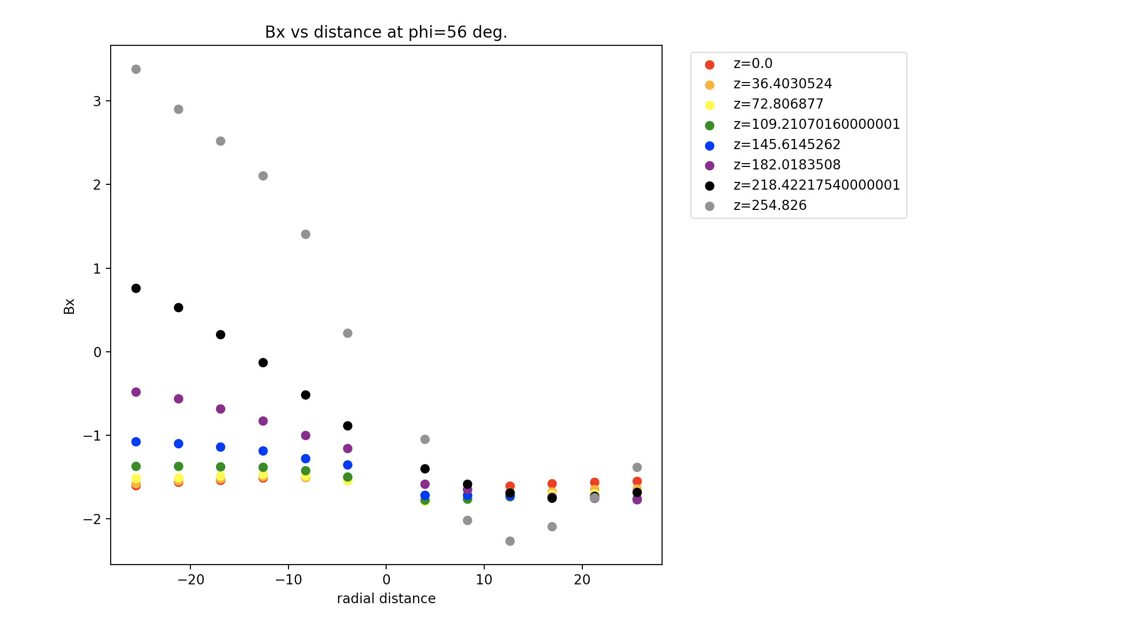
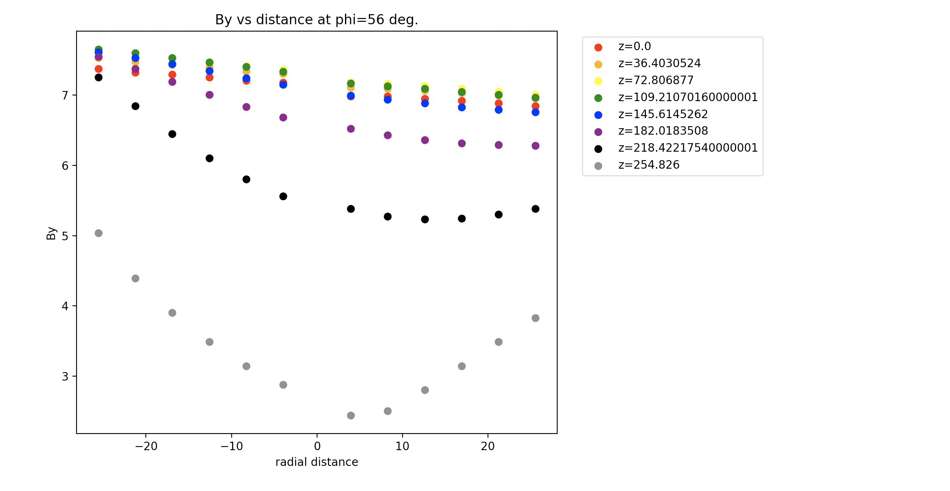
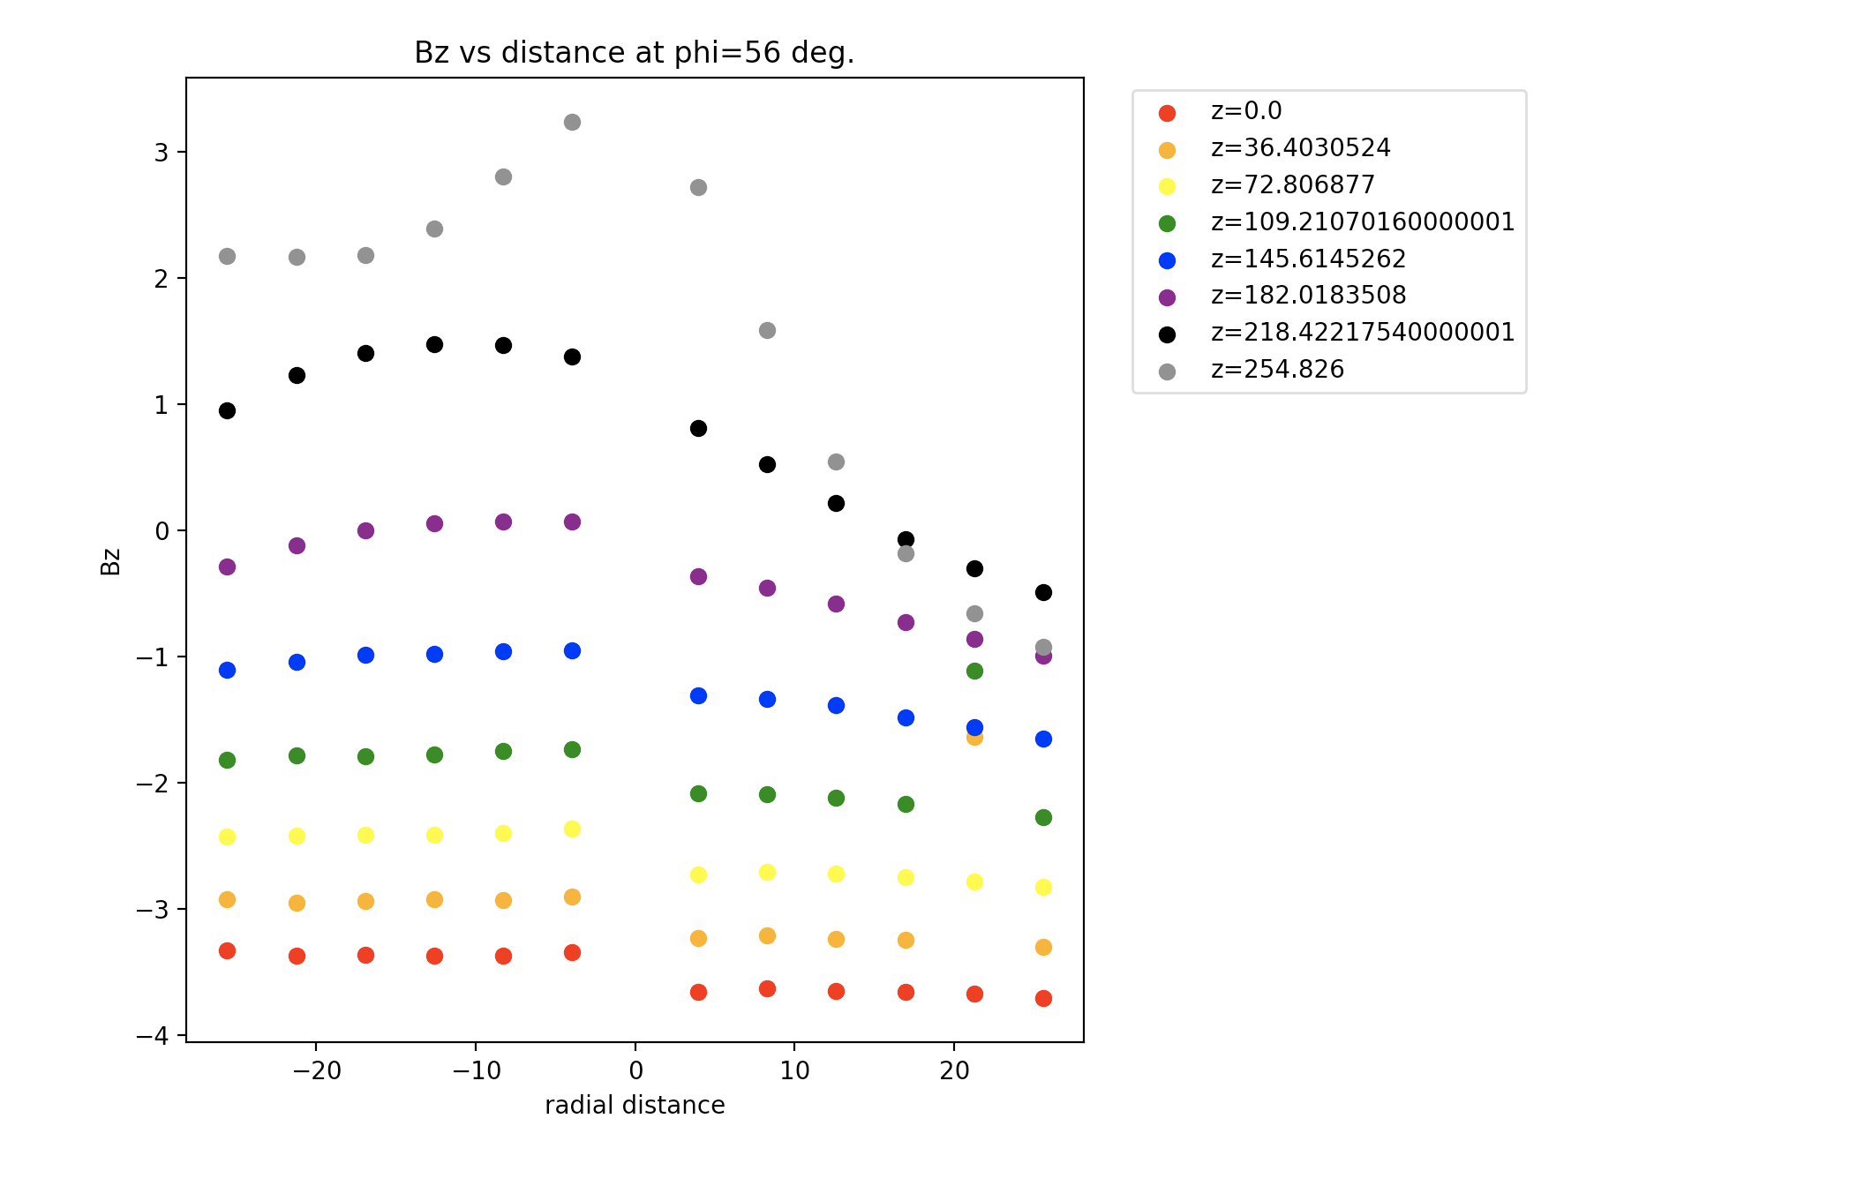
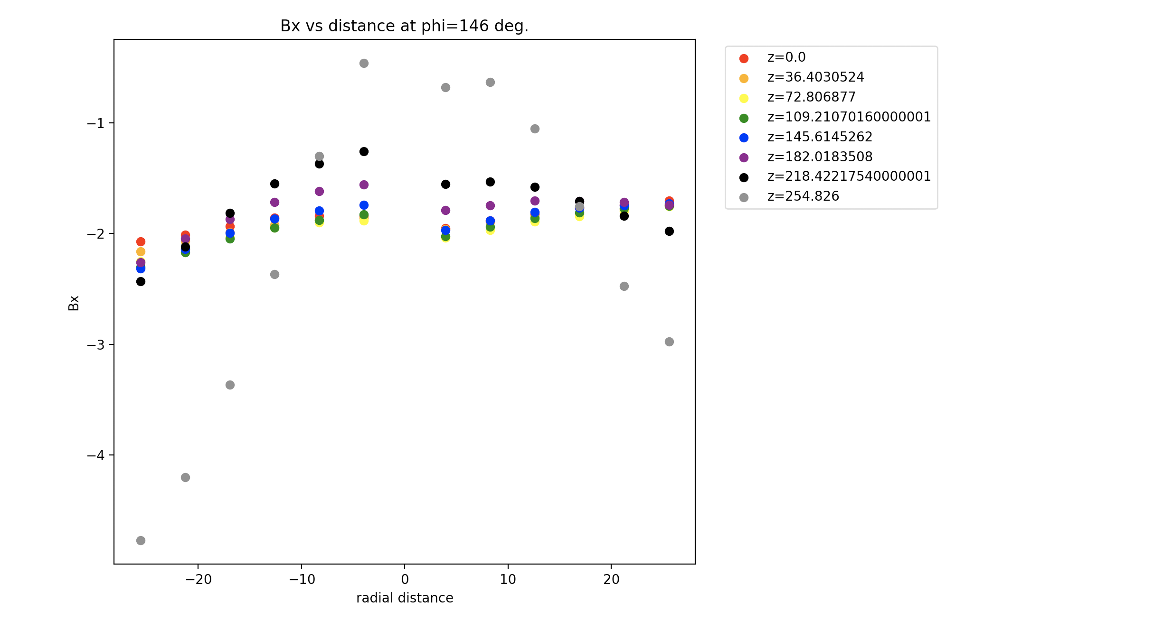
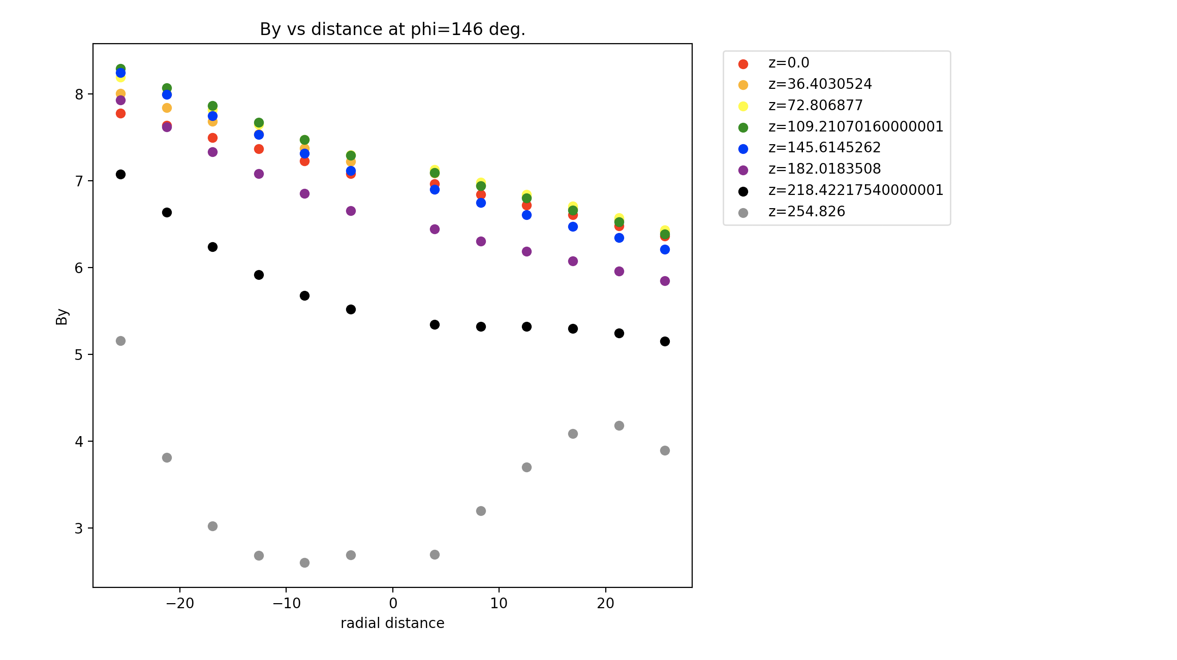
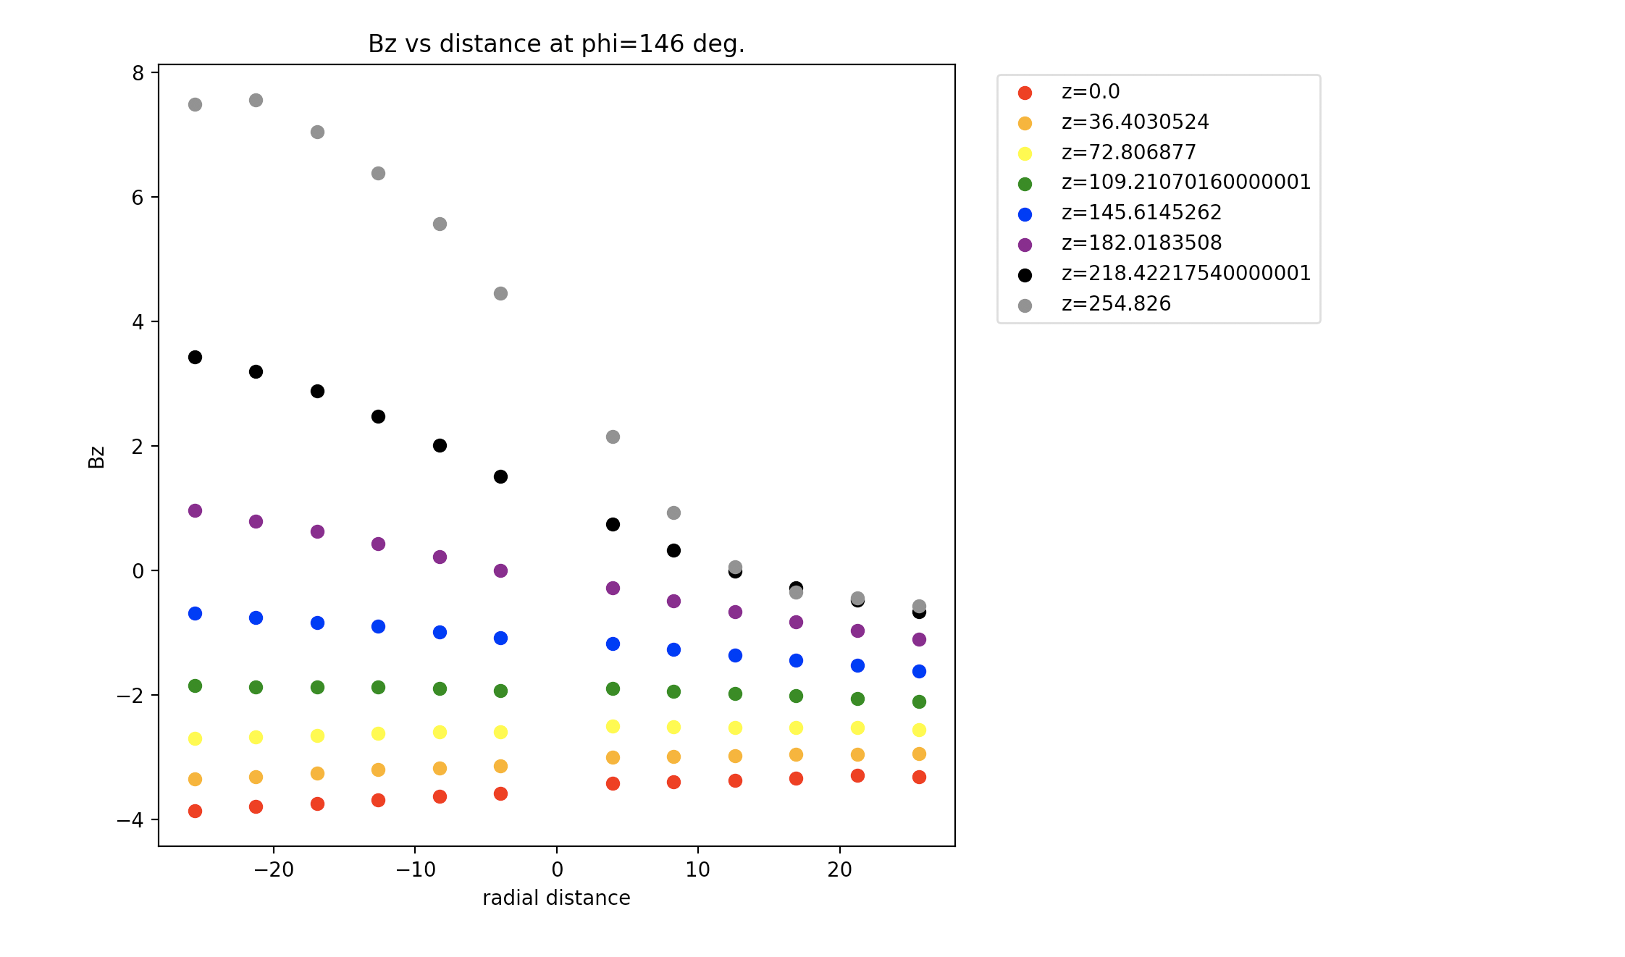
Plotting Bx, By, Bz vs. x
Larger z value means closer to the floor.
Plotting Bx, By, Bz vs. y

Slide 2
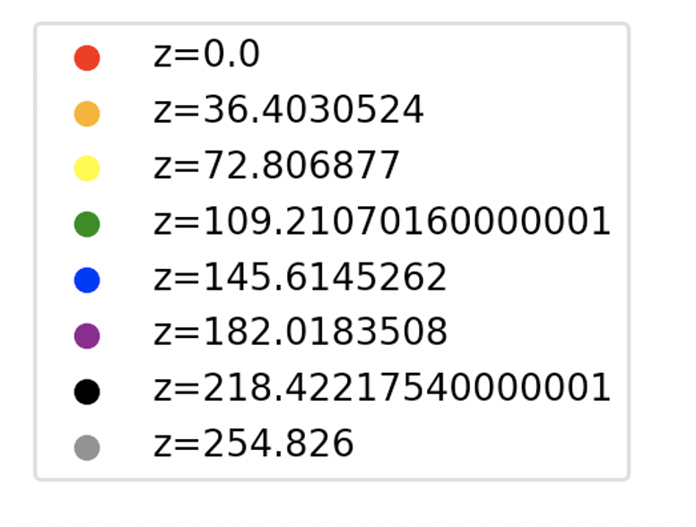
Bx (G)
By (G)
Bz (G)
x (cm)
x (cm)
x (cm)
Bx (G)
By (G)
Bz (G)
y (cm)
y (cm)
y (cm)

Slide 3
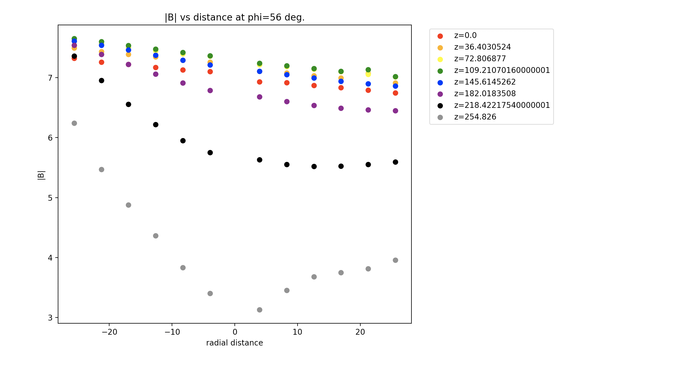
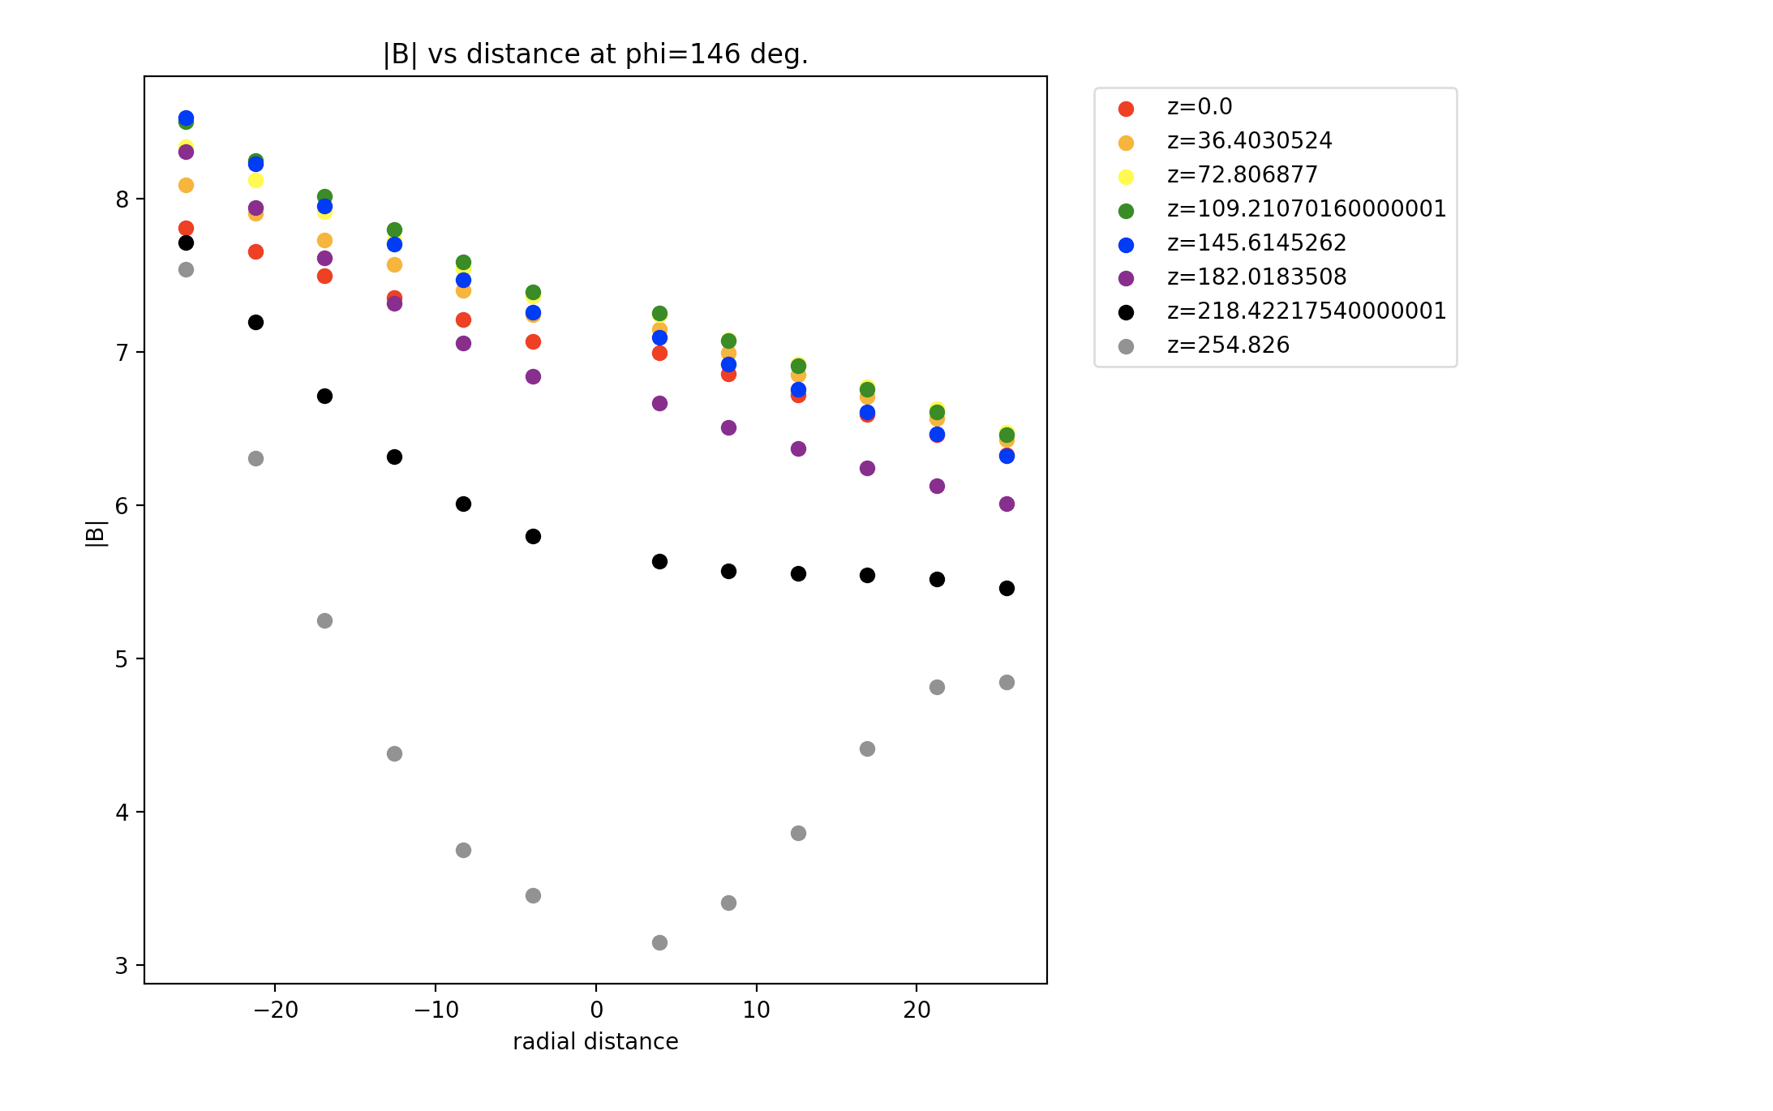
Plotting mag(B) vs. x
Plotting mag(B) vs. y

Slide 4
|B| (G)
|B| (G)
x (cm)
y (cm)

