Slide 1
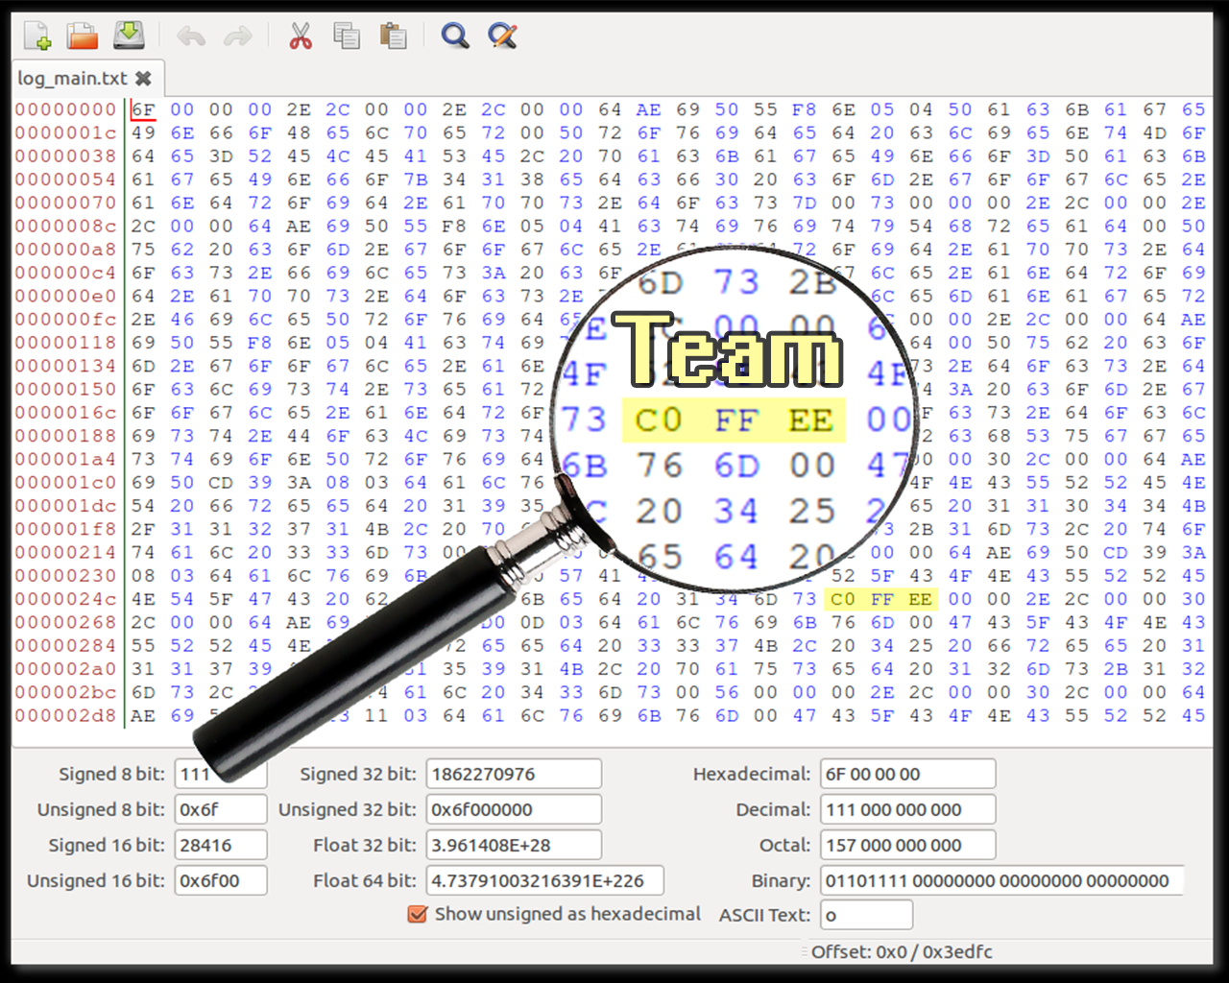

Slide 2

Team 0xC0FFEE
Chris Woodard, Adam Lowther, Robert Ries

Slide 3
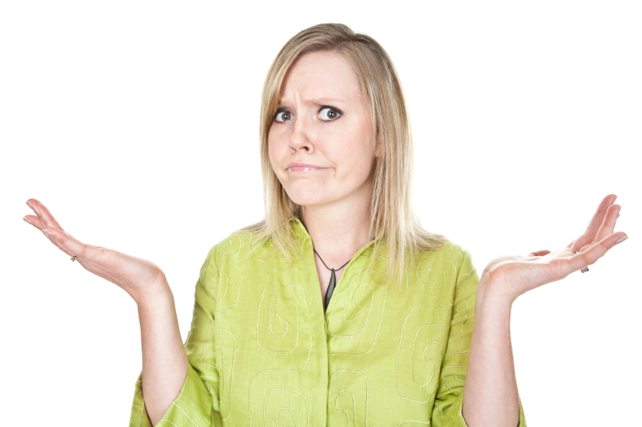
theproblem:
Barrier of entry to ride the bus
Which route do I want?
When does the bus come?
What bus should I get on?

Slide 4
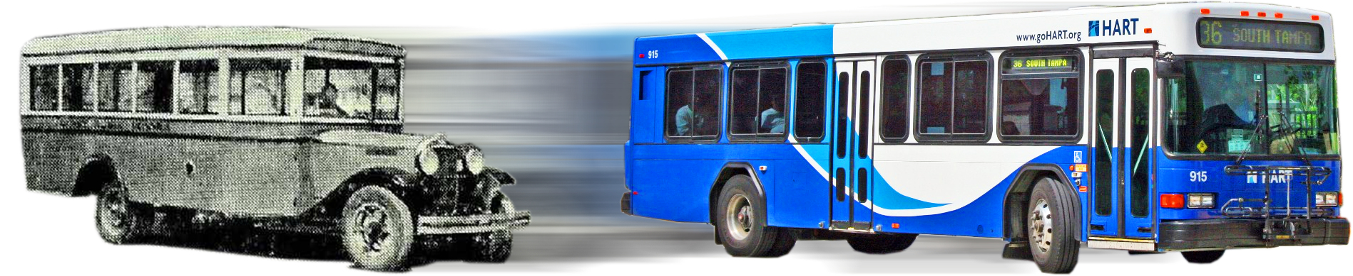
wethink:
Public transportation needs a makeover

Slide 5
thesolution:
A smart phone application that
Provides real-time data on
When does the bus come?
What bus should I get on?

