Slide 1

AWS REINVENT HACK 2018
GoodWILL INDUSTRIES, TEAM 35
GOODWILL hEROES BOT

Slide 2
CURRENT Problems
Manual Process with Job Seeking
Scheduled Feedback Loop missing between job seekers and goodwill employees on how the case was assessed?

Slide 3

GOODWILL HEROES BOT
Ask for Help via Phone Call or TEXT
Help Goodwill Case manager with Suggestions & Predictions
Automated Feedback Scheduler

Slide 4
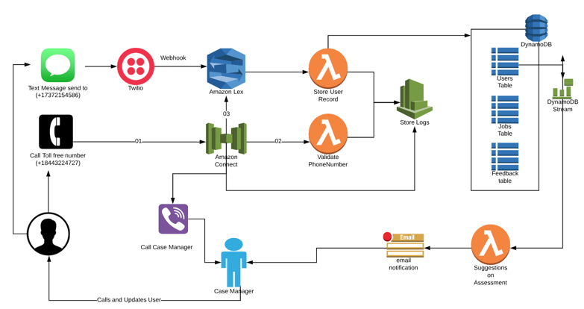
FIND JOB AND CAREER HELP FLOW

Slide 5
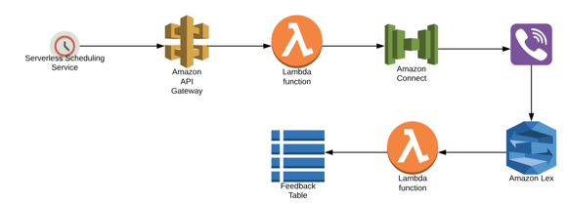
GET FEEDBACK

Slide 6
DEMO OPTIONS
CALL :
+ 1 844 322 4727
OR
TEXT:
+1 737 215 4586

Slide 7
FUTURE POSSIBLE ENCHANCEMENTS
Support for Donate Stuff Module( Like integration with Payment Services and Automated Biweekly Pick Up Scheduling using maps integrations)
Fetch Jobs from sources like linkedin, burning Glass, ESMI, chamber of commerce & US labour and have a machine learning algorithm which can predicts and suggests the matches for assessment created.

