Slide 1
YourCarbonTeam
By:
Ajaya Loya
Pavan Nalam
Quin Outland
Vikrant B

Slide 2
Overview
What does it do?
Data we used
Calculations used
AWS Infrastructure

Slide 3
What does it do?
Gives companies the opportunity to optimize both cost and carbon emissions by determining idle time of ec2 instances.
Similar to AWS Compute Optimizer, but for Carbon Emissions
The dashboard gives users an idea of their carbon footprint within the cloud

Slide 4

Data we used
Data provided by Thoughtworks
AWS instance types (including cpu class)
CPU power usage
Grid Cost coefficients
Constraints
Only AWS Instances
Only includes US Regions
Only AMD processors

Slide 5
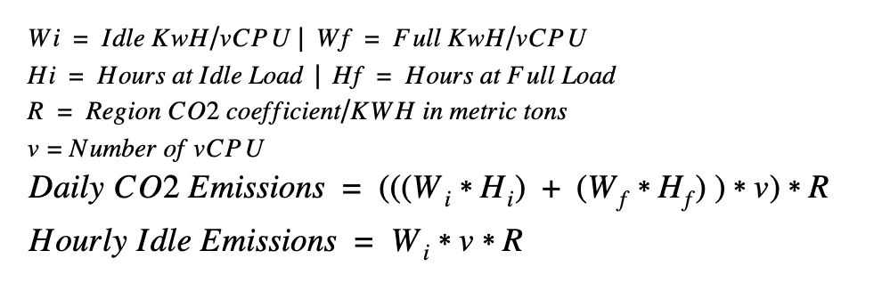
Calculations
Since we can’t determine the real CPU used for EC2 instances (unless bare-metal) we took an average of power consumption for the entire class
ie: AMD Epyc Generation 1
Power consumptions are represented in both idle time and full load per vCPU
Carbon emissions per region were then calculated per instance within the region

Slide 6
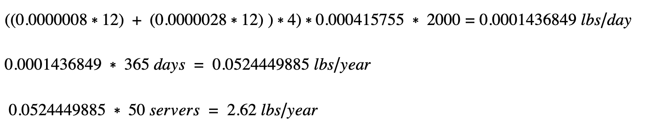
Example (m5a.xlarge)
It may not seem like much, but this is only for a single server!

Slide 7
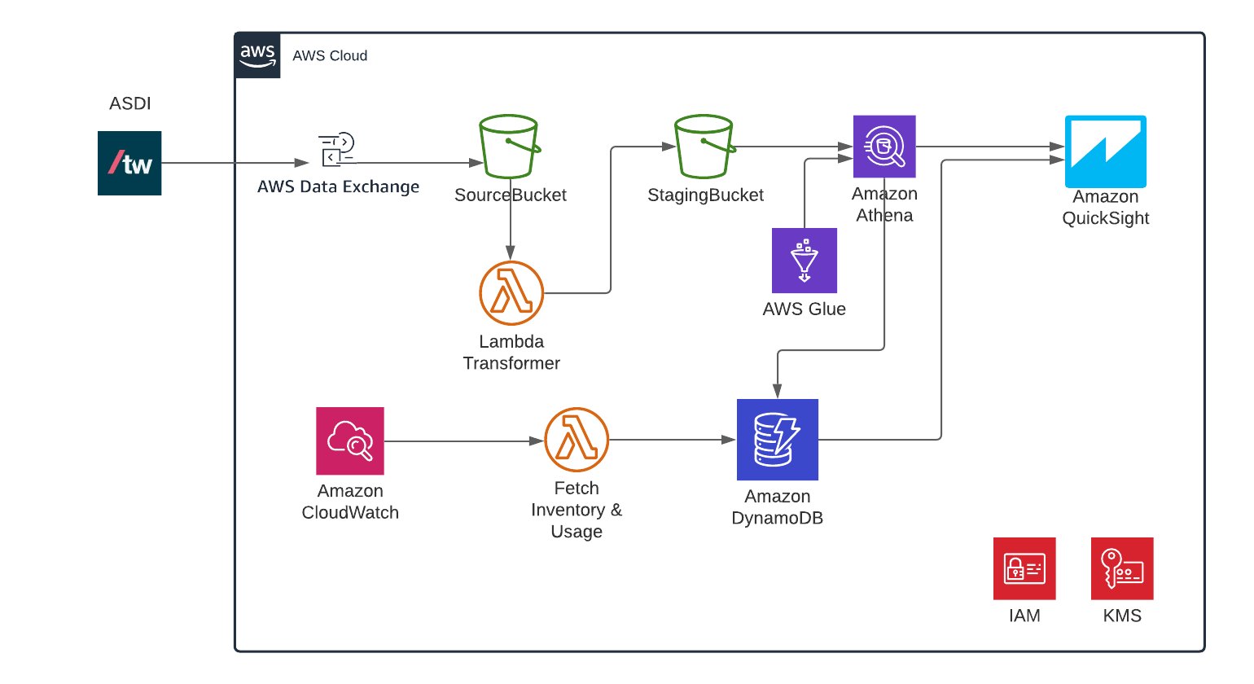
AWS Infrastructure

