Slide 1

Student Course Enrollment Platform
Sofiane Akli
Course: CST499: Capstone for Computer Software Technology (CSF2537A)
Instructor: Charmelia Butler
University of Arizona Global Campus
Date: October 13, 2025

Slide 2


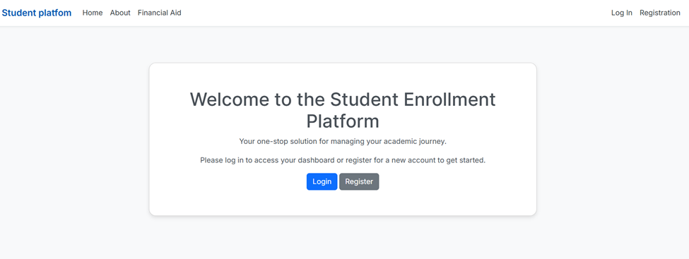
Project Overview
(GeeksforGeeks, 2025)
(GeeksforGeeks, 2025)
(GeeksforGeeks, 2025)
The Student Course Enrollment Platform is a web-based system that enables students to register, log in, browse available courses, enroll, and manage their course registrations. It also provides administrative tools for course management and student account.

Slide 3

Purpose of the SRS Document
The Software Requirements Specification (SRS) defines the functional and non-functional requirements for the platform. It serves as a guide for developers, project managers, and stakeholders to ensure alignment on the project’s goals and deliverables (GeeksforGeeks, 2025).

Slide 4
System Features Summary
User registration and login
Course catalog browsing
Waiting list management
Administrator dashboard for managing courses and users.
Course enrollment and withdrawal

Slide 5
System Users and Environment
Primary users: Students and Administrators.
Operating Environment: Web-based, compatible with Windows, macOS, and Linux.
Constraints: Requires secure authentication, MySQL database, and role-based access control.

Slide 6
UML Design Model Overview
The UML design includes (GeeksforGeeks, 2025a):
• Use Case Diagram – Describes user interactions with the system.
• Class Diagram – Defines main entities (Student, Course, Enrollment, Admin).
• Sequence Diagrams – Show registration and enrollment flows.
• Activity Diagrams – Outline process steps for registration and enrollment.
• State Diagram – Shows course status transitions.

Slide 7
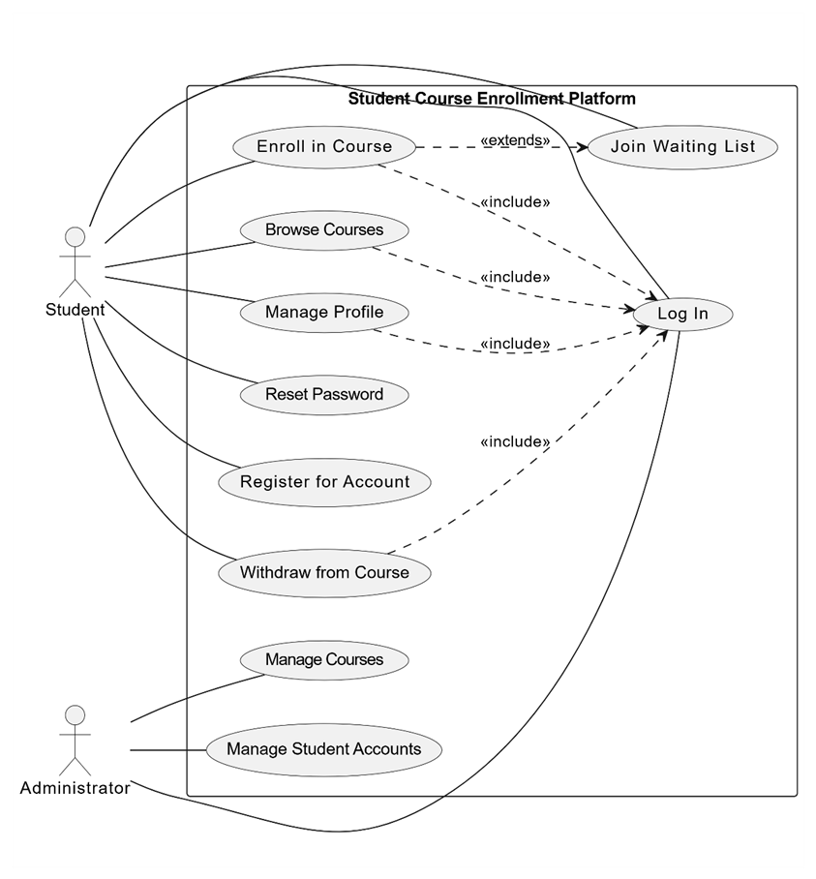
Use case diagram

Slide 8
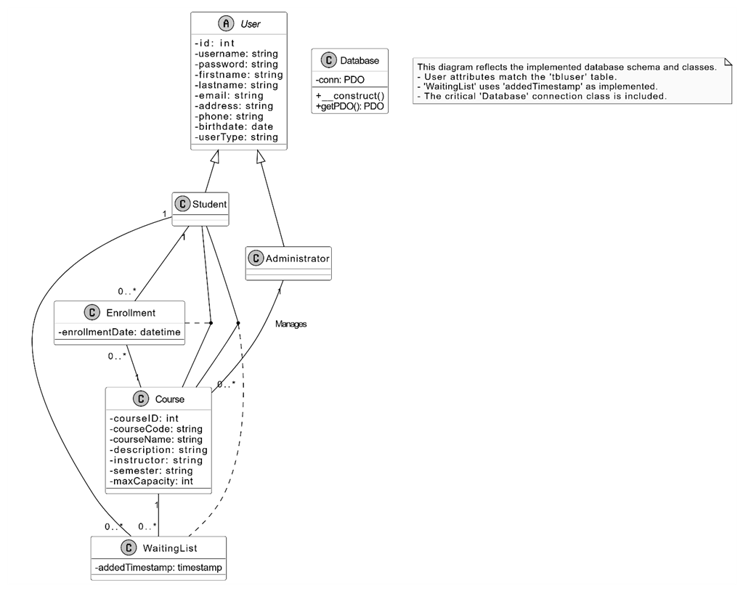
Class Diagram

Slide 9
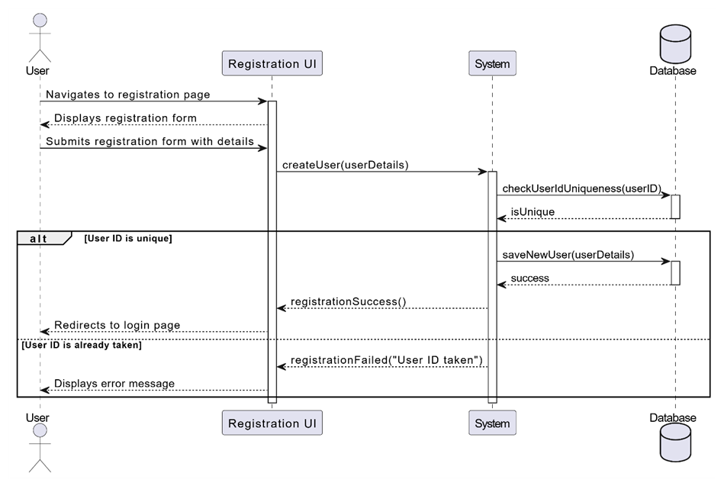
Sequence diagram ( registration process as an example

Slide 10

Landing Page Design
The landing page provides system access, highlighting key features and login/registration buttons. It uses a simple, responsive layout to ensure accessibility and usability.

Slide 11

Login Page Design
The login page includes fields for user ID and password, error handling for invalid credentials, and a 'Forgot Password' feature. It ensures secure authentication and redirects users to their dashboard upon success.

Slide 12

Enrollment Page Design
The enrollment page displays available courses, including course code, description, instructor, and capacity. It supports enrollment, waiting list, and withdrawal options, updating the database dynamically.

Slide 13
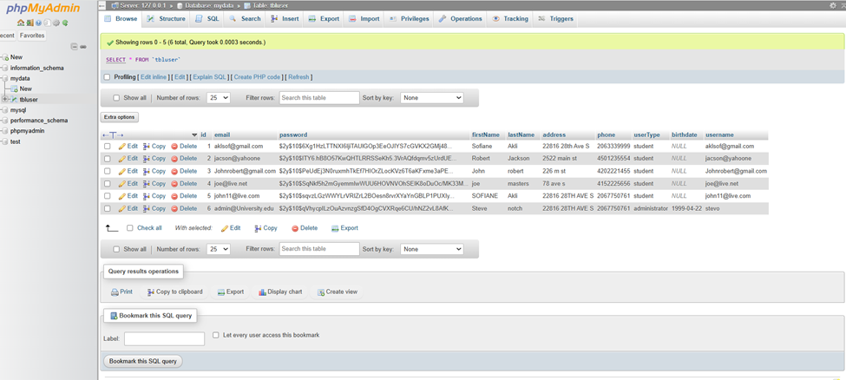
MySQL Database Design
The MySQL database includes tables for users, courses, enrollments, and waiting lists. Relationships are defined via primary and foreign keys. The database ensures data integrity and supports queries for course and student management.

Slide 14
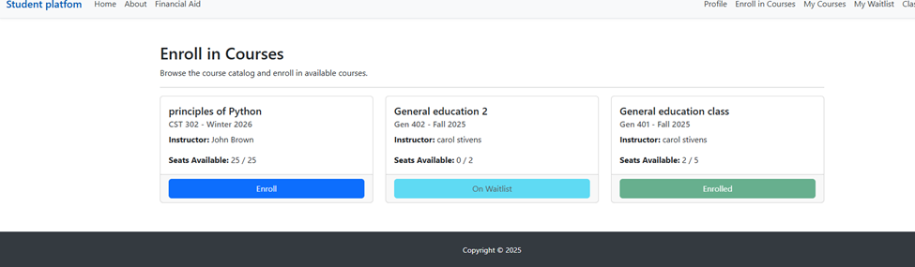
Class Registration Process
Students register for classes through a PHP interface connected to the MySQL database. The process validates course availability, updates enrollment data, and triggers notifications for waiting list movements.

Slide 15
PHP Code and Functionality
PHP scripts handle backend logic for registration, login, enrollment, and course management. Code includes SQL queries, session handling, and validation to protect against injection and XSS vulnerabilities.

Slide 16

Security and Performance Considerations
The system uses HTTPS, password hashing, and role-based access. It supports up to 1000 concurrent users and includes automatic backups for safety.

Slide 17
Conclusion
The Student Course Enrollment Platform integrates secure web development, database management, and structured software design principles to create a scalable and user-friendly enrollment system.

Slide 18
References
GeeksforGeeks. (2018, June 19). Classification of Software Requirements Software Engineering. https://www.geeksforgeeks.org/software-engineering/software-engineering-classification-of-software-requirements/
Gullberg, M. (2025, July 28). A detailed website requirements document [free template]. Feedbucket.app. https://www.feedbucket.app/blog/website-requirements-document-template/
Process Impact. (2023). Training and Presentations. https://www.processimpact.com/training.html

