Slide 1
Real-time Polling Application for live crowd
Akshay Malav
Chinmay Garg

Slide 2
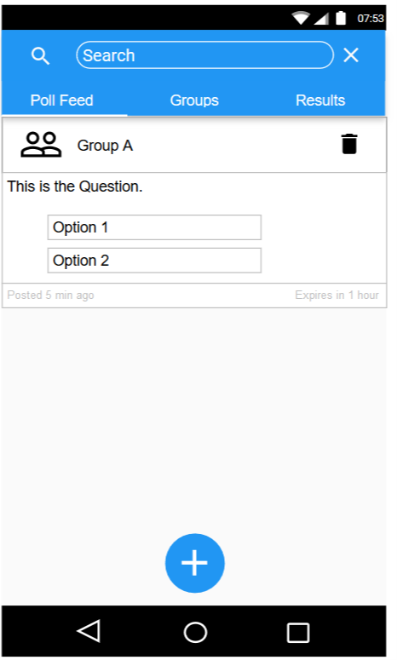

Slide 3
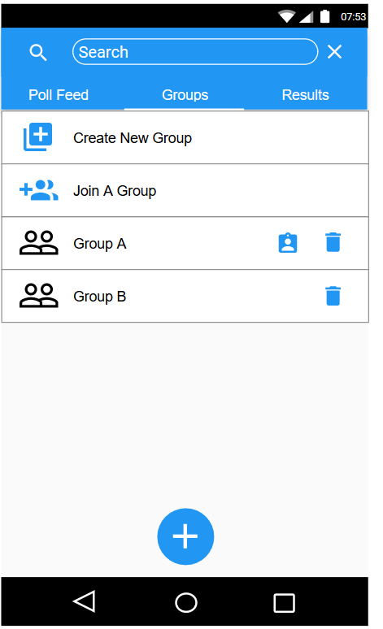

Slide 4
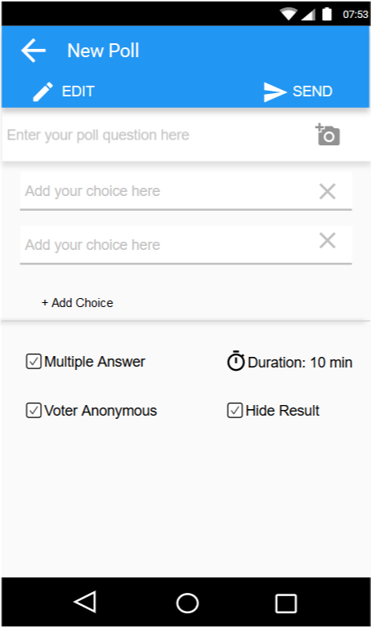

Slide 5
