Slide 1
POLLING APPLICATION
Dr. Sumit Kalra
Akshay Malav
Chinmay Garg

Slide 2
Modes of Operation
ONLINE
OFFLINE

Slide 3

Online

Slide 4


Database
Firebase

Slide 5

Key Features

Slide 6

Make Groups
User can make groups and also
Join existing groups
Can Exit the group if he/she wants to.
Can view the members of the group.

Slide 7

Conduct Poll
User can conduct poll in a
particular group
Can create new poll and send to different groups.
Can have many options for the poll as needed.

Slide 8

See the Result
Only Poll conductor can see the
result of the poll
Results can be updated till the poll is expired.
Conductor can also see who has marked which option.

Slide 9
Offline

Slide 10
Working Model

Slide 11
Phase-I
Subscriber
Publisher

Slide 12
Phase-II
Publisher
Subscriber

Slide 13
Key Features

Slide 14
Use Cases
QUIZ
POLL

Slide 15

Quiz
In this use case the user can conduct Quiz in a classroom
Quiz conductor can send more than one questions in a session
Results are sorted in order of Roll no

Slide 16

Poll
In this case a person can conduct a poll among the people who are nearby
Can create new poll and send to different people.
Results are sorted in order of the responses like ‘A’ option first and so on.

Slide 17
Results

Slide 18
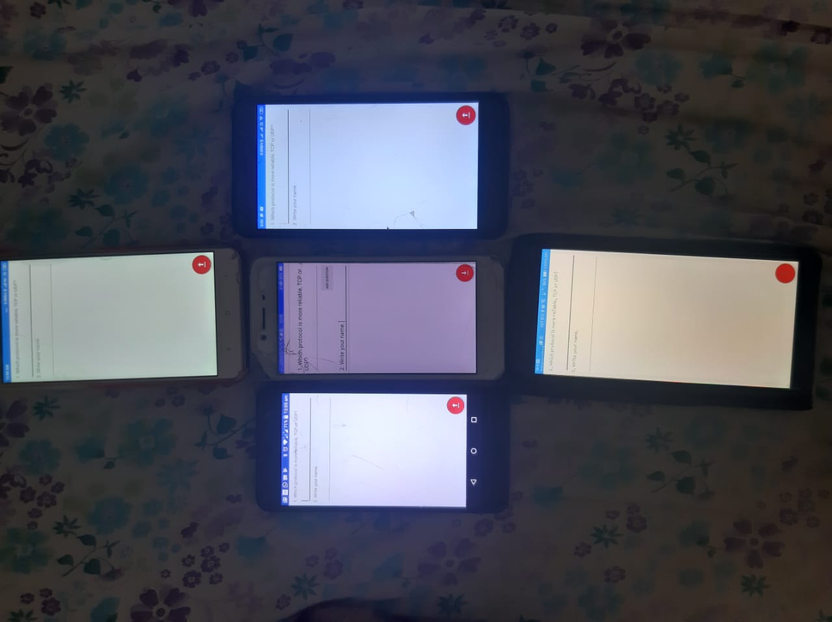
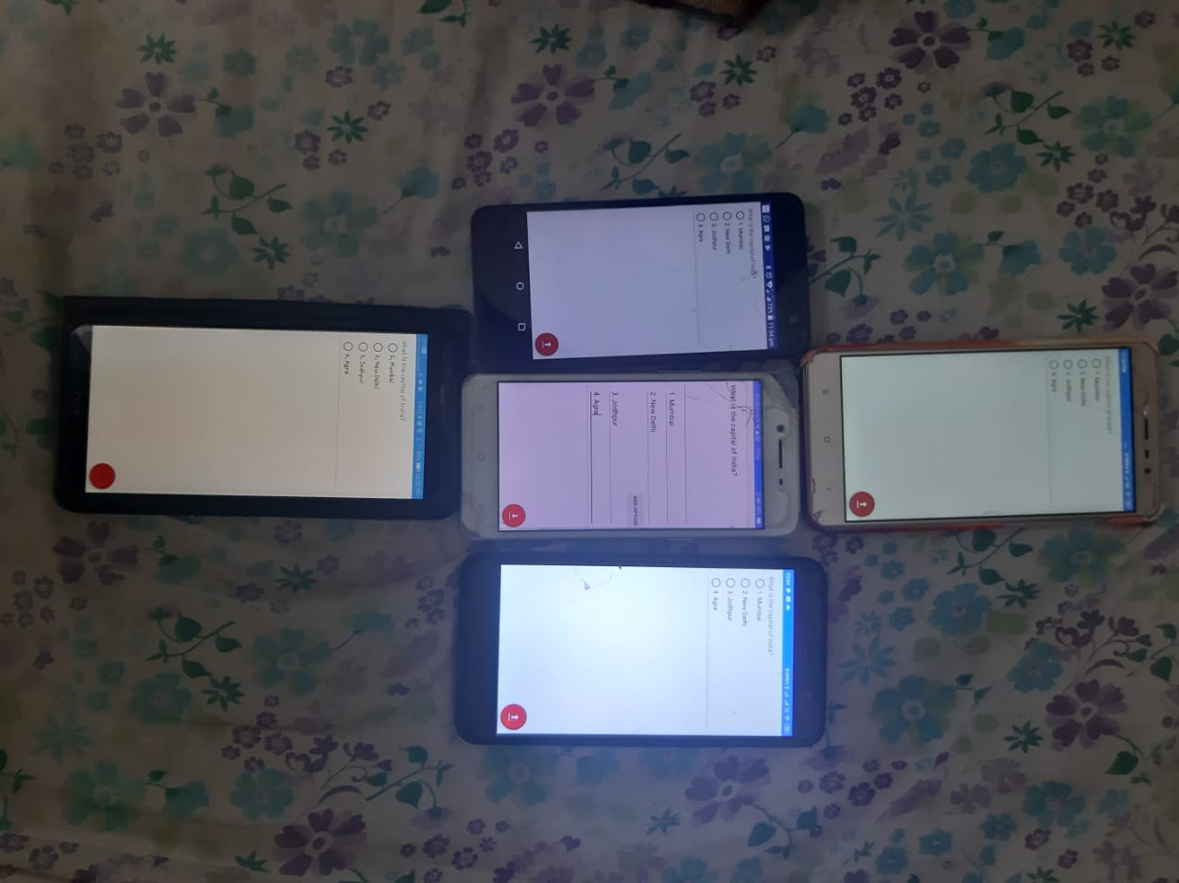
Quiz POLL

Slide 19
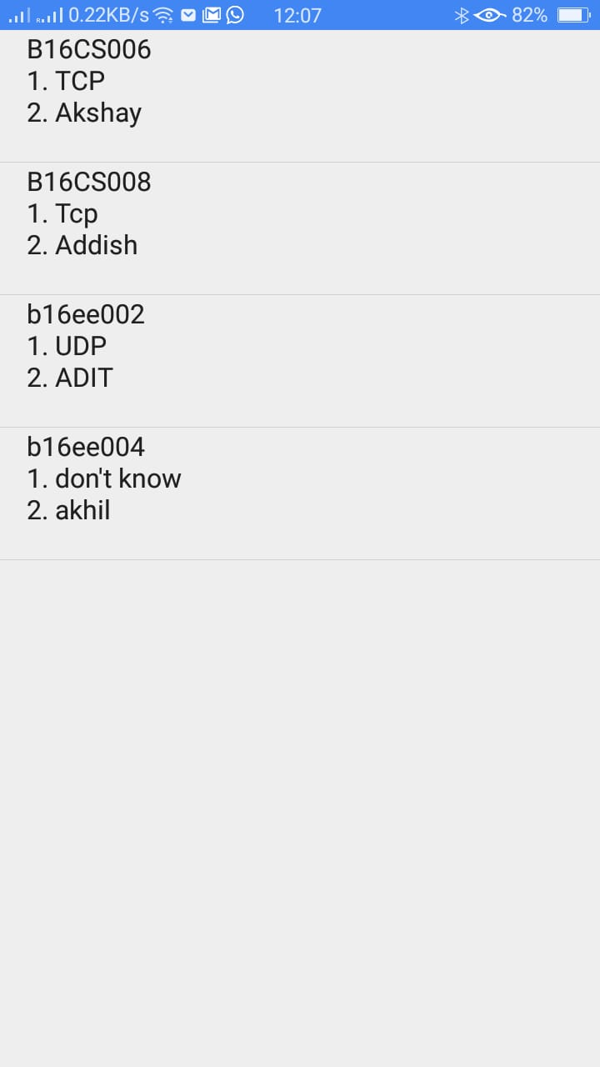
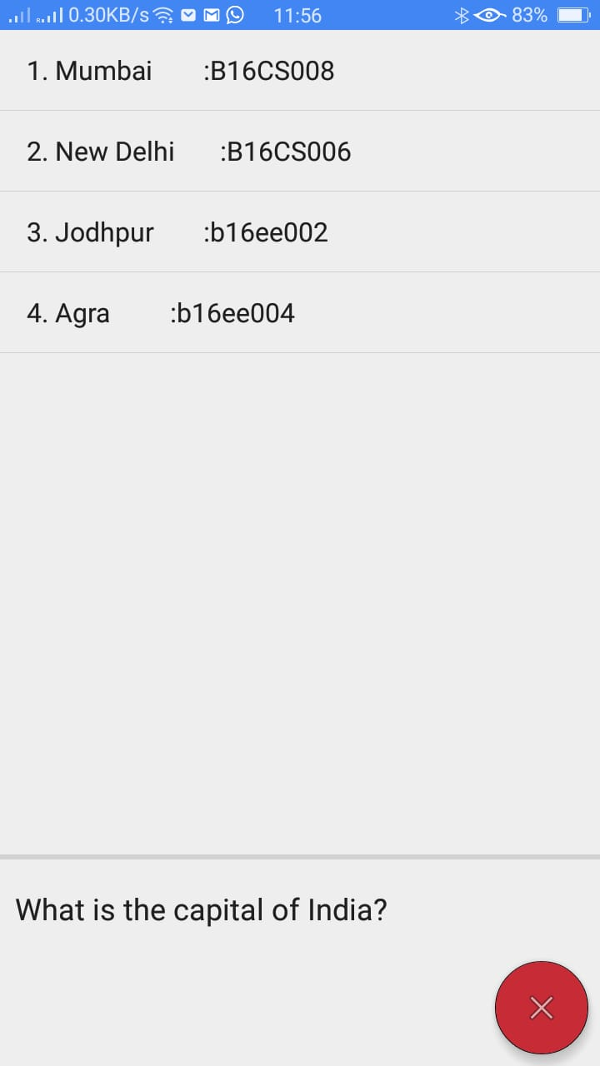
QUIZ POLL

Slide 20
Thank You

