Slide 1

Pattern Recognition Lab – A short introduction
模式识别实验室简介
Prof. Dr.-Ing. habil. Andreas Maier, Pattern Recognition Lab
Friedrich-Alexander-Universität Erlangen-Nürnberg, Germany

Slide 2
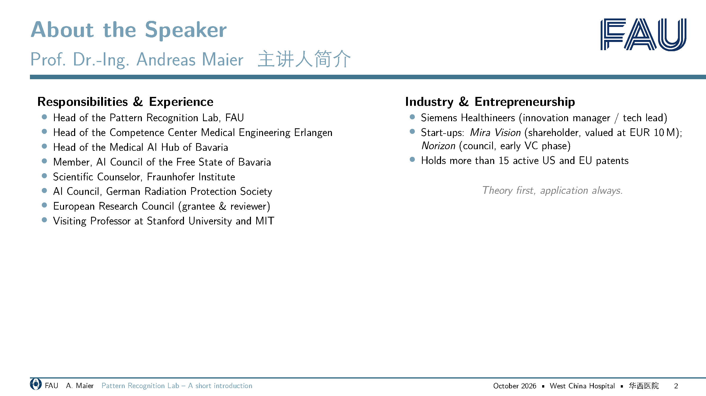
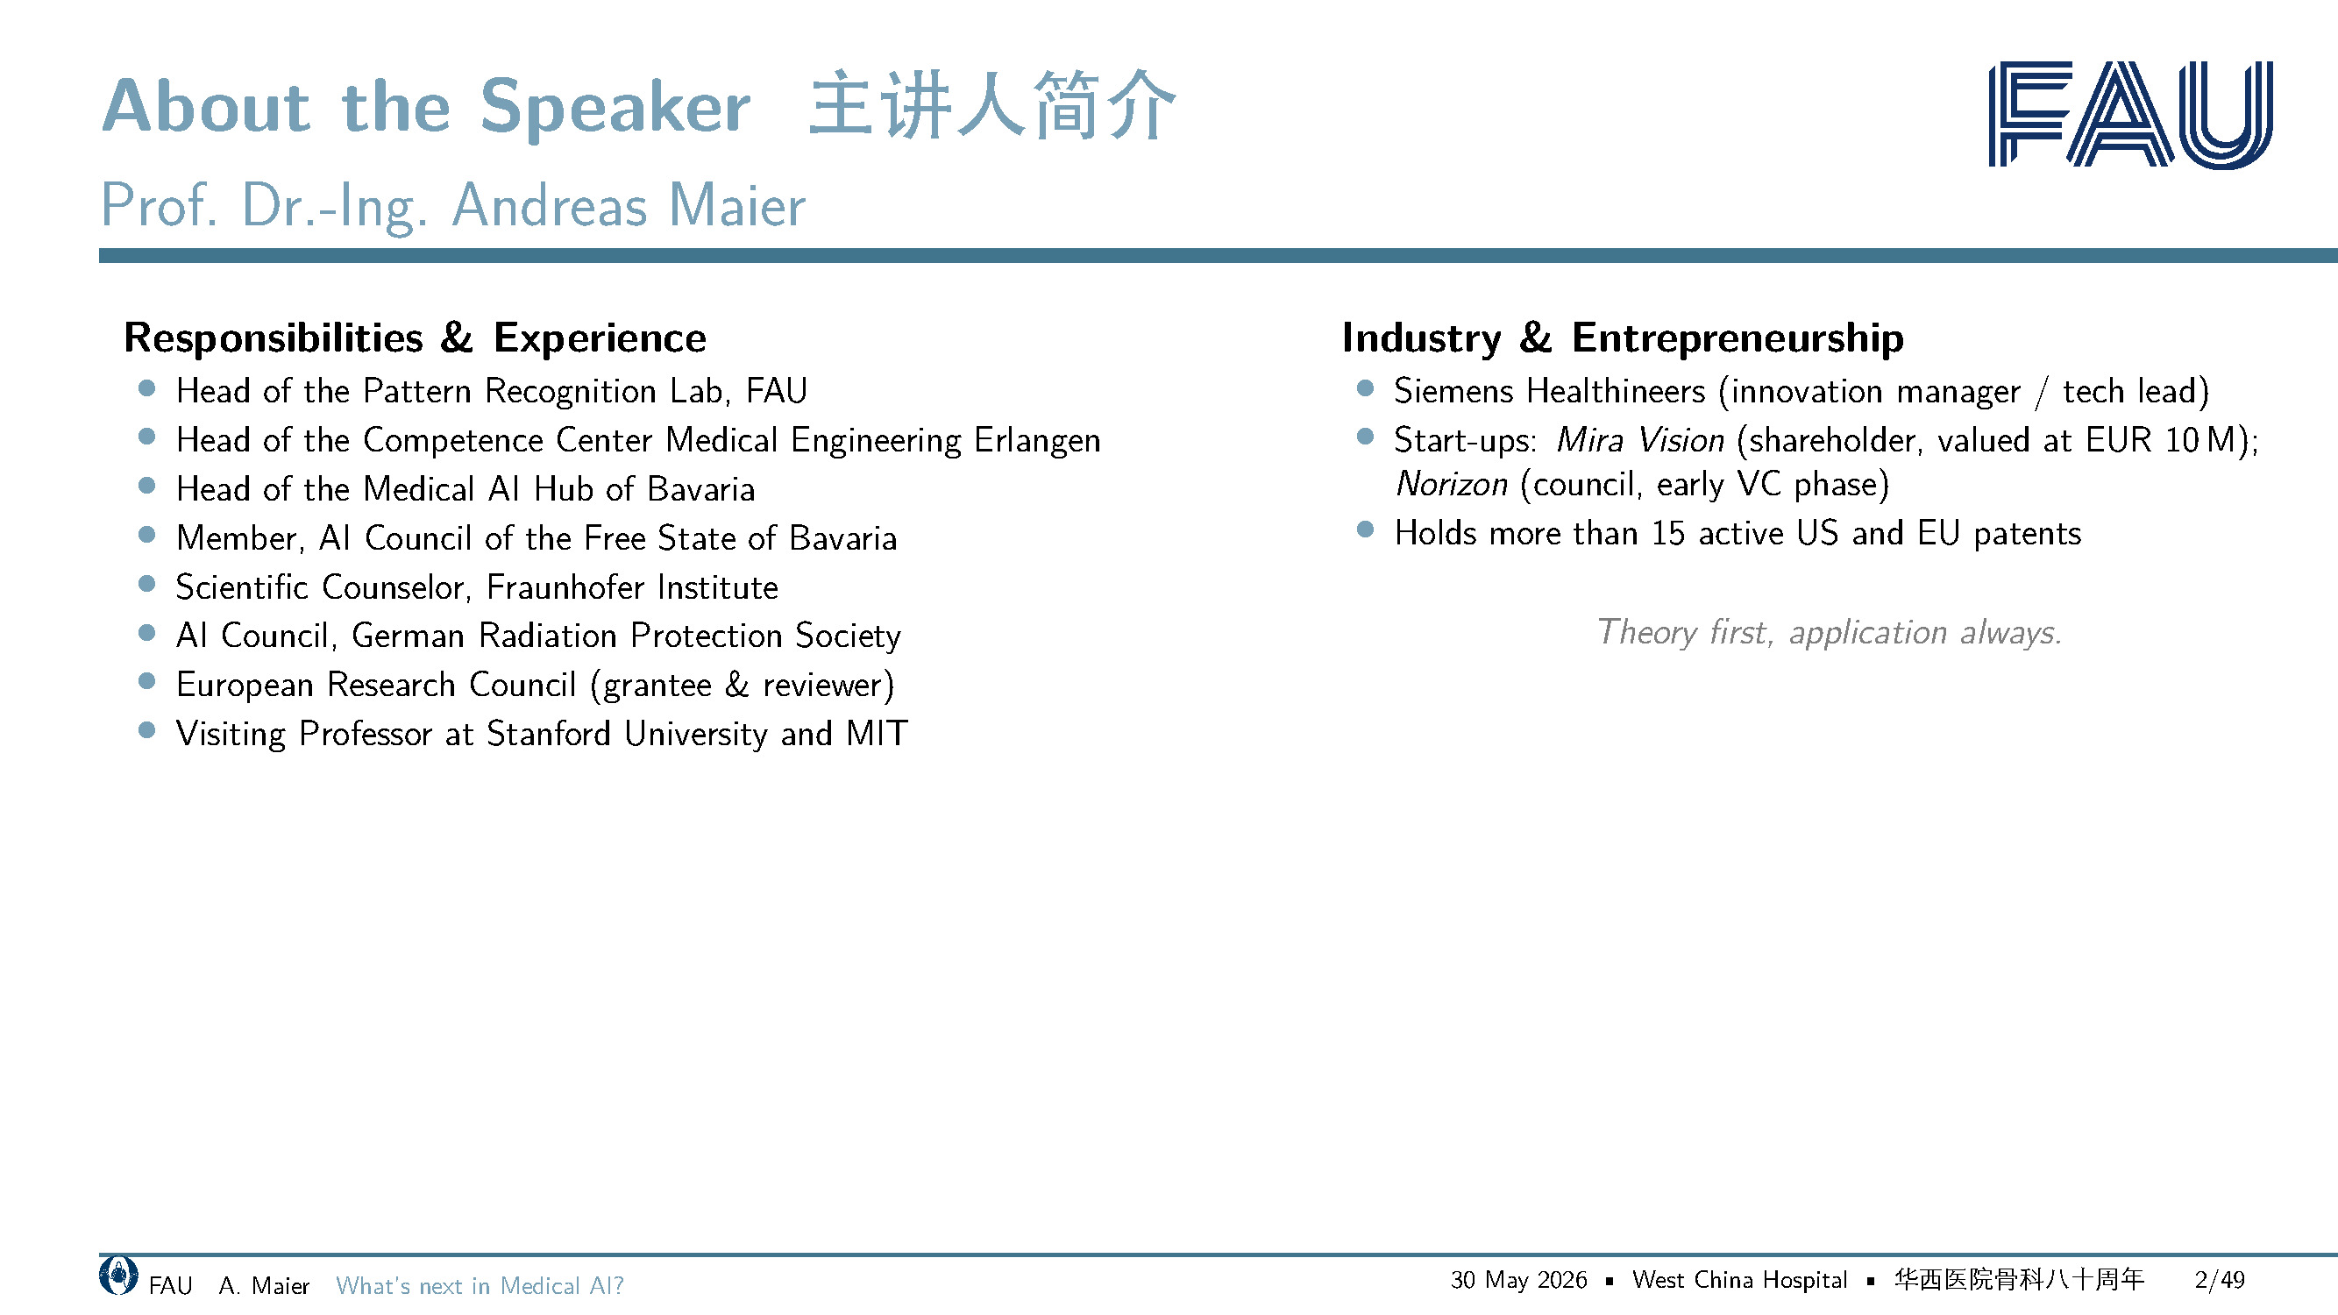

Slide 3

Profile Center FAU MT
FAU医学工程重点研究中心

Slide 4

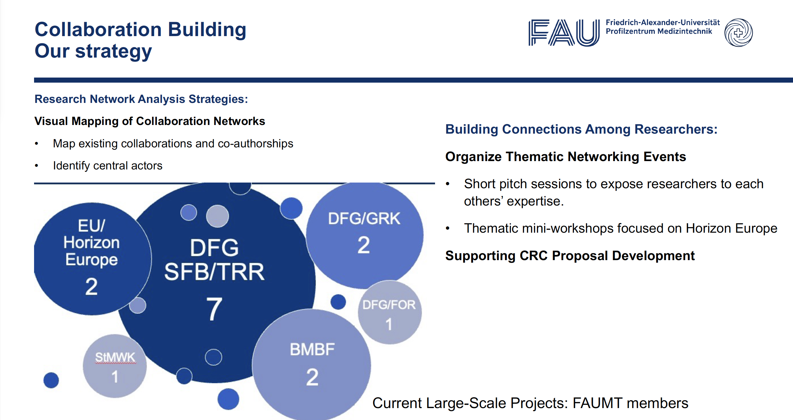
战略目标

Slide 5
合作网络建设：我们的策略

Slide 6
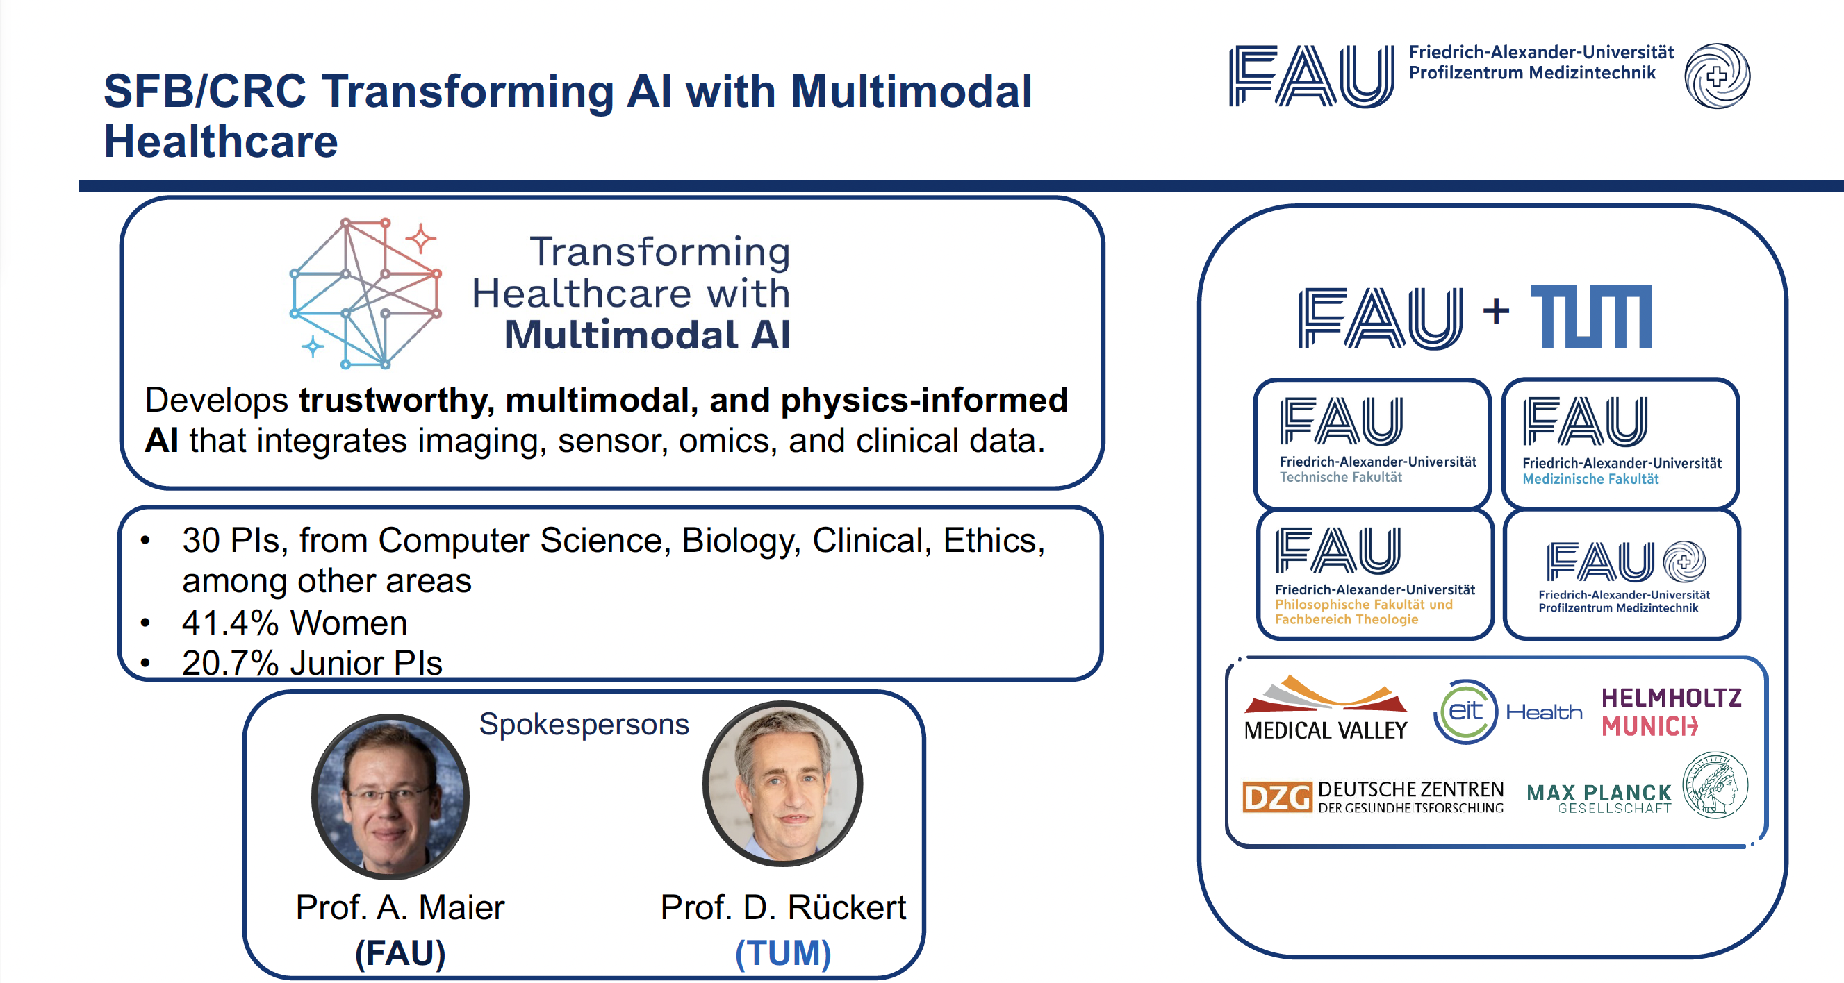
合作研究中心：以多模态人工智能变革医疗

Slide 7
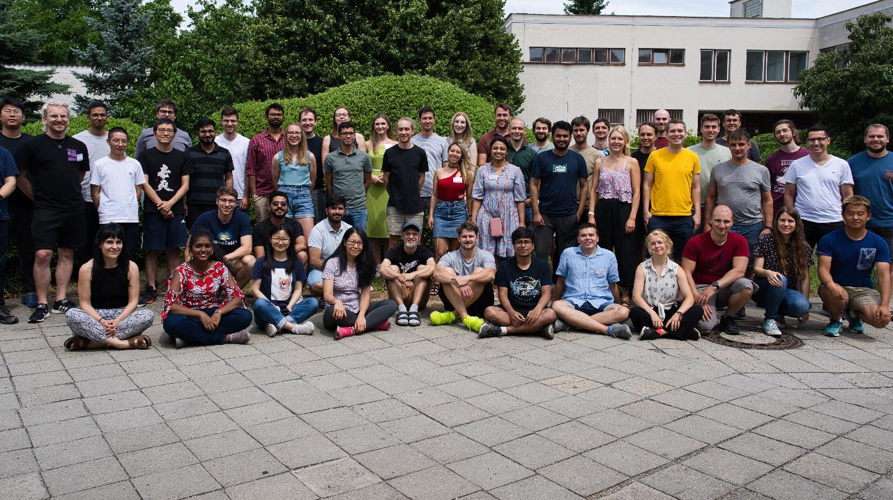
Pattern Recognition Lab
Friedrich-Alexander Universität Erlangen-Nürnberg
模式识别实验室

Slide 8
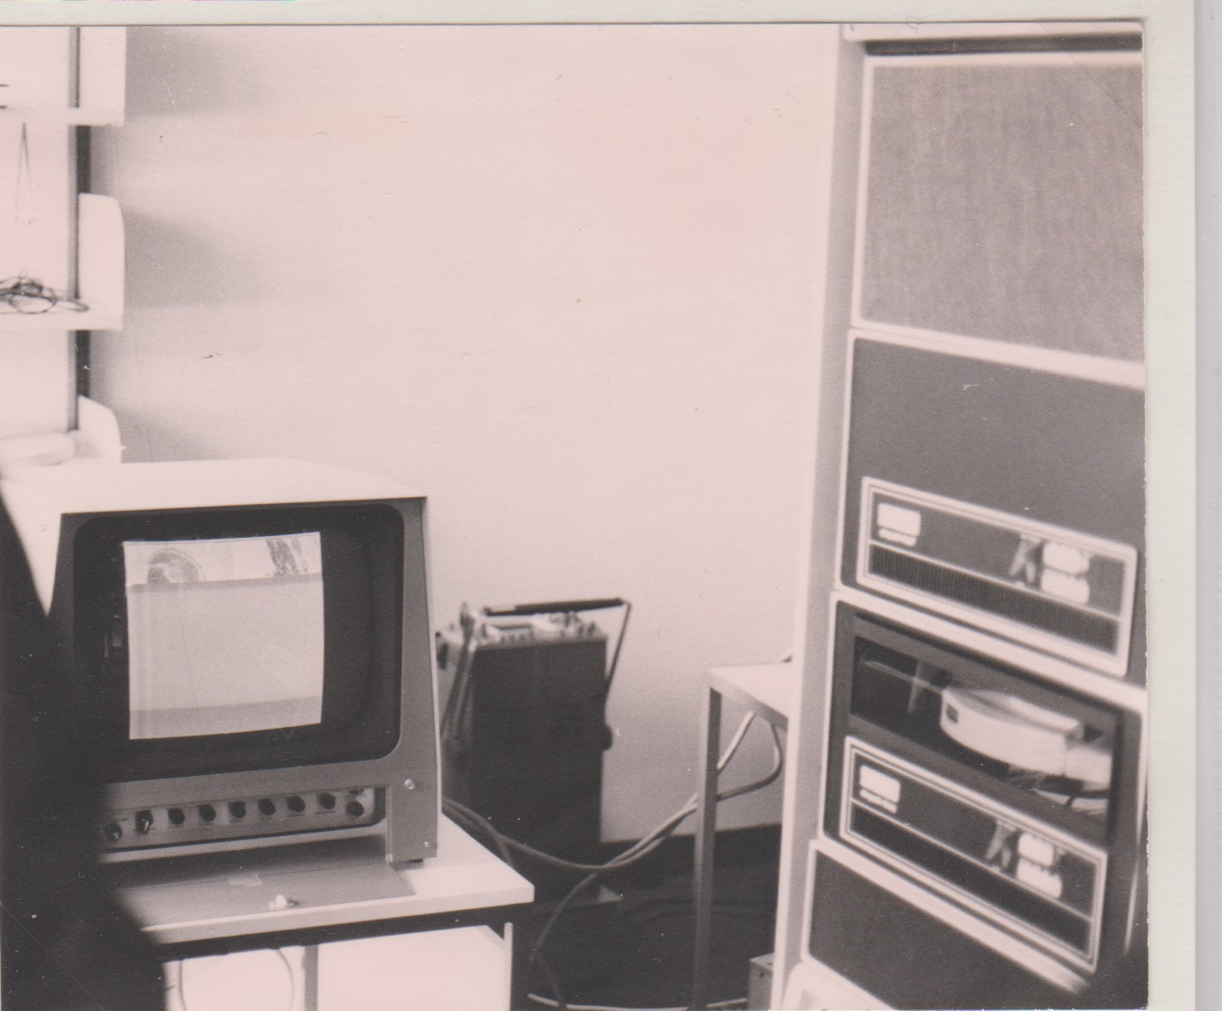
Know the Past to Understand the Future
温故而知新
Founded in 1975, Founder: Heinrich Niemann
Germany’s first dedicated Pattern Recognition / Machine Learning Lab
Medical Imaging as early as 1981
First Computer. PDP11/34 with 248 kB, 2.5 MHz
Focus: Theory & good Understanding of Hardware

Slide 9
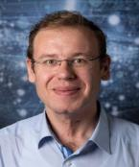


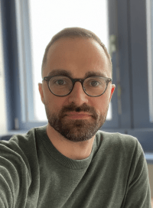
Our Team Today
Pattern Recognition Lab 我们的团队
Head of the Lab
Secretaries
Technician
Alexandra H.
Claudia S.
Prof. Dr.-Ing. Andreas Maier
Sven G.
~60 PhD students & 8 PostDocs
2 Emeritus Professors
~3709 Master & Bachelor students
Academic partners in Europe, Asia, North/South America, Australia
Industry partners: Siemens, Fraunhofer, Adidas, Intel, Audi, IBM, and more

Slide 10
Research Areas
Pattern Recognition Lab 研究方向
Computer Vision
Learning Algorithms for
Medical Big Data Analysis
Time Series Intelligence
Speech Processing
& Language Understanding
Magnetic Resonance
Imaging
Inverse Problems & Applications
Data Processing for
Utility Infrastructure

Slide 11
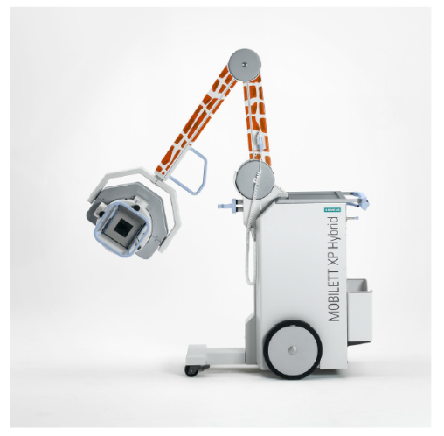
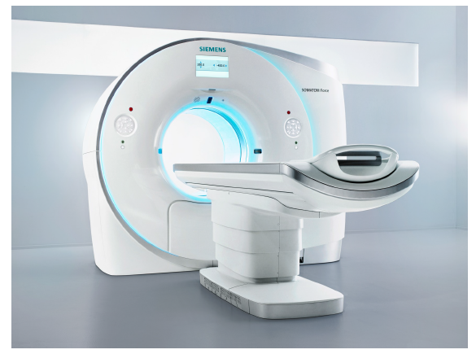
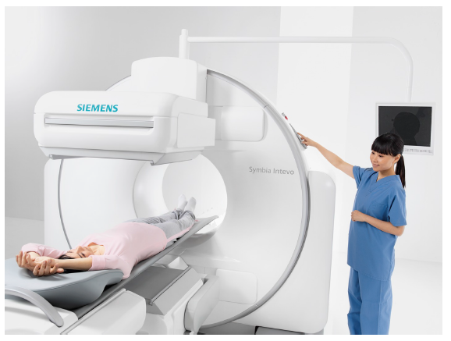
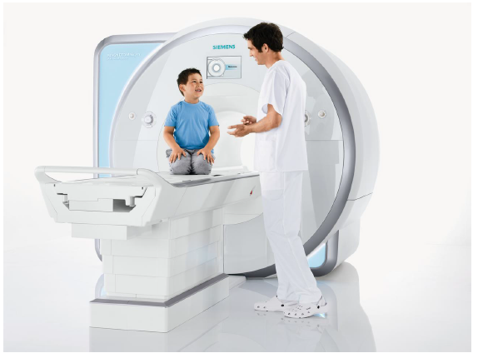
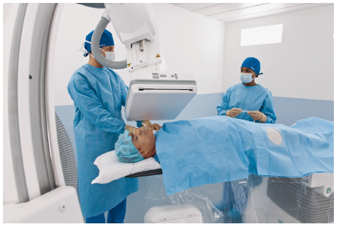
Work at the Lab
实验室的工作

Slide 12
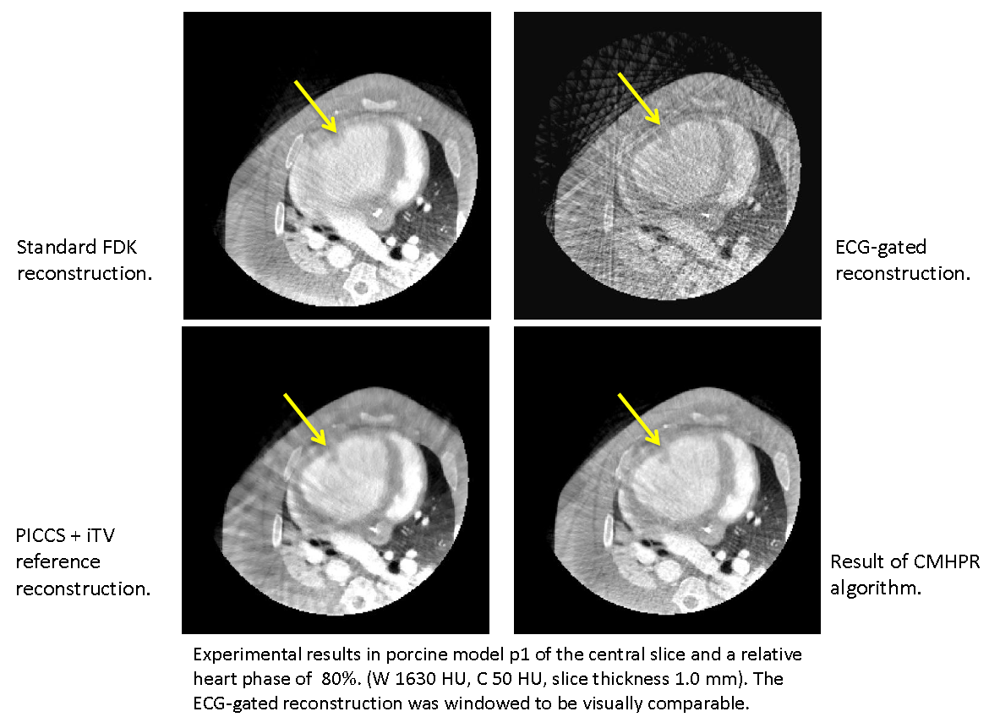
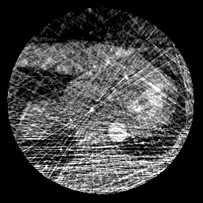
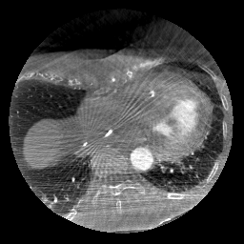
Motion Compensation
运动补偿

Slide 13
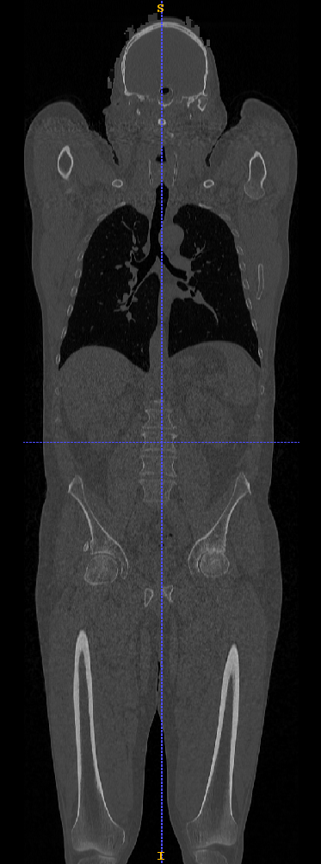
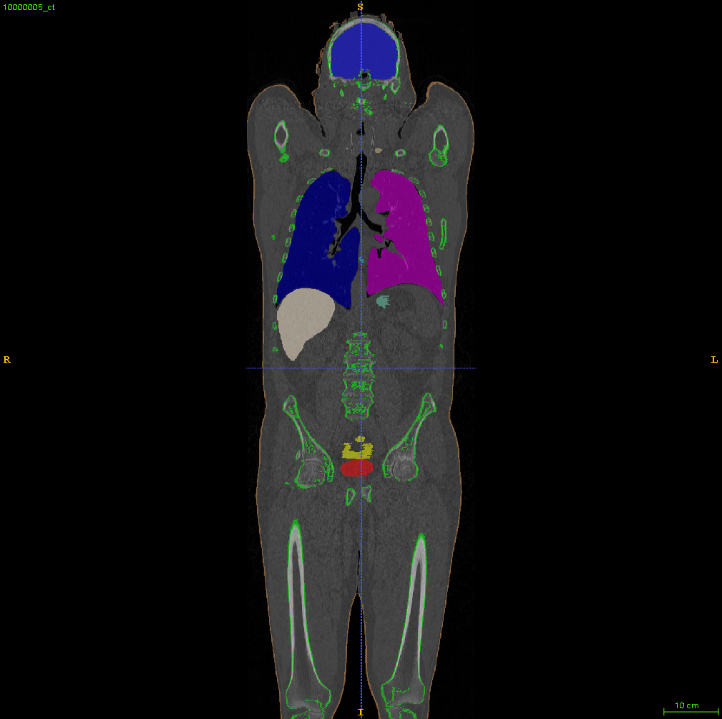
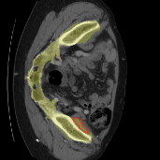
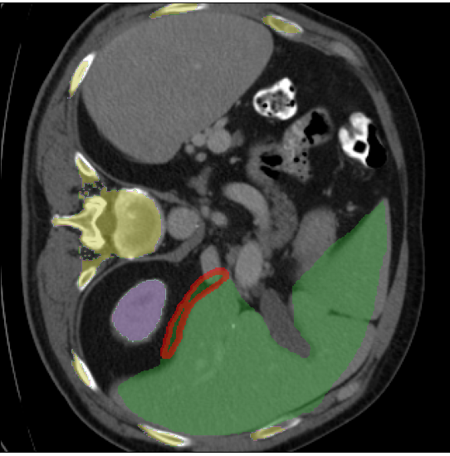
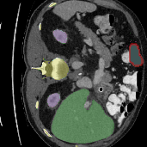
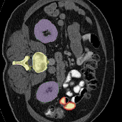
Multi-Organ Segmentation
多器官分割
Bone
Kidney
Liver
Lung
MCW-Object

Slide 14
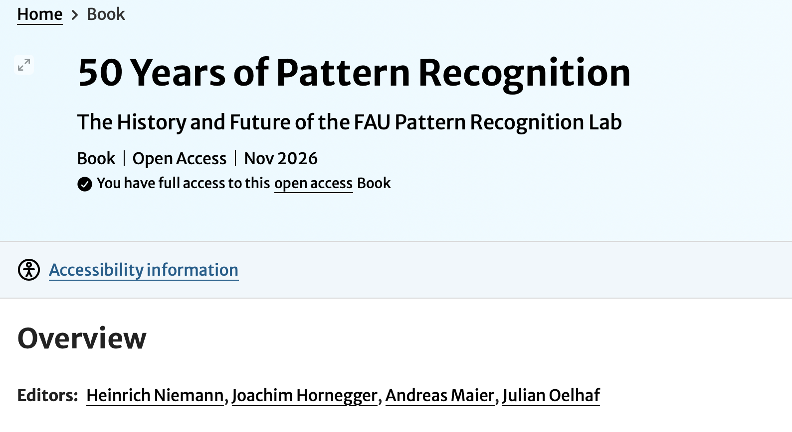
50 Years in a Nutshell
五十年历程概览

Slide 15
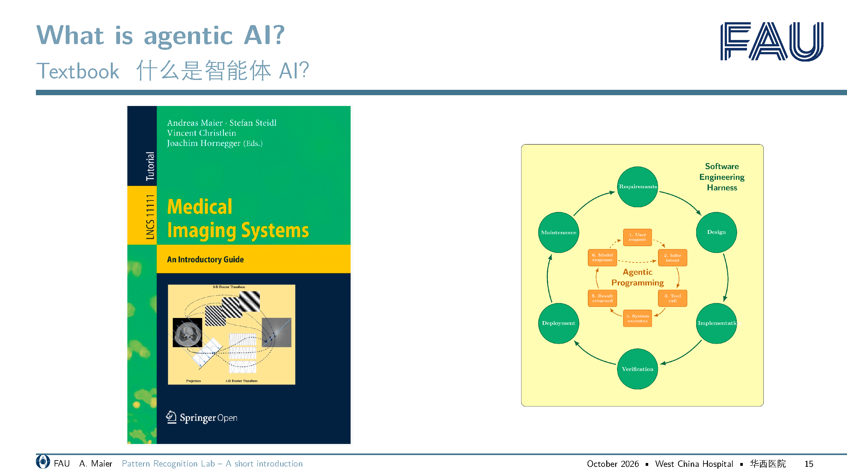


Slide 16

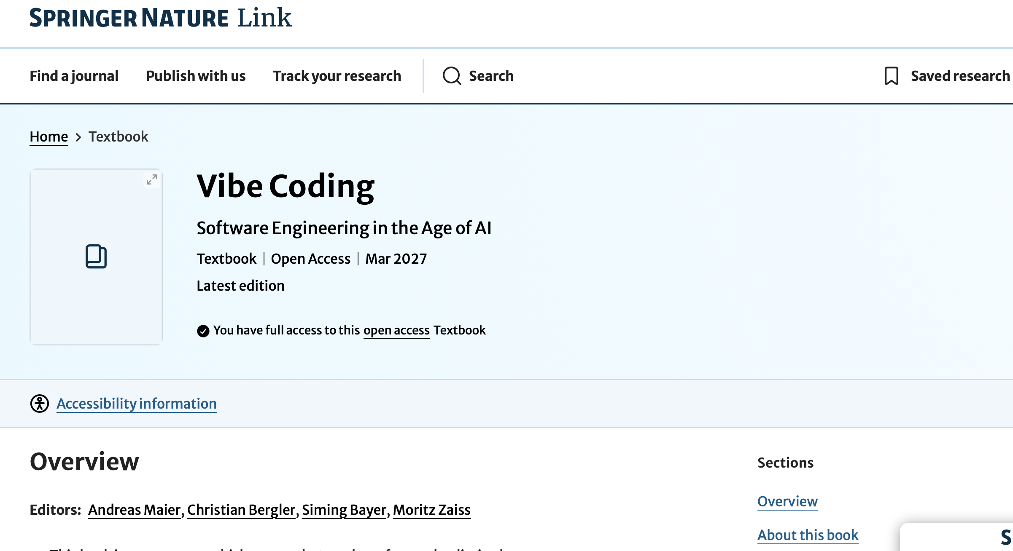

Slide 17
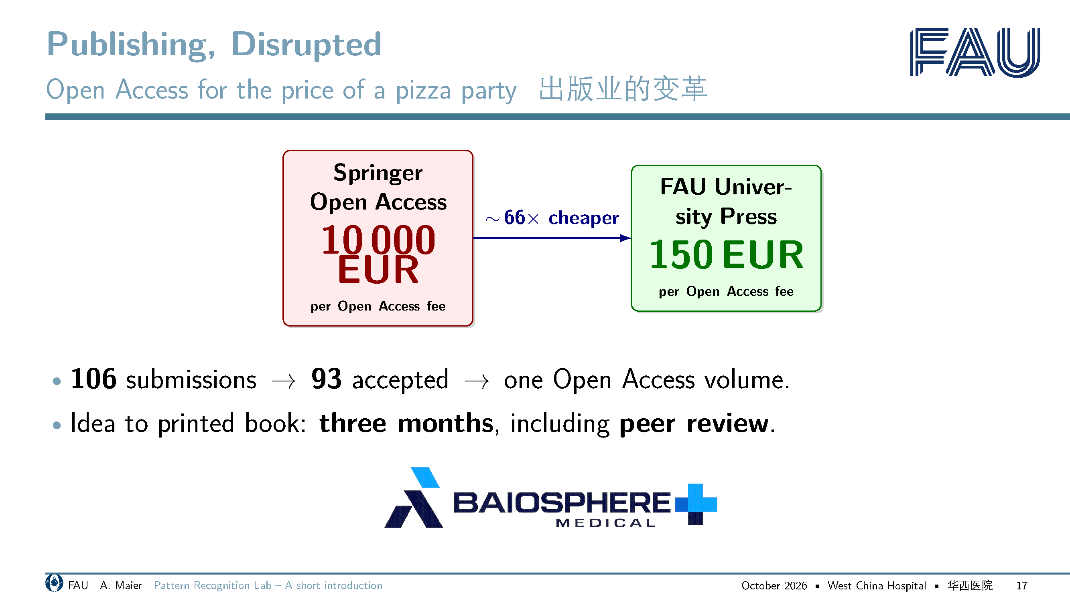
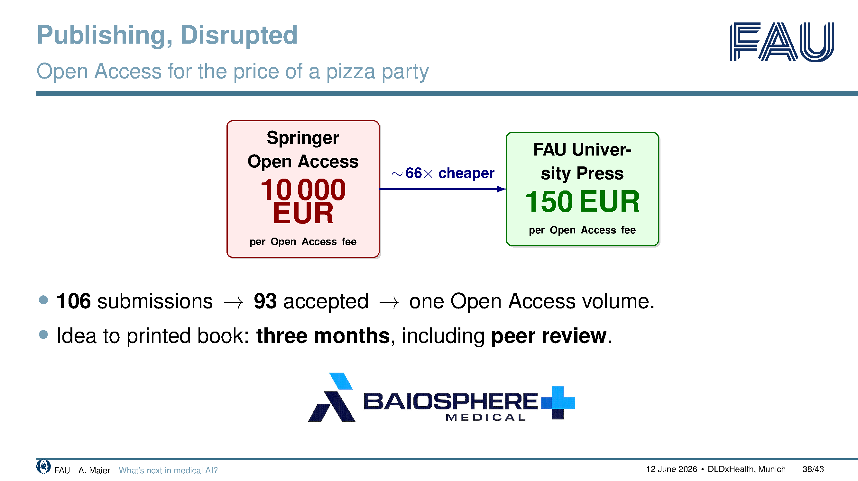

Slide 18
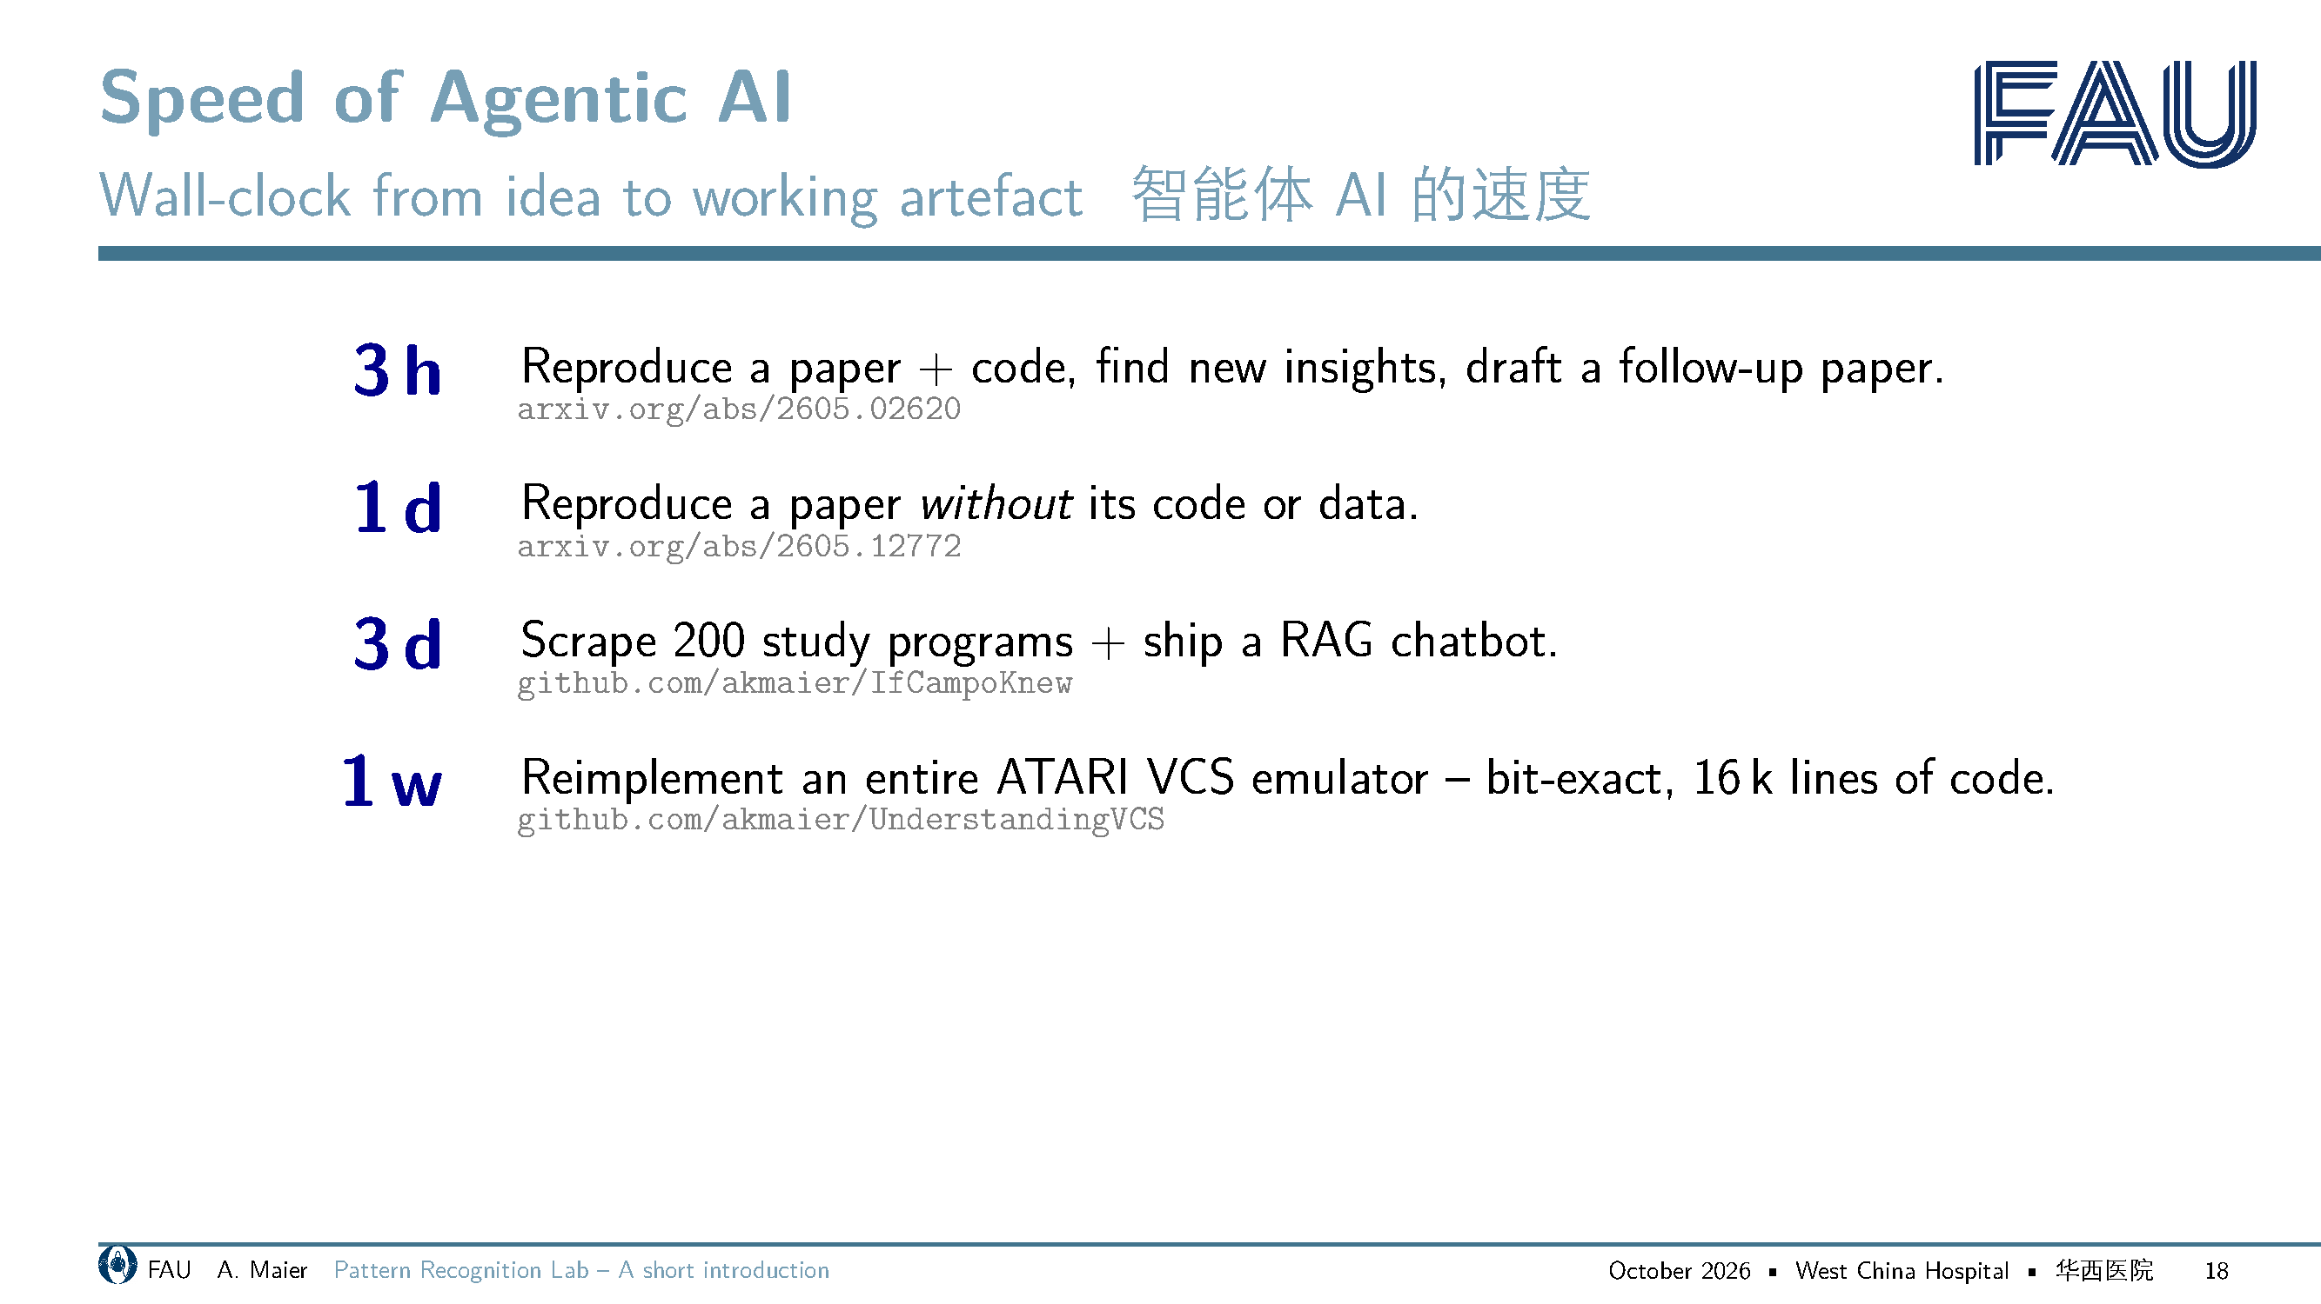
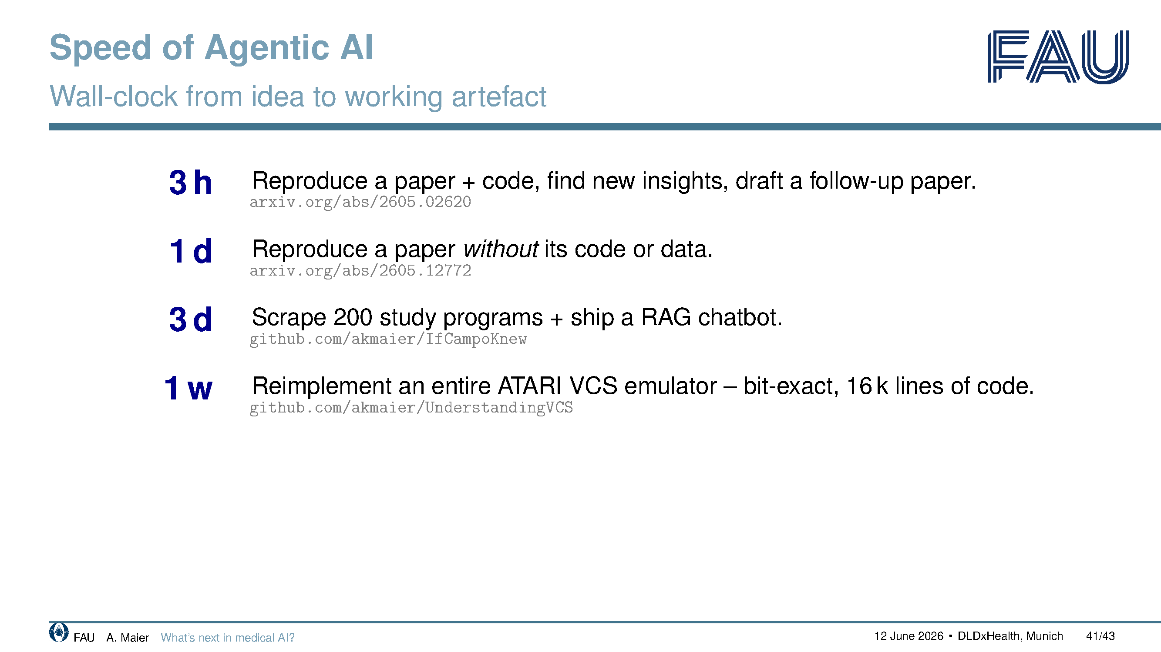

Slide 19

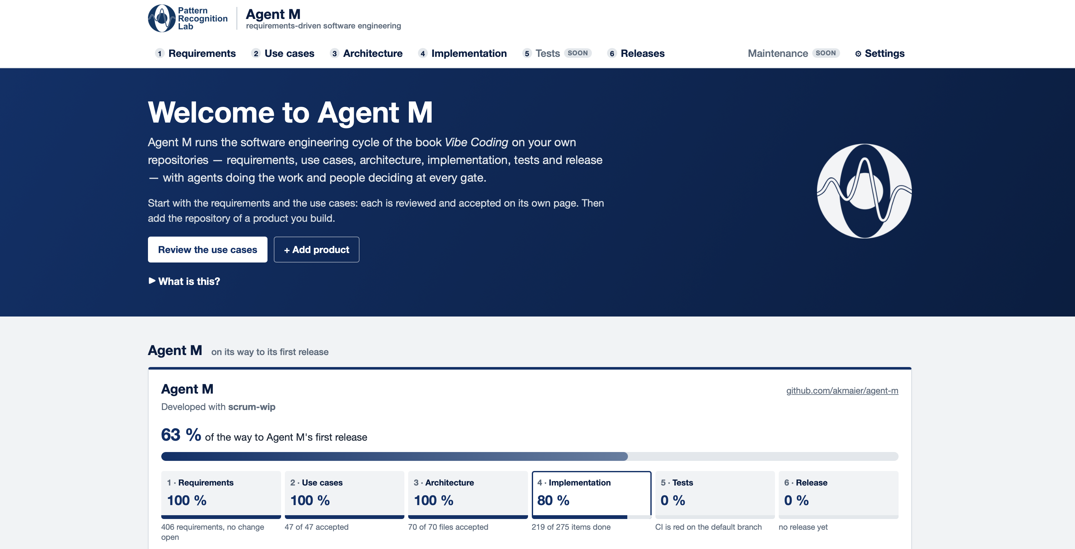

Slide 20

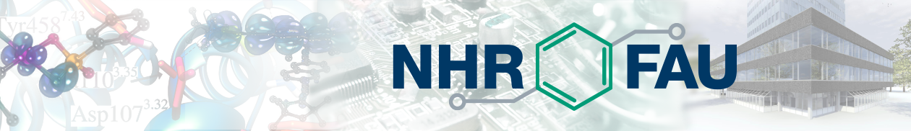
NHR @ FAU – Equipment Snapshot
NHR@FAU高性能计算中心：设备概览
Main GPU Clusters Alex and Helma:
    Alex runs A100 40 GB and A40 GPUs.
    Helma GPUs are Nvidia H100 and H200 accelerators.
One Helma node is exclusively reserved for LME
Total NHR GPU count across projects is 2000

Slide 21
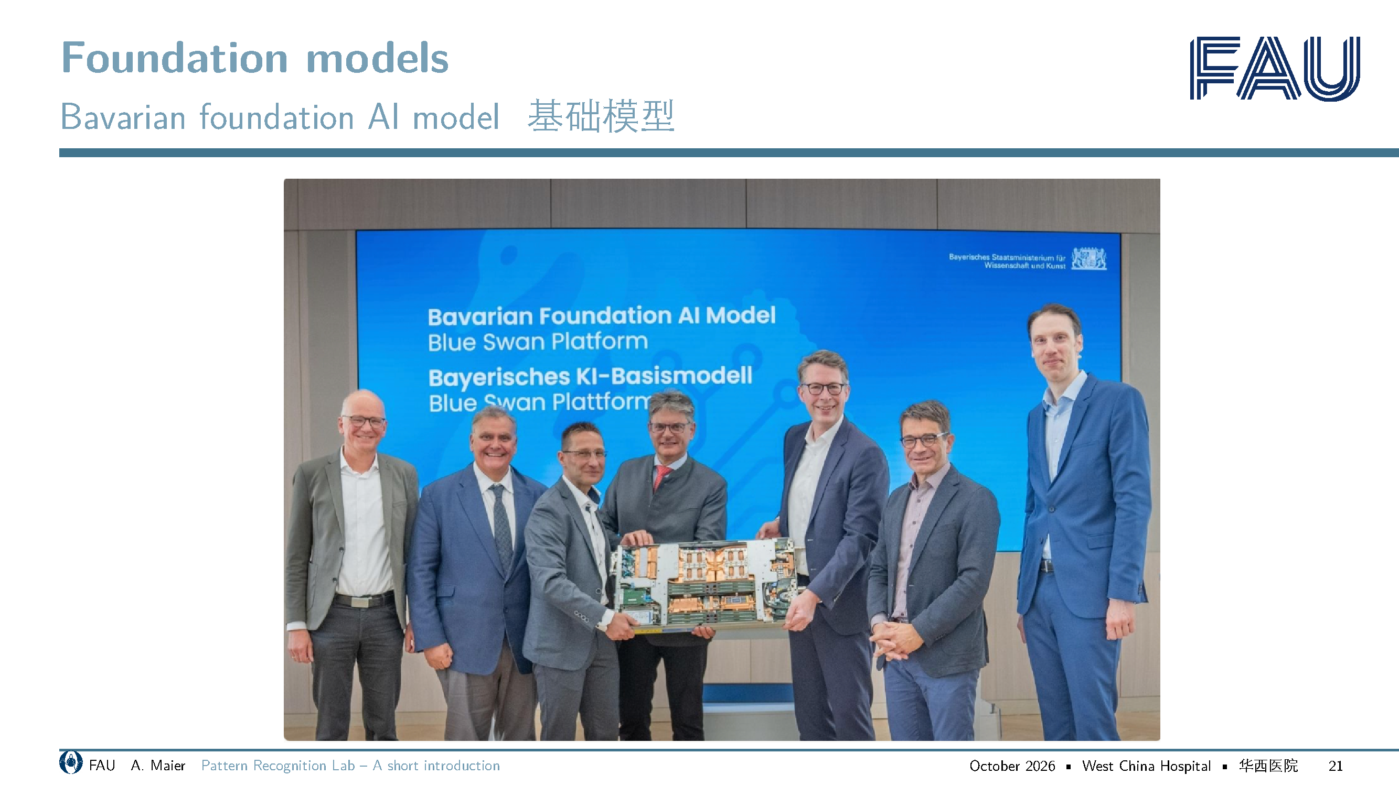
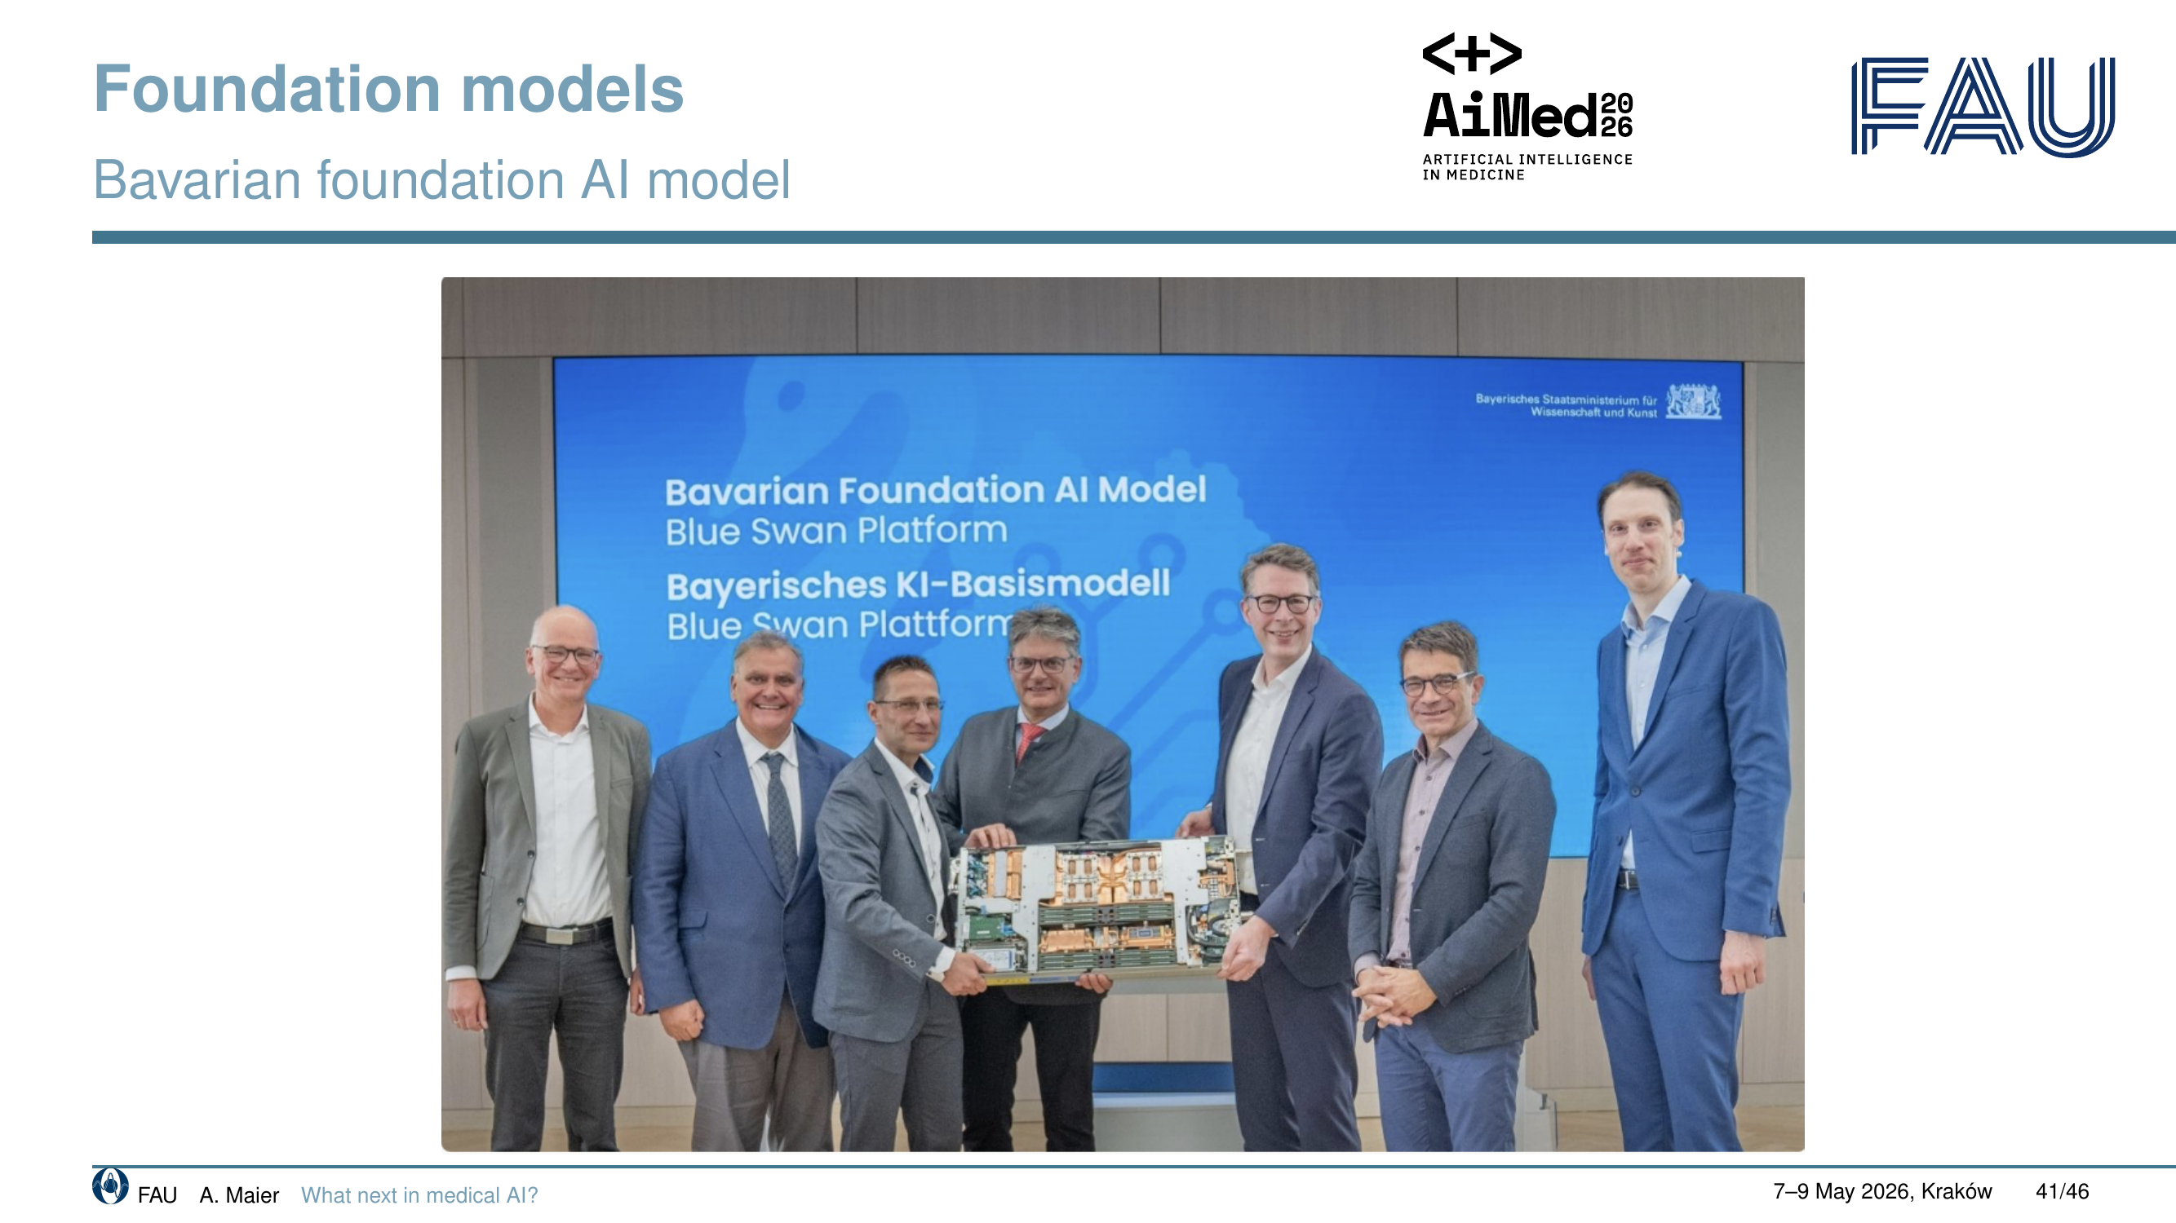

Slide 22
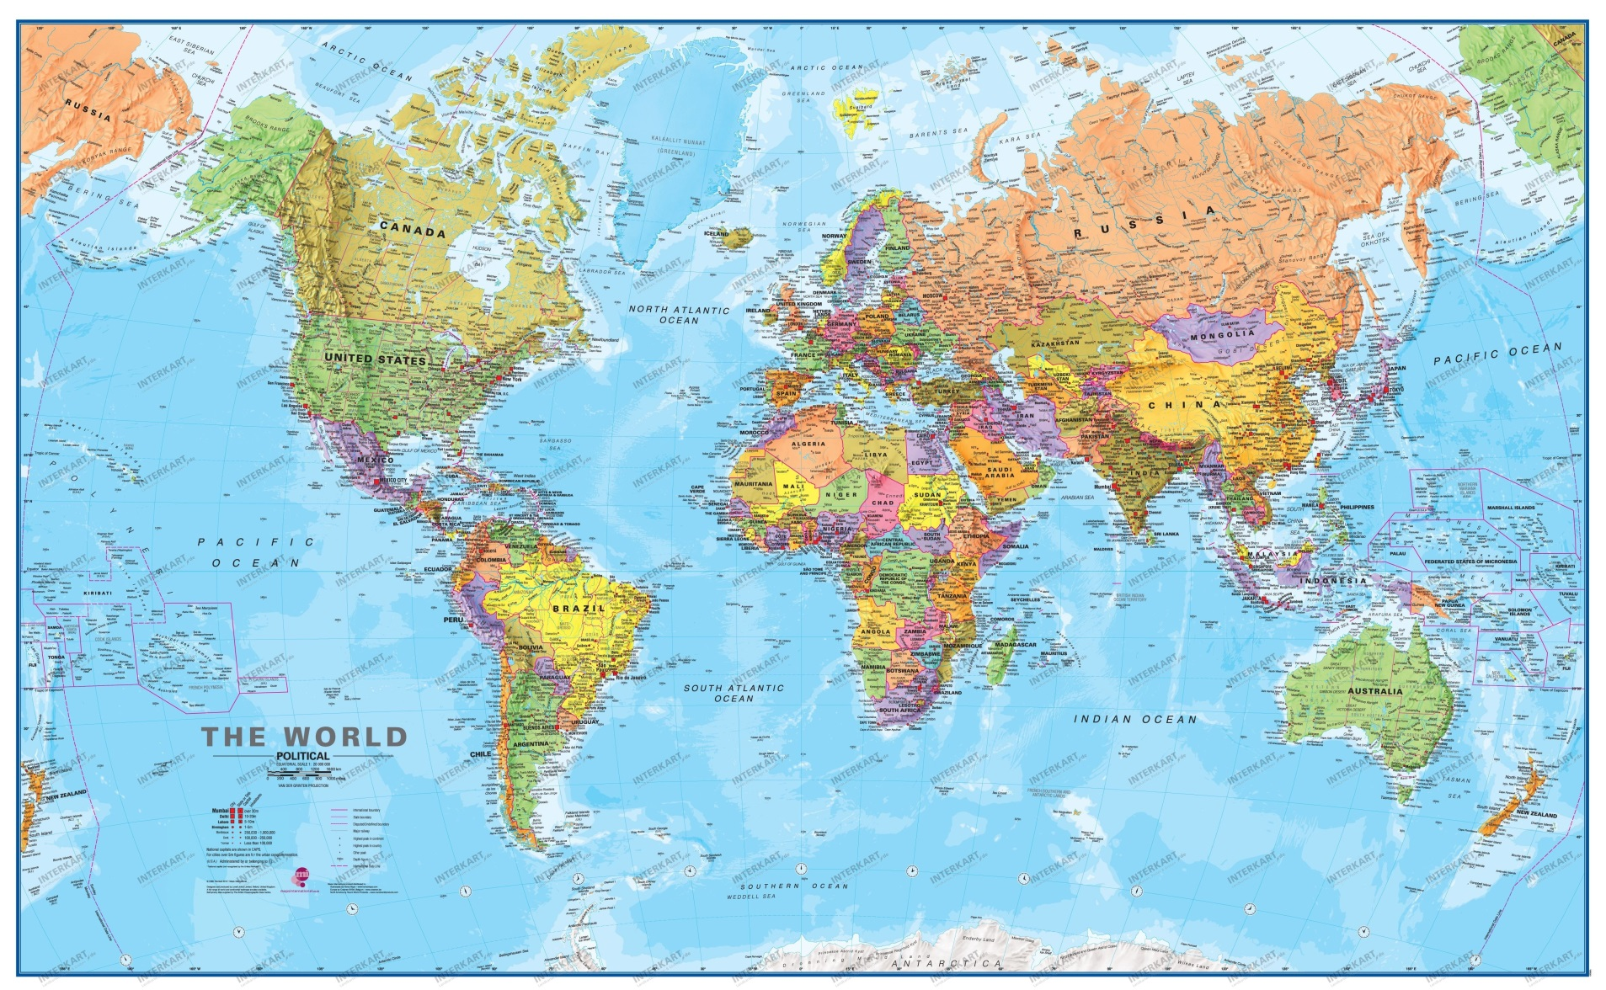
Cooperations
合作伙伴
Recent new cooperation sites
(in close collaboration w. R. Jerecic):
Shanghai Chest
West China Hospital
Peking Union Medical College Hospital
IIT Bengaluru
NIMHANS
Center for Brain Research
University of Alberta / Edmonton

Slide 23
