Slide 1

JAVA Major Project Download Manager

Slide 2
Collaborators
Aashima Sachdeva 18CSU003
Aditya Choudhary 18CSU011
Akshay Makkar 18CSU013
Anmol Nagpal 18CSU023
Anmol Sarpal 18CSU024

Slide 3
Problem Statement
A java application where we enter the download URL and the output folder.
The application can download the file from the entered URL to the provided folder.

Slide 4
Definition of Done
The system should ask the user to enter a valid URL. System should validate the URL.
The system should ask user to enter valid output folder path. System should validate the path.
The system should download the file from the provided URL and save it in the output folder and display the status.
The system should maintain the list of downloads requested and its status.
The project directory structure should explain about all subdirectories and what kind of files to be kept in particular subdirectory.
All configuration data should be kept in properties file. It should include maintainable data based on different categories.
The system should use ‘log4-j’ for logging. Logger should use console and file appender for file logging.

Slide 5
Workflow:
Welcome to Download Manager
Enter URL
Validation of URL
Enter Filename
(with extension)
Validation of Path
Enter Path
File gets downloaded if both validations are TRUE.
Write features of file to CSV file
Thank You for using Download Manager

Slide 6
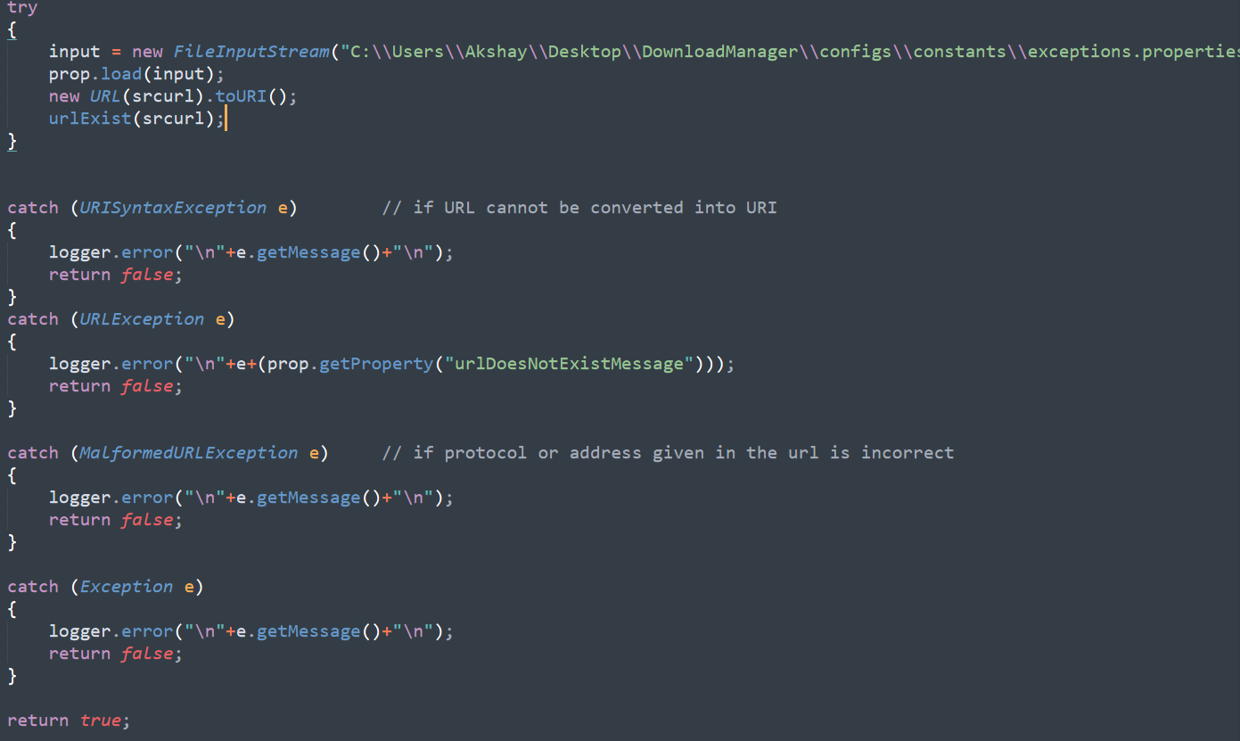
DoD 1: The system should ask the user to enter a valid URL. System should validate the URL.

Slide 7
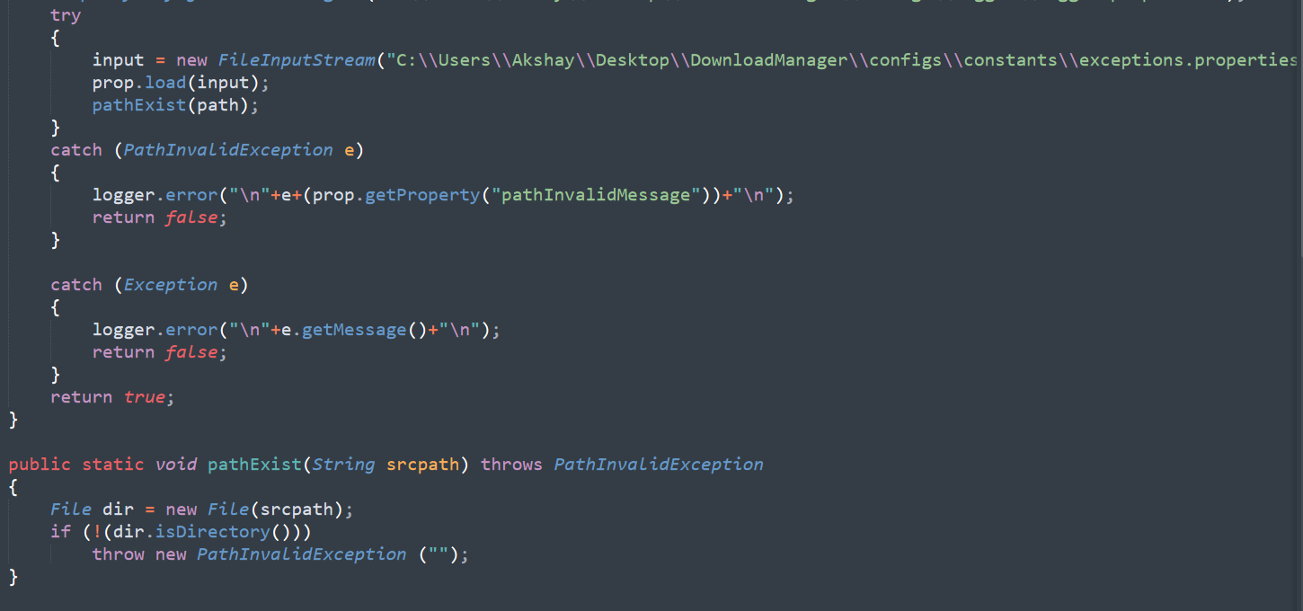
DoD 2: The system should ask user to enter valid output folder path. System should validate the path.

Slide 8
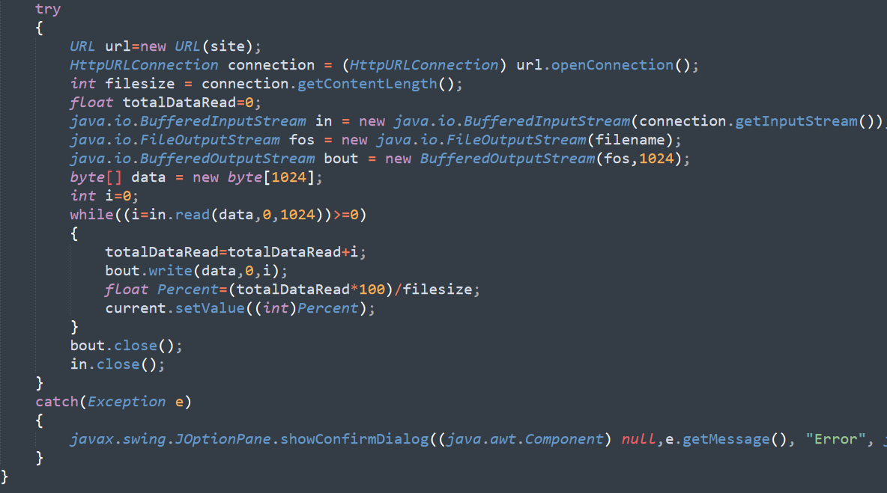
DoD 3: The system should download the file from the provided URL and save it in the output folder and display the status.

Slide 9
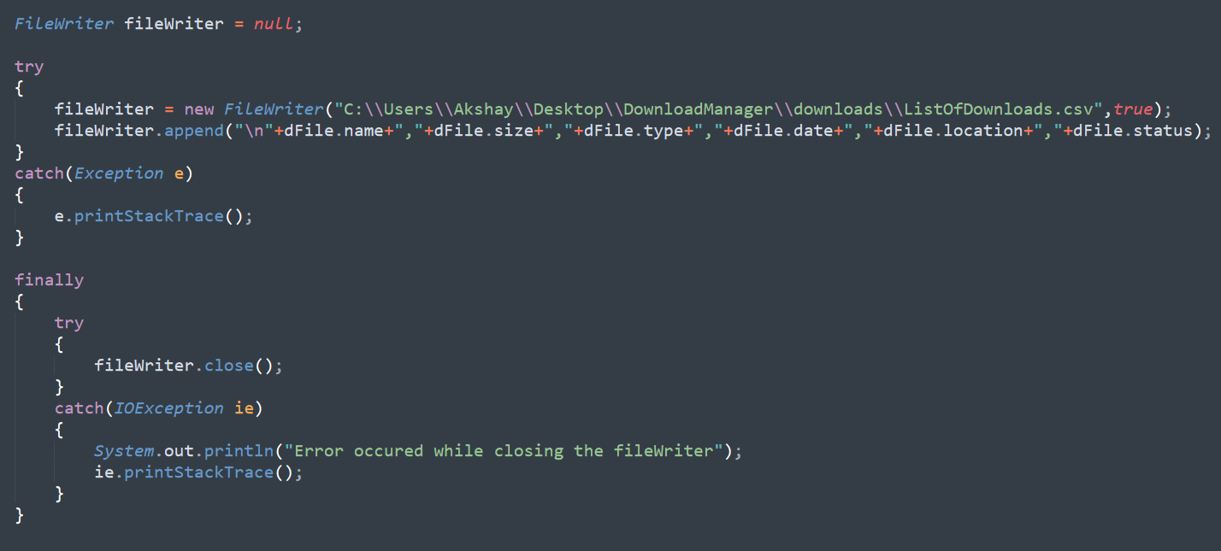
DoD 4: The system should maintain the list of downloads requested and its status.

Slide 10
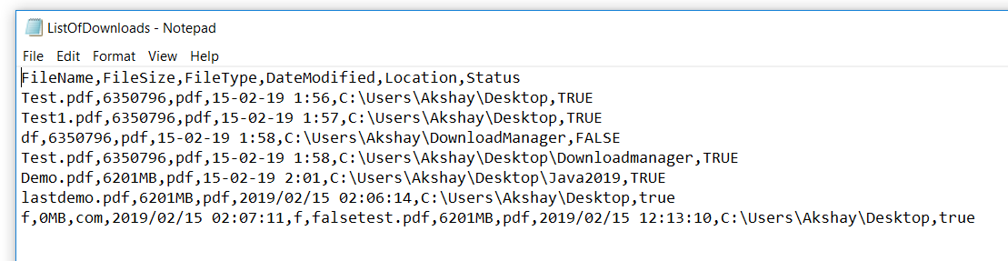
Maintained List

Slide 11
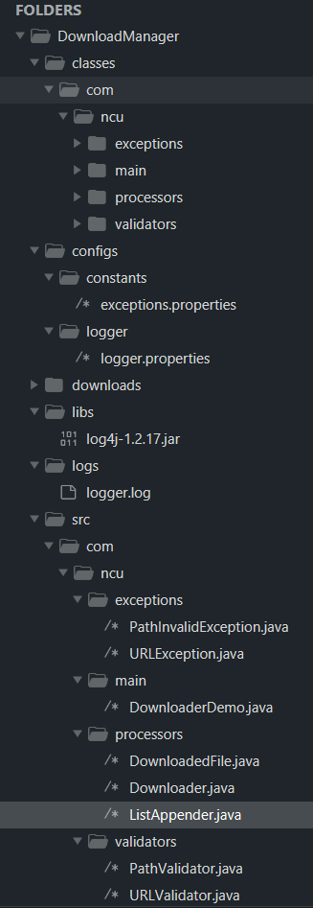
DoD 5: The project directory structure should explain about all subdirectories and what kind of files to be kept in particular subdirectory.

Slide 12
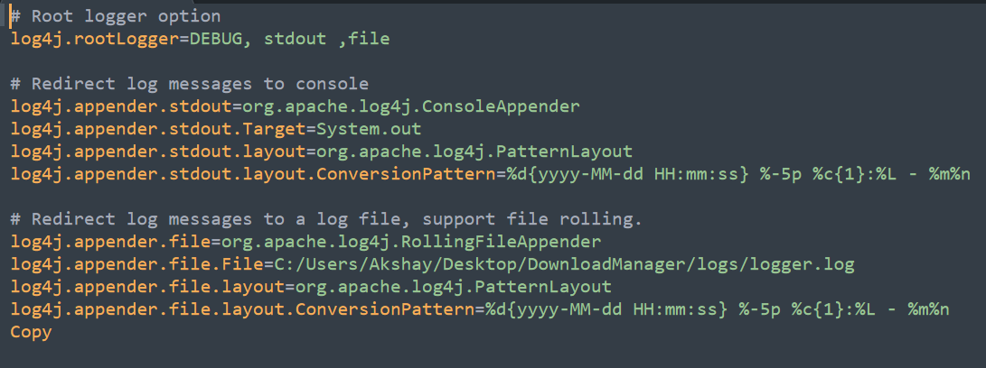
DoD 6: All configuration data should be kept in properties file. It should include maintainable data based on different categories.

Slide 13
DoD 7: The system should use ‘log4-j’ for logging. Logger should use console and file appender for file logging.

Slide 14
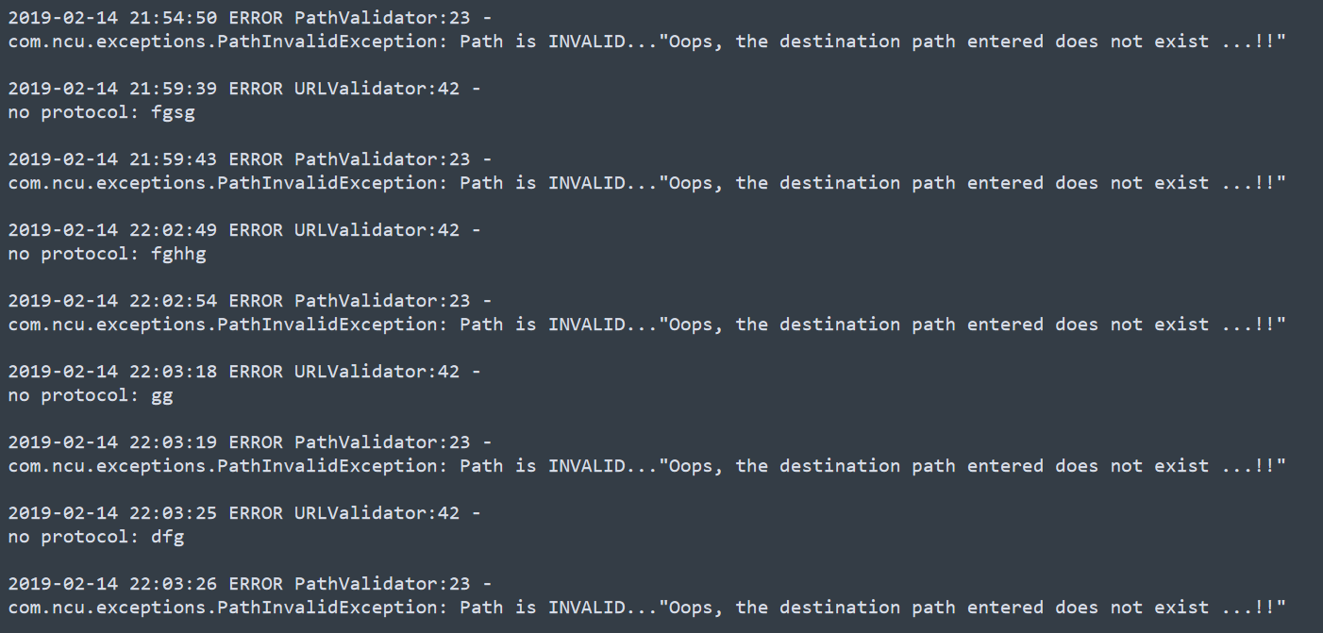
Created Logs

Slide 15
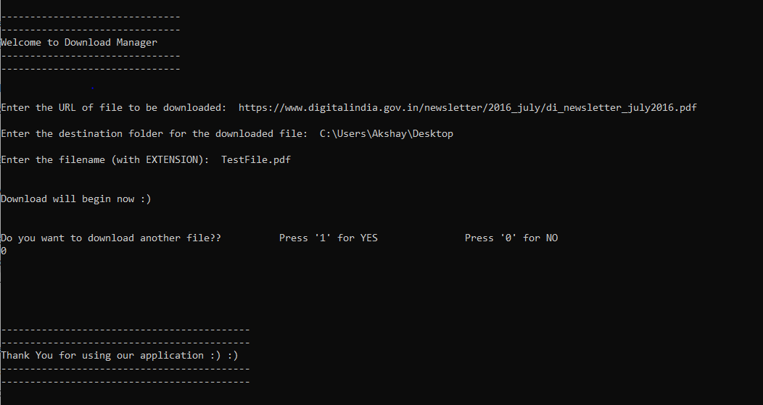
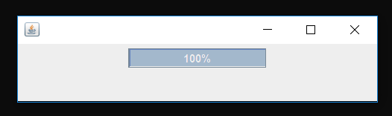
Demo Successful Execution

Slide 16
Additional Features
Displayed live download status bar.
Added different features of file in the maintained list:
size, type, location, date modified.

Slide 17
Thank You

