Slide 1
Java Project
Collaborators:
Aashima Sachdeva – 18CSU003
Aditya Choudhary – 18CSU011
Akshay Makkar – 18CSU013
Anmol Nagpal – 18CSU023
Anmol Sarpal – 18CSU024

Slide 2
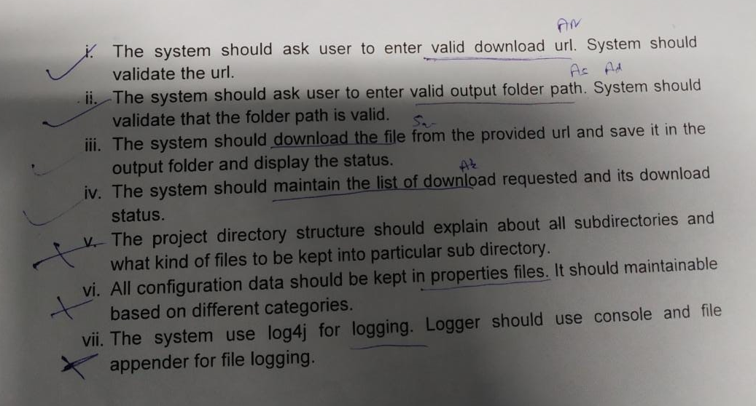
Overview
Title: Download Manager
DODs:

Slide 3
Basic Workflow:
Enter URL
Enter Destination
Download in progress
File Downloaded [if url and destination are valid]

Slide 4
Tasks performed today:
Tasks Status
Validating URL 65%
Validating Destination Folder 100%
Overview of MAIN class 80%
Maintaining download list and status 20%
Folder Structure 100%
Git Private Repository 100%
Added Collaborators 100%

Slide 5
Source Code:

Slide 6
Path Validator
package com.ncu.validators;
import java.io.*;
public class PathValidator
{
public static boolean checkPath(String path)
{
File dir = new File(path);
return dir.isDirectory();
}
}

Slide 7
URL Validator

Slide 8
Main:
package com.ncu.main;
import java.util.*;
import com.ncu.exceptions.*;
import com.ncu.validators.*;
import com.ncu.processors.*;
public class DownloaderDemo
{
public static void main(String[] args)
{
Downloader obj = new Downloader();
Scanner scan = new Scanner(System.in);
System.out.println("Enter the URL of file to be downloaded: ");
URLValidator validURL = new URLValidator();
obj.url = scan.nextLine();
boolean isFileURLOk = validURL.checkURL(obj.url);

Slide 9
System.out.println("Enter the destination folder for the downloaded file: ");
PathValidator validPath = new PathValidator();
obj.path = scan.nextLine();
boolean isPathOk = validPath.checkPath(obj.path);
if (isFileURLOk && isPathOk)
obj.downloader();
}
}

Slide 10
Day-2:

Slide 11
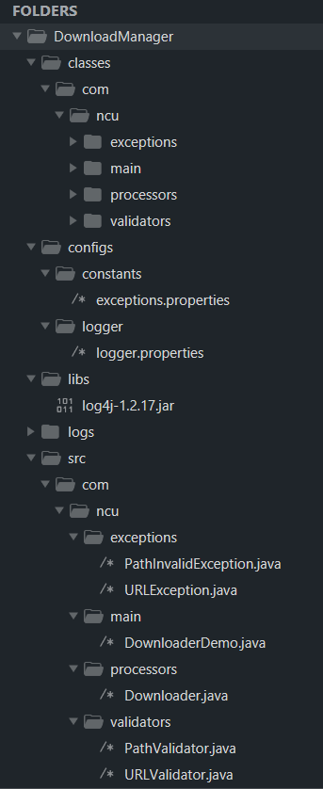
Folder Structure

Slide 12
Progress:
Validators
PathValidator 100%
URLValidator 100%
Processors
Downloader 100%
Exceptions
PathException 100%
URLException 100%
Main
DownloaderDemo 80%
TOTAL PROGRESS 85%

Slide 13
Demo:
Test File URL: https://www.digitalindia.gov.in/newsletter/2016_july/di_newsletter_july2016.pdf
Test File Location:
C:\Users\Akshay\Desktop

Slide 14
References:
Geeksforgeeks.com
Java1000projects.com
Marvinlee.wordpress.com

