Slide 1


JAVA Major Project Download Manager
FOCP-II (CSL-108)

Slide 2

Collaborators:
Aditya Choudhary
Aashima Sachdeva
Group
02
Akshay Makkar
Anmol Sarpal
Anmol Nagpal

Slide 3
Problem Statement:
A java application where we enter the download URL and the output folder.
The application can download the file from the entered URL to the provided folder.
18 February, 2019

Slide 4
Definition of Done:
The system should ask the user to enter a valid URL. System should validate the URL.
The system should ask user to enter valid output folder path. System should validate the path.
The system should download the file from the provided URL and save it in the output folder and display the status.
The system should maintain the list of downloads requested and its status.
The project directory structure should explain about all subdirectories and what kind of files to be kept in particular subdirectory.
All configuration data should be kept in properties file. It should include maintainable data based on different categories.
The system should use ‘log4-j’ for logging. Logger should use console and file appender for file logging.
18 February, 2019

Slide 5
Workflow:
Welcome to Download Manager
Enter URL of file to be downloaded
Validation of URL
Enter Filename
Validation of Path
Choose default path or enter custom path
File gets downloaded if both validations are TRUE.
Write features of file to CSV file
Thank You for using Download Manager
18 February, 2019

Slide 6
Code Snippets for each DoD:
18 February, 2019

Slide 7
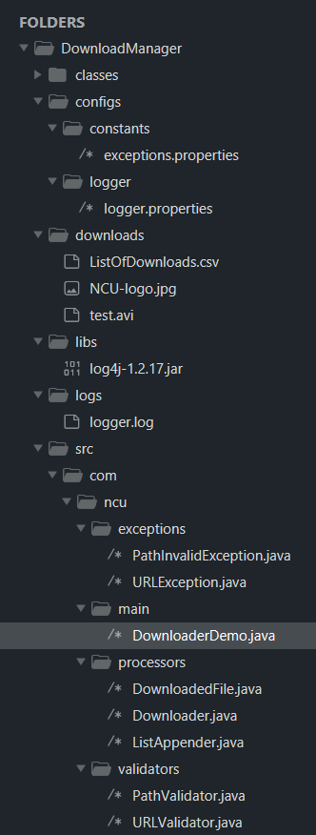
DoD : The project directory structure should explain about all subdirectories and what kind of files to be kept in particular subdirectory.
18 February, 2019

Slide 8
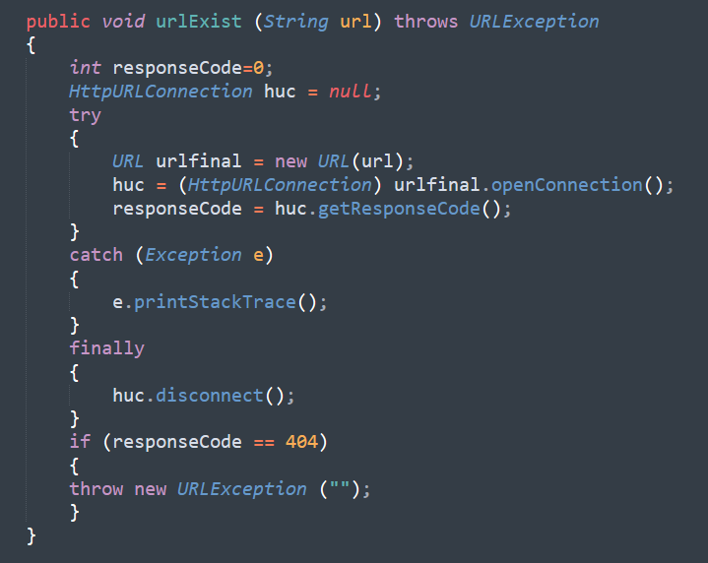
DoD: The system should ask the user to enter a valid URL. System should validate the URL.
18 February, 2019

Slide 9
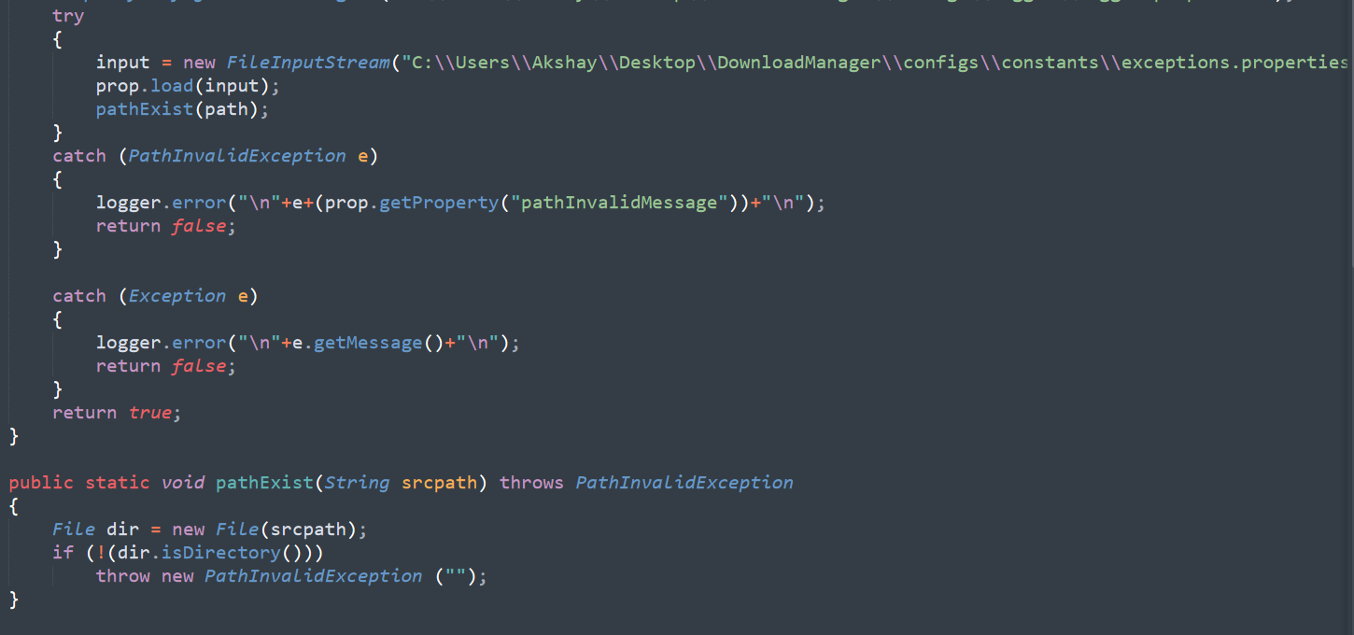
DoD: The system should ask user to enter valid output folder path. System should validate the path.
18 February, 2019

Slide 10
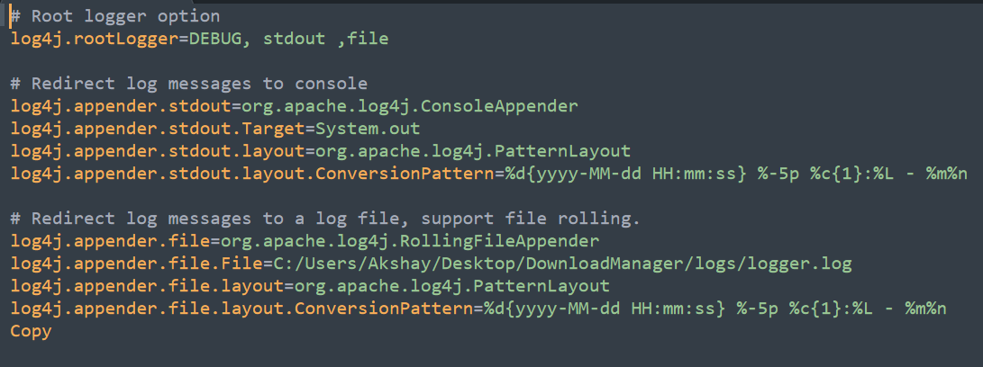
DoD: All configuration data should be kept in properties file. It should include maintainable data based on different categories. The system should use ‘log4-j’ for logging. Logger should use console and file appender for file logging.
18 February, 2019

Slide 11
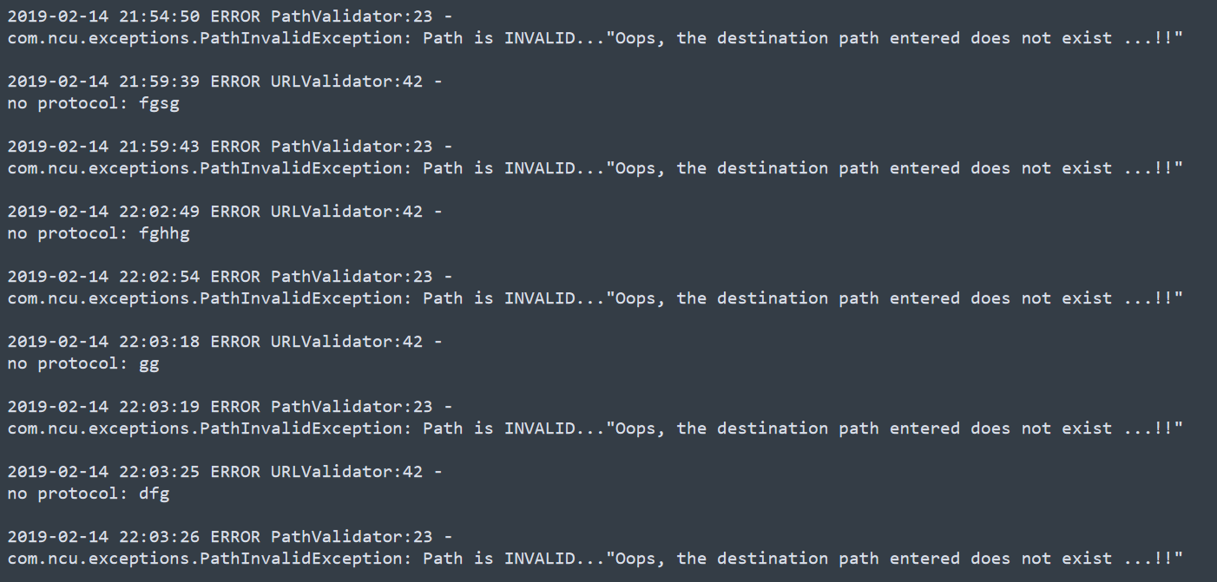
Created Logs
18 February, 2019

Slide 12
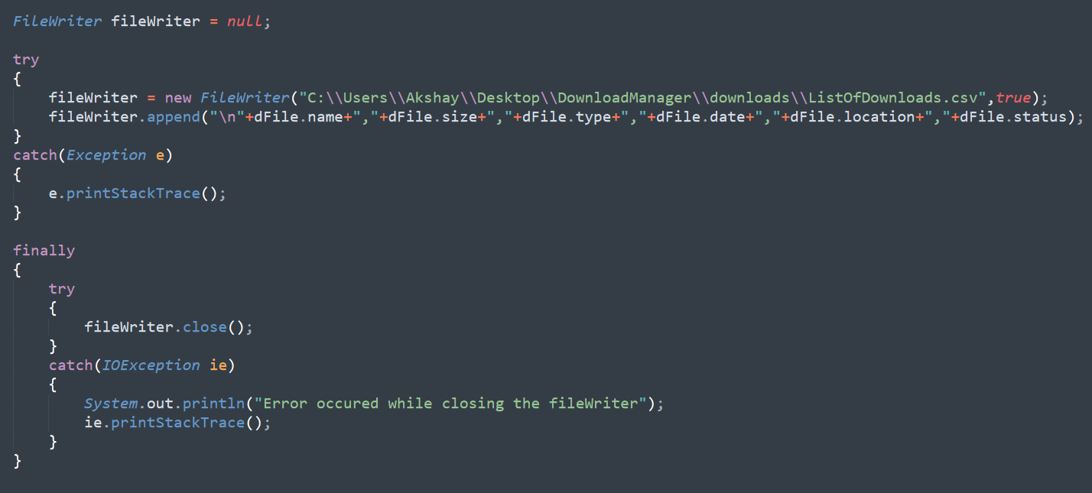
DoD: The system should maintain the list of downloads requested and its status.
18 February, 2019

Slide 13
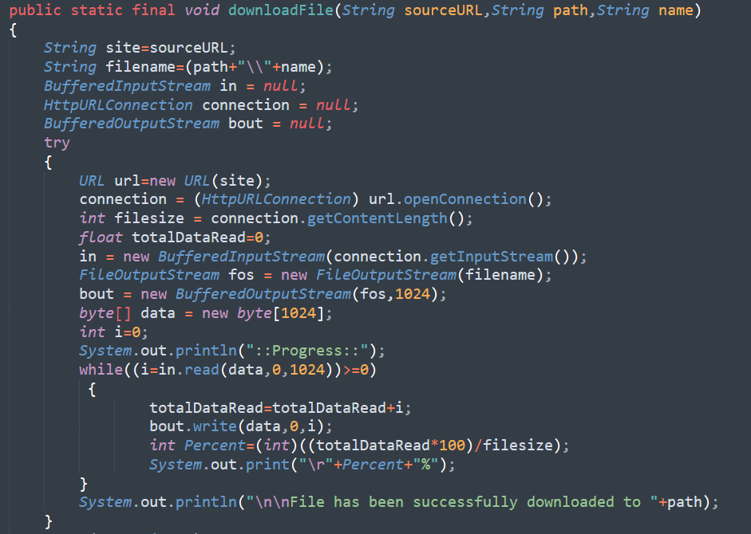
DoD: The system should download the file from the provided URL and save it in the output folder and display the status.
18 February, 2019

Slide 14
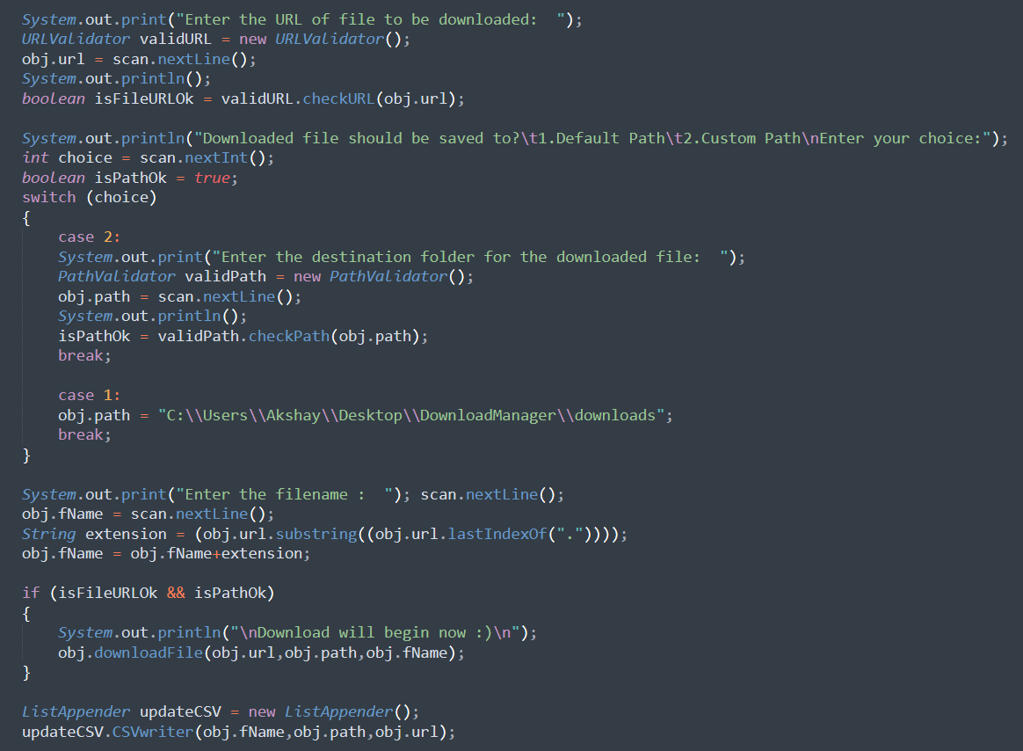
Driver:
18 February, 2019

Slide 15
Additional features added:
18 February, 2019

Slide 16
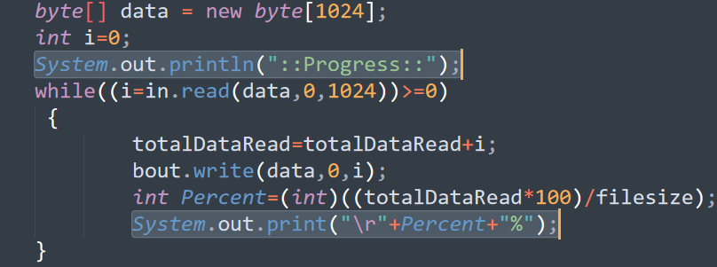
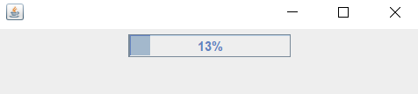
Displayed live download status.
18 February, 2019

Slide 17
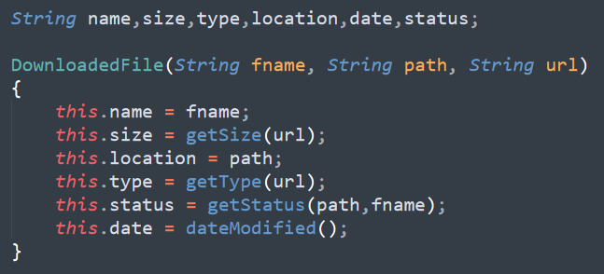
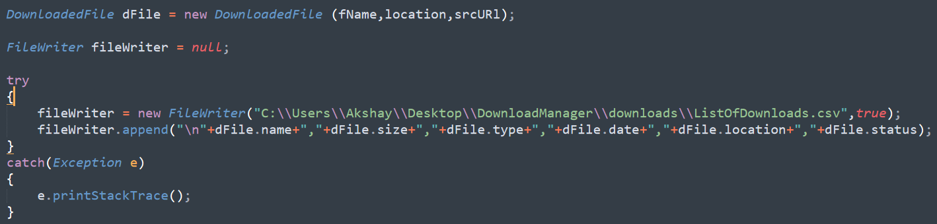
Added different features of file in the maintained list:
size, type, location, date modified.
18 February, 2019

Slide 18
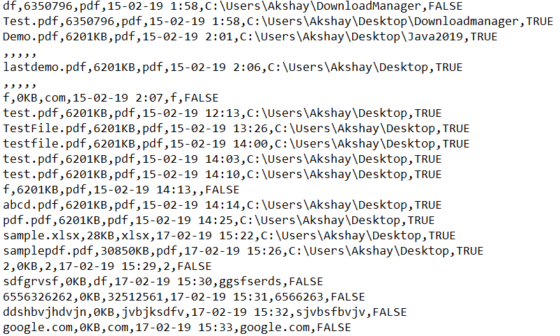
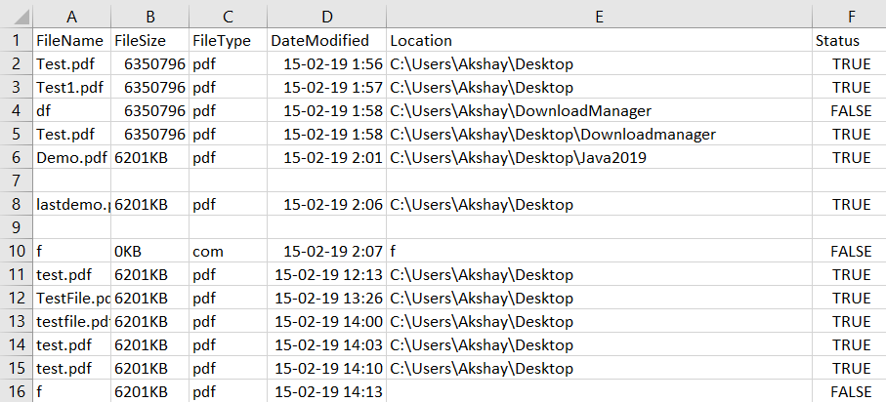
Maintained List:
As seen in notepad
As seen in spreadsheet
18 February, 2019

Slide 19
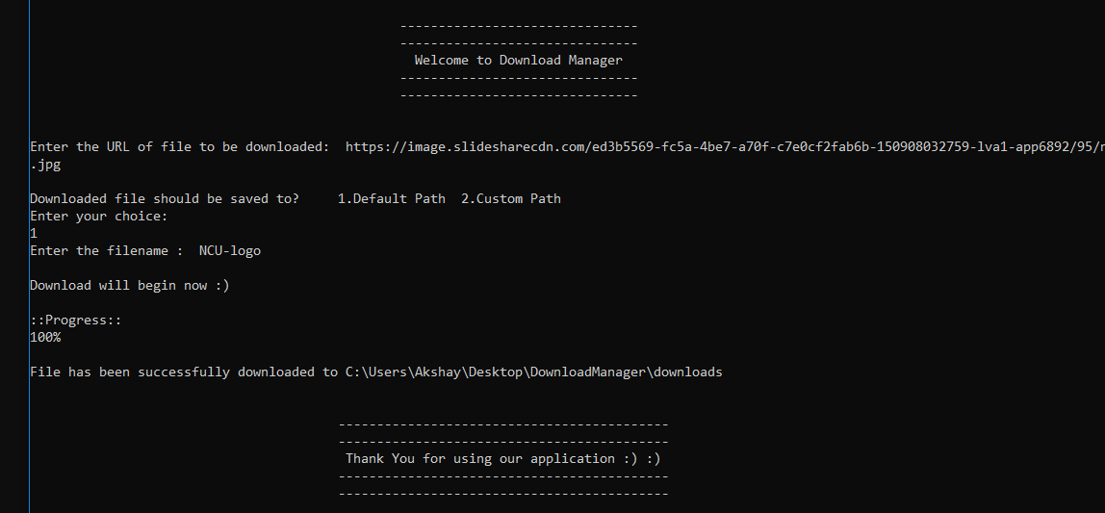
Demo Successful Execution
18 February, 2019

Slide 20
Live Demo:
Open Command Prompt
Run Statement:
java -cp libs/log4j-1.2.17.jar;classes/; com.ncu.main.DownloaderDemo
Test File URL:
https://www.digitalindia.gov.in/newsletter/2016_july/di_newsletter_july2016.pdf
18 February, 2019

Slide 21
References:
Java - The Complete Reference [Herbert and Schildt]
docs.oracle.com
geeksforgeeks.org
stackoverflow.com
18 February, 2019

Slide 22
Thank You
18 February, 2019

