Slide 1

High Impact Skills Development Program for Gilgit Baltistan
Glacier Guard
(AI Powered System for Glacier Monitoring and Future Prediction)
Presented By
Akmal Ali

Slide 2

Table of Content:
Introduction
Scope
Problem
Objectives
Tool Used
AI Powered Glacier Guard

Slide 3
Introduction
The Glacier Guard project uses satellite imagery and deep learning to monitor and predict glacier changes. It detects glacier retreat, forecasts future behavior, and provides visual insights for decision-making.
Badswat Glacier is being used as a test case, with plans to extend the coverage to all glaciers in Gilgit in the upcoming years.
AI Powered Glacier Guard

Slide 4
Scope:
Our project, Glacier Guard, provides a comprehensive solution for monitoring and predicting glacier changes, offering value to environmental researchers, disaster management authorities, and policymakers.
Glacier Guard
AI Powered Glacier Guard

Slide 5

Problem:
Climate change accelerates glacial melting, leading to GLOFs, water scarcity, and threats to food security. These challenges disrupt livelihoods, force human migration, and demand urgent solutions to mitigate risks and ensure sustainability.
AI Powered Glacier Guard

Slide 6

Objectives:
To monitor accelerated glacier retreat and provide early warnings for GLOFs, while offering climate change insights and addressing socio-economic impacts.
To integrate advanced machine learning models with cloud-based solutions for accurate prediction of glacial lake outbursts and their socio-economic impacts.
AI Powered Glacier Guard

Slide 7
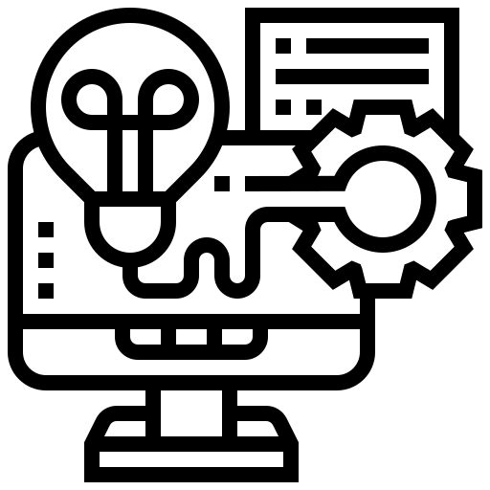
Tools Used:
Data Collection: Earth Explorer (USGS)
Data Labelling: Roboflow
Machine Learning: ML algorithms, NLP, Deep Learning
Temporary GUI: Gradio (Python Library)
AI Powered Glacier Guard

Slide 8
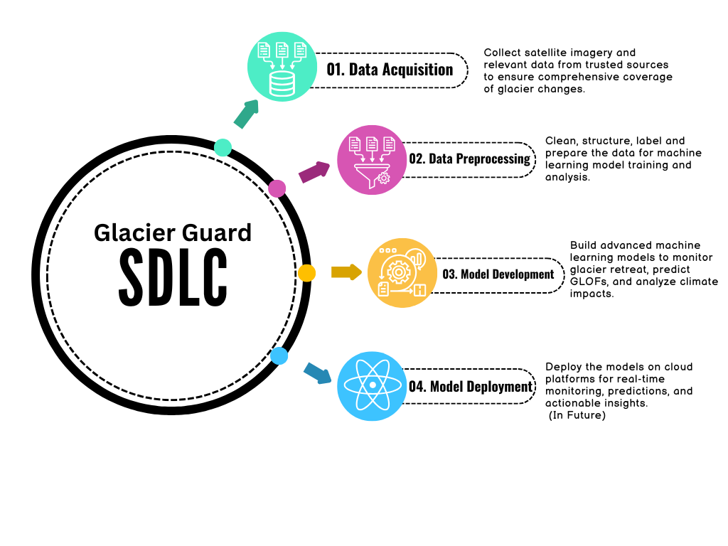
AI Powered Glacier Guard

Slide 9

Thank You

