Slide 1

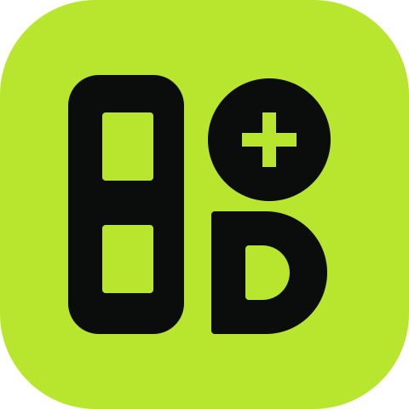
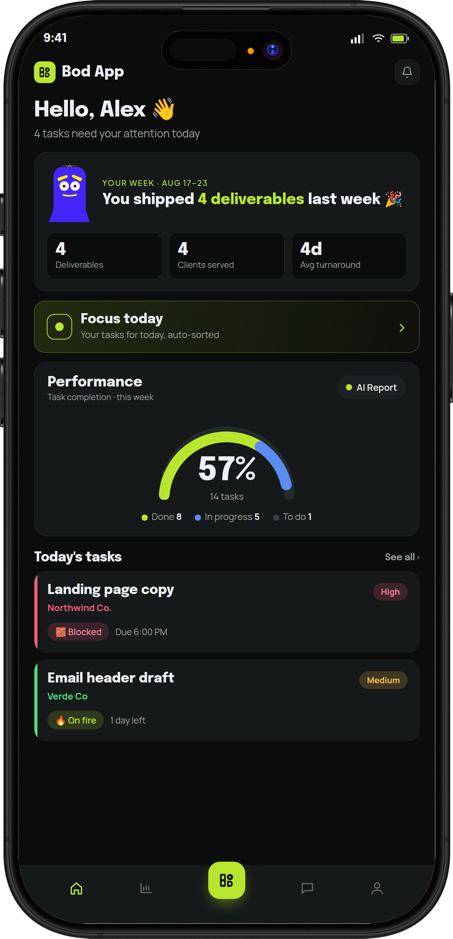
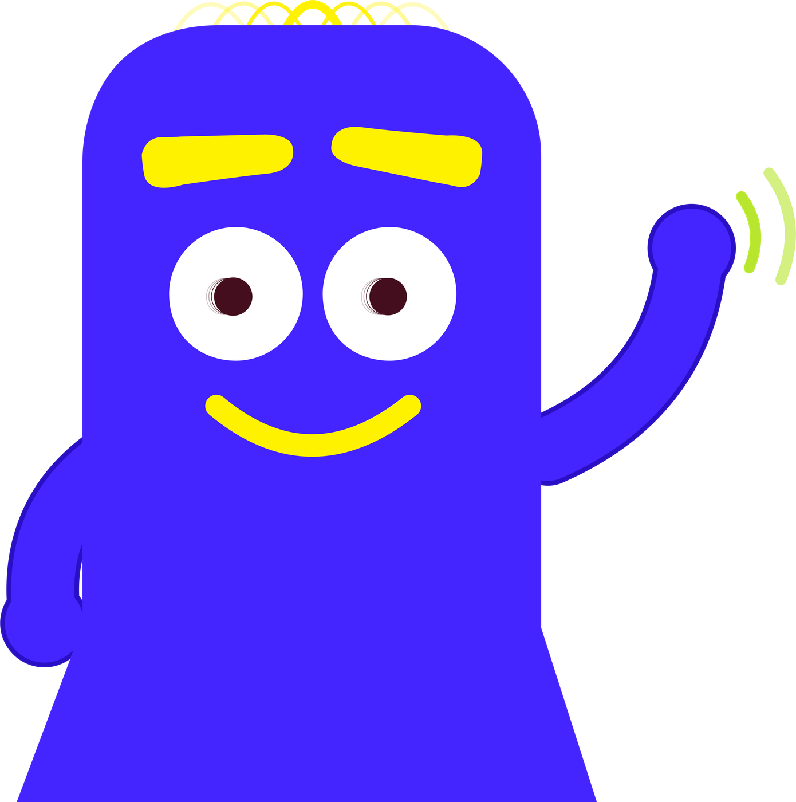
A BOD STUDIO PRODUCT
Bod App
Come in. Let me show you around.
The task app for creative agencies.
It handles the admin, so your team can do the work.
MYBODSTUDIO.COM
Notes:
Open light. Bod Annan greets the room; the phone shows the home screen.

Slide 2
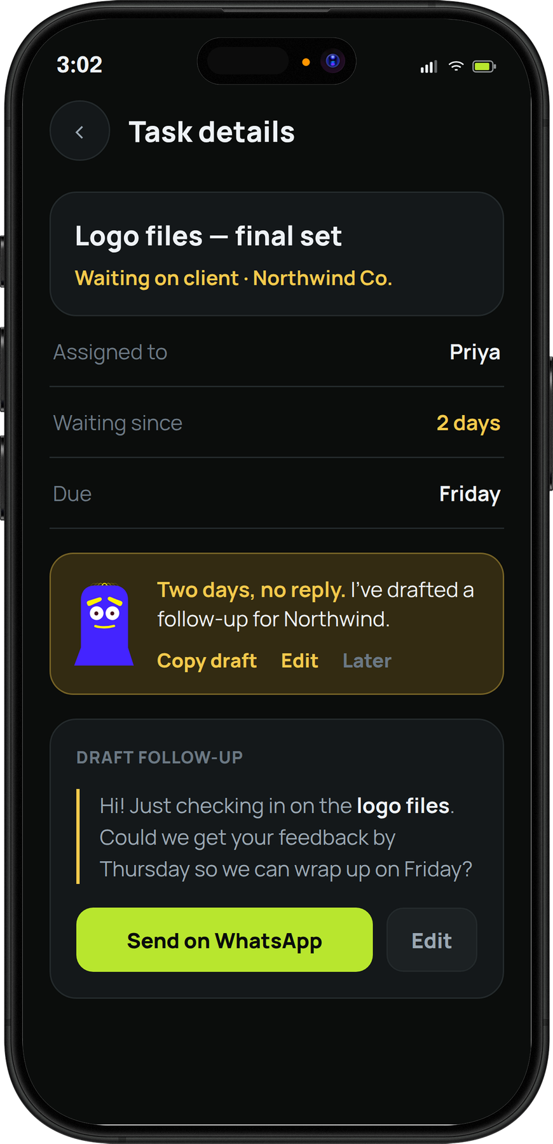
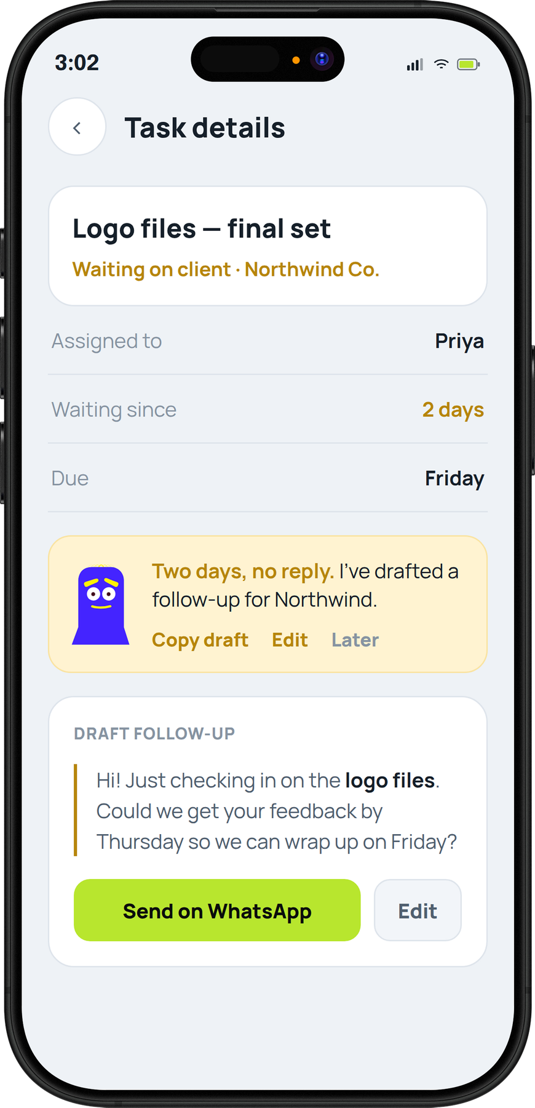
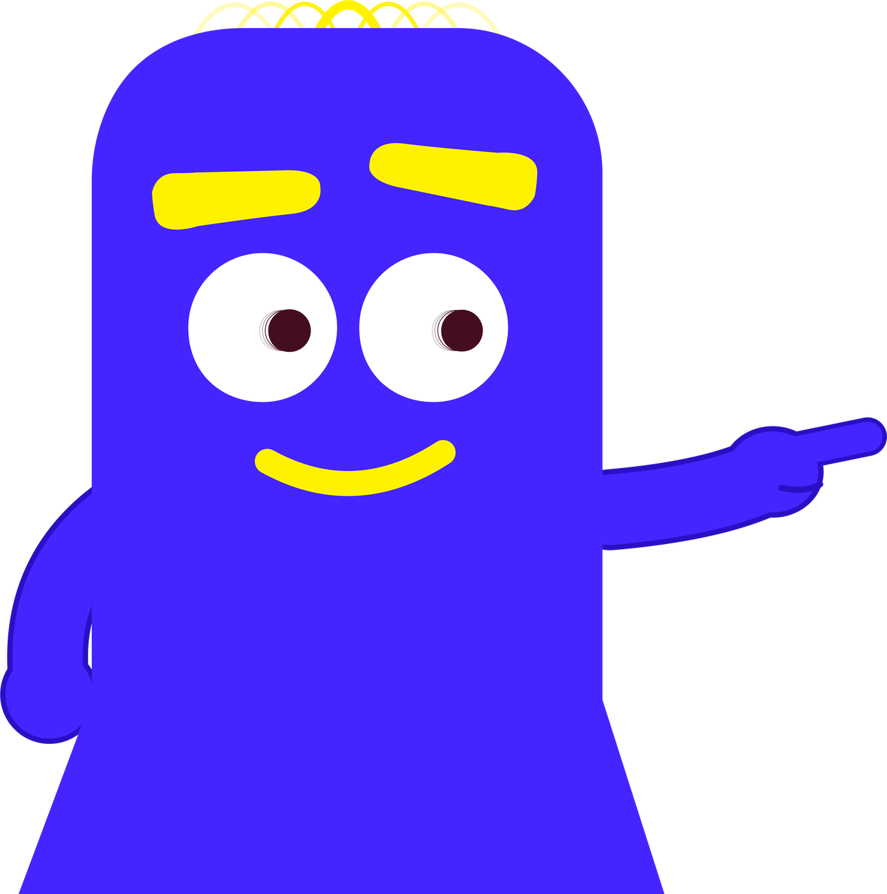
3 PM
The client's
gone quiet.
After two days of waiting, Bod App drafts the follow-up. You just send it.
Two days, no reply. I've written it for you.
BOD APP · THE TASK APP FOR CREATIVE AGENCIES
DARK THEME
LIGHT THEME
Notes:
This is the follow-up nudge. It appears once a task has waited on a client for two days.

Slide 3
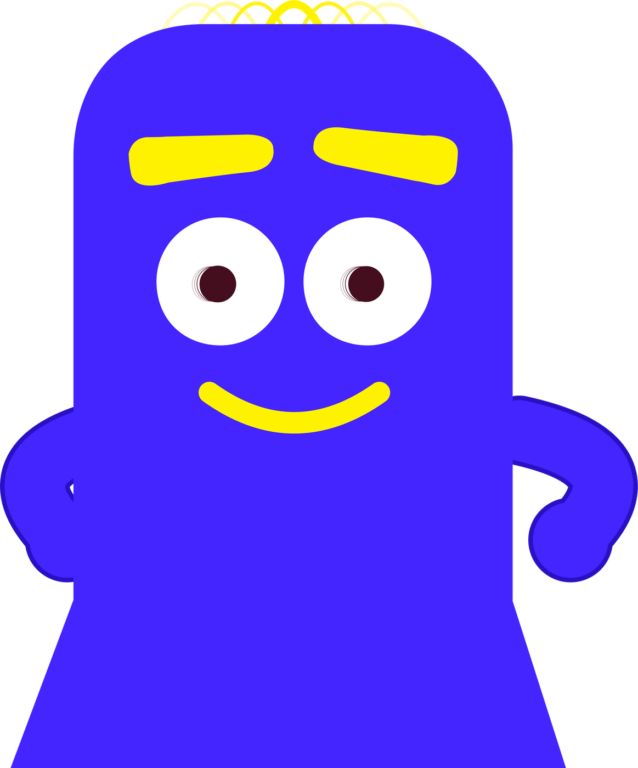
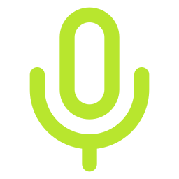
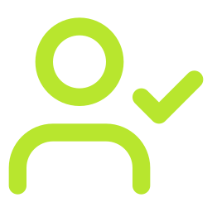

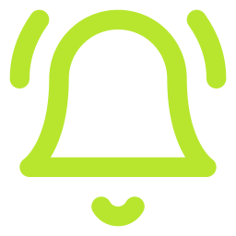

HOW IT WORKS
From brief to invoice.
Every job, same path. I watch every step.
Every job takes the same five steps.
STEP 1
STEP 2
STEP 3
STEP 4
STEP 5
Brief comes in
Gets assigned
Work happens
Client nudged
Billed
Say it, type it or drop the PDF.
The PM approves it once.
Everyone can see where it's at.
Quiet for two days? It follows up.
Done work goes straight to billing.
BOD APP · THE TASK APP FOR CREATIVE AGENCIES
11
Notes:
Usually: briefs arrive on WhatsApp at 11 pm, nobody knows who owns what, status lives in people's heads, the client goes quiet for three days, and finished work sits unbilled. With Bod App each of those steps is handled.

