Slide 1

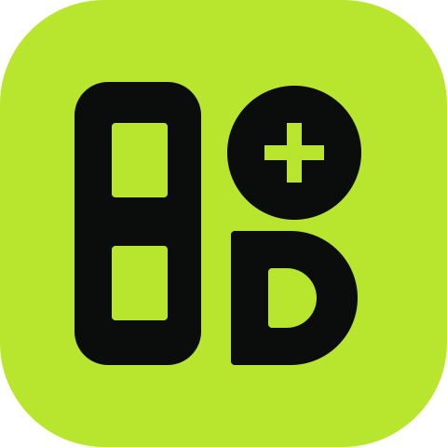
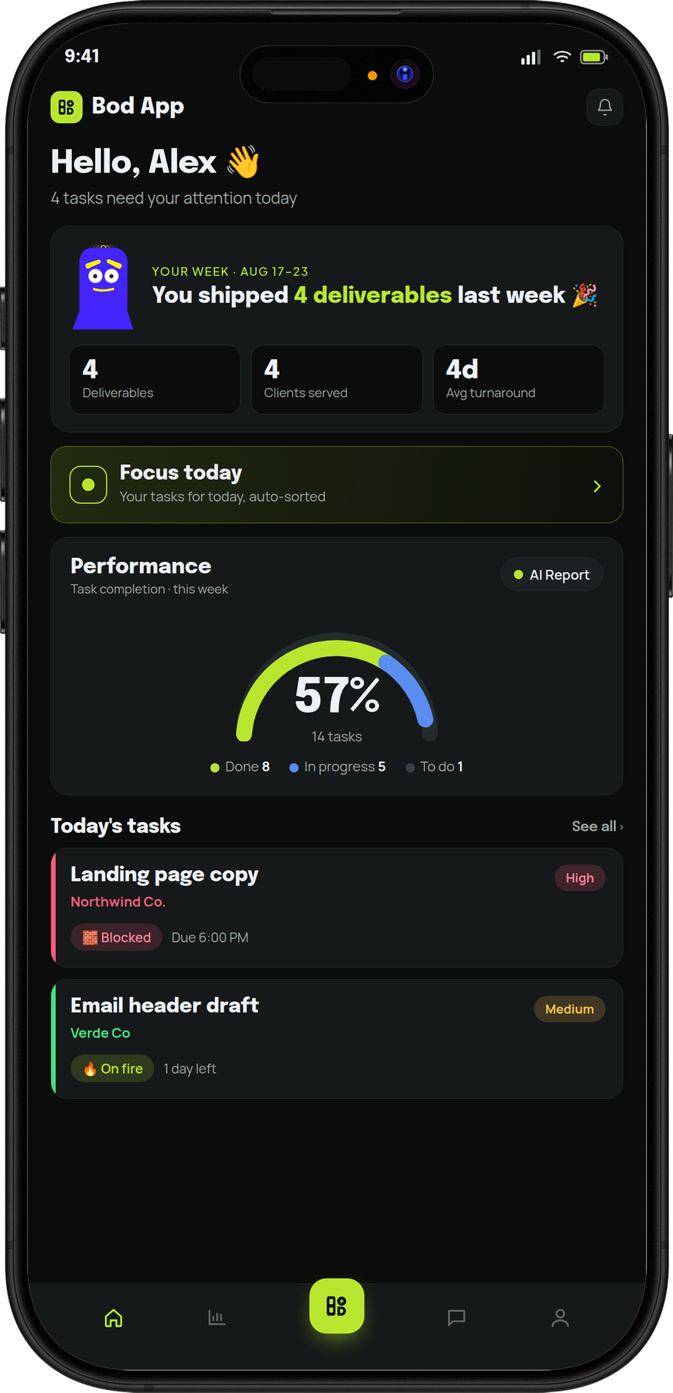

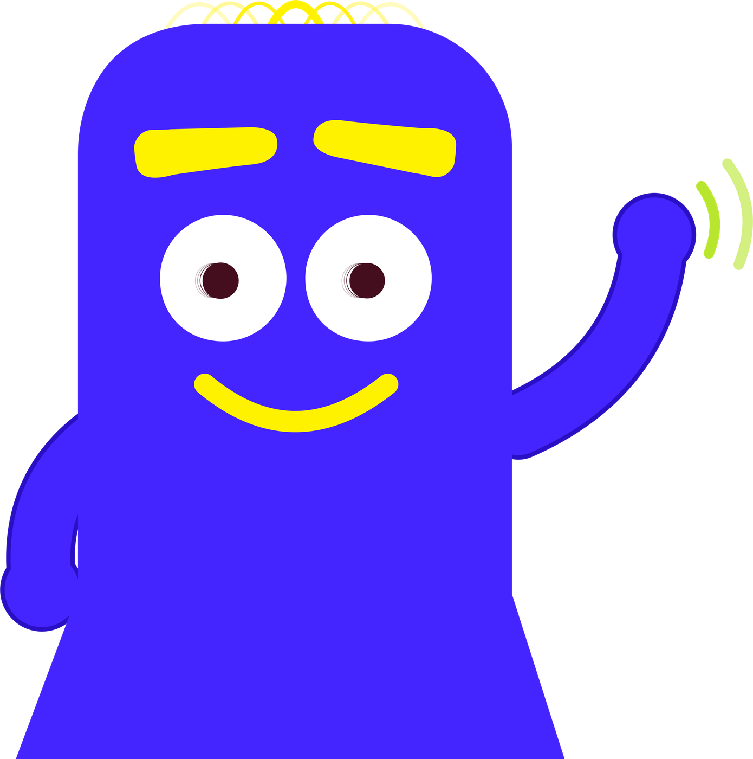
A BOD STUDIO PRODUCT
Bod App
Come in. Let me
show you around.
The task app for creative agencies.
It handles the admin, so your team can do the work.
BODSTUDIO.COM
Notes:
Open light. This is a studio sharing the tool it built for itself. Bod Annan will guide the story.

Slide 2

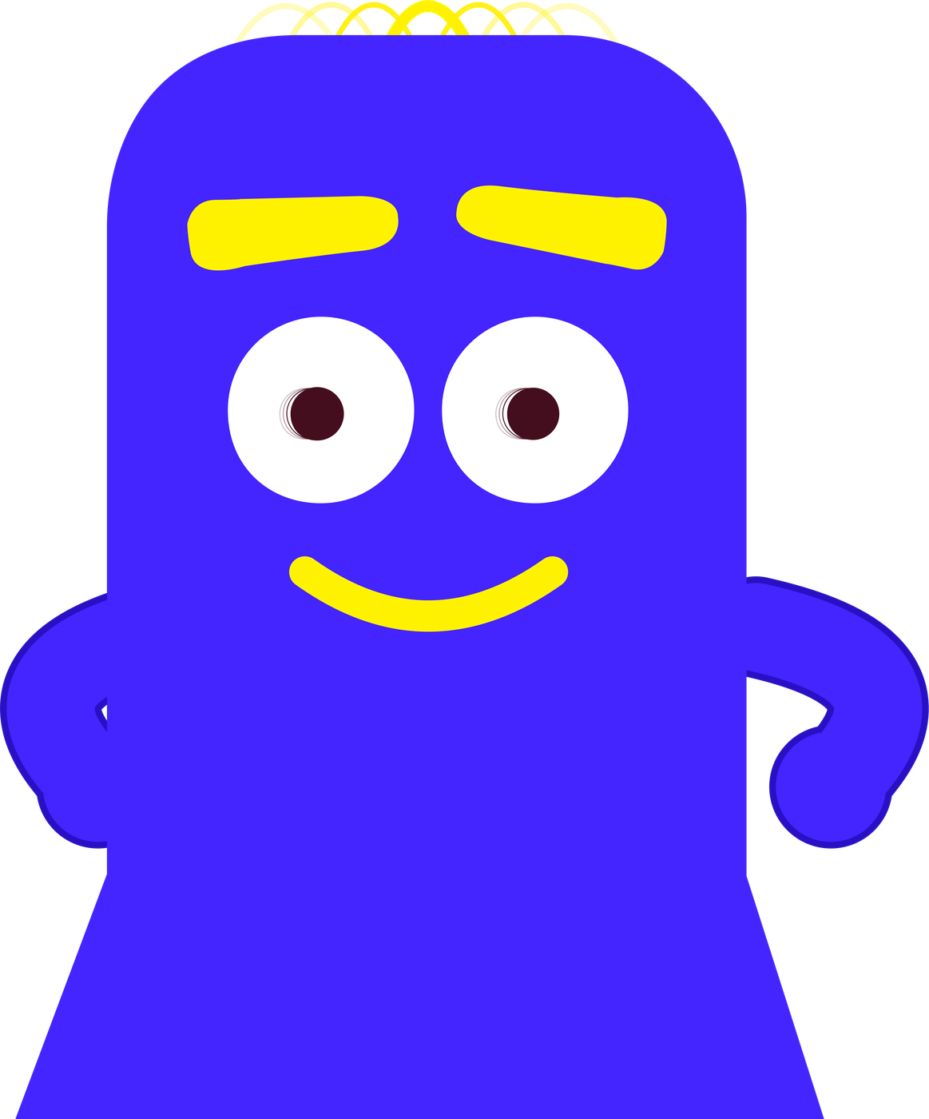
We all love
the work.
This part? You're
good at this.
The ideas, the shoots, the late edits that finally click.
BOD APP · THE TASK APP FOR CREATIVE AGENCIES
02
Notes:
Pause here. Most studio owners will nod. This is why they started.

Slide 3

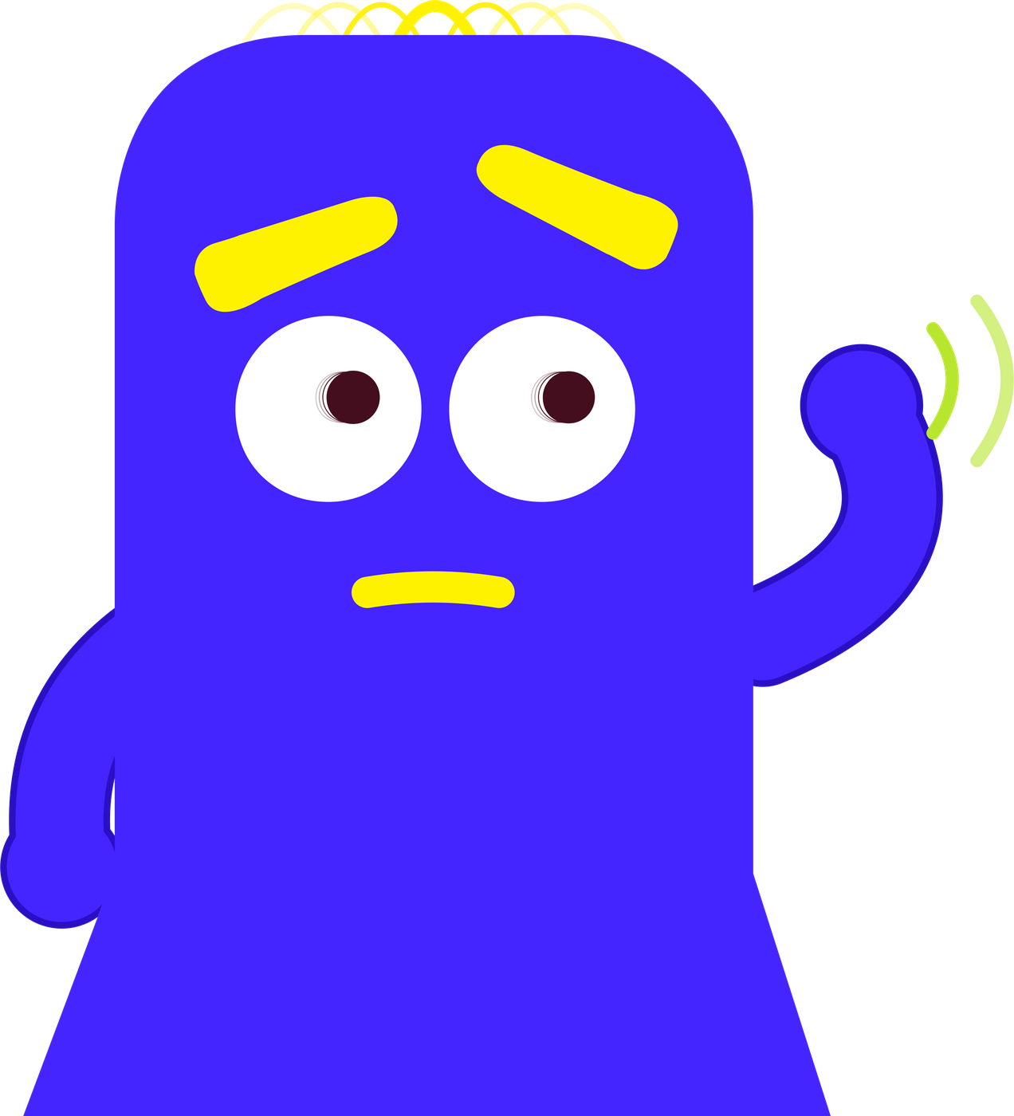
It's the rest of it.
Updating the status, again.
And this part… I know.
Chasing a reply from the client.
“Where's that file?”
The morning standup.
Working out what to bill.
BOD APP · THE TASK APP FOR CREATIVE AGENCIES
03
Notes:
Read these slowly. Every studio lives with them. None of it is the work clients pay for.

Slide 4
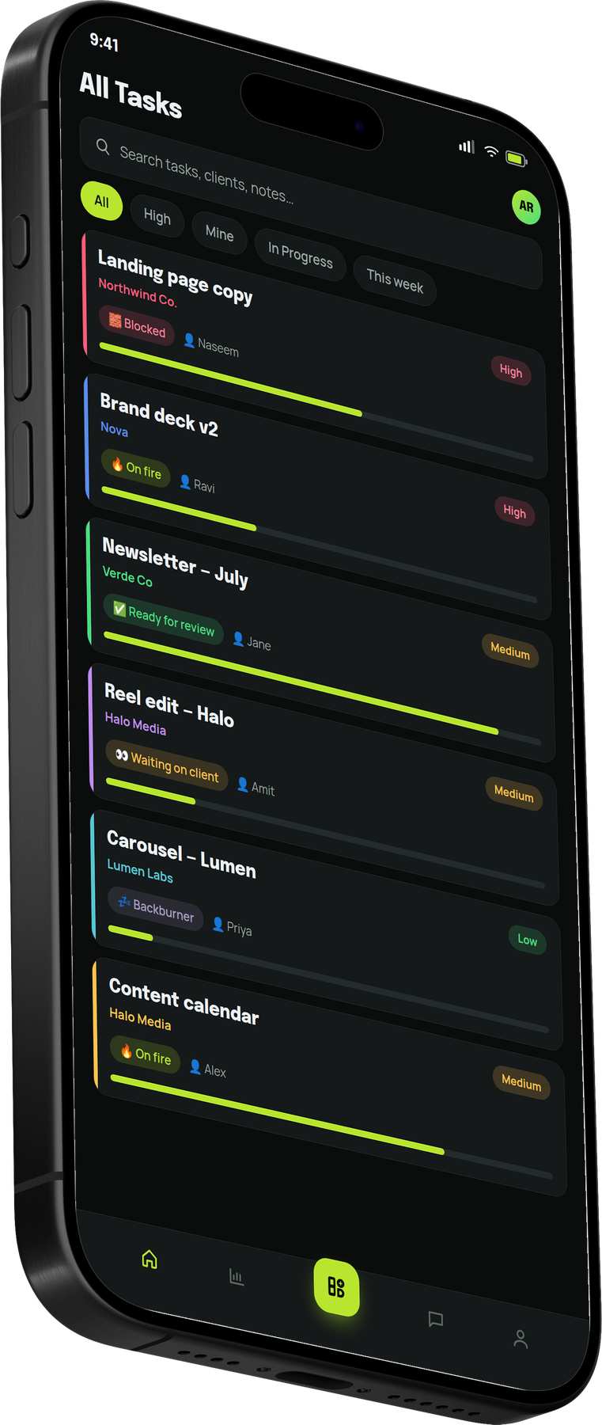
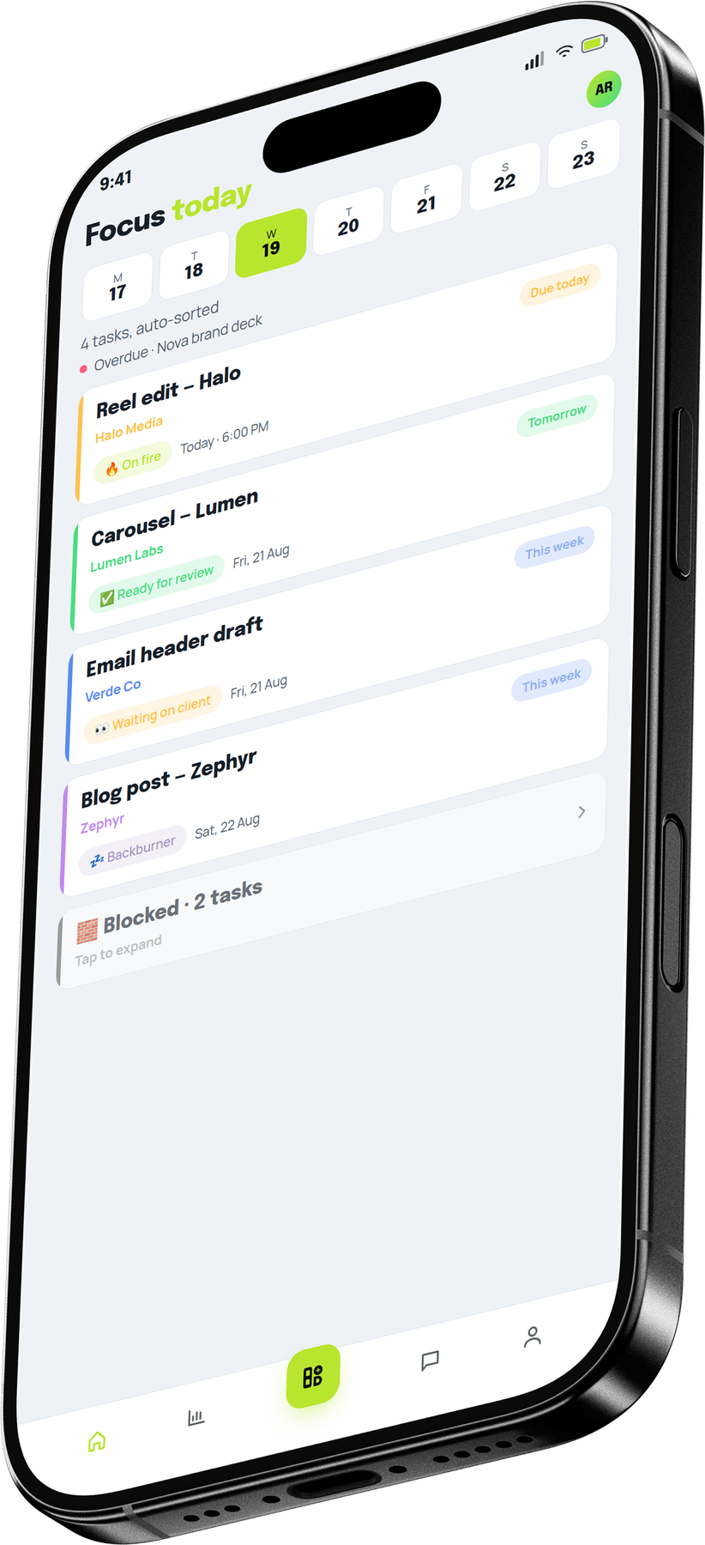

MEET BOD APP
So we built
Bod App.
A task app that takes care of the rest. Made for our own studio first.
I'm Bod Annan.
Leave the rest to me.
BOD APP · THE TASK APP FOR CREATIVE AGENCIES
04
Notes:
Bod App ran the Storibod floor before anyone else saw it. Introduce Bod Annan lightly; he guides the rest of the story.

Slide 5
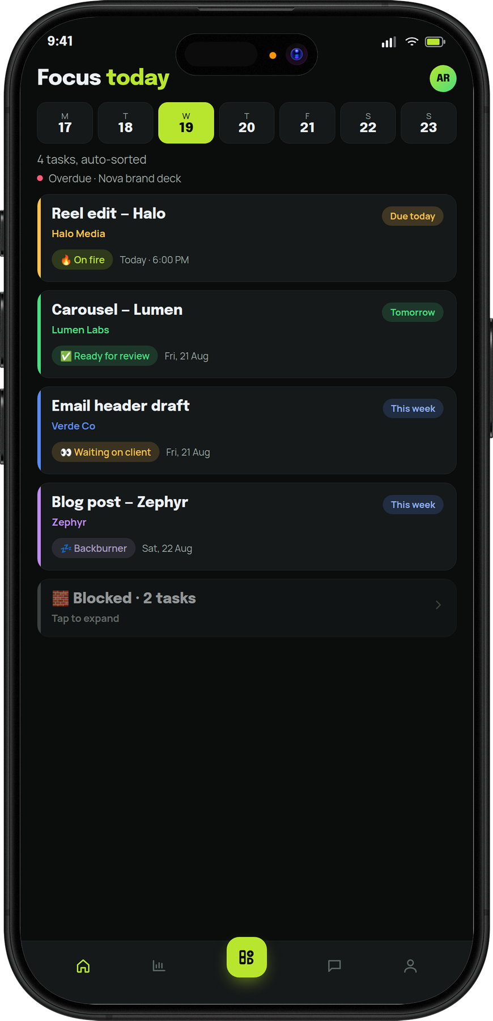
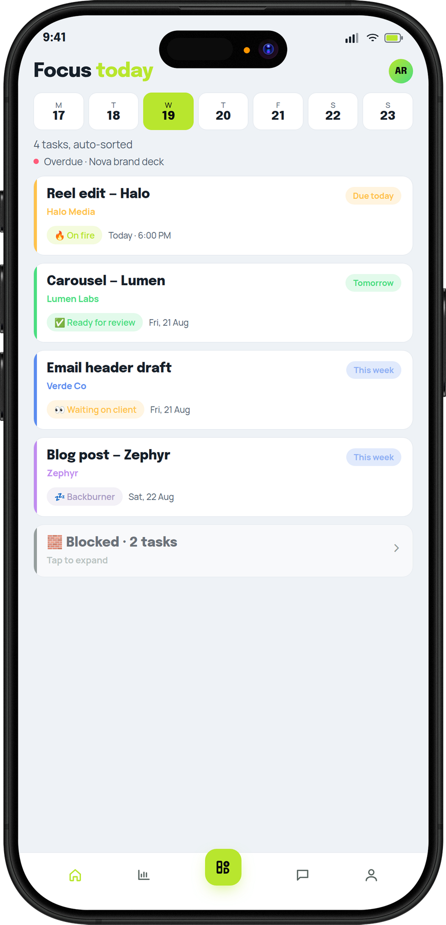

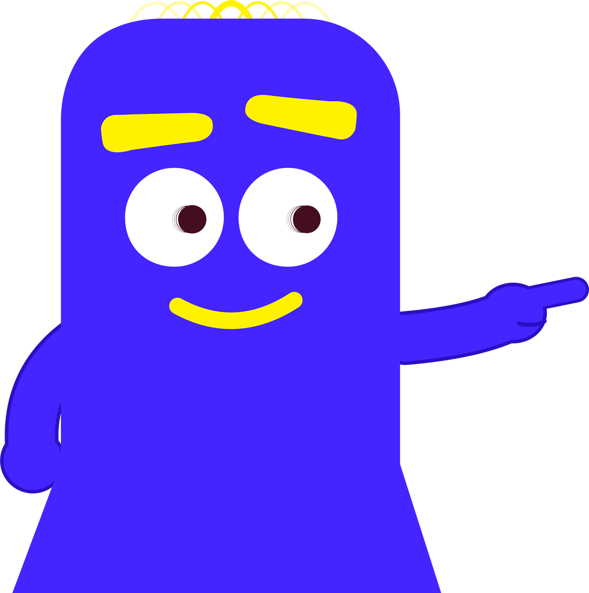
FOCUS QUEUE
Your day,
already sorted.
Overdue first, then what's due. Anything stuck waits at the bottom.
Start with the
reel. It's due today.
BOD APP · THE TASK APP FOR CREATIVE AGENCIES
DARK THEME
LIGHT THEME
Notes:
Nobody has to plan the day or scroll a board. Open the app and the order is decided.

Slide 6
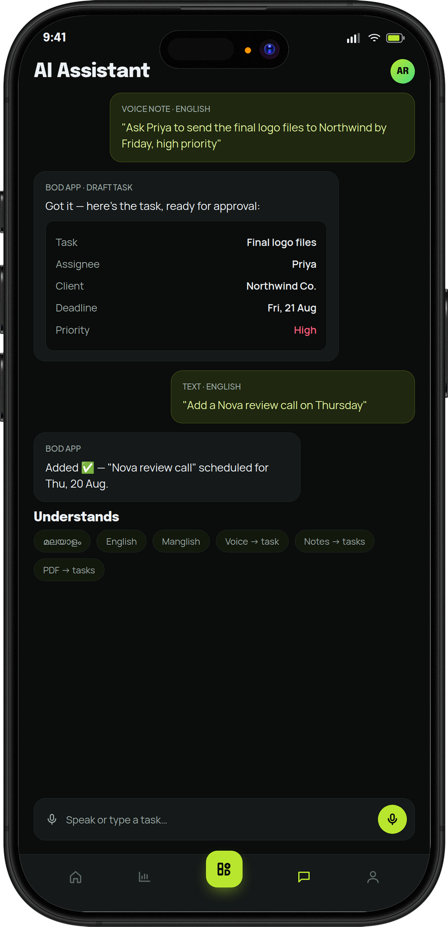
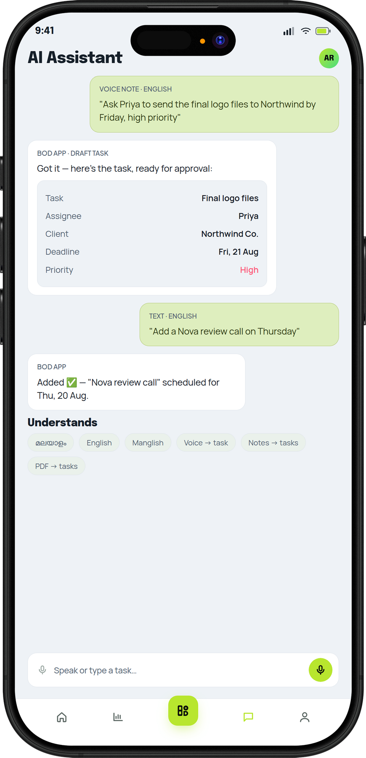

AI CAPTURE
Just say what
needs doing.
Say it or type it. It becomes a task, with who, what and when filled in.
Heard you. It's
on Priya's list.
BOD APP · THE TASK APP FOR CREATIVE AGENCIES
DARK THEME
LIGHT THEME
Notes:
Works by voice or text, in English, Malayalam or Manglish. New tasks go to the project manager to approve.

Slide 7
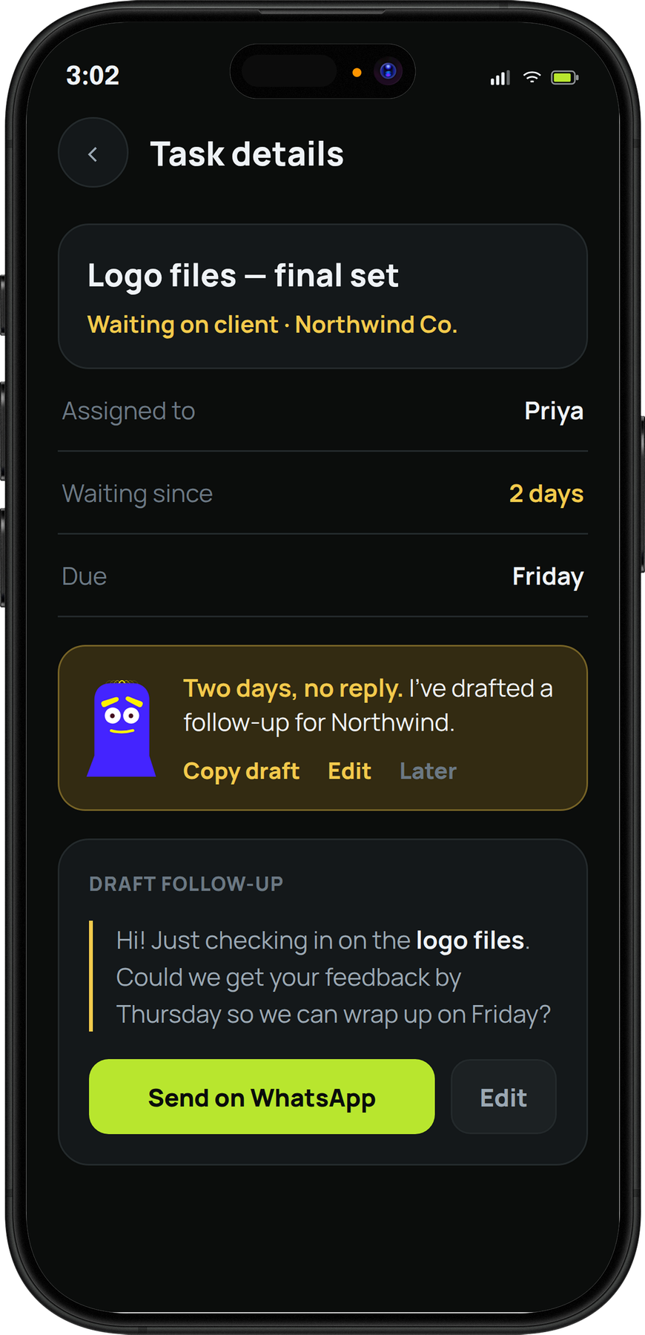
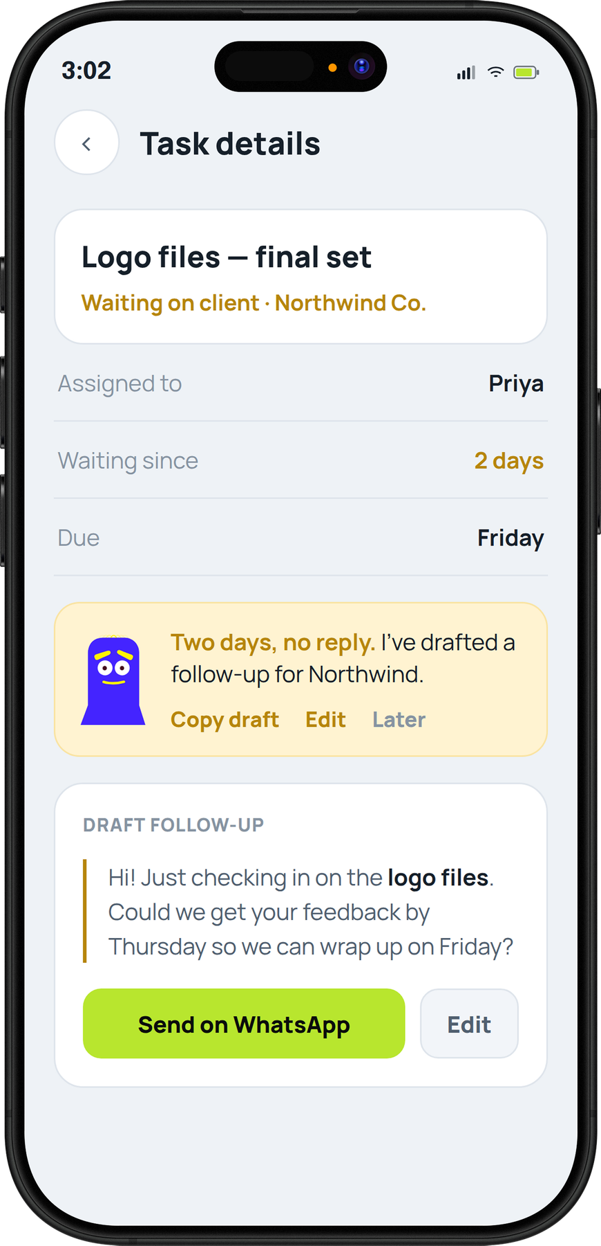

FOLLOW-UPS
The client's
gone quiet.
Bod App notices, and drafts the follow-up for you. You just send it.
No reply yet? I've written
the follow-up for you.
BOD APP · THE TASK APP FOR CREATIVE AGENCIES
DARK THEME
LIGHT THEME
Notes:
The nudge appears when a task has been waiting on a client. Each team sets how long that is.

Slide 8
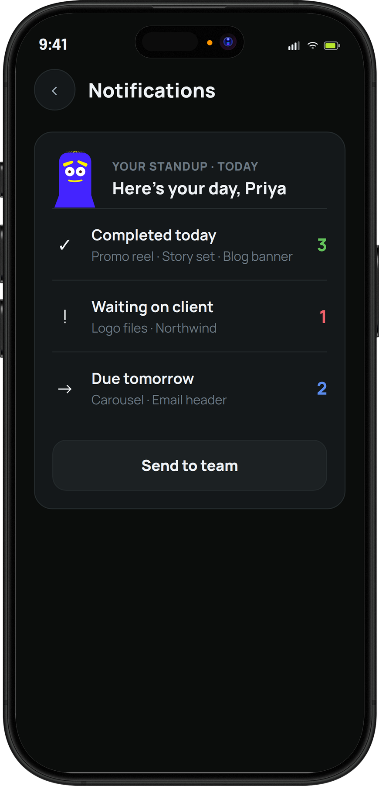
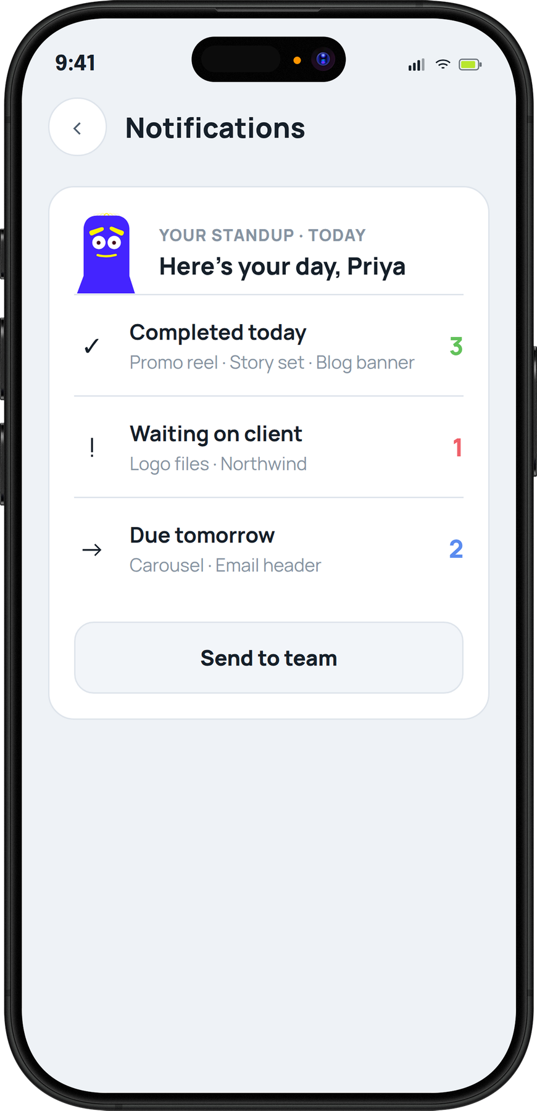

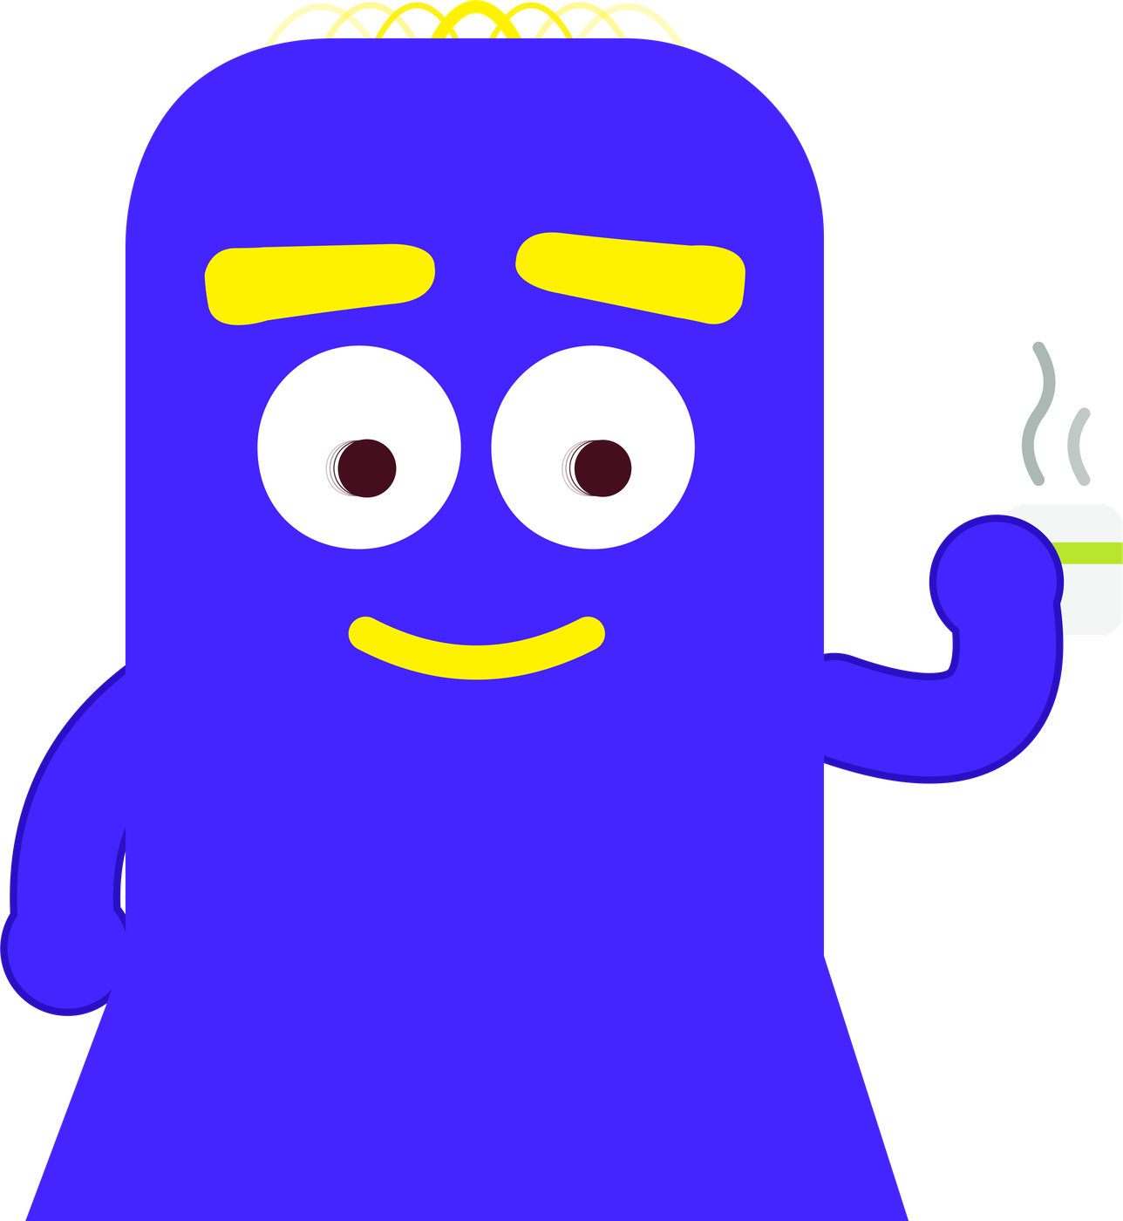
STANDUP
The standup
writes itself.
What got done, what's moving and what's stuck. Read it, send it, go home.
Go home. I've
got it from here.
BOD APP · THE TASK APP FOR CREATIVE AGENCIES
DARK THEME
LIGHT THEME
Notes:
The daily standup is drafted from what actually moved. Teams choose when it arrives.

Slide 9
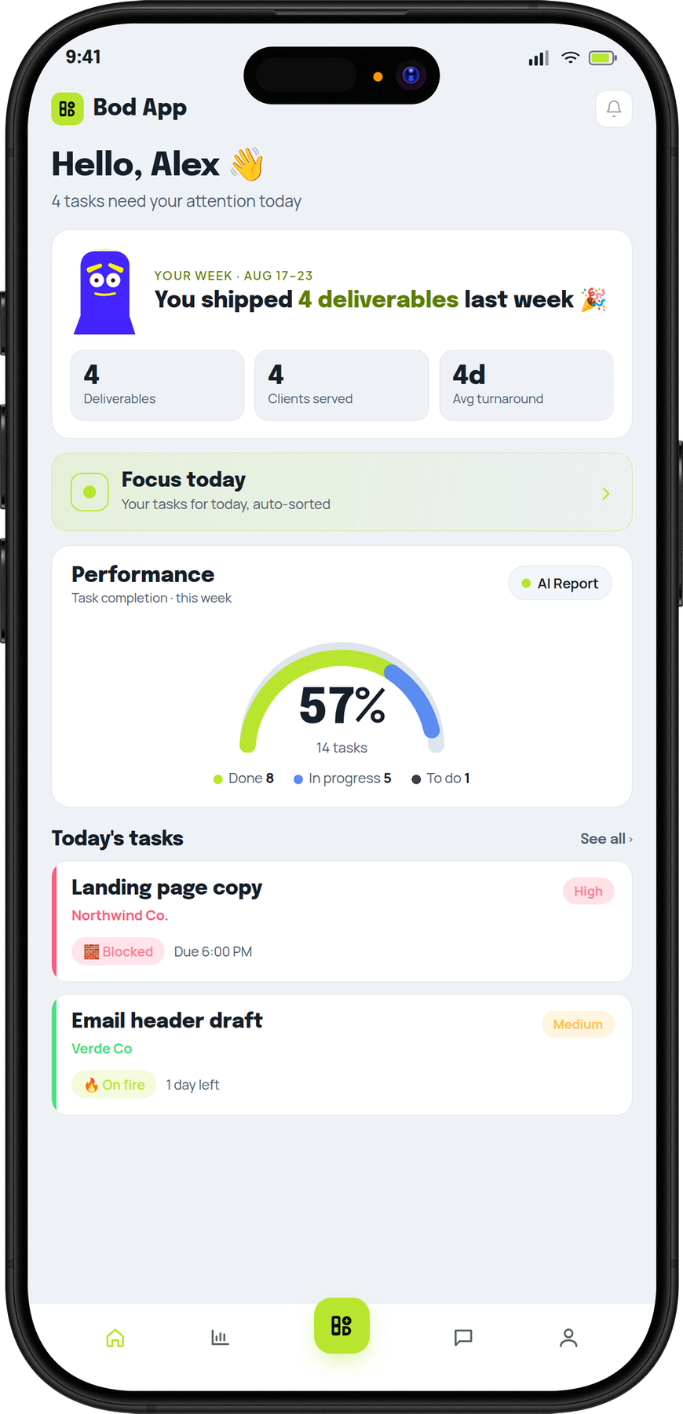

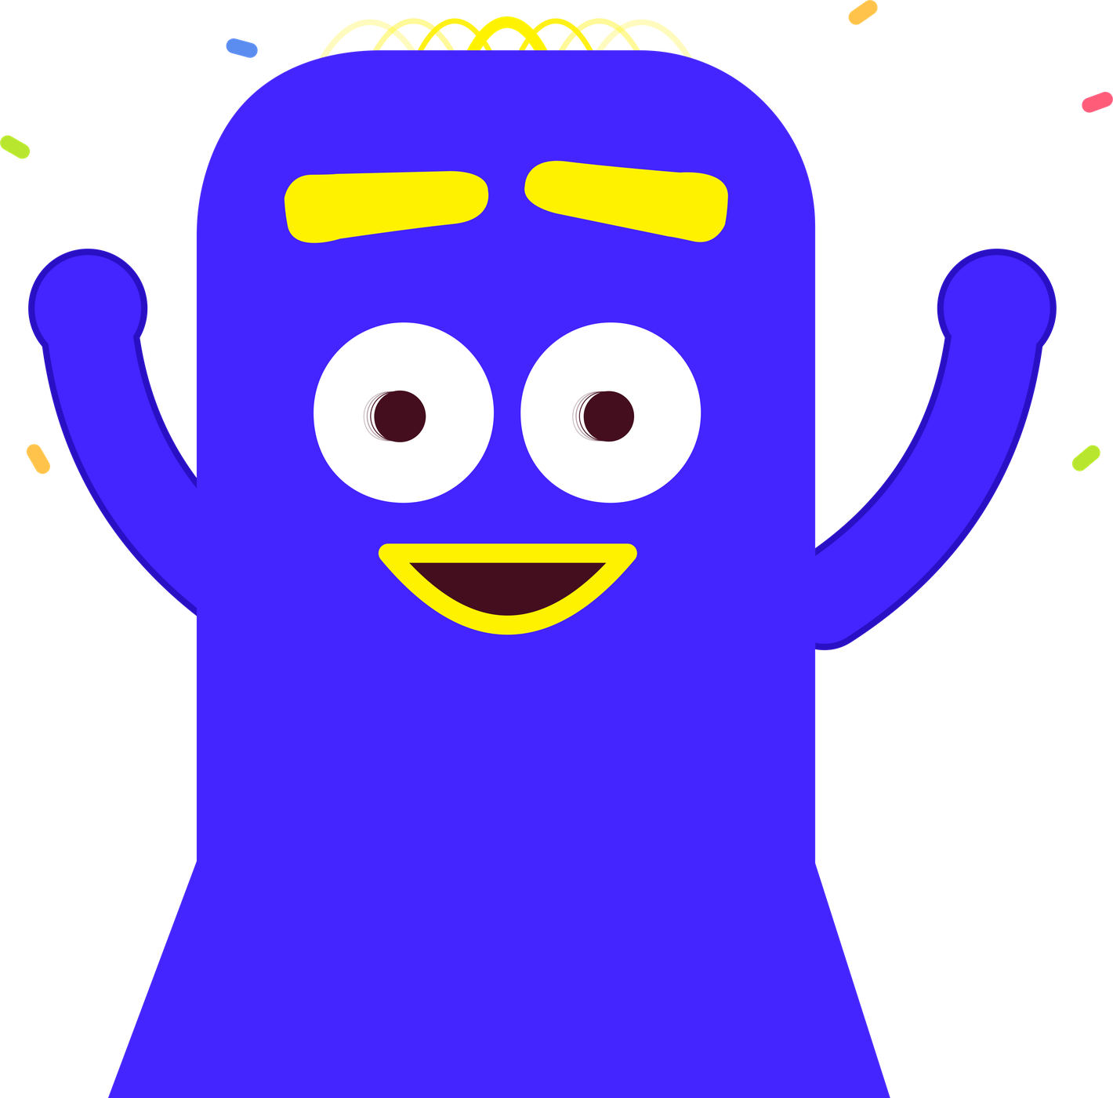
WEEKLY WINS
The week starts
with a win.
Every week opens with what your team shipped, so good work gets noticed.
Four deliverables.
Proud of you lot.
BOD APP · THE TASK APP FOR CREATIVE AGENCIES
DARK THEME
LIGHT THEME
Notes:
This is the moment people smile at. Small, honest recognition every week.

Slide 10

The week
feels lighter.
See? Less chasing.
More making.
LESS OF
MORE OF
“Any update?”
The work itself.
“Just following up.”
Clear heads.
“Who's on this?”
Leaving on time.
BOD APP · THE TASK APP FOR CREATIVE AGENCIES
10
Notes:
That's the story. From here, show how it works and what's in the app.

Slide 11






HOW IT WORKS
Every job, same path.
I watch every step.
From brief to invoice.
Every job takes the same five steps.
STEP 1
STEP 2
STEP 3
STEP 4
STEP 5
Brief comes in
Gets assigned
Work happens
Client nudged
Billed
Say it, type it or drop the PDF.
The PM approves it once.
Everyone can see where it's at.
Gone quiet? It drafts the follow-up.
Done work goes straight to billing.
BOD APP · THE TASK APP FOR CREATIVE AGENCIES
11
Notes:
Usually: briefs arrive on WhatsApp late at night, nobody knows who owns what, status lives in people's heads, the client goes quiet, and finished work sits unbilled. With Bod App each of those steps is handled.

Slide 12



















WHAT'S INSIDE
Everything in Bod App.
Tasks and boards
Focus Queue
Voice to task
Notes and PDFs to tasks
Approvals
Task vibes
Client colours
Follow-up nudges
All of this. Quietly,
in the background.
Team and task chat
Daily AI summary
“What's next?”
Auto standup
Weekly wins
Analytics
Ready to bill
Leave and HR
Google Sheets sync
Roles and permissions
Widgets and alerts
iOS, Android and web
BOD APP · THE TASK APP FOR CREATIVE AGENCIES
12
Notes:
Everything here is in the app today.

Slide 13
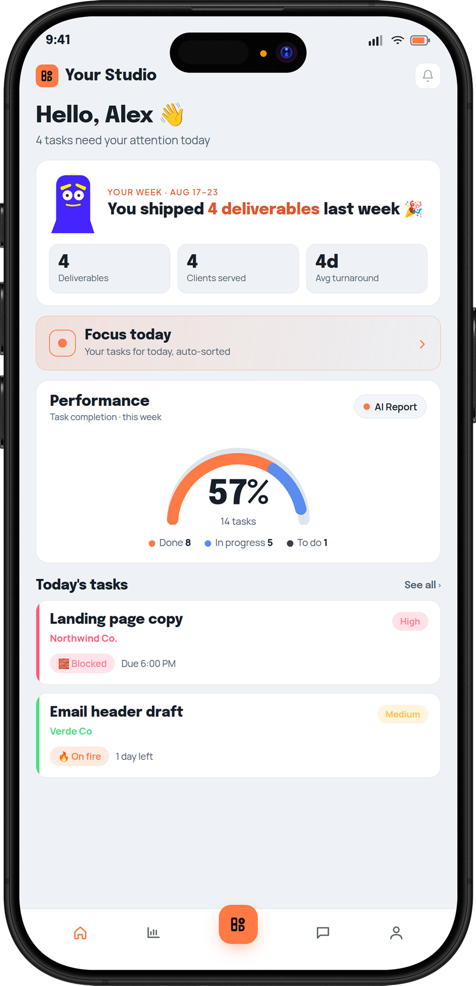

MADE FOR YOUR STUDIO
Your look,
your way.
Light or dark, in your colours and logo, with your pipeline, categories and roles. We can set it all up for you.
Your colours suit me.
BOD APP DARK
BOD APP LIGHT
YOUR BRAND
BOD APP · THE TASK APP FOR CREATIVE AGENCIES
Notes:
Every studio gets its own look: theme, accent colour, logo, pipeline stages, categories and roles. We set it up with you.

Slide 14

GET STARTED
Start with a month free.
Bring the team.
First month's on us.
Up to 3 people, basic setup, on us. Then pick the plan that fits.
BASIC
ADVANCED
PREMIUM
₹199
₹299
₹499
per person, per month
per person, per month
per person, per month
The essentials for a small team.
Everything we use at Storibod.
Set up around your own workflow.
BOD APP · THE TASK APP FOR CREATIVE AGENCIES
14
Notes:
Lead with the free month. Advanced is the setup Storibod runs on. Premium is configured around their workflow.

Slide 15

LET'S TALK
Come see
how it feels.
A 20-minute walkthrough on your own workflow.
Come by. I'll
show you around.
bodstudio.com
SALES
+91 7356 333 965
EMAIL
info@storibodcreatives.com
INSTAGRAM
@storibodstudio
POWERED BY BOD STUDIO
Notes:
Close by offering the walkthrough, not the sale.

