Slide 1
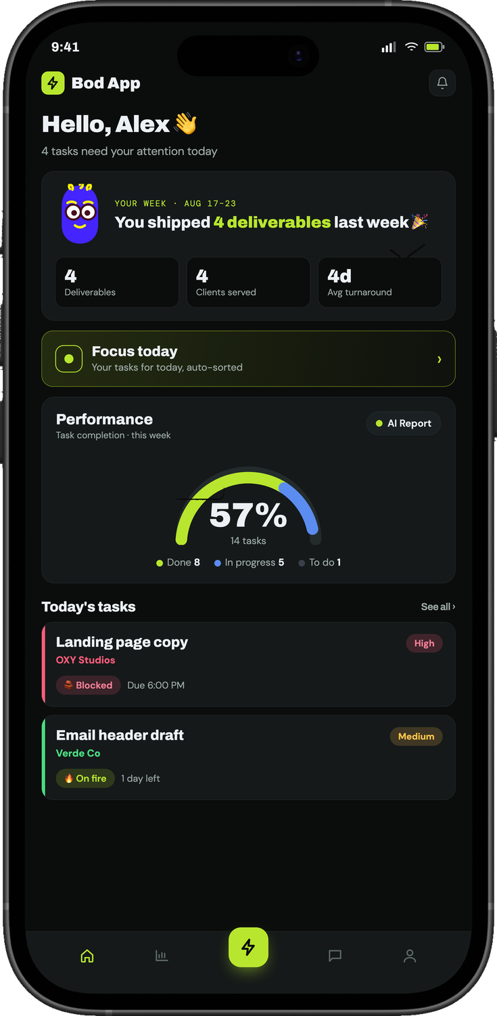
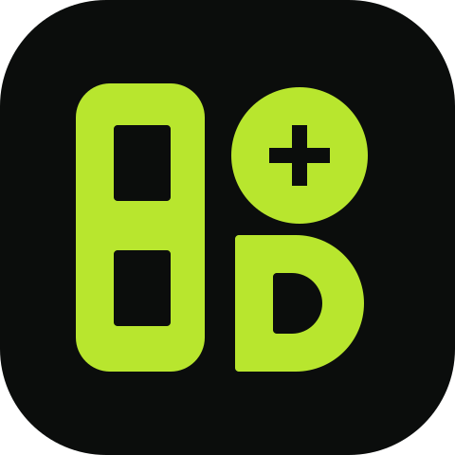
Bod App
PRODUCT SALES DECK · 2026
A BOD STUDIO PRODUCT
On fire · due today
Stop juggling.
Start shipping.
Run your whole studio from one calm app.
57% shipped this week
Tasks, approvals, billing prompts, standups and AI capture — one app instead of five. Built for marketing agencies and creative studios.
6 PM standup ready
START FREE TRIAL →
BOOK A DEMO
Kochi, Kerala · info@storibodcreatives.com · +91 7356 333 975 · mybodstudio.com
Notes:
Open on the promise: one calm app that replaces the five places a studio's work lives today. Bod App is a Bod Studio product, built and run inside Storibod first.

Slide 2








01 · THE PROBLEM
BOD APP / SALES DECK
Your team isn't disorganised. Your tools are.
A busy studio's work lives in five places at once — so none of it can be tracked honestly.
WHERE THE WORK LIVES TODAY
WhatsApp
Briefs, approvals and follow-ups
Deadlines slip quietly
You hear about it when the client calls, not the day it happens.
Spreadsheets
The task list nobody updates
Delivered work goes unbilled
Email
Files, feedback and revisions
Shipped deliverables fall through the gap between done and invoiced.
Memory
What's done and ready to bill
Founders fly blind
Meetings
The daily "where are we?"
There's no honest read of where the week — or the team's capacity — went.
THE RESULT The project tool gets abandoned by month two, and the team goes back to chasing each other.
BOD APP · RUN YOUR STUDIO THE CALM WAY
02
Notes:
Name the pain before the product. Most studios aren't disorganised — their work is split across WhatsApp, sheets, email, memory and meetings. The cost shows up as slipped deadlines, unbilled work and a founder with no real view.

Slide 3
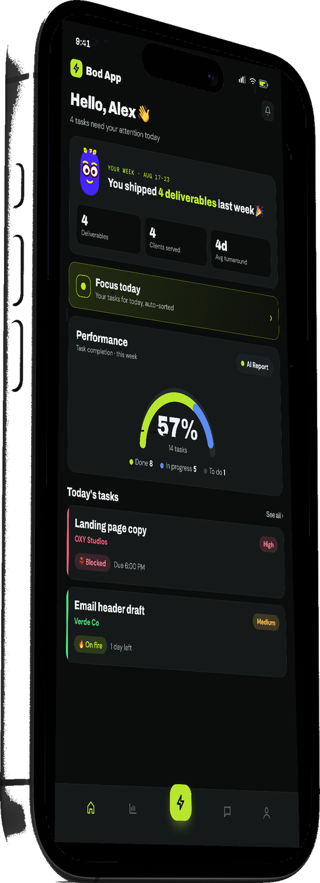
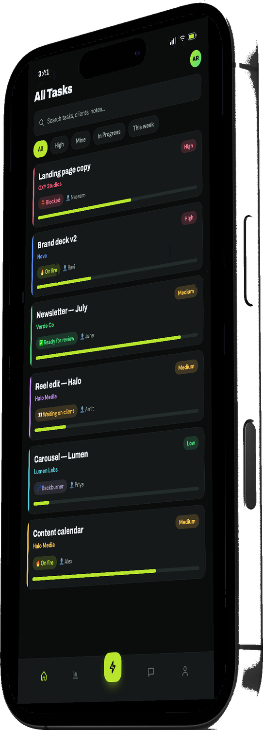
02 · MEET BOD APP
BOD APP / SALES DECK
One calm app for
the whole studio.
The workspace a marketing agency runs on: tasks, approvals, billing, AI capture and standups in one place. Built and battle-tested inside Storibod's own studio.
5→1
3
TOOLS, REPLACED
LANGUAGES, SPOKEN
Tasks, approvals, billing prompts, standups and AI in one app.
Capture work in Malayalam, English or Manglish — voice or text.
6 PM
3
STANDUP, AUTOMATED
PLATFORMS, ONE APP
A daily digest of what shipped and what's next, written for you.
iOS, Android and web — at the desk or on a shoot, always in sync.
BOD APP · RUN YOUR STUDIO THE CALM WAY
03
Notes:
Bod App in one line: the workspace an agency runs on. Four numbers do the selling — five tools become one, three languages, a standup written at 6 PM, and one app across iOS, Android and web.

Slide 4
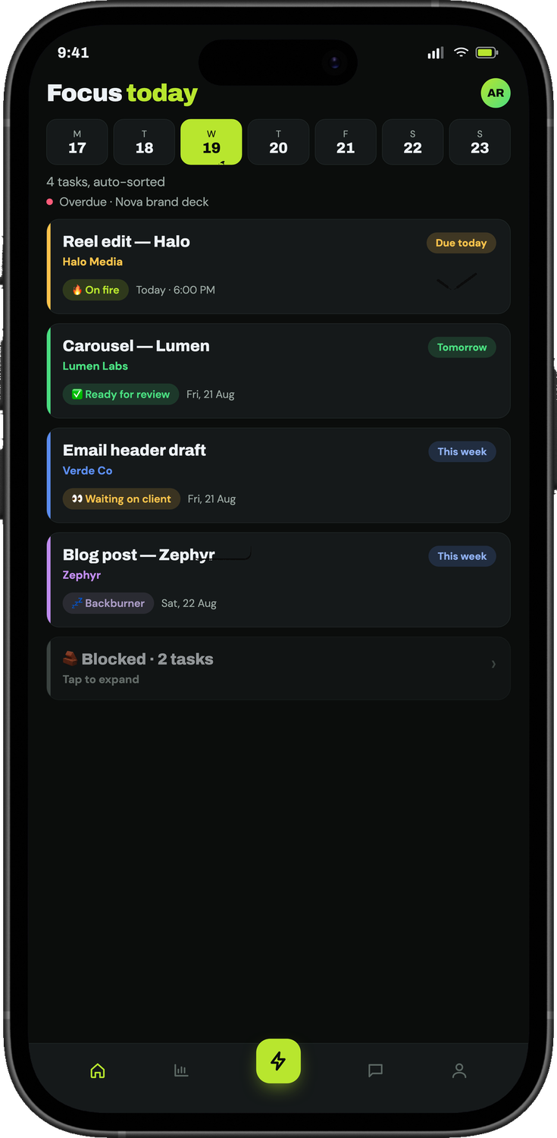



03 · SMART FOCUS QUEUE
Start every day already sorted.
Open the app and today is decided for you — overdue and blocked work first, the rest in the order that keeps clients happy. No planning meeting, no scrolling a board.
Overdue & blocked surfaced at the top
The queue is auto-sorted every morning, per person.
One tap into a calm focus mode
Just today's work — nothing else competing for attention.
Vibe status, so the team feels the load
Tap to set the mood of a task. Leads see pressure before it becomes a problem.
VIBE STATUS
On fire
Waiting on client
Ready for review
Backburner
BOD APP · RUN YOUR STUDIO THE CALM WAY
04
Notes:
This is the screen designers and creators live in. Every morning the queue is already sorted — overdue and blocked first. Vibe status lets the team say how a task feels, so leads spot overload early.

Slide 5
04 · THE WORKFLOW
BOD APP / SALES DECK
Brief to billed.
Five stages, role-aware at every step. Nothing shipped goes uninvoiced.
1
→
2
→
3
→
4
→
5
Pending
In Progress
Completed
Ready to Bill
Billed
Captured or requested. Waits for approval.
Assigned and moving, with a live vibe.
Delivered. Counts toward your week.
Enters the Finance queue with notes.
Invoiced in Zoho and closed out.
PM APPROVES
TEAM OWNS
TEAM MARKS
PM HANDS OFF
FINANCE CLOSES
Role-gated at every step. People can only move work their role owns. Billed work is archived; cancelled work stays off-track.
No change to your accounting. Finance works a first-come Ready to Bill queue with an urgent-bill flag. Amounts stay in Zoho.
BOD APP · RUN YOUR STUDIO THE CALM WAY
05
Notes:
Walk the pipeline left to right and name who owns each step. The key sell for founders is stage four: Ready to Bill. Delivered work lands in Finance's queue automatically, so nothing shipped goes uninvoiced. Invoicing itself stays in Zoho.

Slide 6


05 · AI CAPTURE
Speak it. It becomes a task.
YOU · VOICE NOTE · MANGLISH
“Naseem-inod OXY landing page copy Friday-il venam, high priority.”
A voice note or a messy line of notes turns into a clean, assigned task — the who, what and when already filled in. In the language your team actually speaks.
BOD APP · DRAFT TASK
Here's the task, ready for approval:
Task
OXY landing page copy
Malayalam
English
Manglish
Voice → task
PDF → tasks
Assignee
Naseem
Assignee, deadline and priority parsed for you
Deadline
Friday
Lands in the PM approval queue, with duplicate detection
Priority
High
Works from a voice note, rough notes or a PDF brief
APPROVE
EDIT
BOD APP · RUN YOUR STUDIO THE CALM WAY
06
Notes:
Play this out loud if you can. A Manglish voice note becomes a fully-formed draft task — assignee, deadline and priority parsed — sitting in the PM's approvals inbox. It also works from messy notes or a PDF brief.

Slide 7
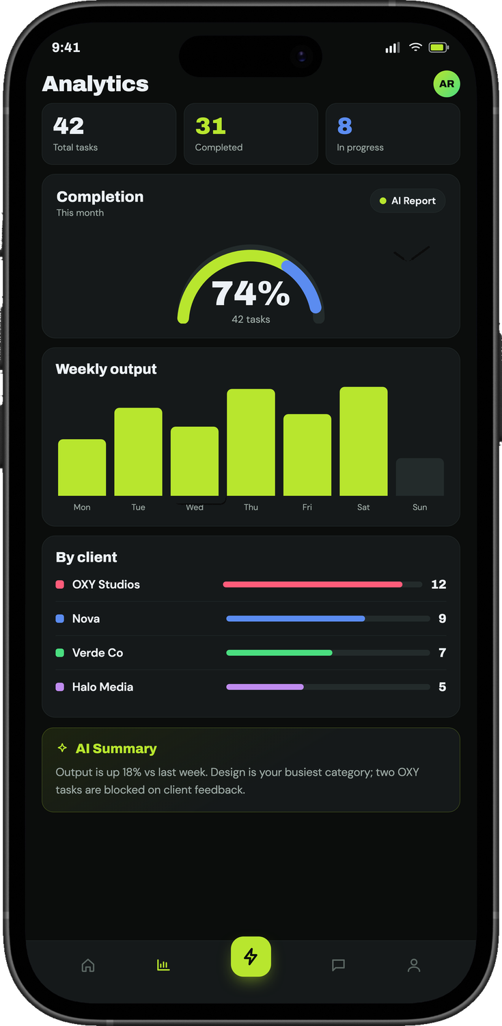




06 · ANALYTICS & AUTO STANDUP
See the whole studio at a glance.
Deliverables shipped, clients served, average turnaround — the numbers a founder actually asks for, without a single spreadsheet.
Output per client
AI summaries
Every client gets its own colour, so the workload split is obvious.
A daily briefing per person and a plain-English read of the week.
Auto standup at 6 PM
Blocked-task nudges
A daily digest of what shipped and what's next. One tap to copy.
48 hours waiting on a client? The follow-up is drafted for you.
BOD APP · RUN YOUR STUDIO THE CALM WAY
07
Notes:
This is the founder's slide. Analytics, a weekly AI summary and a 6 PM standup mean the founder never has to ask for a status update. Blocked-task nudges take chasing off the PM's plate.

Slide 8








07 · EVERYTHING IN ONE WORKSPACE
BOD APP / SALES DECK
Less juggling. More shipping.
Twelve features that replace a board, a sheet, a WhatsApp group and a standup meeting.
Focus Queue
Task pipeline
Vibe status
AI capture
One auto-sorted list for today, overdue first.
Pending to Billed, role-aware at every step.
Long-press a task to set its mood.
Voice or text in Malayalam, English, Manglish.
Client colours
Smart nudges
Auto standup
Billing checklist
Every client gets its own accent, everywhere.
A follow-up drafted after 48h on a client.
A 6 PM digest, one tap to copy or post.
What to bill, not how much. Zoho keeps the rest.
Approvals hub
Team & task chat
What's next? AI
Home widgets
Requests, notes and PDF tasks in one PM inbox.
Group and per-task threads, files, voice notes.
Ask which task to pick up next. Get a reason.
Your top tasks and AI briefing on the home screen.
BOD APP · RUN YOUR STUDIO THE CALM WAY
08
Notes:
The full feature set on one page. Point out that none of these need setup or training — they show up the moment the team starts adding tasks.

Slide 9




08 · BUILT FOR THE WHOLE STUDIO
BOD APP / SALES DECK
One app, every seat.
Everyone sees the same work through their own lens — no status meetings required.
Founder
Project manager
Creative team
Finance & HR
The whole studio at a glance — deliverables shipped, clients served, and what's ready to bill.
Assign, chase and approve from one inbox. Blocked-task nudges write the follow-up.
A calm focus queue — today's work, auto-sorted, with the vibe of each task at a tap.
A Ready to Bill queue and a “what to bill” checklist, so nothing shipped goes uninvoiced.
THEY LIVE IN
THEY LIVE IN
THEY LIVE IN
THEY LIVE IN
Analytics · AI weekly summary · 6 PM standup
Approvals hub · Nudges · AI capture
Focus Queue · Vibe status · Focus mode
Ready to Bill · PM–Finance board · Leave & holidays
BOD APP · RUN YOUR STUDIO THE CALM WAY
09
Notes:
Tailor this to who's in the room. If it's the founder, lead with the lime card. If it's an ops or PM lead, spend time on the approvals inbox and nudges.

Slide 10


09 · THE CHANGE
BOD APP / SALES DECK
Same team. Different week.
From chasing status to seeing the work.
BEFORE BOD APP
WITH BOD APP
Briefs scattered across WhatsApp, email and memory
Every brief captured once — by voice, in any language
Status known only by asking each person
Status visible at a glance, with a live vibe
Blocked work waits until someone notices
Blocked-task nudges write the follow-up
Delivered work slips through before it's billed
A Ready to Bill queue: nothing shipped goes uninvoiced
The morning goes on a status meeting
A 6 PM standup digest, written for you
BOD APP · RUN YOUR STUDIO THE CALM WAY
10
Notes:
Read the rows across — each 'before' has a matching 'after'. Ask the prospect which row describes their week right now.

Slide 11
10 · THE COST
BOD APP / SALES DECK
The bill for coordination nobody counts.
Illustration: 10 people · 22 working days · 30 minutes of coordination per person, per day.
30 min
110 hrs
₹2,990
PER PERSON / DAY
PER MONTH
BOD APP ADVANCED / MONTH
Chasing status, re-explaining briefs and hunting for files.
Lost across a ten-person team — most of a full-time salary.
The full setup for that same ten-person team (10 seats × ₹299).
Run the arithmetic with your own team size and hourly cost. It rarely comes out close.
BOD APP · RUN YOUR STUDIO THE CALM WAY
11
Notes:
10 people × 30 minutes × 22 days = 110 hours a month spent on coordination. Compare that with ₹2,990 a month for ten seats on Advanced. Ask for their team size and do the maths live.

Slide 12
11 · PRICING
BOD APP / SALES DECK
Simple per-seat plans.
14 days free. Full features. No card.
BASIC
ADVANCED
MOST POPULAR
PREMIUM
₹199 / seat / mo
₹299 / seat / mo
₹499 / seat / mo
Small teams finding their rhythm.
Growing agencies, many clients.
Studios wanting a custom build.
The essentials, not every feature
The full setup we run on ourselves
Custom setup, configured with you
Full task pipeline & board
Everything in Basic, plus:
Everything in Advanced, plus:
Focus Queue & vibe status
AI capture: voice, notes, PDF
Custom pipeline, categories & roles
Per-client colour
Approvals hub & requests
Zoho & Sheets sync
iOS, Android & web
Nudges, standup & recap
SSO & role controls
Billing checklist & analytics
Onboarding & priority support
Per seat, per month. Talk to us about annual billing and larger teams. · GCC clients can be billed in AED or SAR.
BOD APP · RUN YOUR STUDIO THE CALM WAY
12
Notes:
Advanced is the recommendation for most agencies — it's the exact setup Storibod runs on. Basic is for small teams getting started; Premium is a custom setup with Zoho and Sheets sync, SSO and priority onboarding. Every plan starts with a 14-day free trial, no card.

Slide 13






12 · WHY BOD STUDIO
BOD APP / SALES DECK
Built by a studio.
Fits your stack.
PLAYS NICE WITH WHAT YOU USE
Zoho
Google Sheets
Invoices & books
Live task sync
Bod App was built to run the Storibod floor before it was offered to anyone else. Every feature earned its place on real client work.
WhatsApp
iOS
BATTLE-TESTED ON WORK FOR
Nudges & demos
iPhone & iPad
OXY · Salison's · Restlon · Papacheri · Vijayan Master's · Plum Stories
Android
Web
Phone & tablet
Any browser
A Bod Studio product
Built by Storibod Creatives in Kochi, Kerala. Support stays human — on WhatsApp.
BOD APP · RUN YOUR STUDIO THE CALM WAY
13
Notes:
Credibility slide. This isn't a startup guessing at agency workflows — it's the tool a working agency built for itself. On integrations: invoices stay in Zoho, exports go to Sheets, and it runs on every device.

Slide 14
13 · GETTING STARTED
BOD APP / SALES DECK
From first call to a decision in 14 days.
A real workflow, not a generic demo.
DAY 0
DAY 1
DAYS 2–13
DAY 14
Walkthrough
Set up
Run real work
Decide
20 minutes on your actual workflow — on WhatsApp or a call.
Invite the team, set roles, add clients and their colours. No migration.
Put live client work through the pipeline. Standups and nudges run themselves.
Read your own analytics and AI summary. Keep it only if it earned its place.
14 days, full features, no card. If it hasn't earned its place, walk away — there's no contract to unwind.
BOD APP · RUN YOUR STUDIO THE CALM WAY
14
Notes:
Make the trial the ask. Offer the 20-minute walkthrough on their real workflow, set them up on day one, and book a review call on day 14 to read the analytics together.

Slide 15
14 · QUESTIONS
BOD APP / SALES DECK
The questions you're already thinking.
Short answers. No jargon.
We already use WhatsApp.
We tried a project tool. It died.
WhatsApp is where work gets discussed, not tracked. Bod App gives the work a home — and still nudges on WhatsApp.
Usually because it demanded setup before it gave anything back. Bod App sorts your day from the first task you add.
Who has time to migrate?
Does it replace our invoicing?
There's nothing to migrate. Start with this week's tasks — or speak them in. History can stay where it is.
No. It runs a “what to bill” checklist and a Ready to Bill queue. Amounts and invoices stay in Zoho.
Is the AI really multilingual?
Which devices?
Yes — Malayalam, English or Manglish, by voice or text. It parses the who, what and when into a draft task.
iOS, Android and web from one codebase — with home-screen widgets on mobile and offline caching when the signal drops.
BOD APP · RUN YOUR STUDIO THE CALM WAY
15
Notes:
Pre-empt the objections. The two that come up most: 'we already use WhatsApp' and 'does it replace our invoicing'.

Slide 16
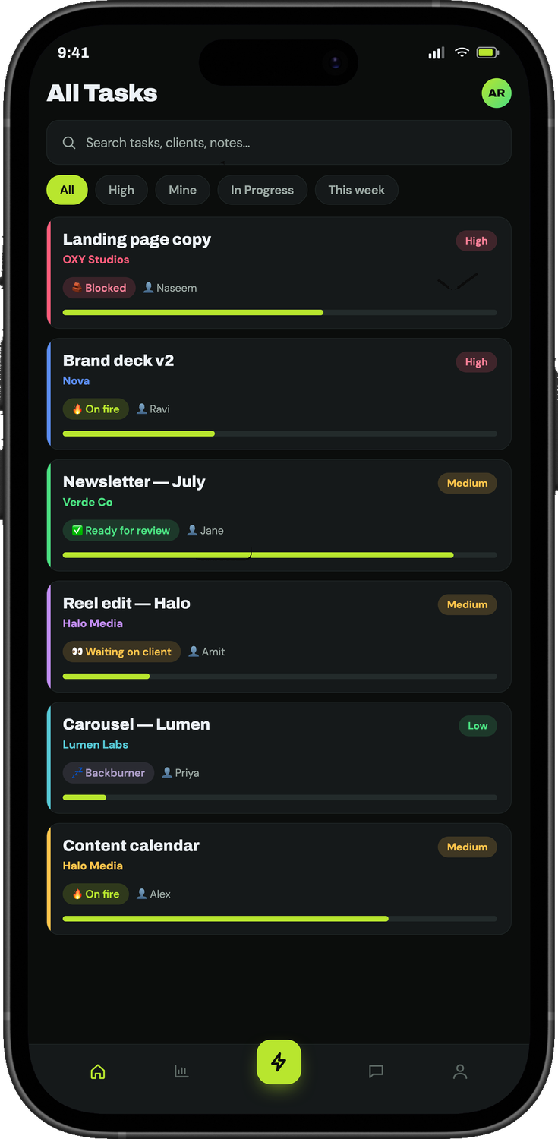
Bod App
A BOD STUDIO PRODUCT
NEXT STEP
Run your studio
the calm way.
Start the 14-day free trial, or book a 20-minute walkthrough on your real workflow. If it doesn't hold up, you've lost two weeks and no money.
START FREE TRIAL →
DEMO ON WHATSAPP
WHATSAPP
EMAIL
WEB
INSTAGRAM
+91 7356 333 975
info@storibodcreatives.com
mybodstudio.com
@storibod.creatives
Notes:
Close on the trial. Two options: start free (email) or a WhatsApp demo. Leave this slide up while you swap contact details.

