Slide 1
FinGuard AI
AI-Powered Personal Finance Tracker with Real-Time Fraud Detection,
OCR Bill Scanning & GPT-Assisted Savings Advice
Final Year Project Presentation
[Your Name] · [Your Institution] · [Date]

Slide 2
The Problem
Most personal finance apps just record transactions — they don't tell you anything is wrong.
Financial fraud and mistakes usually show up first as an unusual transaction — but users only notice it during a monthly review, if at all.
Manually re-typing every paper receipt is tedious enough that most people simply stop tracking their spending.
Bank-linked aggregator apps solve some of this, but require handing over real account access — not appropriate or necessary for every use case.

Slide 3
Objectives
Secure, multi-user finance tracker with category budgeting
Real-time ML fraud/anomaly scoring on every transaction
Next-month expense forecasting from spend history
OCR receipt scanning → user-confirmed transaction
GPT-assisted savings advice with a rule-based fallback
Admin panel for platform-wide oversight
Real deployment readiness: Docker, CI, security hardening

Slide 4
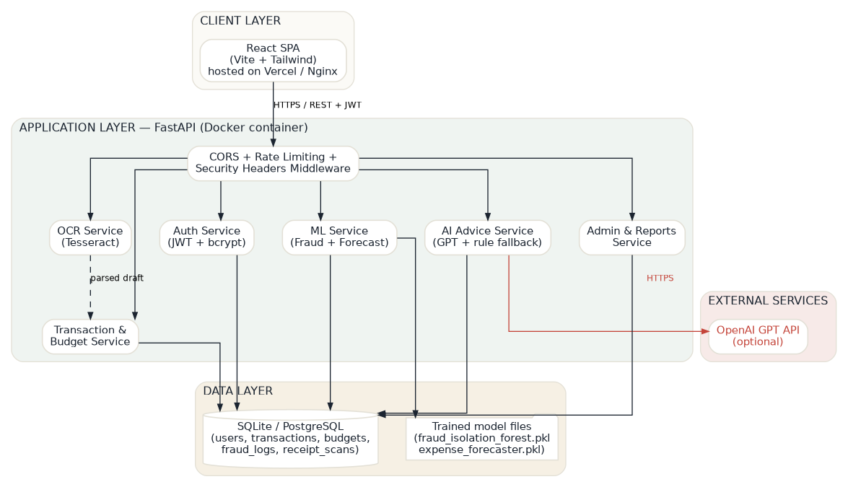
System Architecture

Slide 5
Technology Stack
Frontend | React 18, Vite, Tailwind CSS, Axios, Recharts
Backend | Python 3.11, FastAPI, SQLAlchemy, Pydantic
Auth & Security | JWT (python-jose), bcrypt, slowapi rate limiting
Machine Learning | scikit-learn — Isolation Forest + Linear Regression
OCR | Tesseract OCR engine + pytesseract + Pillow
AI Advice | OpenAI GPT API, with rule-based fallback
Database | SQLite (dev) / PostgreSQL / MySQL (prod)
Infra | Docker, Docker Compose, Nginx, Gunicorn, GitHub Actions

Slide 6
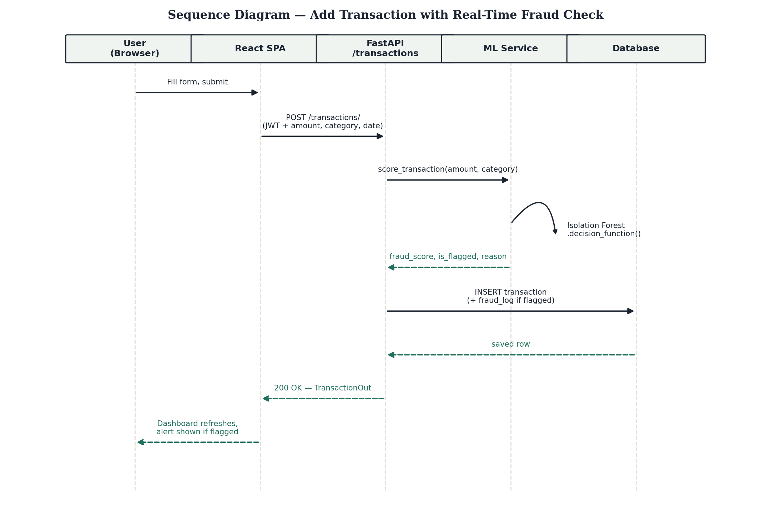
Feature: Real-Time Fraud Detection
Every transaction is scored the instant it's created — not in a nightly batch job.

Slide 7
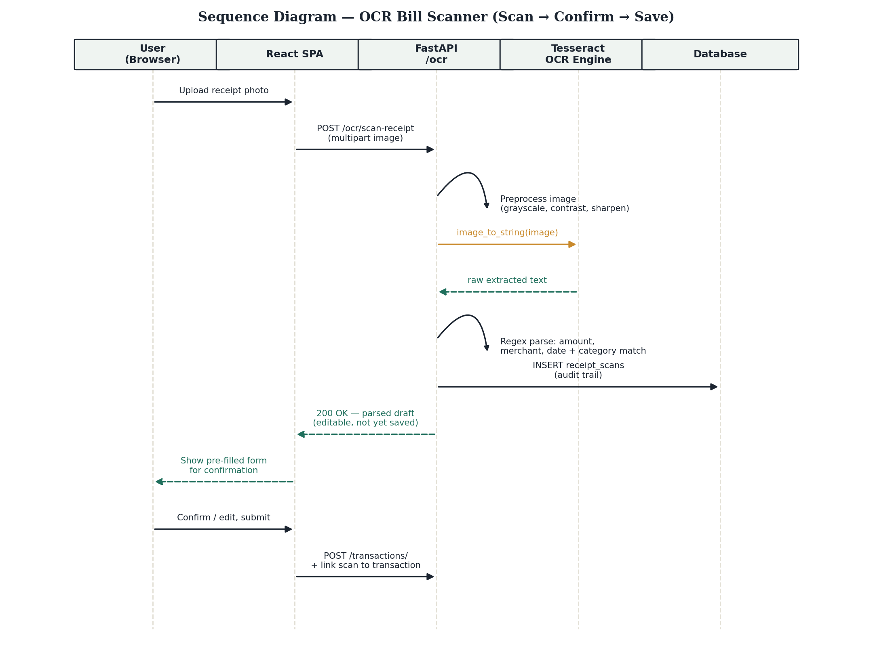
Feature: OCR Bill Scanner
Photograph a receipt → Tesseract extracts text → fields are parsed → user confirms before saving.

Slide 8
Machine Learning — Results
Fraud Detector (Isolation Forest)
Expense Forecaster (Linear Regression)
MAE ≈ 34.75
average error on predicted monthly spend
Predicts next month's total spend from trailing 3-month history + category mix.
Trained on a synthetic-but-realistic labelled dataset (no real fraud data available for this project).

Slide 9
Production Security
bcrypt password hashing — never stored in plaintext
JWT-signed sessions; production refuses to boot with a default secret
Rate limiting: global + tighter limit on login (5/min) against brute force
Environment-driven CORS — no wildcard origins in production
Structured global error handling — no stack traces ever reach the client
Security response headers (X-Frame-Options, HSTS in production, etc.)

Slide 10
Admin Panel
Platform-wide stats: users, transactions, flagged count, total volume
User management — enable/disable accounts, grant/revoke admin
Fraud review queue across all users, with mark-as-reviewed
One-click CSV export for Power BI / Excel reporting
First registered account on a fresh database is auto-promoted to admin

Slide 11
Deployment
Docker Compose
Render + Vercel
Single VPS
One command, fully offline demo:
docker compose up --build
Live public URL — backend on Render,
frontend on Vercel, split hosting
Same Docker images behind
nginx/Caddy for a custom domain
ML models are pre-trained and shipped inside the Docker image — zero setup steps before the app is fully functional.

Slide 12
Future Scope
Re-train and validate the fraud model on real labelled fraud data
React Native mobile app reusing the same REST API
Multi-item receipt parsing (split one bill into several transactions)
Bank statement (CSV/PDF) bulk import
Shared/family budgets with per-member visibility controls

Slide 13
Thank You
Questions?
Full source, documentation, and deployment guide included in the project ZIP.

