Slide 1



db-LaCAM: Fast and Scalable Multi-Robot Kinodynamic Motion Planning with Discontinuity-Bounded Search and Lightweight MAPF
Akmaral Moldagalieva, Keisuke Okumura, Amanda Prorok, Wolfgang Hönig
TU Berlin, AIST, University of Cambridge
AAAI 2026
January 27, 2026

Slide 2

Multi-Robot Kinodynamic MotionPlanning: Fast, Real-World

Slide 3
Multi-Robot Kinodynamic MotionPlanning: Fast, Scalable
x10
db-CBS, db-ECBS – state-of-the-art
kinodynamic planners

Slide 4
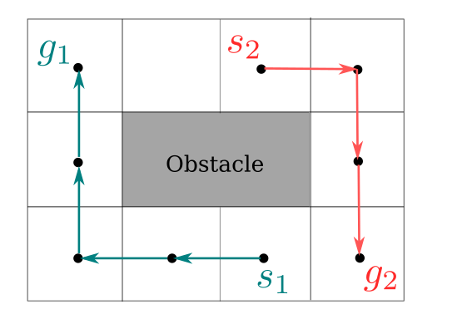
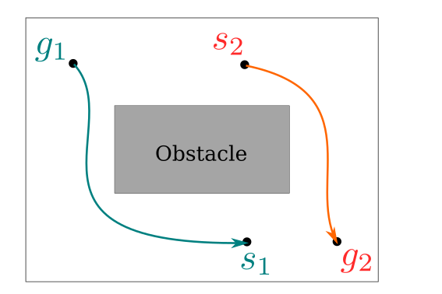
Multi-Robot Coordination
Discrete vs. Continuous
Discrete vs. Continuous Planning
Multi-Agent Path Finding (MAPF) Multi-Robot Motion Planning (MRMP)
Discrete time steps
Grid representation of the world
Continuous state & time
Infinite possible motions

Slide 5
Multi-Robot Coordination: SOTA
Discrete vs. Continuous
MAPF: MRMP:
Fast
Scales well with >1000 agents
Output can be infeasible for real robots
Output respects robot dynamics
Slow, scale poorly beyond few robots

Slide 6
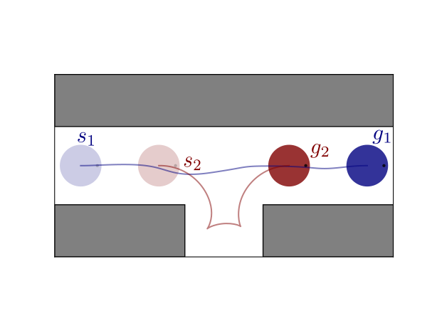
Motivation
MAPF: MRMP:
Fast
Scales well with >1000 agents
Output can be infeasible for real robots
Output respects robot dynamics
Slow, scale poorly beyond few robots
Fast, scalable, dynamic-aware planner for multi-robot systems.

Slide 7
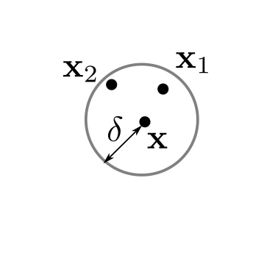

Approach
Our planner, db-LaCAM, is built upon two core ideas
1. discontinuity-bound search
2. LaCAM algorithm
Allows discontinuity-bound ( )
between states
Search-based graph pathfinder

Slide 8
Approach
Extending LaCAM to the continuous domain is non-trivial.
Challenges:
Continuous state space;
Constraints from robot dynamics;
Harder heuristic estimation – Euclidean distance fails.

Slide 9
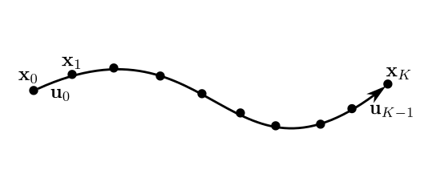
Approach
The planner db-LaCAM uses db-PIBT to generate fixed-length horizon trajectories
using motion primitives:

Slide 10
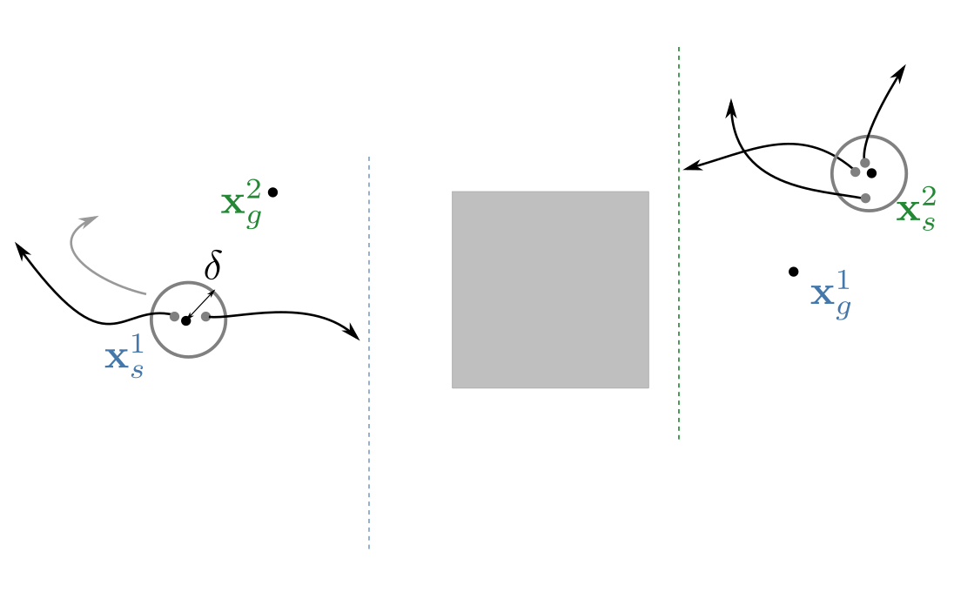
Approach: db-LaCAM
db-PIBT planning fixed-length horizon robot trajectories
Step 1: find applicable motions
horizon I
horizon I

Slide 11
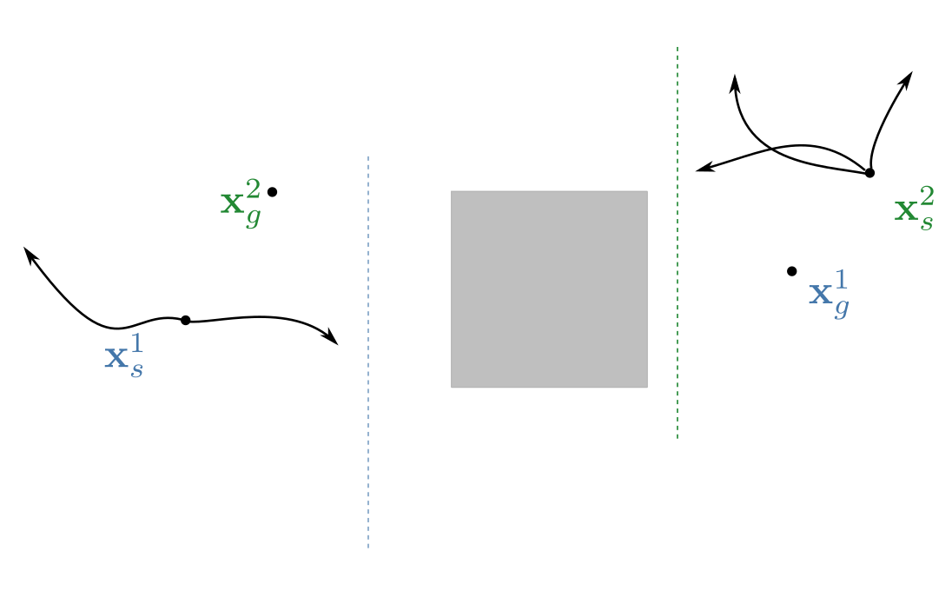
Approach: db-LaCAM
db-PIBT planning fixed-length horizon robot trajectories
Step 2: rollout applicable motions
horizon I
horizon I

Slide 12
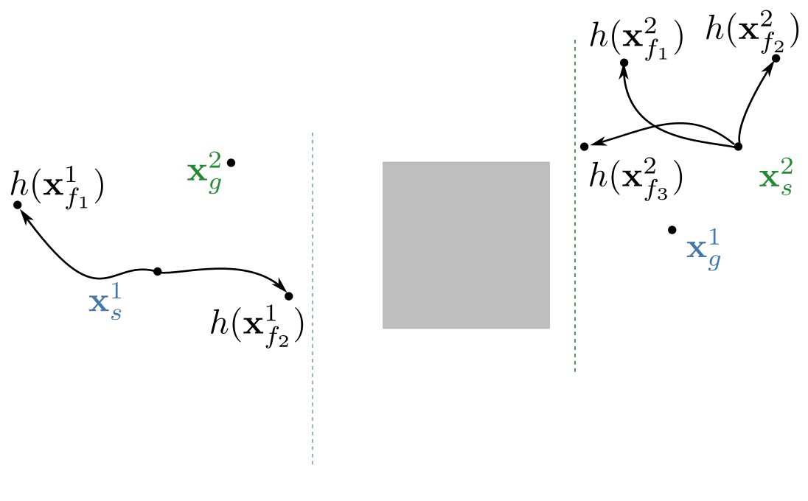
Approach: db-LaCAM
db-PIBT planning fixed-length horizon robot trajectories
Step 3: compute cost-to-go (h) with Hierarchical EST
horizon I
horizon I

Slide 13
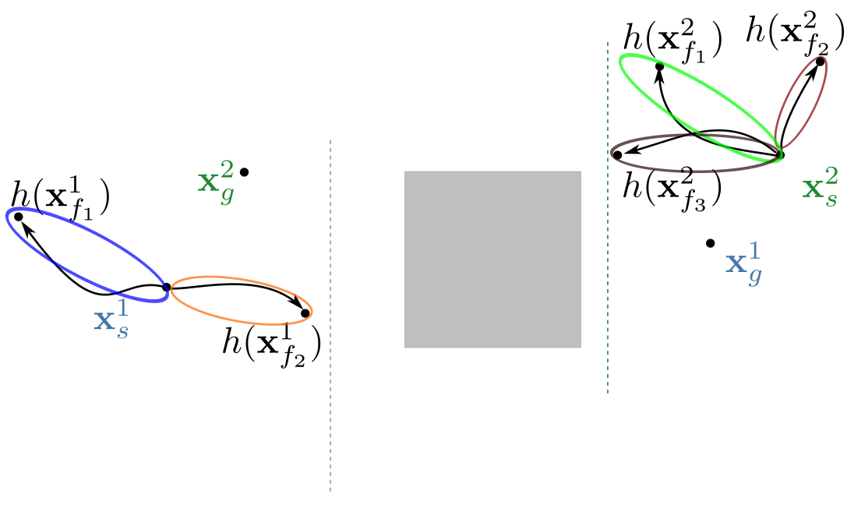
Approach: db-LaCAM
db-PIBT planning fixed-length horizon robot trajectories
Step 4: sort motions based on h-value and cluster
horizon I
horizon I

Slide 14
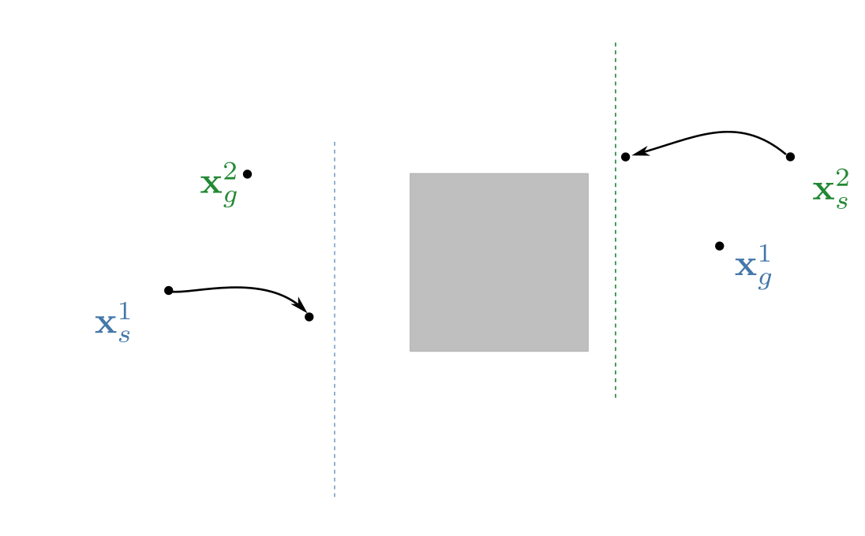
Approach: db-LaCAM
db-PIBT planning fixed-length horizon robot trajectories
Step 5: pick the best motion for both robots
horizon I
horizon I

Slide 15
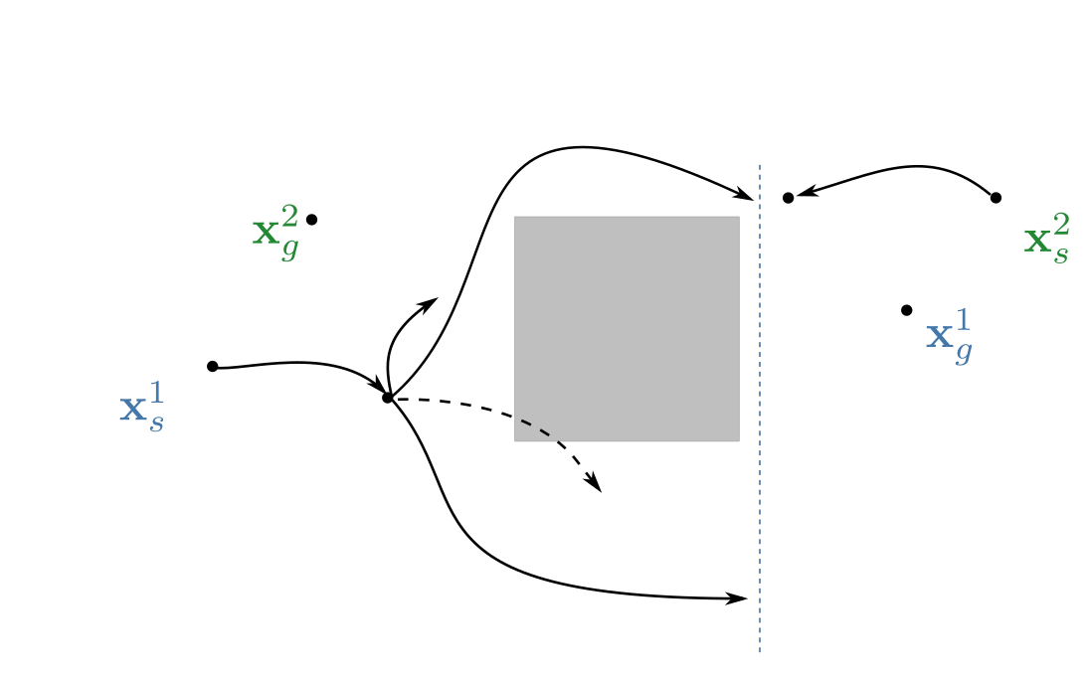
Approach: db-LaCAM
db-PIBT planning fixed-length horizon robot trajectories
Rollout motions for Robot 1 for the next horizon
horizon II

Slide 16
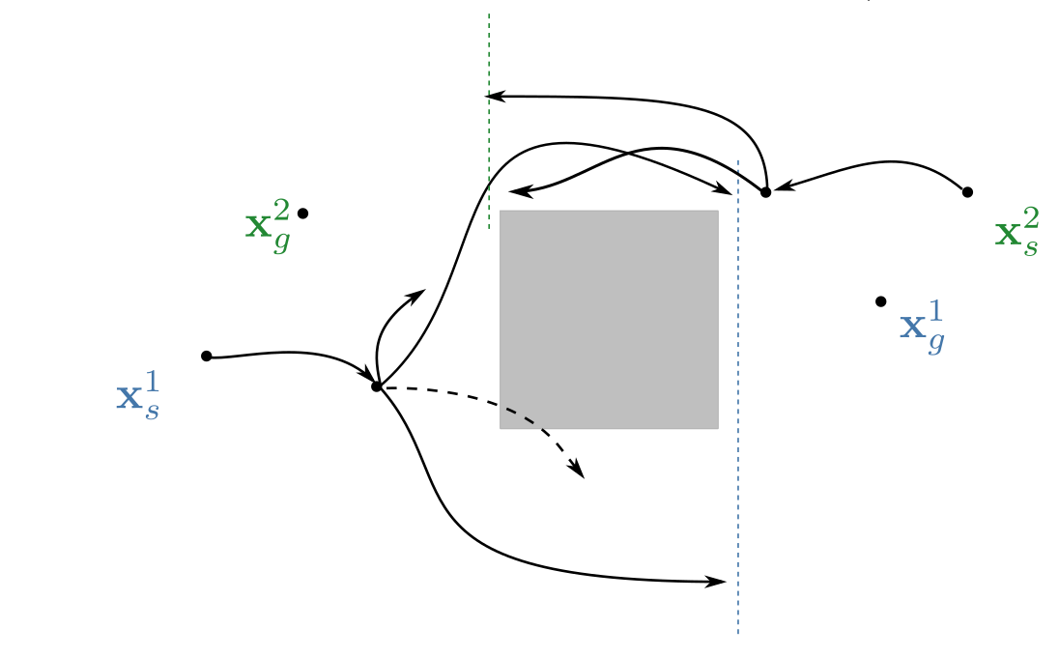
Approach: db-LaCAM
db-PIBT planning fixed-length horizon robot trajectories
Rollout motions for Robot 2 for the next horizon
horizon II
horizon II

Slide 17


Approach: db-LaCAM
db-PIBT planning fixed-length horizon robot trajectories
Robot 1 has potential collision with Robot 2 – Priority Inheritance R1 R2
horizon II
horizon II

Slide 18

Approach: db-LaCAM
db-PIBT planning fixed-length horizon robot trajectories
With priority inheritance Robot 2 plans its trajectory
horizon II
horizon II

Slide 19
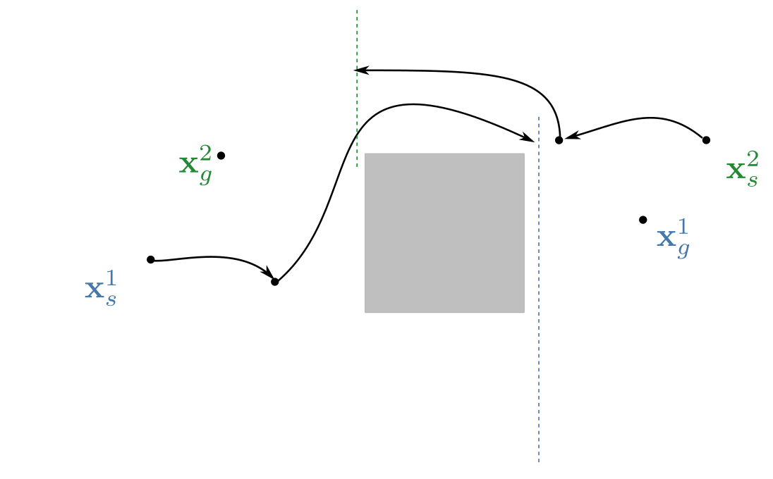
Approach: db-LaCAM
db-PIBT planning fixed-length horizon robot trajectories
Once Robot 2 has plan, Robot 1 reserves its motion
horizon II
horizon II

Slide 20

Approach: db-LaCAM
db-PIBT planning fixed-length horizon robot trajectories
Plan until all robots reach goal states
horizon III
horizon III

Slide 21
Experimental Results
AtGoal instance
x3
db-CBS db-ECBS db-LaCAM (ours)
Runtime [s] 2.1 0.2 0.02
Cost [s] 9.1 9.2 16.8

Slide 22
Experimental Results
Circle instance with N=10 unicycle robots
x6
db-CBS db-ECBS db-LaCAM (ours)
Runtime [s] 9.0 14.1 1.1
Cost [s] 157.8 159.9 196.8

Slide 23
Experimental Results
Random start/goal/obstacles instance with N=8 spherical unicycle robots
x6
db-CBS db-ECBS db-LaCAM (ours)
Runtime [s] 9.2 12 1.7
Cost [s] 135.8 149.1 211.2

Slide 24
Experimental Results
Random start/goal/obstacles instance with N=8 unicycle robots
x6
db-CBS db-ECBS db-LaCAM (ours)
Runtime [s] 6.7 6.9 1.2
Cost [s] 118.9 117.2 139.2

Slide 25
Experimental Results
Maze instance with N=10 unicycle robots
x10
db-CBS db-ECBS db-LaCAM (ours)
Runtime [s] 32.8 9.6 2.9
Cost [s] 210.1 208.7 231.6

Slide 26
Experimental Results
Forest instance with N=10 3D double integrator robots
x10
db-CBS db-ECBS db-LaCAM (ours)
Runtime [s] 31.4 40.8 13.9
Cost [s] 93.7 96.6 132.5

Slide 27
Experimental Results
Heterogeneous team of N=4 flying and N=4 unicycle robots
x4
db-CBS db-ECBS db-LaCAM (ours)
Runtime [s] 4.4 4.9 1.2
Cost [s] 68.1 69.3 36.7

Slide 28
Summary
We introduce db-LaCAM, a planner that:
Is resolution-complete w.r.t motion primitives;
Works with arbitrary robot dynamics;
Up to x10 faster runtime compared to SOTA planners.
Limitations:
Heuristic estimation is expensive

