Slide 1








UNI EMERGENCY HUB APPLICATION
Muhammad Akmal Bin Zainal Abdin S62734
CSM 3114

Slide 2





Project Overview
The "Uni Emergency Hub" app keeps our university safe by providing quick access to emergency contacts, a simple way to report problems, and fast updates during emergencies. It's easy to use, respects privacy, and fits well with our safety plans, making it a must-have for keeping everyone on campus safe and informed.

Slide 3

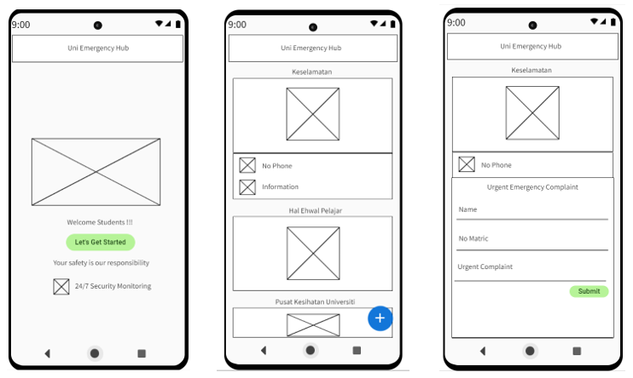
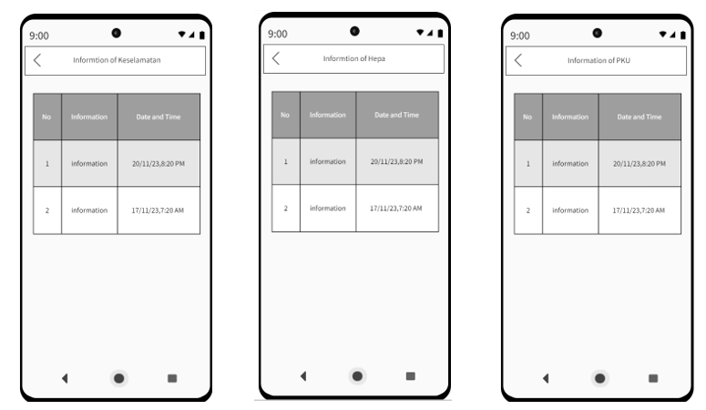

WireFrame

Slide 4
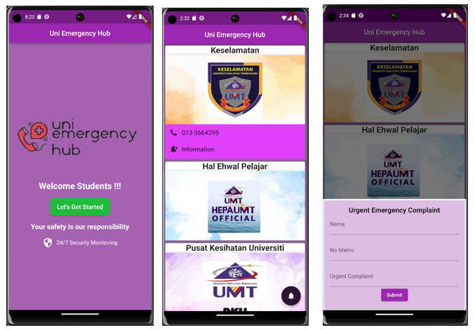
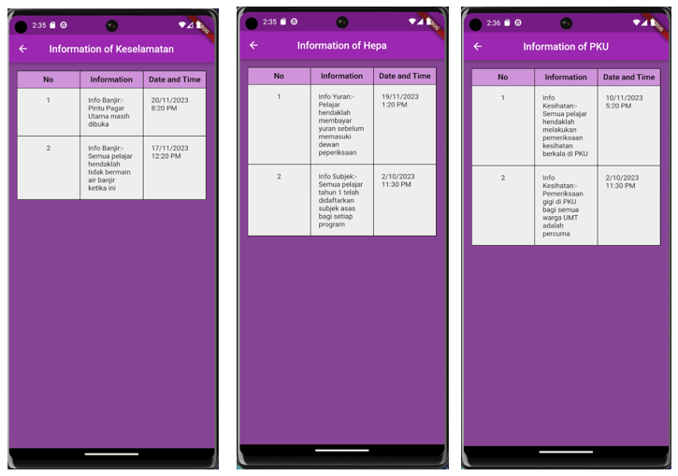
User Interface
First Page
Homepage
Complaint page
Information of Keselamatan, Hepa and PKU

Slide 5



References
1. ListView.builder constructor - ListView - widgets library - Dart API. (2023). Flutter.dev.
https://api.flutter.dev/flutter/widgets/ListView/ListView.builder.html
2. Expanded class - widgets library - Dart API. (2023). Flutter.dev. https://api.flutter.dev/flutter/widgets/Expanded-class.html
3. Code, R. (2020). Navigate One Screen to Another Screen Flutter | MaterialPageRoute Flutter | Flutter Tutorial 2023 [YouTube Video]. In YouTube. https://www.youtube.com/watch?v=Wgl7yj8Uidg
4.ChatGPT. (2024). Openai.com. https://chat.openai.com/c/32fe2602-fe67-4b5e-a07e-d630391fcc01
5. Safety Hubs on Campus | Emergency Management. (2024). Utexas.edu. https://emergencymanagement.utexas.edu/safety-information/safety-hubs-campus
‌

