Slide 1








UNI EMERGENCY HUB APPLICATION
Muhammad Akmal Bin Zainal Abdin S62734
CSM 3114

Slide 2





Project Overview
The "Uni Emergency Hub" app keeps our university safe by providing quick access to emergency contacts, a simple way to report problems, and fast updates during emergencies. It's easy to use, respects privacy, and fits well with our safety plans, making it a must-have for keeping everyone on campus safe and informed.

Slide 3

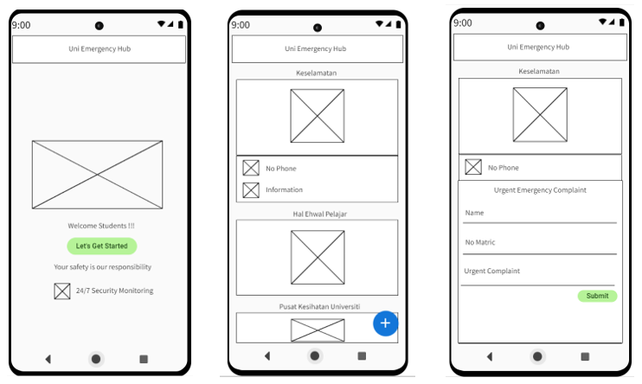
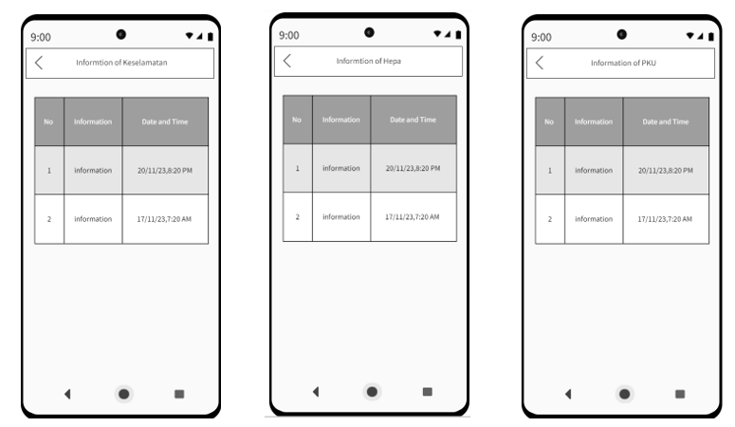

WireFrame

Slide 4
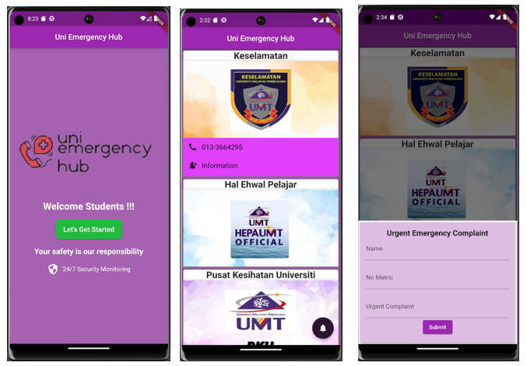
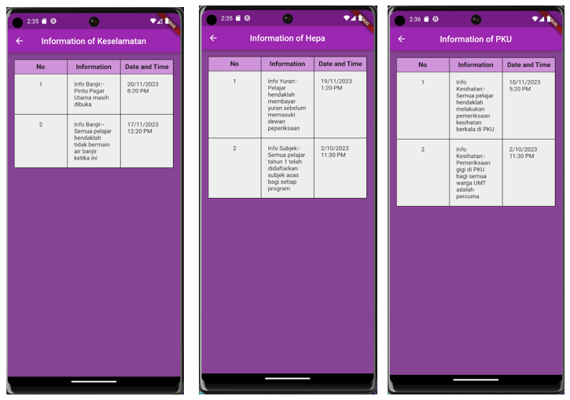
User Interface
First Page
Homepage
Complaint page
Information of Keselamatan, Hepa and PKU

Slide 5



References
1. Safety Hubs on Campus | Emergency Management. (2024). Utexas.edu. https://emergencymanagement.utexas.edu/safety-information/safety-hubs-campus
2. ListView.builder constructor - ListView - widgets library - Dart API. (2023). Flutter.dev.
https://api.flutter.dev/flutter/widgets/ListView/ListView.builder.html
3. Expanded class - widgets library - Dart API. (2023). Flutter.dev. https://api.flutter.dev/flutter/widgets/Expanded-class.html
4. Code, R. (2020). Navigate One Screen to Another Screen Flutter | MaterialPageRoute Flutter | Flutter Tutorial 2023 [YouTube Video]. In YouTube. https://www.youtube.com/watch?v=Wgl7yj8Uidg
5. ChatGPT. (2024). Openai.com. https://chat.openai.com/share/4ed2461d-1be1-4530-a248-1e4485b13dfd
6. ChatGPT. (2024). Openai.com. https://chat.openai.com/share/cdfbfd90-5622-430d-831b-0b05c04c9f13
‌

