Slide 1
Robotics Project
By: Anjali , Jarek , James

Slide 2
Roles
Endurance
Anjali: Manager
SDD, GitHub, robot video, robot testing
James: Planning
algorithm, flowchart, robot testing
Jarek: Lead Programmer
block code, Gantt chart, robot testing
Accuracy
Anjali: Lead Programmer
SDD, block code, robot video, robot testing
James: Planning
algorithm, flowchart, robot testing
Jarek: Manager
GitHub, Gantt chart, robot testing
Agility
Anjali: Manager
SDD, robot video, robot testing
James: Planning
algorithm, flowchart, robot testing
Jarek: Lead Programmer
block code, GitHub, Gantt chart, robot testing
Workflow
Had one person do most of block code each time
All participated in testing and suggesting edits in block code
Helped each other with roles in general but had a main person responsible for each role

Slide 3

Challenges
Time
Individual time constraints
HH208 not always open
sometimes crowded while open
Accuracy
Getting robot correctly oriented before testing
Problems with this = more time spent redoing tests
Determining angles and movement duration
Getting robot to stay on / at least close to blue lines
(especially with Accuracy sprint)

Slide 4
What we learned about software engineering
Takes lots of collaboration to get work done in time
Work done more quickly when all of us could meet up / communicate in real time
Communication is important
Texting about meet up times, asking questions (each other and professor), sending each other material for GitHub and SDD
Have to sometimes accept imperfect results
Could not always stay exactly on lines
Sometimes imperfect results still got the job done

Slide 5
What we would have done differently
Could have made more time for testing
One or two members could have met up while not all available
(we started doing this more towards the end)
Develop strategy for keeping track of orientation
Possibly could have used protractor to make sure robot's light matches up with certain degree while fixing orientation
Would reduce excessive testing due to orientation errors
Write down test cases directly after tests
Usually wrote them after all the tests for that day, relying on memory
Figure out app completely before using
Had various mishaps with both iPhone and Windows applications that occasionally made progress difficult

Slide 6
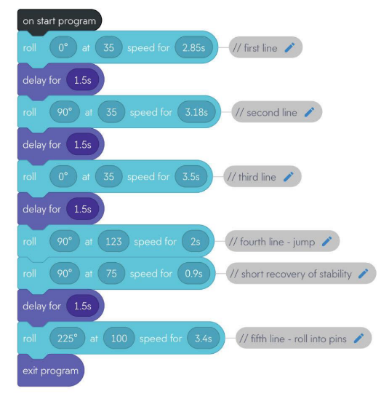
Agility Sprint Block Code

Slide 7

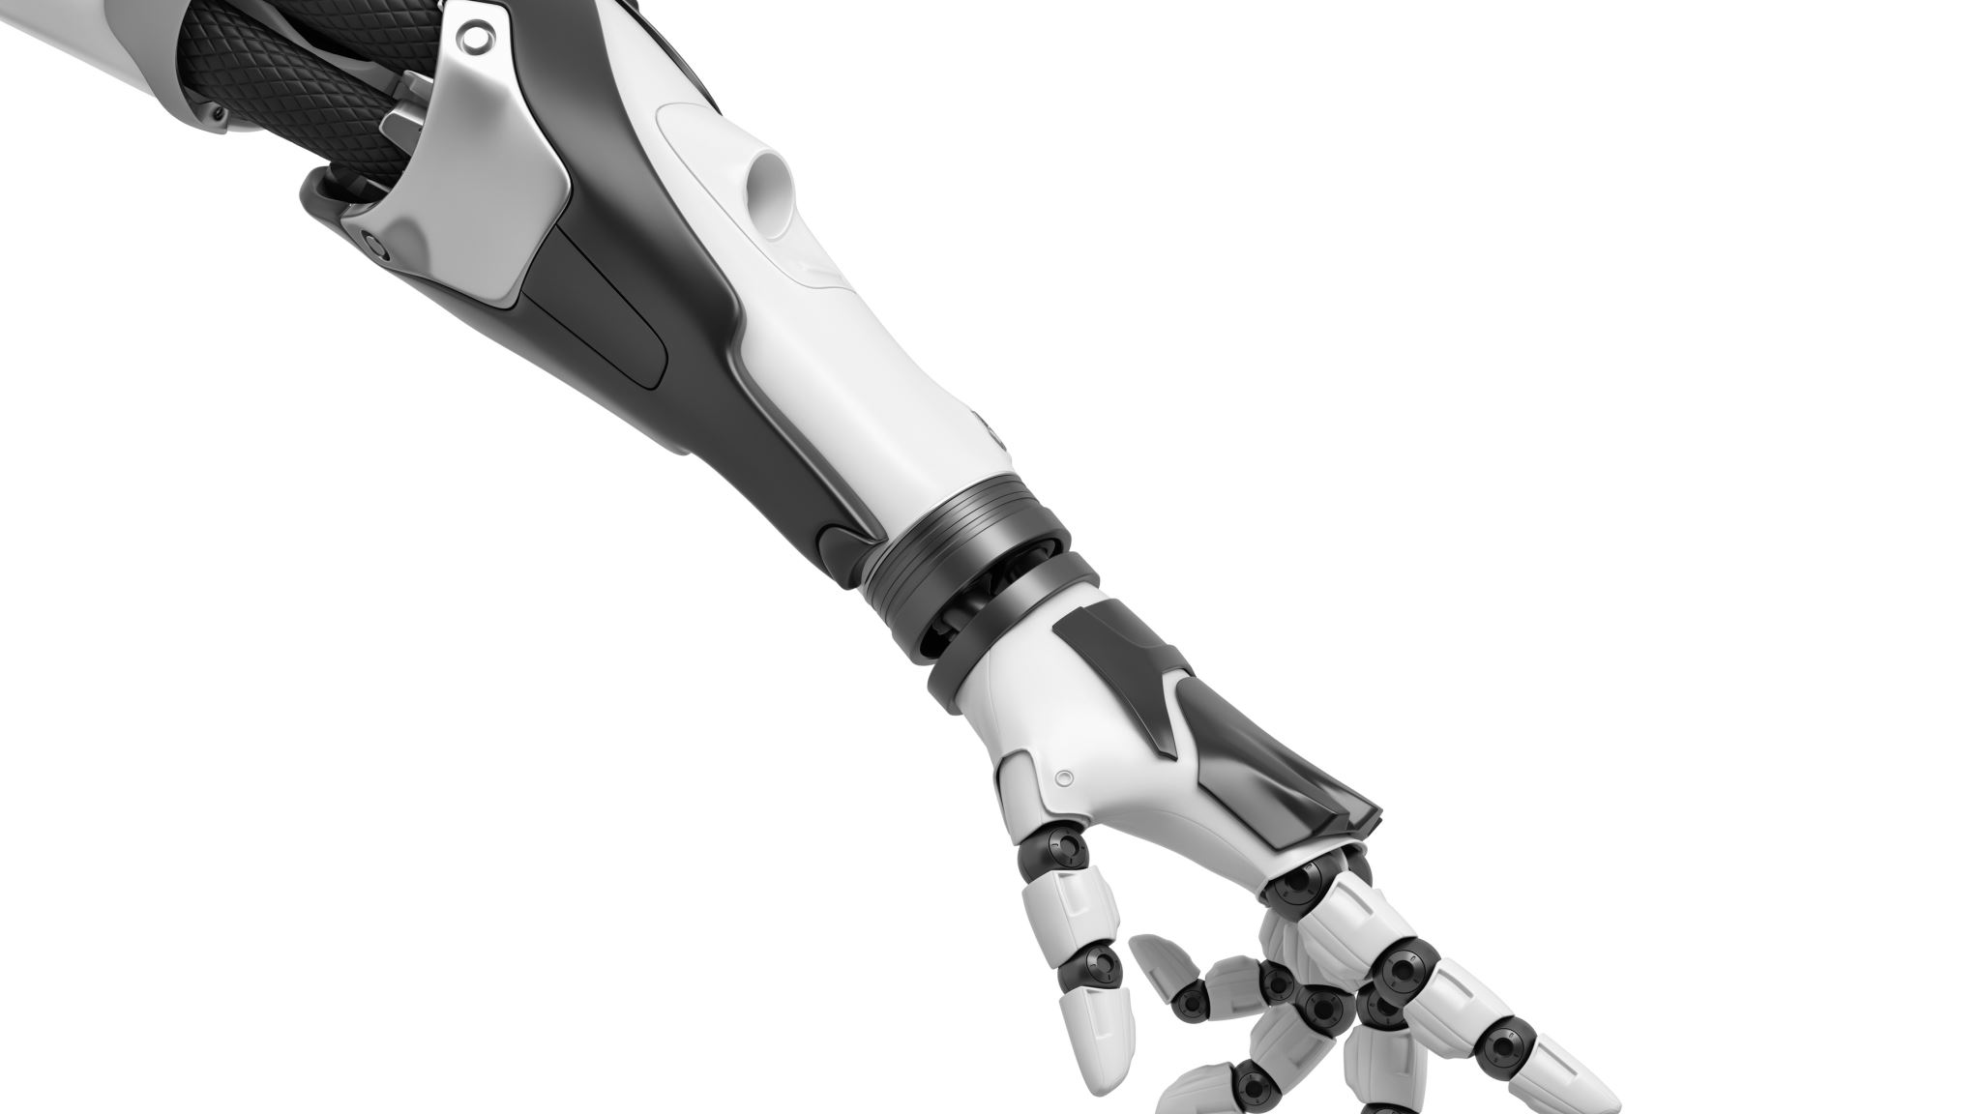
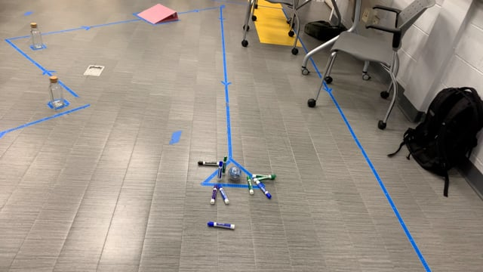
Agility Sprint Video

