Slide 1
CMSC388F: Connect 4
Created By: Akbar Baig, Ryan Mackin, and Walid Mohmand

Slide 2
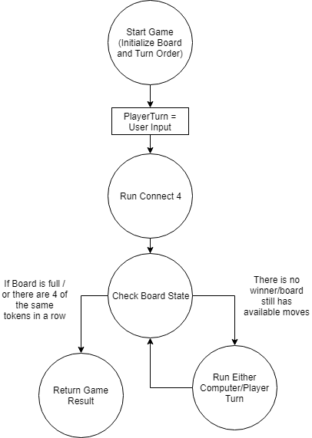
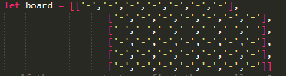
General Flow

Slide 3
Game Demo With Explanation

Slide 4
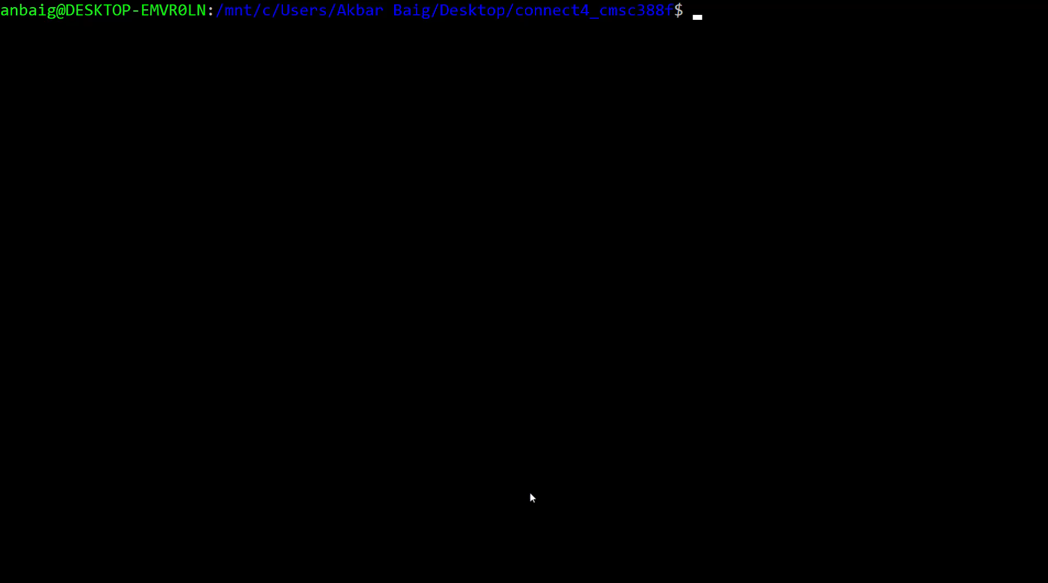

Slide 5
Hardest Parts of Project
Coding up a strategy for the AI to follow
Determining if the game is over/a player has won

