Slide 1
Data Challenge - Bank Marketing
  Ameya Diwan DSA Candidate - Ethical AI

Slide 2
Table of Contents
Background
Data Cleaning
Recommendations
Exploratory Analysis and Insights
Model Evaluation
Data Preparation

Slide 3
Background

Slide 4
Objective
Assist a banking institution to facilitate their marketing efforts, by predicting clients who will be more likely to subscribe to a term deposit product, based on historical campaign data - By uncovering valuable insights and delivering recommendations - By evaluating current model and potentially build a better predictive model for future campaigns
Increase revenue by boosting conversions, and decrease telemarketing costs by more efficient targeting

Slide 5
Dataset Overview
41188 records 20 inputs
Target Variable
Client’s socio-demographical info,
Data from previous contact with client and macro
Social and economic factors
(10 numeric, 10 categorical)
Each record corresponds to every call made to the bank’s clients
Indicates whether the client subscribed to the term deposit
HIGHLY IMBALANCED
( 11.27% subscribed, 88.73% did not subscribe)

Slide 6
Data Cleaning

Slide 7
Cleaning Steps
Removed duplicates
Analyzed variables with unknown values present
Addressed discrepancies in data with respect to previous marketing contacts
Separated the call duration variable from the dataset

Slide 8
Exploratory Analysis

Slide 9
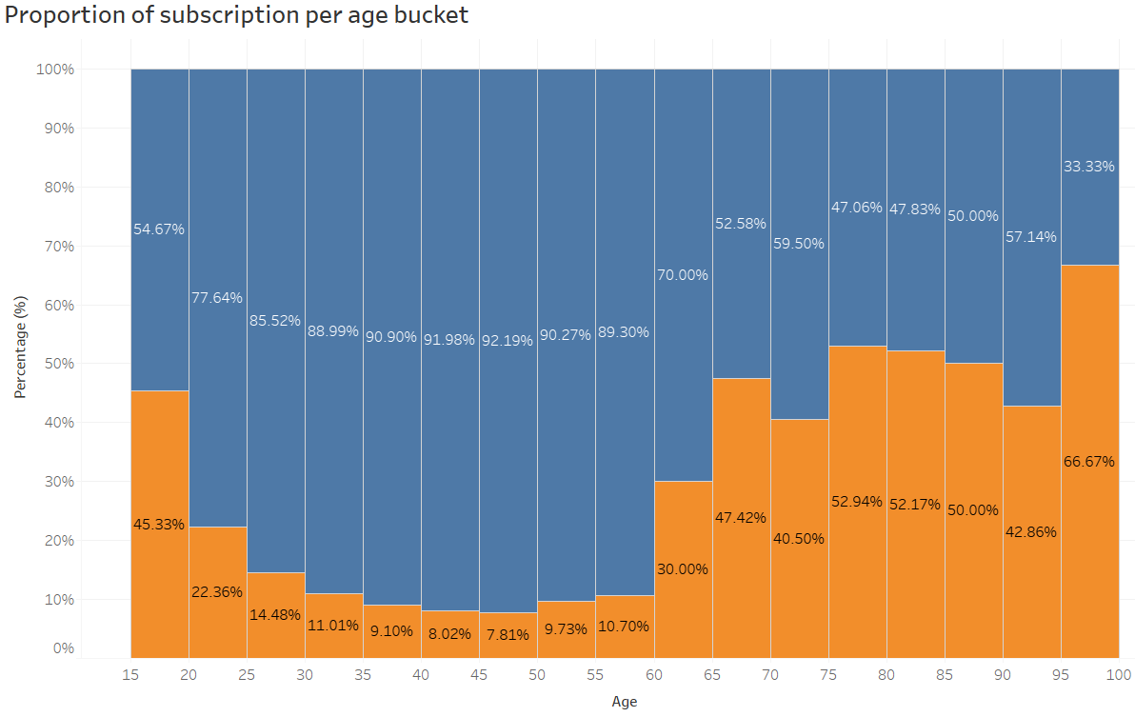
Insights in Focus
Majority of targeted clients are within ages 20 and 60, but interestingly, conversions are significantly higher in clients outside those ranges

Slide 10
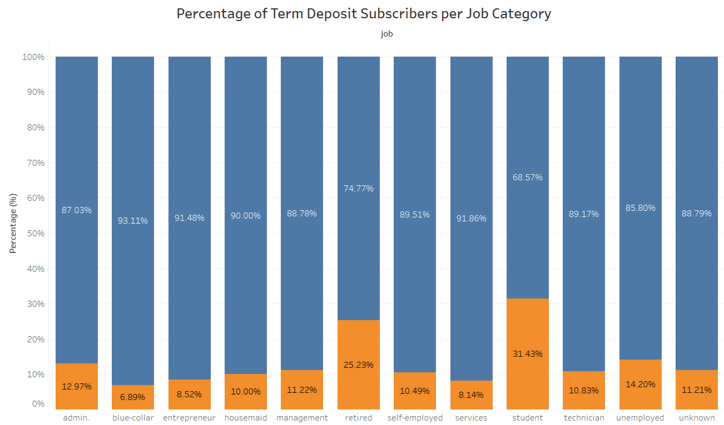
Insights in Focus
Students and retired clients showed higher proportions subscribing compared to their working counterparts

Slide 11
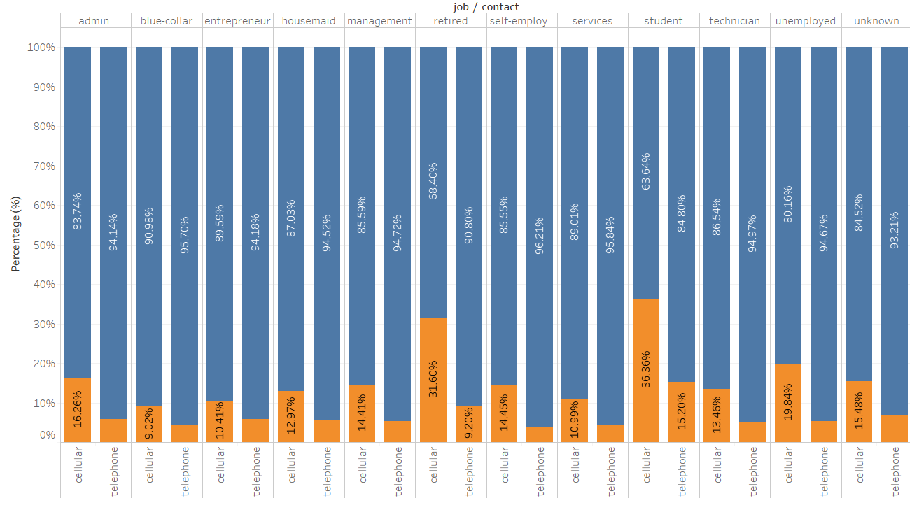
Insights in Focus
Students and retired clients showed higher proportions subscribing compared to their working counterparts

Slide 12
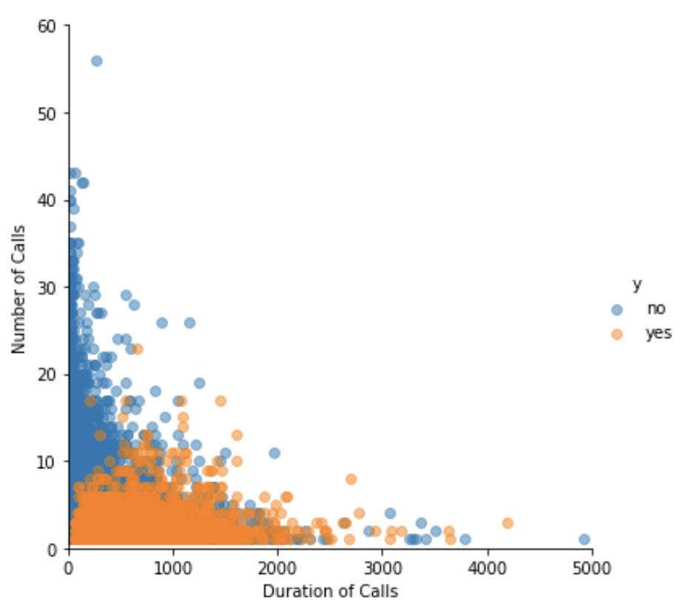
Insights in Focus
Conversions were optimized when clients were contacted multiple times but the total number of calls to each client was limited to not more than 10, and the total duration of calls was kept below 2500 minutes

Slide 13
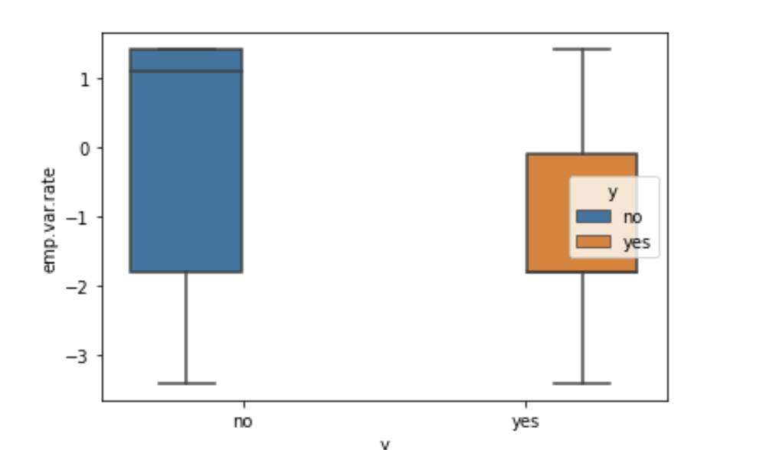
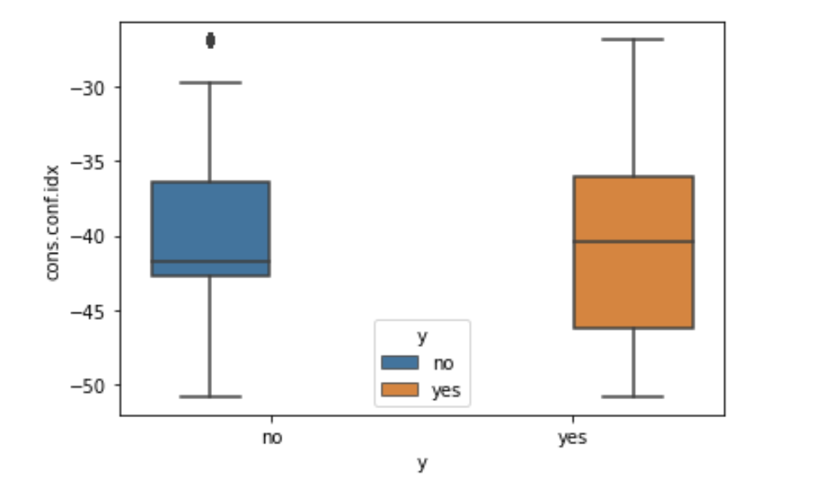
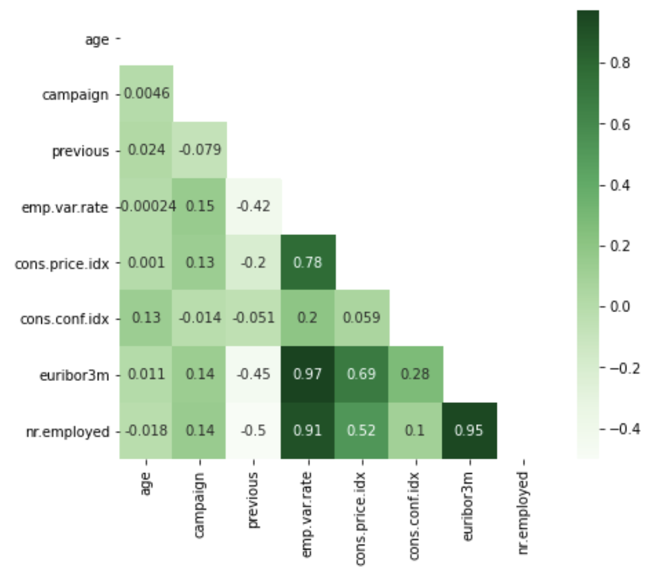
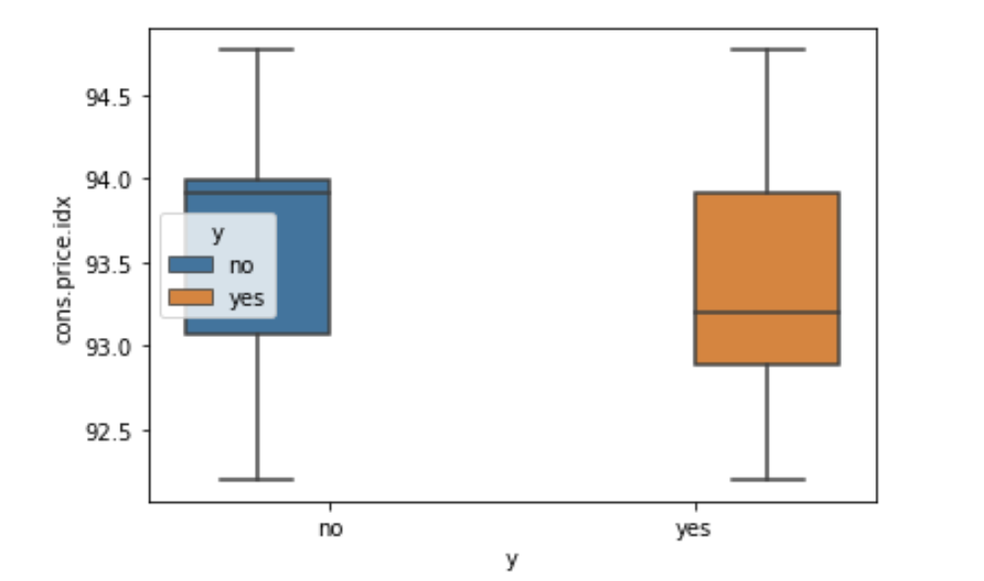
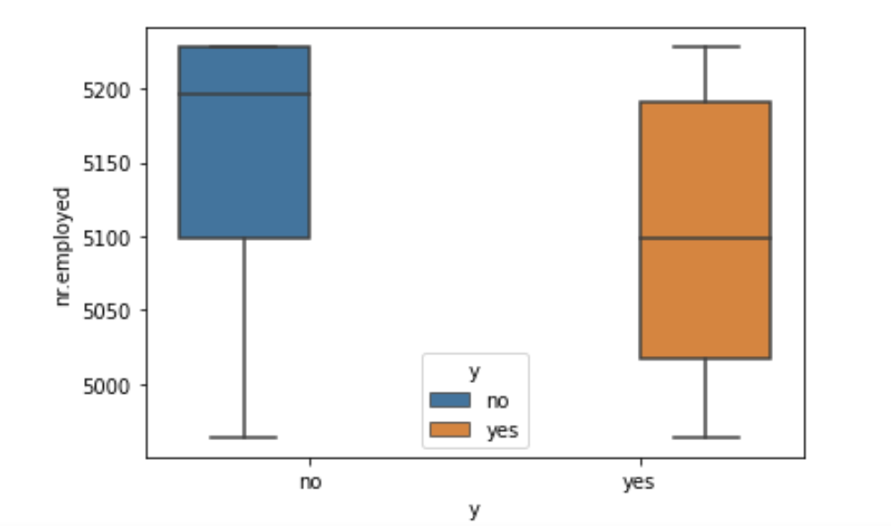
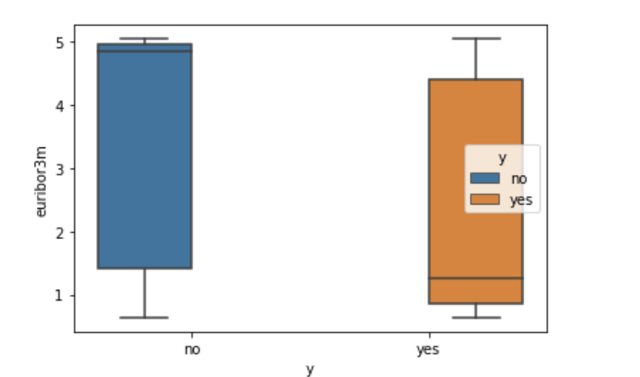
Insights in Focus
The socio-economic indicators are mostly correlated, and also point to patterns with term deposit subscriptions among contacted clients during that timeframe.

Slide 14
Data Preparation

Slide 15
Data Preparation
Converted categorical columns to be represented numerically
Split data into sets for building and evaluating the model

Slide 16
Data Preparation
After initial model evaluation, we carry out synthetic multiplication of data-points in our training set based on data patterns in the training set itself, before training the model again
Source: kaggle.com
Source: kaggle.com

Slide 17
Model Setup and Evaluation

Slide 18
Model Setup Flow
Define goal(s) and metrics of interest
Decide candidate models
Train model on training data segment
Mix and match necessary parameters and tune model
Evaluate performance on unseen test data and compare goal metrics

Slide 19
Evaluation Rubric
Goal is to maximize the number of subscribers predicted correctly
Correctly identifying unlikely subscribers is secondary
Consider metrics to evaluate how well our model performs and identifies subscribers: - Recall : Total proportion of subscribers correctly identified - Precision : Total proportion of predictions that are subscribers - ROC Score : Measure of model performance by comparing True Positive Rate and False Positive Rate

Slide 20
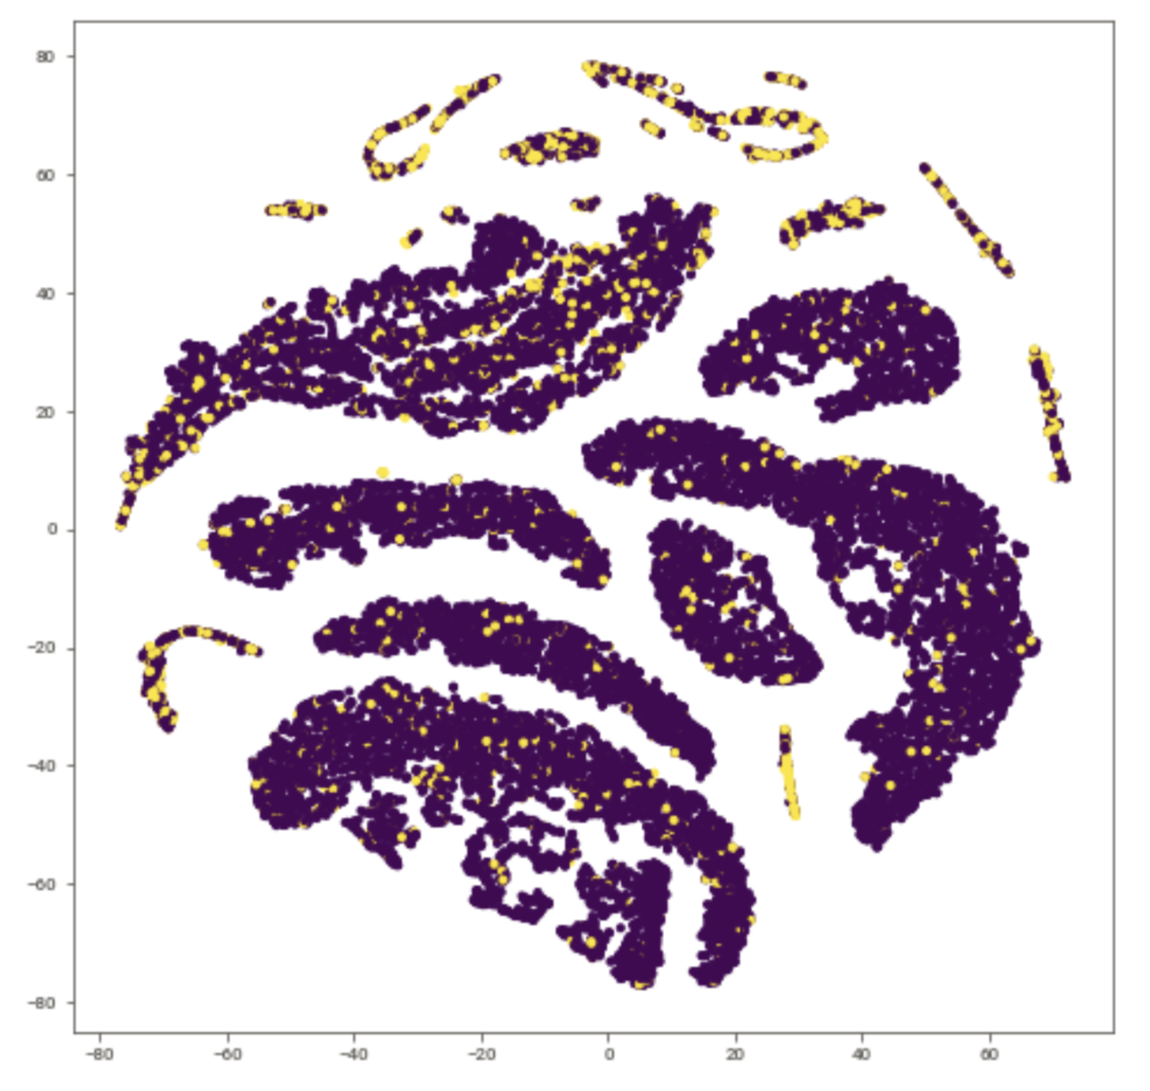
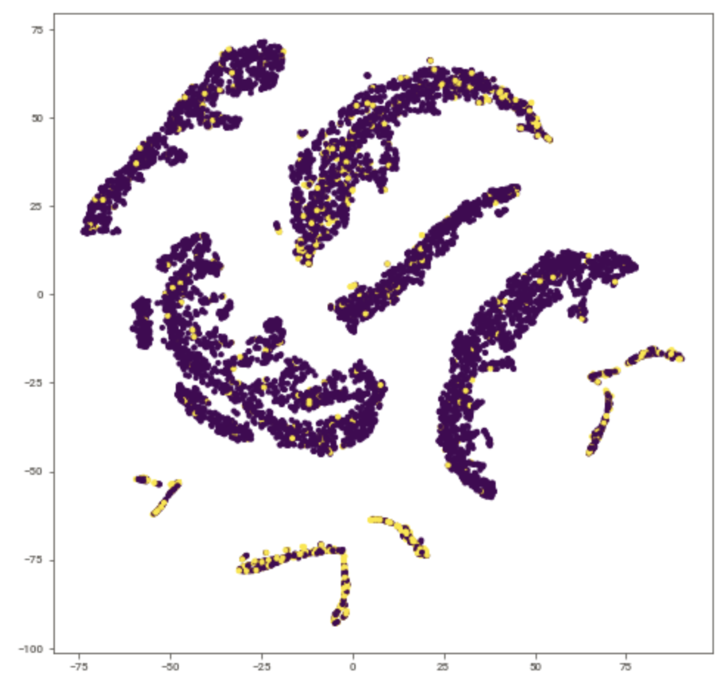
Visualized Feature Space
Training Feature Space
Test Feature Space

Slide 21
Model Consideration
We consider RandomForest and XGBoost models as primary options
    - High performance; ability to accommodate complex non-linear interactions within data
    - Highly tolerance to noise
    - Feature selection capabilities

Slide 22
Model Evaluation
Balanced data - Final Test data scores
Evaluation on Test data
XGBoost model successfully identifies 53% of the converting clients vs 24% in the case of Random Forest
Healthy balance between recall and precision for XGBoost vs imbalanced for Random Forest
XGBoost has a better ROC of 0.792 vs 0.783 in the case of Random Forest
 | Random Forest | XGBoost
Precision | 0.58 | 0.48
Recall | 0.24 | 0.53
ROC AUC | 0.783 | 0.792

Slide 23
Base Model Performance (Current)
Evaluation on entire data set
We have the current model’s likelihood probability to be a subscriber, for each record in the dataset
Focus will be on model’s Recall, Precision and ROC metrics
 | Base Model (Original)
Precision | 0.098
Recall | 0.854
ROC AUC | 0.235

Slide 24
Performance Evaluation
Full Dataset
Evaluation on entire dataset
 | Random Forest | XGBoost | Base Model (Original)
Precision | 0.58 | 0.48 | 0.098
Recall | 0.24 | 0.53 | 0.854
ROC AUC | 0.783 | 0.792 | 0.235
Both newly developed models significantly outperform the base model predictions overall
Random Forest has highest score on the overall dataset but underperforms XGBoost on unseen test data, as it “over-learns” on the training data

Slide 25
Significant Features
XGBoost Model
All socio-economic variables play an important role in making predictions for the model
Having a previous successful outcome in a marketing campaign, age and mode of the call are also all important factors

Slide 26
Relationship of Important Features with Target Variable
XGBoost Model

Slide 27
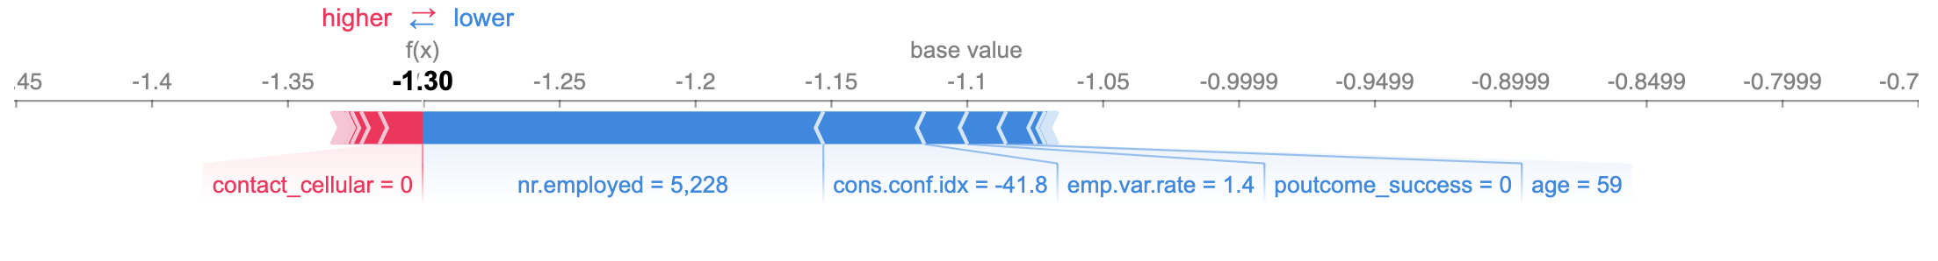
Explaining Predictions Locally
XGBoost Model
Prediction Explanation of the 42nd record in the training dataset

Slide 28
Recommendations and Next Steps

Slide 29
Recommendations
Diversify targeting, especially in the case of ages and occupations; potentially offering term deposit services catered to the needs of younger and older clients, students and retired individuals
Collaborate with economists and time marketing campaigns with respect to broader economic and employment conditions
Prioritize customers who were a part of previous campaign efforts, and incorporate feedback scores from successful, as well as unsuccessful client conversions
Optimize marketing efforts by limiting the number as well as duration of calls

Slide 30
Next Steps
Continuously remodel and fine-tune the model to keep up with changing economic conditions and consumer behavior changes
Evaluate models with dollar metrics involving true costs of similar campaigns
Potentially involve more granular data-points bound to socio-economic nuances (e.g. BISG codes, micro-economic data by regions, etc.)
Allocate resources for monitoring biases in the model predictions based on protected client information, to ensure ethical targeting of clients

Slide 31
Thank you!

