Slide 1
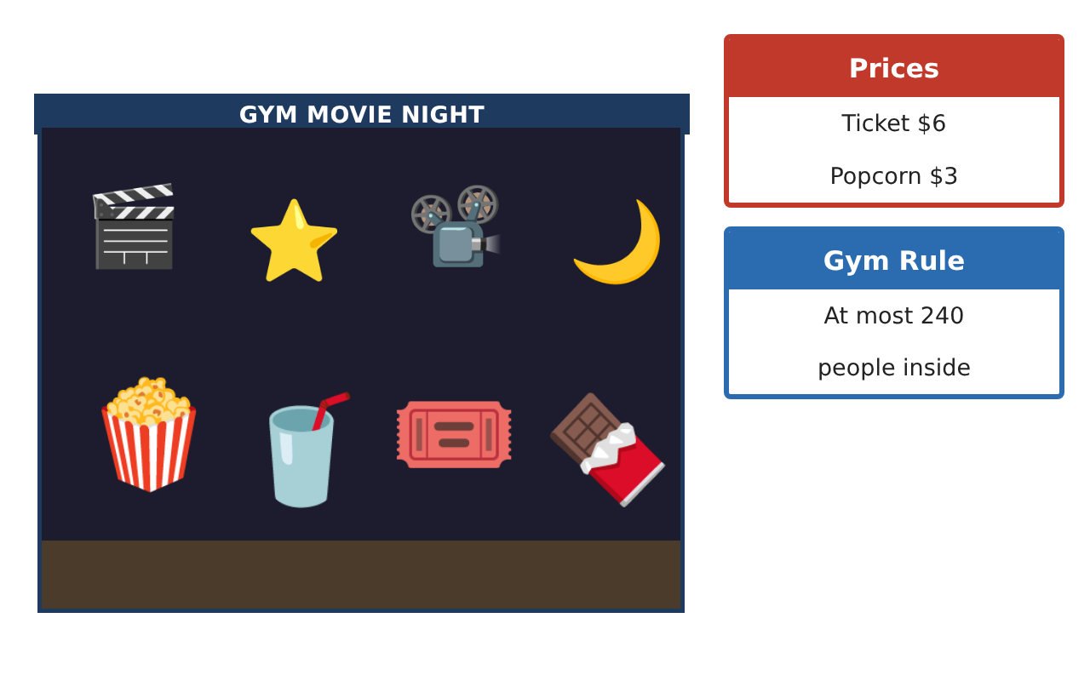
PRE-ALGEBRA (7TH) · UNIT 2: SOLVING ONE-STEP EQUATIONS AND INEQUALITIES
Movie Night Fundraiser
Simplify expressions and solve one-step equations and inequalities to run a school movie night.
CP1 Project
2–3 class periods
Name: ______________________________ Group: ______________________________

Slide 2
The Scenario
CP1
The student council is hosting a movie night in the gym to raise money for new sports equipment. You will sell tickets and snacks, rent a projector, and follow the gym rules.
You will use properties, equations, and inequalities to figure out how many tickets and snacks to sell and whether you will reach the goal.
Pre-Algebra (7th) · Unit 2: Solving One-Step Equations and Inequalities · Movie Night Fundraiser

Slide 3
Learning Goals & Timeline
CP1
Learning Goals
Timeline
• I can use properties and the distributive property to write equivalent expressions.
• I can solve one-step equations with integers and decimals.
• I can solve and graph one-step inequalities, including dividing by a negative.
Day 1
Profit Expressions
Day 2
Equations
Day 3
Inequalities & Plan
Final
Fundraiser Plan + reflection
Pre-Algebra (7th) · Unit 2: Solving One-Step Equations and Inequalities · Movie Night Fundraiser

Slide 4
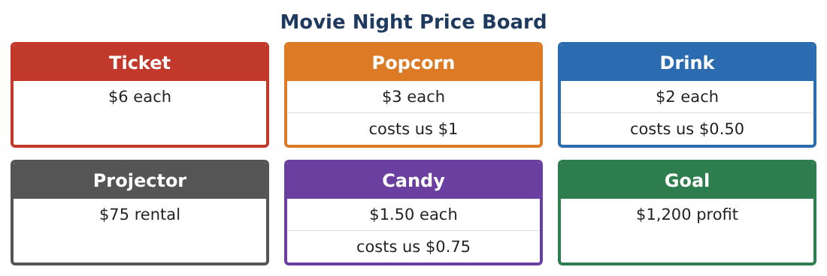
Part 1: Profit Expressions
CP1
Day 1 · Use the Price Board. t = tickets, p = popcorn, d = drinks.
1. Write an expression for the profit on p popcorns and d drinks (price minus our cost).
2. Write and simplify an expression for total profit including tickets and the projector.
3. A "combo" is 1 ticket, 1 popcorn, and 1 drink for $10. Simplify the profit on c combos.
4. Simplify −3(2x − 5) + 4x and name the properties you used.
Pre-Algebra (7th) · Unit 2: Solving One-Step Equations and Inequalities · Movie Night Fundraiser

Slide 5
Part 2: Equations
CP1
Day 2 · Write and solve one-step equations.
5. The combo profit was $595. How many combos were sold?
6. Drink profit was $93. How many drinks were sold?
7. The temperature in the gym fell 6 degrees to 64°F. What was it before?
8. The council split the profit equally among 4 teams; each got $287.50. What was the total profit?
Pre-Algebra (7th) · Unit 2: Solving One-Step Equations and Inequalities · Movie Night Fundraiser

Slide 6
Part 3: Inequalities & Plan
CP1
Day 3 · The goal is $1,200 profit.
9. The council already has $650 profit. How much more profit p is needed? Solve and graph.
10. The air conditioner lowers the gym temperature 2 degrees per hour, and the total change must be no lower than −8 degrees. Solve −2h ≥ −8 and explain what the answer means.
11. Make a plan for selling tickets, combos, and snacks that reaches the $1,200 goal without going over 240 people. Show your calculations.
Pre-Algebra (7th) · Unit 2: Solving One-Step Equations and Inequalities · Movie Night Fundraiser

Slide 7
Final Product: Fundraiser Plan
CP1
Your final product must include:
☐ Profit expressions and simplifications
☐ Four solved equations with checks
☐ Inequalities with graphs
☐ A sales plan that meets the goal and the gym rule
☐ Presentation for the student council
Pre-Algebra (7th) · Unit 2: Solving One-Step Equations and Inequalities · Movie Night Fundraiser

Slide 8
Scoring Rubric
CP1
Criteria | 4 – Exceeds | 3 – Meets | 2 – Approaching | 1 – Beginning
Mathematical Accuracy | All calculations and solutions are correct; answers include units and are checked. | Nearly all work is correct; minor errors do not change conclusions. | Several errors; some conclusions are affected. | Many errors or missing work.
Reasoning & Justification | Clear, complete explanations connect every answer to the situation; uses precise vocabulary. | Explanations are mostly clear and connected to the situation. | Explanations are brief or partly unclear. | Little or no explanation.
Application & Design | Expressions, equations, and inequalities model sales and limits correctly and are used to reach the goal. Goes beyond the minimum with a creative, realistic choice. | Expressions, equations, and inequalities model sales and limits correctly and are used to reach the goal. | Design is incomplete or only partly uses the math from the unit. | Design is missing or unrelated to the unit math.
Communication & Presentation | Fundraiser plan includes expressions, solved equations, graphed inequalities, and a recommendation. Polished, organized, and visually engaging. | Fundraiser plan includes expressions, solved equations, graphed inequalities, and a recommendation. Organized and easy to follow. | Product is missing required parts or is hard to follow. | Product is mostly missing.
Pre-Algebra (7th) · Unit 2: Solving One-Step Equations and Inequalities · Movie Night Fundraiser

Slide 9
Reflection
CP1
R1. Why do you reverse the inequality symbol when you divide by a negative?
R2. How did simplifying expressions make the plan easier?
Pre-Algebra (7th) · Unit 2: Solving One-Step Equations and Inequalities · Movie Night Fundraiser

