Slide 1
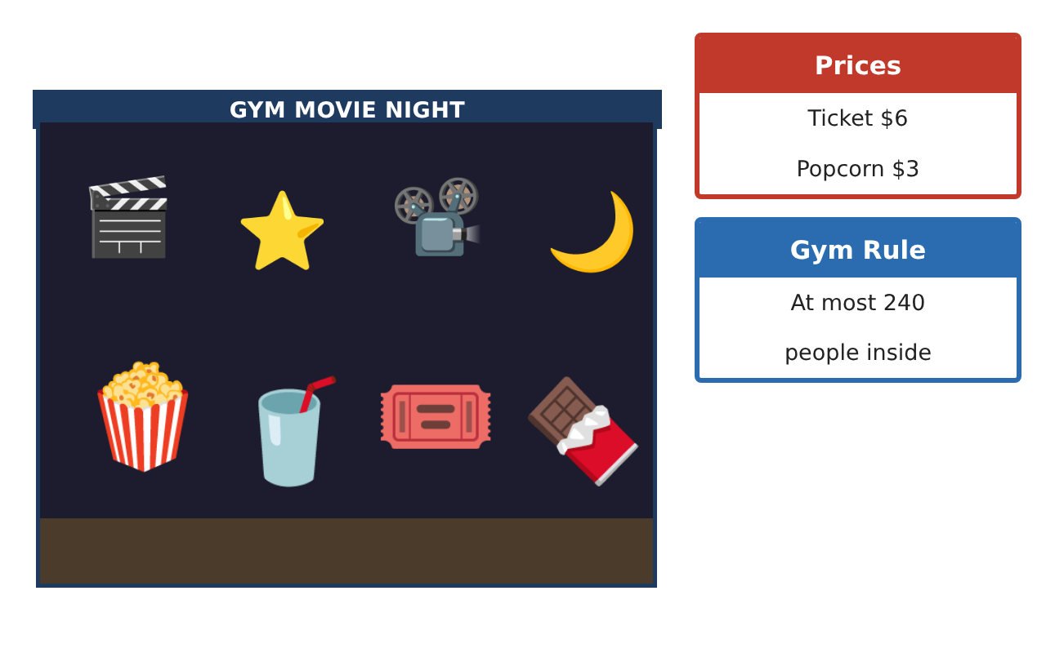
PRE-ALGEBRA (7TH) · UNIT 2: SOLVING ONE-STEP EQUATIONS AND INEQUALITIES
Movie Night Fundraiser
Simplify expressions and solve one-step equations and inequalities to run a school movie night.
Honors Project
2–3 class periods
Name: ______________________________ Group: ______________________________

Slide 2
The Scenario
Honors
The student council is hosting a movie night in the gym to raise money for new sports equipment. You will sell tickets and snacks, rent a projector, and follow the gym rules.
You will use properties, equations, and inequalities to figure out how many tickets and snacks to sell and whether you will reach the goal.
Pre-Algebra (7th) · Unit 2: Solving One-Step Equations and Inequalities · Movie Night Fundraiser

Slide 3
Learning Goals & Timeline
Honors
Learning Goals
Timeline
• I can write equivalent expressions and justify each step with a property.
• I can solve one-step equations and inequalities with rational coefficients.
• I can optimize a plan under constraints.
Day 1
Expression Analysis
Day 2
Equations with Rational Numbers
Day 3
Constraints & Optimization
Final
Fundraiser Plan + reflection
Pre-Algebra (7th) · Unit 2: Solving One-Step Equations and Inequalities · Movie Night Fundraiser

Slide 4
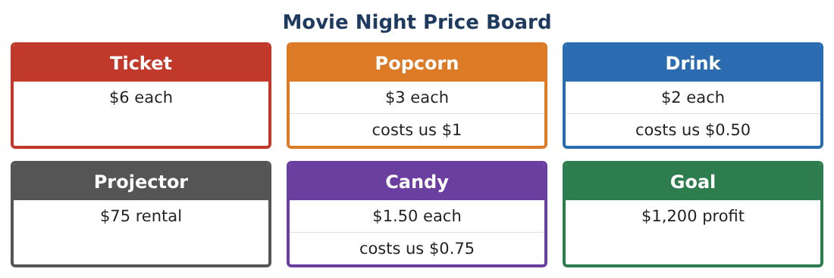
Part 1: Expression Analysis
Honors
Day 1 · Use the Price Board.
1. A family pack is 4 tickets, 3 popcorns, and 4 drinks for $38. Write the profit per pack and simplify. Is the pack a better deal for the council than selling the items separately?
2. Prove 6(t + 2) − 2(3t − 1) is the same for every t. What is its value?
3. Simplify ³⁄₄(8x − 12) − ¹⁄₂(4x + 6).
4. Write two different expressions that equal 12n − 18 and explain the property used.
Pre-Algebra (7th) · Unit 2: Solving One-Step Equations and Inequalities · Movie Night Fundraiser

Slide 5
Part 2: Equations with Rational Numbers
Honors
Day 2 · Solve each one-step equation and interpret.
5. Candy profit is $0.75 per piece. Profit was $67.50. How many pieces sold?
6. ²⁄₃ of the seats were filled with 160 people. How many seats are there?
7. After a −$18.25 refund, the balance was $1,043.75. What was it before?
8. −⁵⁄₄x = 35. Solve and write a movie-night story that this equation could describe.
Pre-Algebra (7th) · Unit 2: Solving One-Step Equations and Inequalities · Movie Night Fundraiser

Slide 6
Part 3: Constraints & Optimization
Honors
Day 3 · Goal: at least $1,200 profit. At most 240 people. Projector $75.
9. Each person buys one ticket and spends on average $3.50 on snacks with average profit $2.10. Write and solve an inequality for the number of people needed to reach the goal.
10. Graph the possible numbers of people on a number line (use both the goal and the gym rule).
11. Recommend a ticket price change that would reach the goal with only 130 people. Justify with an inequality.
Pre-Algebra (7th) · Unit 2: Solving One-Step Equations and Inequalities · Movie Night Fundraiser

Slide 7
Final Product: Fundraiser Plan
Honors
Your final product must include:
☐ Expression proofs with properties
☐ Equations with fractions and decimals
☐ Inequality model for attendance
☐ Graph showing goal and gym constraints
☐ Recommendation memo with a ticket price
Pre-Algebra (7th) · Unit 2: Solving One-Step Equations and Inequalities · Movie Night Fundraiser

Slide 8
Scoring Rubric
Honors
Criteria | 4 – Exceeds | 3 – Meets | 2 – Approaching | 1 – Beginning
Mathematical Accuracy | All calculations and solutions are correct; answers include units and are checked. | Nearly all work is correct; minor errors do not change conclusions. | Several errors; some conclusions are affected. | Many errors or missing work.
Reasoning & Justification | Clear, complete explanations connect every answer to the situation; uses precise vocabulary. | Explanations are mostly clear and connected to the situation. | Explanations are brief or partly unclear. | Little or no explanation.
Application & Design | Expressions, equations, and inequalities model sales and limits correctly and are used to reach the goal. Goes beyond the minimum with a creative, realistic choice. | Expressions, equations, and inequalities model sales and limits correctly and are used to reach the goal. | Design is incomplete or only partly uses the math from the unit. | Design is missing or unrelated to the unit math.
Communication & Presentation | Fundraiser plan includes expressions, solved equations, graphed inequalities, and a recommendation. Polished, organized, and visually engaging. | Fundraiser plan includes expressions, solved equations, graphed inequalities, and a recommendation. Organized and easy to follow. | Product is missing required parts or is hard to follow. | Product is mostly missing.
Pre-Algebra (7th) · Unit 2: Solving One-Step Equations and Inequalities · Movie Night Fundraiser

Slide 9
Reflection
Honors
R1. When does a "deal" earn less profit for the seller? Use your family pack result.
R2. How do two inequalities together describe the possible attendance?
Pre-Algebra (7th) · Unit 2: Solving One-Step Equations and Inequalities · Movie Night Fundraiser

