Slide 1
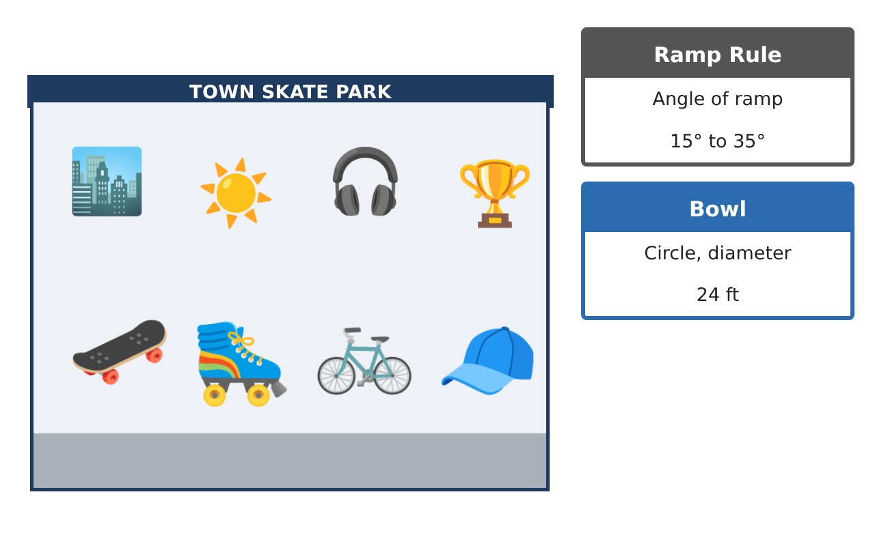
PRE-ALGEBRA (7TH) · UNIT 9: SPATIAL THINKING
Skate Park Designer
Use angles, polygons, circles, and transformations to design a town skate park.
Honors Project
2–3 class periods
Name: ______________________________ Group: ______________________________

Slide 2
The Scenario
Honors
The town council approved a new skate park and wants students to design it. The ramps need exact angles, the rails run parallel, the deck is a polygon, and the bowl is a circle.
You will use angle relationships, polygons, circles, and transformations to create a blueprint and a logo for the park.
Pre-Algebra (7th) · Unit 9: Spatial Thinking · Skate Park Designer

Slide 3
Learning Goals & Timeline
Honors
Learning Goals
Timeline
• I can justify angle relationships with algebra and reasoning.
• I can use polygon properties to design tiling and decks.
• I can apply circles and compositions of transformations.
Day 1
Angle Proofs
Day 2
Deck Design
Day 3
Bowl & Logo
Final
Skate Park Blueprint + reflection
Pre-Algebra (7th) · Unit 9: Spatial Thinking · Skate Park Designer

Slide 4
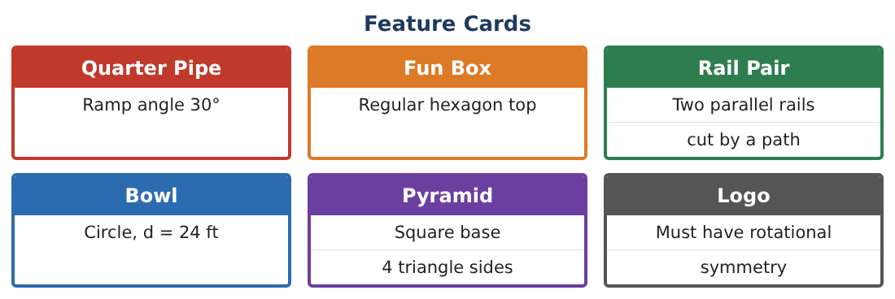
Part 1: Angle Proofs
Honors
Day 1 · Rails are parallel; ramps meet the 15°–35° rule.
1. A path crosses two parallel rails. One angle is (x² − 10)° and its corresponding angle is (3x + 30)° with x > 0. Find x and the angle.
2. Prove that same-side interior angles are supplementary using a corresponding angle and a linear pair.
3. A ramp rises 4 ft for each 10 ft forward. Use a protractor drawing to estimate the angle. Does it meet the rule?
4. The angles of a triangular kicker are in the ratio 1 : 2 : 6. Find them. Does the smallest meet the ramp rule?
Pre-Algebra (7th) · Unit 9: Spatial Thinking · Skate Park Designer

Slide 5
Part 2: Deck Design
Honors
Day 2 · The deck is tiled with polygons.
5. Which regular polygons tile a flat deck by themselves? Use interior angles to explain.
6. Can regular octagons and squares tile together? Show the angle sum at a vertex.
7. A regular polygon deck has interior angles of 150°. How many sides? What is its angle sum?
8. Explain why every regular polygon has exterior angles that add to 360°.
Pre-Algebra (7th) · Unit 9: Spatial Thinking · Skate Park Designer

Slide 6
Part 3: Bowl & Logo
Honors
Day 3 · Use π.
9. The bowl is a circle with diameter 24 ft. A safety zone 4 ft wide surrounds it. Find the area of the safety zone in terms of π and to the nearest square foot.
10. Reflect the logo triangle (1, 1), (4, 1), (1, 3) across the y-axis, then rotate the image 180° about the origin. What single transformation does the same thing?
11. Design a logo with exactly 4 lines of symmetry and rotational symmetry of order 4. Explain how you know.
Pre-Algebra (7th) · Unit 9: Spatial Thinking · Skate Park Designer

Slide 7
Final Product: Skate Park Blueprint
Honors
Your final product must include:
☐ Blueprint with angle proofs
☐ Deck tiling plan with angle sums
☐ Bowl and safety zone areas
☐ Composite transformation of the logo
☐ Presentation to the town council
Pre-Algebra (7th) · Unit 9: Spatial Thinking · Skate Park Designer

Slide 8
Scoring Rubric
Honors
Criteria | 4 – Exceeds | 3 – Meets | 2 – Approaching | 1 – Beginning
Mathematical Accuracy | All calculations and solutions are correct; answers include units and are checked. | Nearly all work is correct; minor errors do not change conclusions. | Several errors; some conclusions are affected. | Many errors or missing work.
Reasoning & Justification | Clear, complete explanations connect every answer to the situation; uses precise vocabulary. | Explanations are mostly clear and connected to the situation. | Explanations are brief or partly unclear. | Little or no explanation.
Application & Design | Angles, polygons, circle measures, and transformations are correct and produce a buildable design. Goes beyond the minimum with a creative, realistic choice. | Angles, polygons, circle measures, and transformations are correct and produce a buildable design. | Design is incomplete or only partly uses the math from the unit. | Design is missing or unrelated to the unit math.
Communication & Presentation | Blueprint is labeled with angles and measurements and includes the logo and calculations. Polished, organized, and visually engaging. | Blueprint is labeled with angles and measurements and includes the logo and calculations. Organized and easy to follow. | Product is missing required parts or is hard to follow. | Product is mostly missing.
Pre-Algebra (7th) · Unit 9: Spatial Thinking · Skate Park Designer

Slide 9
Reflection
Honors
R1. Why do only some regular polygons tile a plane?
R2. How can two transformations combine to equal a single transformation?
Pre-Algebra (7th) · Unit 9: Spatial Thinking · Skate Park Designer

